Slide 1
Work Hire Marketplace
PROJECT PROPOSAL
BCA6_18
PROJECT PROPOSAL

Slide 2
INTRODUCTION
Connects employers and freelancers
Online work hire portal
PROJECT PROPOSAL

Slide 3
DEFINITION
Work Hire Marketplace is a web-based marketplace that connects employers with freelancers. Based on their ratings, freelancers can be assigned work. They can look for work depending on their skills and submit proposal.
PROJECT PROPOSAL

Slide 4
PURPOSE
SCOPE
Improve skill set and raise income
No provide payment mechanisms and no limitation on work
PROJECT PROPOSAL

Slide 5
Registration Login Profile
Functional Requirements
Work Recommendation Add work proposal Apply for work Hire freelancer
Forum rating
Communication via chat
01
02
03
04
PROJECT PROPOSAL

Slide 6
Security
Non-Functional Requirements
Performance
User-friendly interface
01
02
03
PROJECT PROPOSAL

Slide 7
Admin
Employer
User of System
Freelancer
01
02
03
PROJECT PROPOSAL

Slide 8
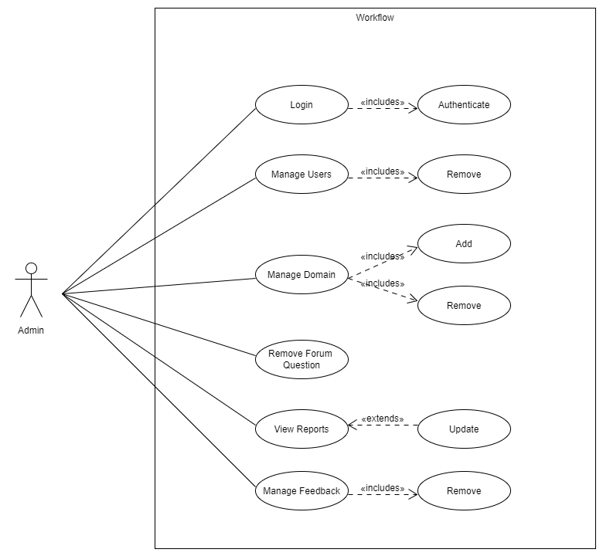
Admin
01
PROJECT PROPOSAL

Slide 9

Characteristics
View user’s details
See number of users, works, domain
Add and delete domain
View all work according to the status
View skill
PROJECT PROPOSAL

Slide 10
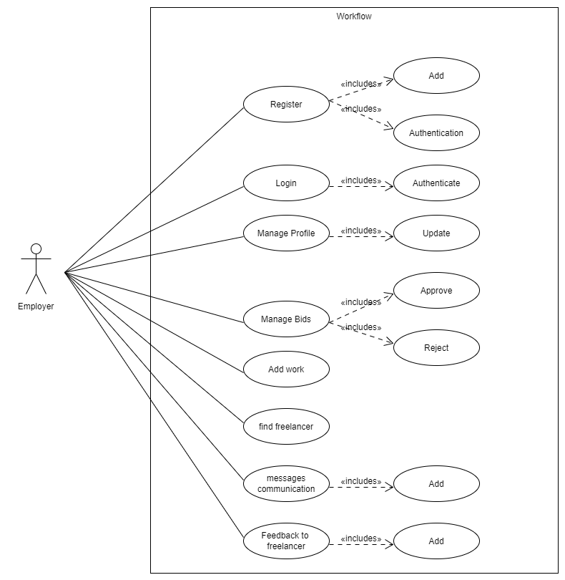
Employer
02
PROJECT PROPOSAL

Slide 11
Characteristics
Update profile
See list of employer who have place bids
Hire freelancers
Communicate via chat
PROJECT PROPOSAL

Slide 12
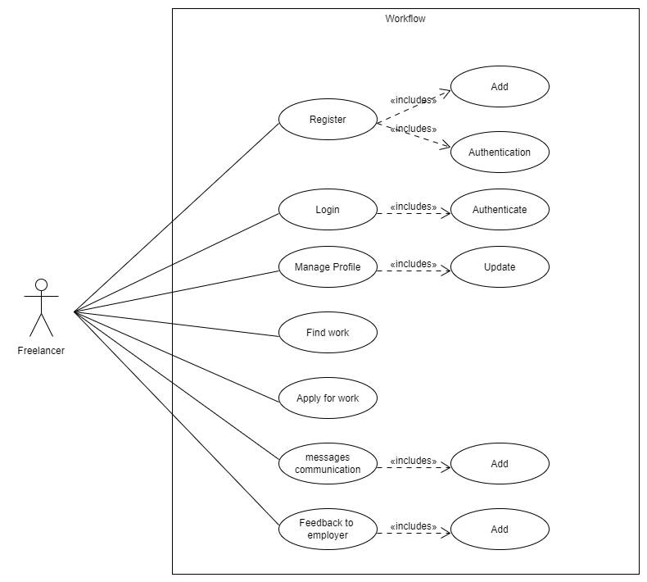
Freelancer
03
PROJECT PROPOSAL

Slide 13
Characteristics
Update profile
Place bids
Communicate via chat
PROJECT PROPOSAL

Slide 14
Activity Diagrams
PROJECT PROPOSAL

Slide 15
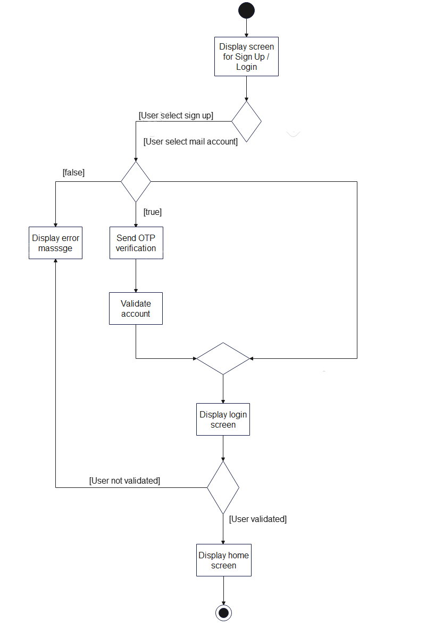
Registration and login
PROJECT PROPOSAL

Slide 16
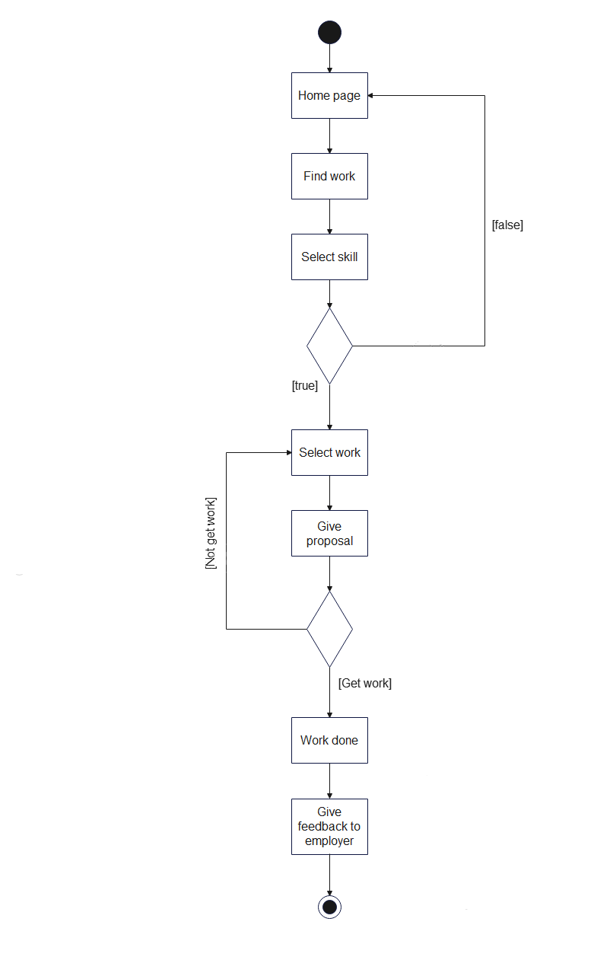
Find work and proposal
PROJECT PROPOSAL

Slide 17
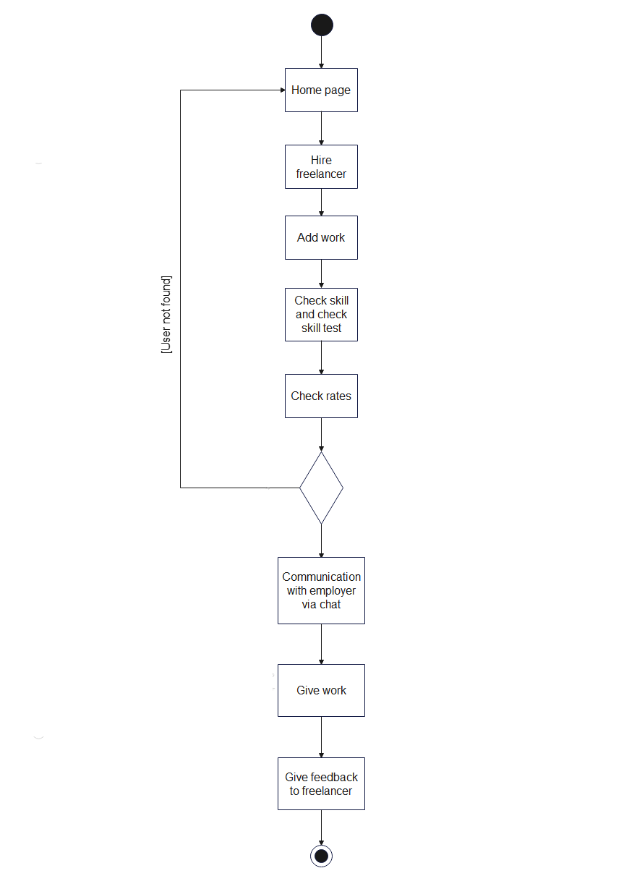
Hire freelancer
PROJECT PROPOSAL

Slide 18
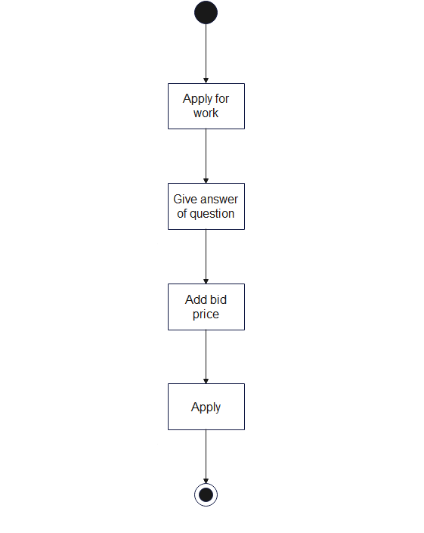
Apply for work
PROJECT PROPOSAL

Slide 19
System Flow Diagrams
PROJECT PROPOSAL

Slide 20
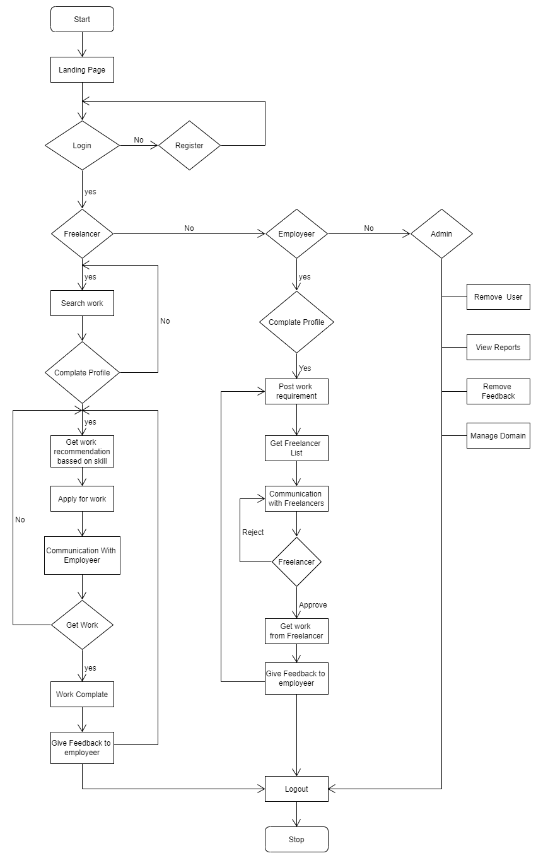
PROJECT PROPOSAL

Slide 21
System Design
PROJECT PROPOSAL

Slide 22
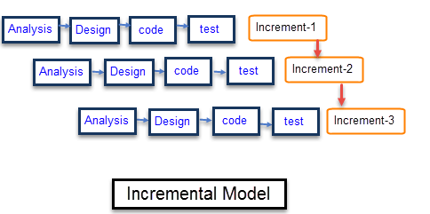
PROJECT PROPOSAL

Slide 23
workflow_database.pdf
PROJECT PROPOSAL

Slide 24
System_testing.pdf
PROJECT PROPOSAL

Slide 25
suggest.docx
PROJECT PROPOSAL

Slide 26
rating calculations.xlsx
PROJECT PROPOSAL

Slide 27
Let’s see demonstration
PROJECT PROPOSAL

