Slide 1

Chapter 12 File Management
Operating Systems: Internals and Design Principles, 6/E William Stallings

Slide 2
File Management
File management system consists of system utility programs that run as privileged applications
Concerned with secondary storage

Slide 3
File System Properties
Long-term existence
Sharable between processes
Structure

Slide 4
File Operations
Create
Delete
Open
Close
Read
Write

Slide 5
File Terms
Field
Basic element of data
Contains a single value
Characterized by its length and data type
Record
Collection of related fields
Treated as a unit

Slide 6
File Terms
File
Collection of similar records
Treated as a single entity
Have file names
May restrict access
Database
Collection of related data
Relationships exist among elements

Slide 7
Typical Operations
Retrieve_All
Retrieve_One
Retrieve_Next
Retrieve_Previous

Slide 8
Typical Operations
Insert_One
Delete_One
Update_One
Retrieve_Few

Slide 9
File Management Systems
The way a user or application may access files
Programmer does not need to develop file management software

Slide 10
Objectives for a File Management System
Meet the data management needs and requirements of the user
Guarantee that the data in the file are valid
Optimize performance
Provide I/O support for a variety of storage device types

Slide 11
Objectives for a File Management System
Minimize or eliminate the potential for lost or destroyed data
Provide a standardized set of I/O interface routines
Provide I/O support for multiple users

Slide 12
Minimal Set of Requirements
Each user should be able to create, delete, read, write and modify files
Each user may have controlled access to other users’ files
Each user may control what type of accesses are allowed to the users’ files
Each user should be able to restructure the user’s files in a form appropriate to the problem

Slide 13
Minimal Set of Requirements
Each user should be able to move data between files
Each user should be able to back up and recover the user’s files in case of damage
Each user should be able to access the user’s files by using symbolic names

Slide 14
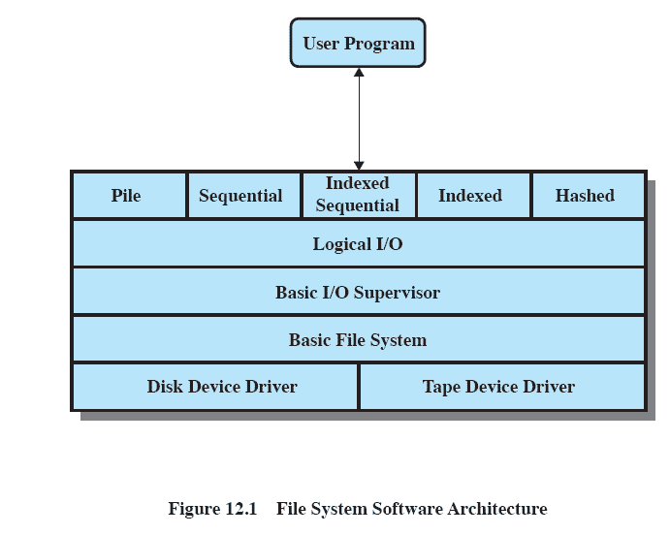
Files System Software Architecture

Slide 15
Device Drivers
Lowest level
Communicates directly with peripheral devices
Responsible for starting I/O operations on a device
Processes the completion of an I/O request

Slide 16
Basic File System
Physical I/O
Deals with exchanging blocks of data
Concerned with the placement of blocks
Concerned with buffering blocks in main memory

Slide 17
Logical I/O
Enables users and applications to access records
Provides general-purpose record I/O capability
Maintains basic data about file

Slide 18
Access Method
Reflect different file structures
Different ways to access and process data

Slide 19
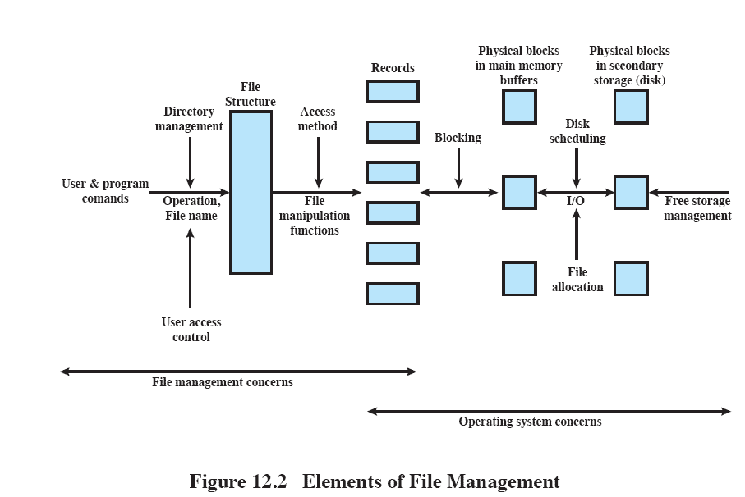
Elements of File Management

Slide 20
File Management Functions
Identify and locate a selected file
Use a directory to describe the location of all files plus their attributes
On a shared system, describe user access control

Slide 21
Criteria for File Organization
Short access time
Needed when accessing a single record
Ease of update
File on CD-ROM will not be updated, so this is not a concern

Slide 22
Criteria for File Organization
Economy of storage
Should be minimum redundancy in the data
Redundancy can be used to speed access such as an index
Simple maintenance
Reliability

Slide 23
File Organization
The Pile
Data are collected in the order they arrive
Purpose is to accumulate a mass of data and save it
Records may have different fields
No structure
Record access is by exhaustive search

Slide 24
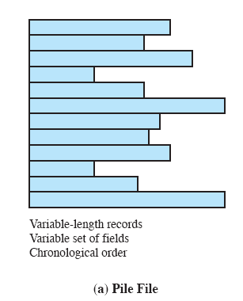
The Pile

Slide 25
File Organization
The Sequential File
Fixed format used for records
Records are the same length
All fields the same (order and length)
Field names and lengths are attributes of the file

Slide 26
File Organization
The Sequential File
One field is the key field
Uniquely identifies the record
Records are stored in key sequence

Slide 27
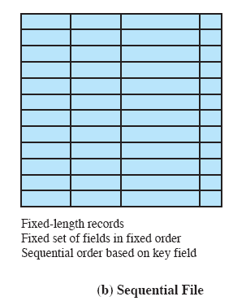
The Sequential File

Slide 28
File Organization
Indexed Sequential File
Index provides a lookup capability to quickly reach the vicinity of the desired record
Contains key field and a pointer to the main file
Indexed is searched to find highest key value that is equal to or precedes the desired key value
Search continues in the main file at the location indicated by the pointer

Slide 29
File Organization
Comparison of sequential and indexed sequential
Example: a file contains 1 million records
On average 500,00 accesses are required to find a record in a sequential file
If an index contains 1000 entries, it will take on average 500 accesses to find the key, followed by 500 accesses in the main file. Now on average it is 1000 accesses

Slide 30
File Organization
Indexed Sequential File
New records are added to an overflow file
Record in main file that precedes it is updated to contain a pointer to the new record
The overflow is merged with the main file during a batch update
Multiple indexes for the same key field can be set up to increase efficiency

Slide 31
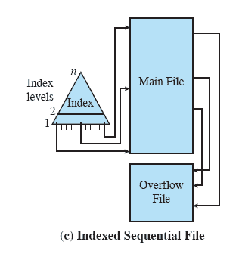
Indexed Sequential File

Slide 32
File Organization
Indexed File
Uses multiple indexes for different key fields
May contain an exhaustive index that contains one entry for every record in the main file
May contain a partial index

Slide 33
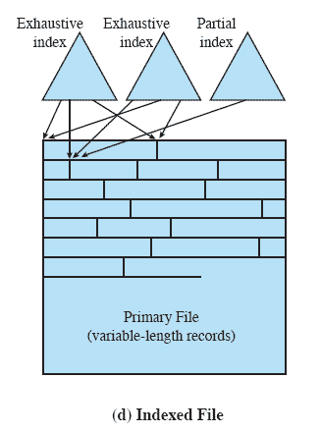
Indexed File

Slide 34
File Organization
The Direct or Hashed File
Directly access a block at a known address
Key field required for each record

Slide 35
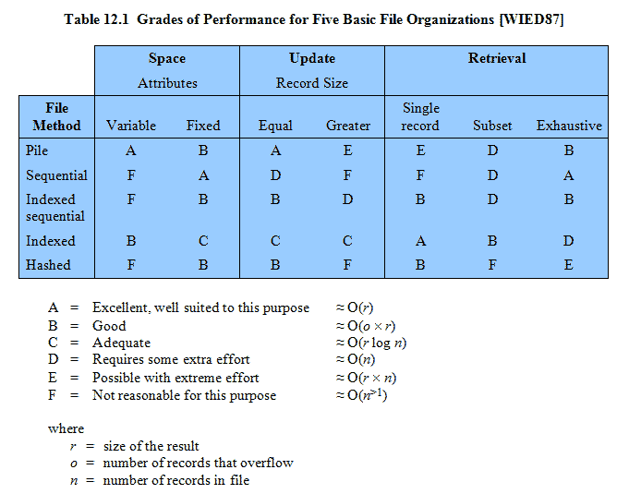
Performance

Slide 36
File Directories
Contains information about files
Attributes
Location
Ownership
Directory itself is a file owned by the operating system
Provides mapping between file names and the files themselves

Slide 37
Simple Structure for a Directory
List of entries, one for each file
Sequential file with the name of the file serving as the key
Provides no help in organizing the files
Forces user to be careful not to use the same name for two different files

Slide 38
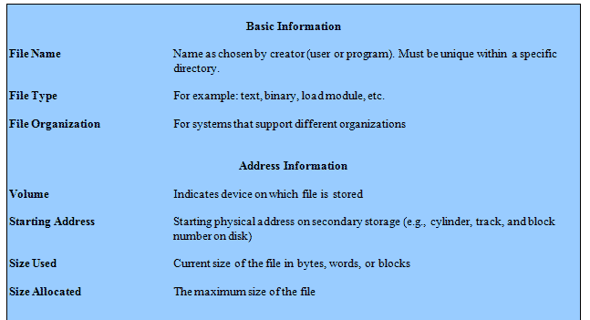
Information Elements of a File Directory

Slide 39
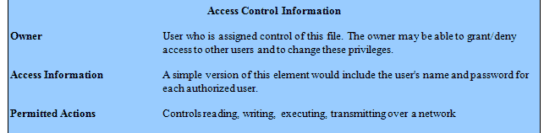
Information Elements of a File Directory

Slide 40
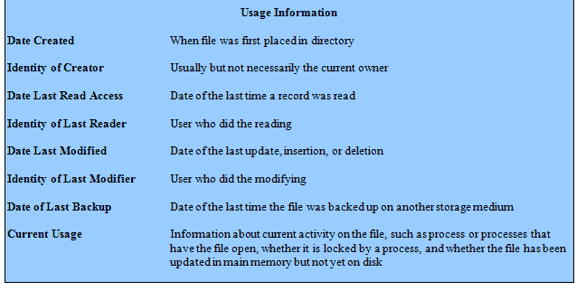
Information Elements of a File Directory

Slide 41
Two-Level Scheme for a Directory
One directory for each user and a master directory
Master directory contains entry for each user
Provides address and access control information

Slide 42
Two-Level Scheme for a Directory
Each user directory is a simple list of files for that user
Still provides no help in structuring collections of files

Slide 43
Hierarchical, or Tree-Structured Directory
Master directory with user directories underneath it
Each user directory may have subdirectories and files as entries

Slide 44
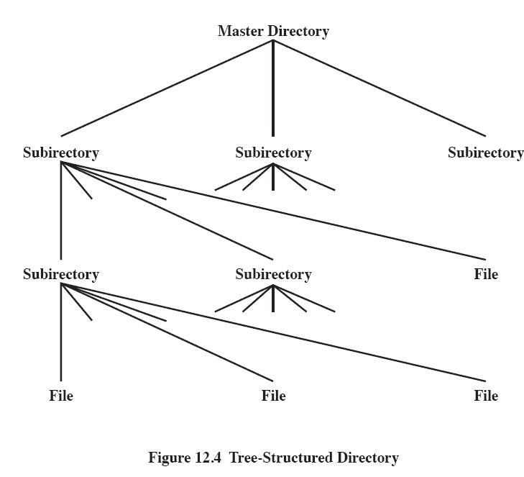
Tree-Structured Directory

Slide 45
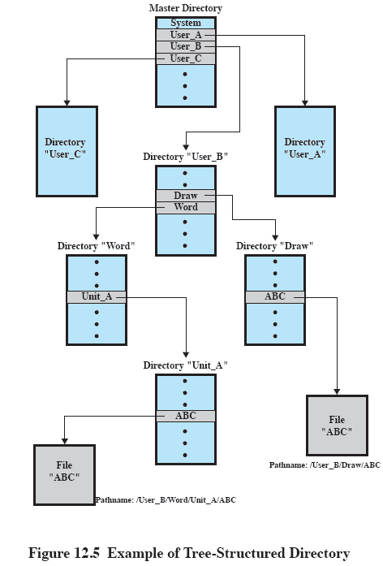
Example of Tree-Structured Directory

Slide 46
Hierarchical, or Tree-Structured Directory
Files can be located by following a path from the root, or master, directory down various branches
This is the pathname for the file
Can have several files with the same file name as long as they have unique path names

Slide 47
Hierarchical, or Tree-Structured Directory
Current directory is the working directory
Files are referenced relative to the working directory

Slide 48
File Sharing
In multiuser system, allow files to be shared among users
Two issues
Access rights
Management of simultaneous access

Slide 49
Access Rights
None
User may not know of the existence of the file
User is not allowed to read the user directory that includes the file
Knowledge
User can only determine that the file exists and who its owner is

Slide 50
Access Rights
Execution
The user can load and execute a program but cannot copy it
Reading
The user can read the file for any purpose, including copying and execution
Appending
The user can add data to the file but cannot modify or delete any of the file’s contents

Slide 51
Access Rights
Updating
The user can modify, deleted, and add to the file’s data. This includes creating the file, rewriting it, and removing all or part of the data
Changing protection
User can change access rights granted to other users
Deletion
User can delete the file

Slide 52
Access Rights
Owners
Has all rights previously listed
May grant rights to others using the following classes of users
Specific user
User groups
All for public files

Slide 53
Simultaneous Access
User may lock entire file when it is to be updated
User may lock the individual records during the update
Mutual exclusion and deadlock are issues for shared access

Slide 54
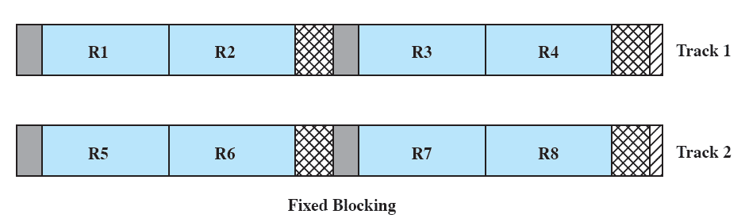
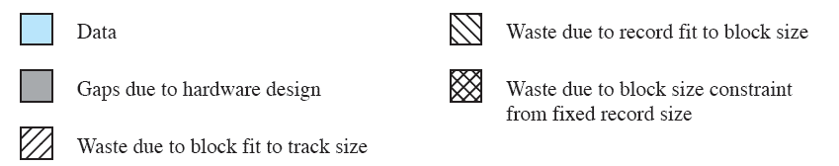
Fixed Blocking

Slide 55
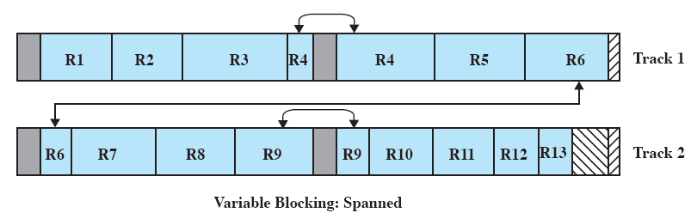
Variable Blocking: Spanned

Slide 56
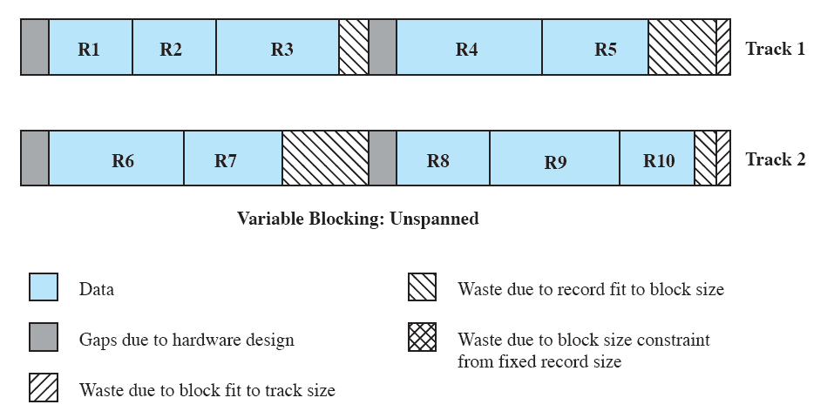
Variable Blocking: Unspanned

Slide 57
Secondary Storage Management
Space must be allocated to files
Must keep track of the space available for allocation

Slide 58
Preallocation
Need the maximum size for the file at the time of creation
Difficult to reliably estimate the maximum potential size of the file
Tend to overestimate file size so as not to run out of space

Slide 59
Contiguous Allocation
Single set of blocks is allocated to a file at the time of creation
Only a single entry in the file allocation table
Starting block and length of the file
External fragmentation will occur
Need to perform compaction

Slide 60
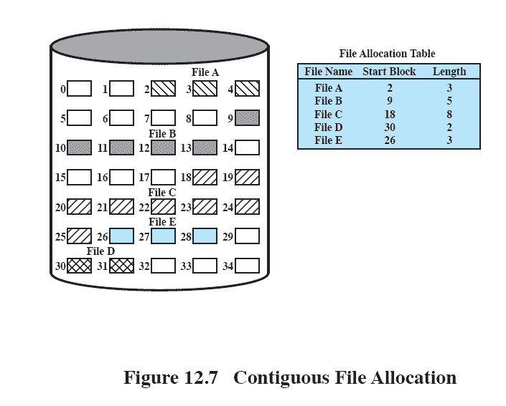
Contiguous File Allocation

Slide 61
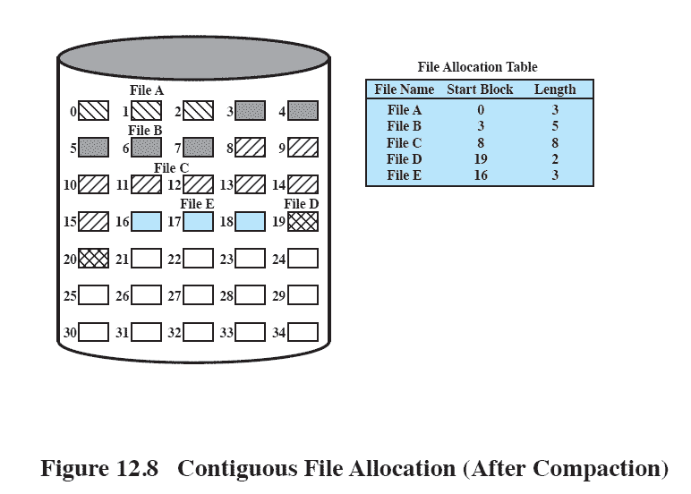
Contiguous File Allocation

Slide 62
Chained Allocation
Allocation on basis of individual block
Each block contains a pointer to the next block in the chain
Only single entry in the file allocation table
Starting block and length of file

Slide 63
Chained Allocation
No external fragmentation
Best for sequential files
No accommodation of the principle of locality

Slide 64
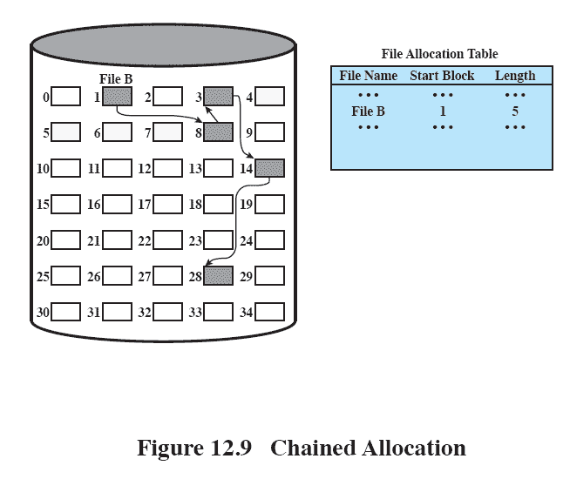
Chained Allocation

Slide 65
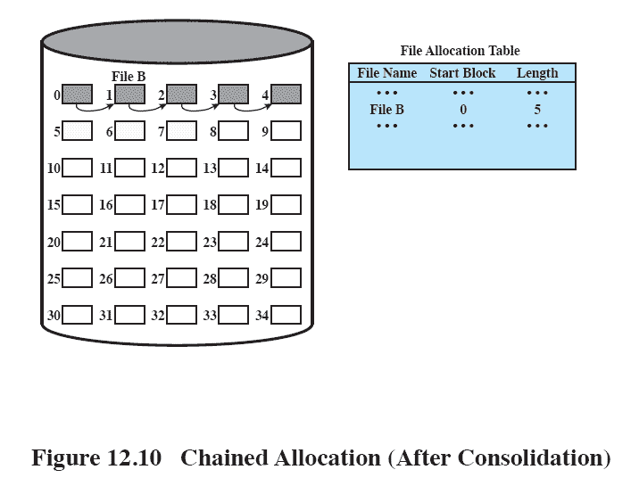
Chained Allocation

Slide 66
Indexed Allocation
File allocation table contains a separate one-level index for each file
The index has one entry for each portion allocated to the file
The file allocation table contains block number for the index

Slide 67
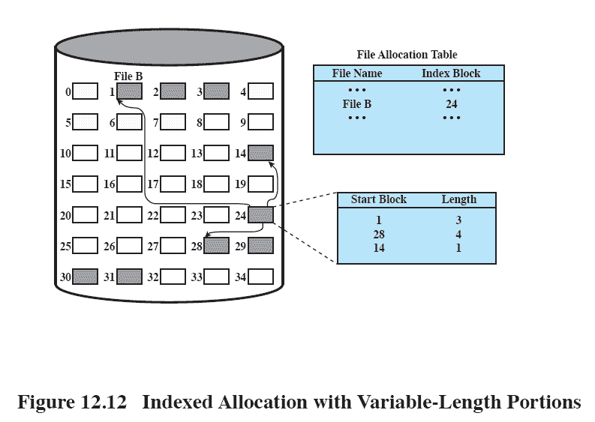
Indexed Allocation

Slide 68
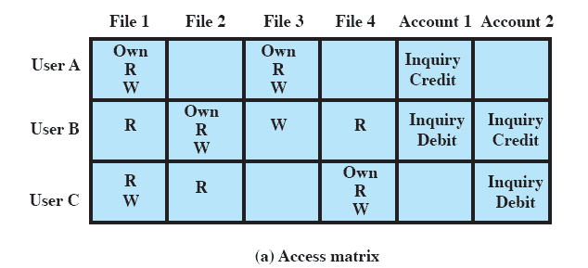
Access Matrix

Slide 69
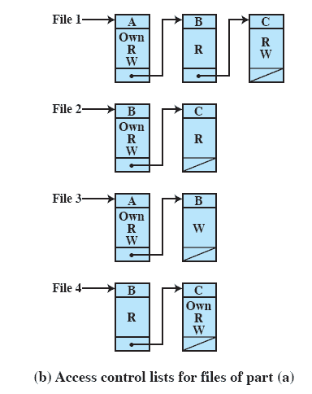
Access Control List

Slide 70
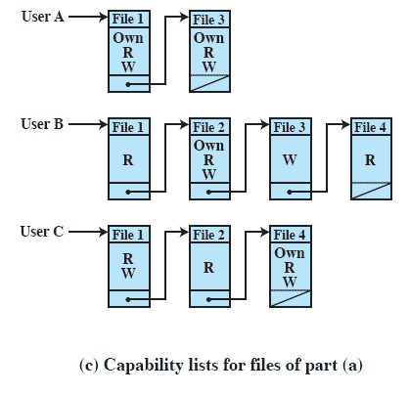
Capability Lists

Slide 71
UNIX File Management
Types of files
Regular, or ordinary
Directory
Special
Named pipes
Links
Symbolic links

Slide 72
Inodes
Index node
Control structure that contains key information for a particular file

Slide 73
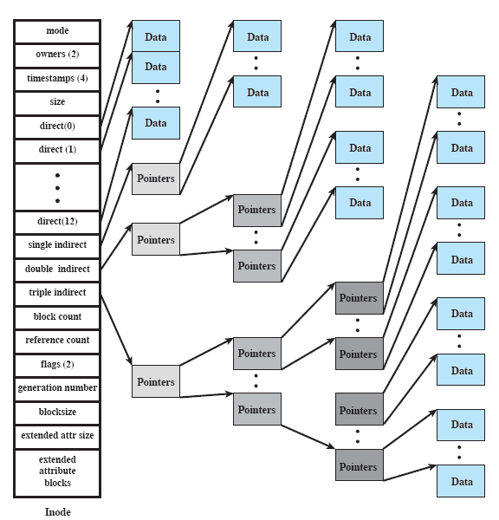
Structure of FreeBSD Inode and File

Slide 74
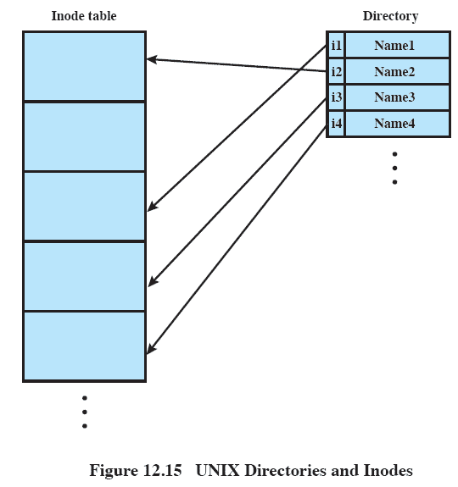
UNIX Directories and Inodes

Slide 75
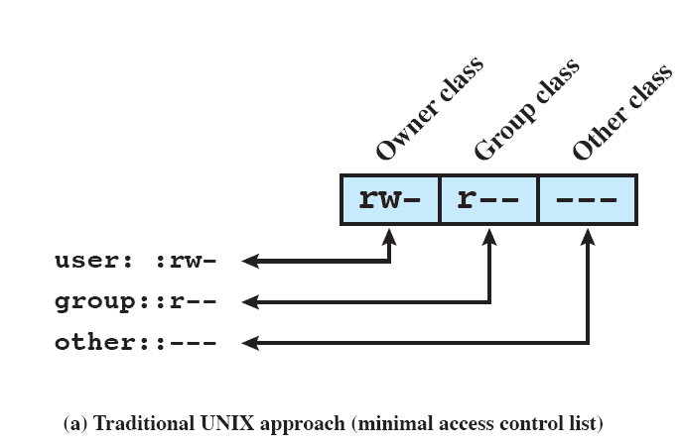
UNIX File Access Control

Slide 76
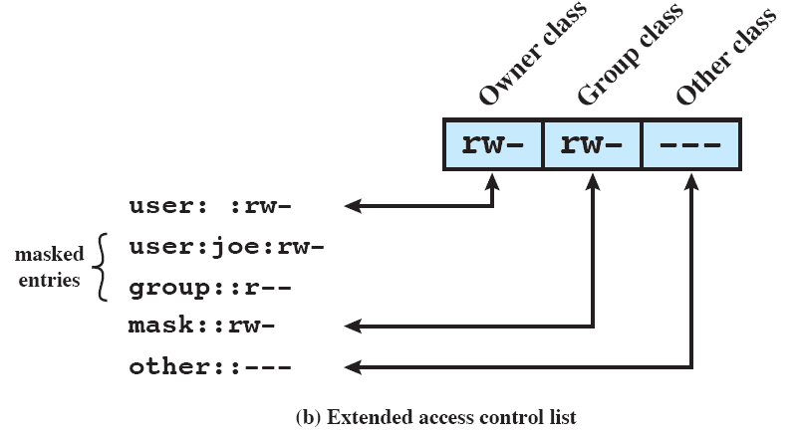
UNIX File Access Control

Slide 77
Linux Virtual File System
Uniform file system interface to user processes
Represents any conceivable file system’s general feature and behavior
Assumes files are objects that share basic properties regardless of the target file system

Slide 78
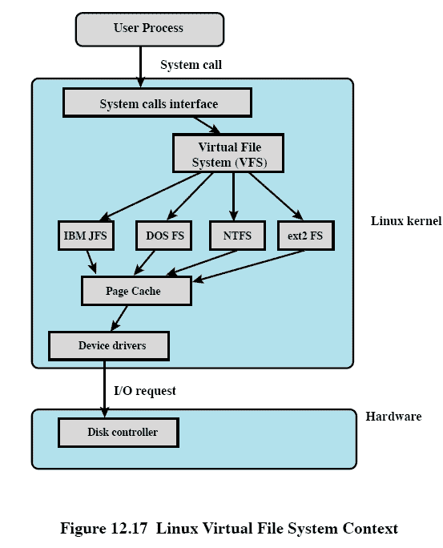
Linux Virtual File System Context

Slide 79
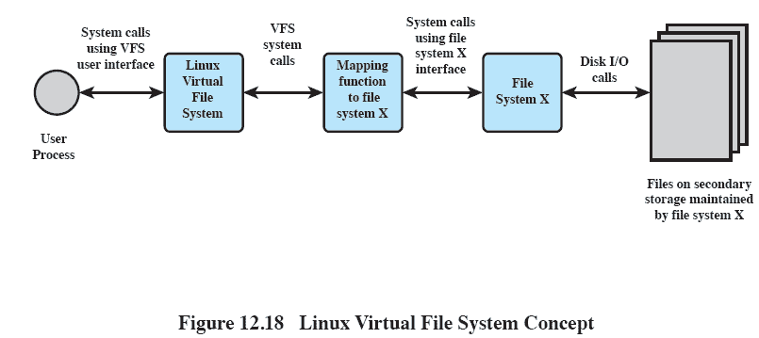
Linux Virtual File System Concept

Slide 80
Primary Objects in VFS
Superblock object
Represents a specific mounted file system
Inode object
Represents a specific file
Dentry object
Represents a specific directory entry
File object
Represents an open file associated with a process

Slide 81
Windows File System
Key features of NTFS
Recoverability
Security
Large disks and large files
Multiple data streams
Journaling
Compression and Encryption

Slide 82
NTFS Volume and File Structure
Sector
The smallest physical storage unit on the disk
Cluster
One or more contiguous sectors
Volume
Logical partition on a disk

Slide 83
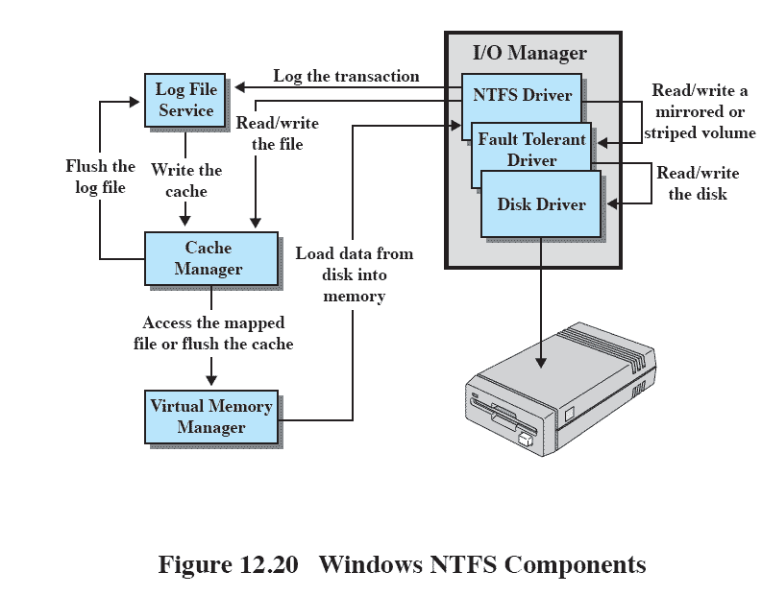
Windows NTFS Components

