Slide 1

Chapter 11 I/O Management and Disk Scheduling
Operating Systems: Internals and Design Principles, 6/E William Stallings
Notes:
These slides are intended to help a teacher develop a presentation. This PowerPoint covers the entire chapter and includes too many slides for a single delivery. Professors are encouraged to adapt this presentation in ways which are best suited for their students and environment.

Slide 2
Roadmap
I/O Devices
Organization of the I/O Function
Operating System Design Issues
I/O Buffering
Disk Scheduling
Raid
Disk Cache
UNIX SVR4 I/O
LINUX I/O
Windows I/O
Notes:
Beginning with a brief discussion of I/O devices and the organization of the I/O functions.
Next examine operating system design issues, including design objectives, and the way in which the I/O function can be structured.
Then I/O buffering is examined;
The next sections of the chapter are devoted to magnetic disk I/O.
We begin by developing a model of disk I/O performance and then examine several techniques that can be used to enhance performance.

Slide 3
Categories of I/O Devices
Difficult area of OS design
Difficult to develop a consistent solution due to a wide variety of devices and applications
Three Categories:
Human readable: to communicate with users
Machine readable: to communicate with electronic equipments
Communications: to communicate with remote devices, e.g. modems, network devices

Slide 4
Human readable
Devices used to communicate with the user
Printers and terminals
Video display
Keyboard
Mouse etc
Notes:
Suitable for communicating with the computer user.
Examples include printers and terminals, the latter consisting of video display, keyboard, and perhaps other devices such as a mouse.

Slide 5
Machine readable
Used to communicate with electronic equipment
Disk drives
USB keys
Sensors
Controllers
Actuators
Notes:
Suitable for communicating with electronic equipment.
Examples are disk drives, USB keys, sensors, controllers, and actuators.

Slide 6
Communication
Used to communicate with remote devices
Digital line drivers
Modems
Notes:
Suitable for communicating with remote devices.
Examples are digital line drivers and modems.

Slide 7
Differences in I/O Devices
Devices differ in a number of areas
Data Rate
Application
Complexity of Control
Unit of Transfer
Data Representation
Error Conditions
Notes:
Each of these are covered in subsequent slides
This diversity makes a uniform and consistent approach to I/O, both from the point of view of the operating system and from the point of view of user processes, difficult to achieve.

Slide 8
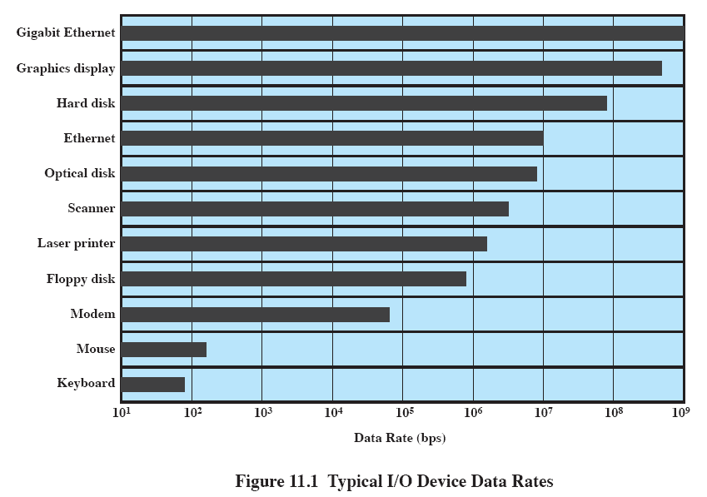
Data Rate
May be massive difference between the data transfer rates of devices
Notes:
There may be differences of several orders of magnitude between the data transfer rates.

Slide 9
Application
Disk used to store files requires file management software
Disk used to store virtual memory pages needs special hardware and software to support it
These applications have an impact on disk scheduling algorithms.
Terminal used by system administrator may have a higher priority
Notes:
The use to which a device is put has an influence on the software and policies in the operating system and supporting utilities.
Examples:
disk used for files requires the support of file management software.
disk used as a backing store for pages in a virtual memory scheme depends on the use of virtual memory hardware and software.
These applications have an impact on disk scheduling algorithms.
Another example, a terminal may be used by an ordinary user or a system administrator.
implying different privilege levels and perhaps different priorities in the operating system.

Slide 10
Complexity of control
A printer requires a relatively simple control interface.
A disk is much more complex.
This complexity is filtered to some extent by the complexity of the I/O module that controls the device.
Notes:
A printer requires a relatively simple control interface while a disk is much more complex.
This complexity is filtered to some extent by the complexity of the I/O module that controls the device.

Slide 11
Unit of transfer
Data may be transferred as
a stream of bytes or characters (e.g., terminal I/O)
or in larger blocks (e.g., disk I/O).
Notes:
Data may be transferred as a stream of bytes or characters (e.g., terminal I/O) or in larger blocks (e.g., disk I/O).

Slide 12
Data representation
Different data encoding schemes are used by different devices,
including differences in character code and parity conventions.
Notes:
Different data encoding schemes are used by different devices, including differences in character code and parity conventions.

Slide 13
Error Conditions
The nature of errors differ widely from one device to another.
Aspects include:
the way in which they are reported,
their consequences,
the available range of responses
Notes:
The nature of errors, the way in which they are reported, their consequences, and the available range of responses differ widely from one device to another.

Slide 14
Roadmap
I/O Devices
Organization of the I/O Function
Operating System Design Issues
I/O Buffering
Disk Scheduling
Raid
Disk Cache
UNIX SVR4 I/O
LINUX I/O
Windows I/O

Slide 15
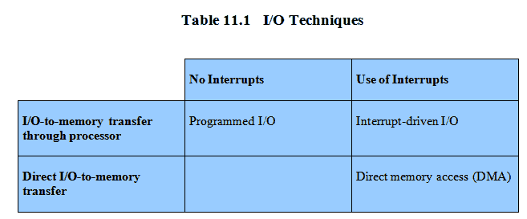
Techniques for performing I/O
Programmed I/O
Interrupt-driven I/O
Direct memory access (DMA)
Notes:
From section 1.7
Programmed I/O:
Processor issues an I/O command, on behalf of a process, to an I/O module;
that process then busy waits for the operation to be completed before proceeding.
Interrupt-driven I/O:
Processor issues an I/O command on behalf of a process.
If the I/O instruction from the process is nonblocking, then the processor continues to execute instructions from the process that issued the I/O command.
If the I/O instruction is blocking, then the next instruction that the processor executes is from the OS, which will put the current process in a blocked state and schedule another process.
Direct memory access (DMA):
A DMA module controls the exchange of data between main memory and an I/O module.
The processor sends a request for the transfer of a block of data to the DMA module and is interrupted only after the entire block has been transferred.
Table 11.1 indicates the relationship among these three techniques.

Slide 16
Programmed I/O
Processor issues an I/O command, on behalf of a process, to an I/O module;
that process then busy waits for the operation to be completed before proceeding.

Slide 17
Interrupt-driven I/O
Processor issues an I/O command on behalf of a process.
If the I/O instruction from the process is nonblocking, then the processor continues to execute instructions from the process that issued the I/O command.
If the I/O instruction is blocking, then the next instruction that the processor executes is from the OS, which will put the current process in a blocked state and schedule another process.

Slide 18
Direct memory access (DMA)
A DMA module controls the exchange of data between main memory and an I/O module.
The processor sends a request for the transfer of a block of data to the DMA module and is interrupted only after the entire block has been transferred.

Slide 19
Evolution of the I/O Function
Processor directly controls a peripheral device
Controller or I/O module is added
Processor uses programmed I/O without interrupts
Processor does not need to handle details of external devices
Notes:
The processor directly controls a peripheral device.
This is seen in simple microprocessor-controlled devices.
A controller or I/O module is added.
The processor uses programmed I/O without interrupts.
With this step, the processor becomes somewhat divorced from the specific details of external device interfaces.

Slide 20
Evolution of the I/O Function cont…
Controller or I/O module with interrupts
Efficiency improves as processor does not spend time waiting for an I/O operation to be performed
Direct Memory Access
Blocks of data are moved into memory without involving the processor
Processor involved at beginning and end only
Notes:
3. Now interrupts are employed.
The processor need not spend time waiting for an I/O operation to be performed, thus increasing efficiency.
4. The I/O module is given direct control of memory via DMA.
It can now move a block of data to or from memory without involving the processor, except at the beginning and end of the transfer.

Slide 21
Evolution of the I/O Function cont…
I/O module is a separate processor
CPU directs the I/O processor to execute an I/O program in main memory.
The I/O processor fetches and executes these instructions without processor intervention.
Allowing the processor to specify a sequence of I/O activities and to be interrupted only when the entire sequence has been performed.
Notes:
5. I/O module is enhanced to become a separate processor, with a specialized instruction set tailored for I/O.
CPU directs the I/O processor to execute an I/O program in main memory.
The I/O processor fetches and executes these instructions without processor intervention.
Allowing the processor to specify a sequence of I/O activities and to be interrupted only when the entire sequence has been performed.
6. The I/O module has a local memory of its own and is, in fact, a computer in its own right.
A large set of I/O devices can be controlled, with minimal processor involvement.
Commonly used to control communications with interactive terminals. The I/O processor takes care of most of the tasks involved in controlling the terminals.

Slide 22
Evolution of the I/O Function cont…
6. I/O processor
I/O module has its own local memory, in fact, a computer in its own right.
Commonly used to control communications with interactive terminals
The I/O processor takes care of most of the tasks involved in controlling the terminals.
Notes:
5. I/O module is enhanced to become a separate processor, with a specialized instruction set tailored for I/O.
CPU directs the I/O processor to execute an I/O program in main memory.
The I/O processor fetches and executes these instructions without processor intervention.
Allowing the processor to specify a sequence of I/O activities and to be interrupted only when the entire sequence has been performed.
6. The I/O module has a local memory of its own and is, in fact, a computer in its own right.
A large set of I/O devices can be controlled, with minimal processor involvement.
Commonly used to control communications with interactive terminals. The I/O processor takes care of most of the tasks involved in controlling the terminals.

Slide 23
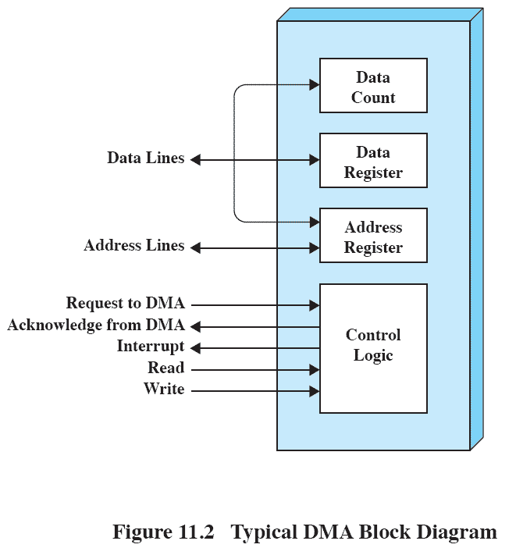
Direct Memory Address
Processor delegates I/O operation to the DMA module
DMA module transfers data directly to or form memory
When complete DMA module sends an interrupt signal to the processor

Slide 24
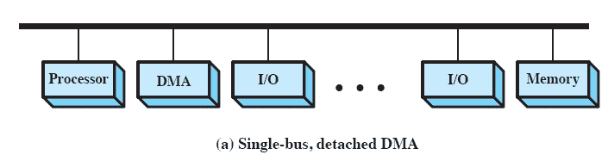
DMA Configurations: Single Bus
DMA can be configured in several ways
Shown here, all modules share the same system bus
Notes:
The DMA mechanism can be configured in a variety of ways.
Some possibilities are shown here In the first example, all modules share the same system bus.
The DMA module, acting as a surrogate processor, uses programmed I/O to exchange data between memory and an I/O module through the DMA module.
This is clearly inefficient: As with processor-controlled programmed I/O, each transfer of a word consumes two bus cycles (transfer request followed by transfer).

Slide 25
DMA Configurations: Single Bus
The DMA module, acting as a surrogate processor, uses programmed I/O to exchange data between memory and an I/O module through the DMA module.
This is clearly inefficient: As with processor-controlled programmed I/O, each transfer of a word consumes two bus cycles (transfer request followed by transfer).

Slide 26
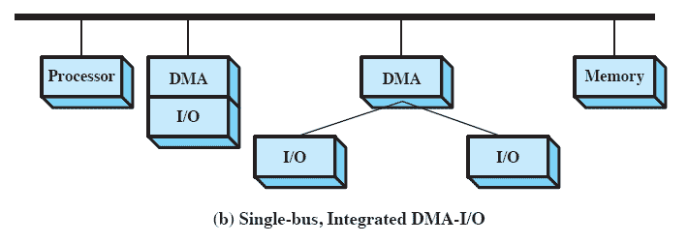
DMA Configurations: Integrated DMA & I/O
Direct Path between DMA and I/O modules that does not include the system bus. It substantially cuts the required bus cycles
The DMA logic may actually be a part of an I/O module, or it may be a separate module that controls one or more I/O modules.
Notes:
The number of required bus cycles can be cut substantially by integrating the DMA and I/O functions.
This means that there is a path between the DMA module and one or more I/O modules that does not include the system bus.
The DMA logic may actually be a part of an I/O module, or it may be a separate module that controls one or more I/O modules.

Slide 27
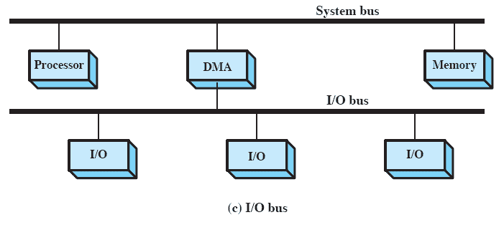
DMA Configurations: I/O Bus
Connecting I/O modules to the DMA module using an I/O bus
Reduces the number of I/O interfaces in the DMA module
Notes:
This concept can be taken one step further by connecting I/O modules to the DMA module using an I/O bus
This reduces the number of I/O interfaces in the DMA module to one and provides for an easily expandable configuration.
In all of these cases the system bus that the DMA module shares with the processor and main memory is used by the DMA module only to exchange data with memory and to exchange control signals with the processor.
The exchange of data between the DMA and I/O modules takes place off the system bus.

Slide 28
Roadmap
I/O Devices
Organization of the I/O Function
Operating System Design Issues
I/O Buffering
Disk Scheduling
Raid
Disk Cache
UNIX SVR4 I/O
LINUX I/O
Windows I/O

Slide 29
Goals: Efficiency
Most I/O devices extremely slow compared to main memory
Use of multiprogramming allows for some processes to be waiting on I/O while another process executes
I/O cannot keep up with processor speed
Swapping used to bring in ready processes
But this is an I/O operation itself, hence the need
The area that has received the most attention, because of its importance, is disk I/O.
Notes:
Efficiency is important because I/O operations often form a bottleneck in a computing system.
One way to tackle this problem is multiprogramming, which, as we have seen, allows some processes to be waiting on I/O operations while another process is executing.
However, even with the vast size of main memory in today’s machines, often I/O is not keeping up with the activities of the processor.
Swapping is used to bring in additional ready processes to keep the processor busy, but this in itself is an I/O operation.
Thus, a major effort in I/O design has been schemes for improving the efficiency of the I/O.
The area that has received the most attention, because of its importance, is disk I/O.

Slide 30
Generality
For simplicity and freedom from error it is desirable to handle all I/O devices in a uniform manner
This applies both to the way in which processes view I/O devices and the way in which the operating system manages I/O devices and operations.
Hide most of the details of device I/O in lower-level routines, e.g. R, W, O, C, Lock, Unlock…
Difficult to completely generalize, but can use a hierarchical modular design of I/O functions
Notes:
For simplicity and freedom from error, it is desirable to handle all devices in a uniform manner.
This applies both to the way in which processes view I/O devices and the way in which the operating system manages I/O devices and operations.
Because of the diversity of device characteristics, it is difficult in practice to achieve true generality.
What can be done is to use a hierarchical, modular approach to the design of the I/O function.
T his hides most of the details of device I/O in lower-level routines so that user processes and upper levels of the operating system see devices in terms of general functions, such as read, write, open, close, lock, unlock.

Slide 31
Hierarchical design
A hierarchical philosophy leads to organizing an OS into layers
Each layer relies on the next lower layer to perform more primitive functions
It provides services to the next higher layer.
Changes in one layer should not require changes in other layers
Notes:
The hierarchical philosophy developed in Chapter 2 suggested that the functions of the operating system should be separated according to their complexity, their characteristic time scale, and their level of abstraction.
This approach leads to an organization of the operating system into a series of layers.
Each layer performs a related subset of the functions required of the operating system.
It relies on the next lower layer to perform more primitive functions and to conceal the details of those functions.
It provides services to the next higher layer.
Ideally, the layers should be defined so that changes in one layer do not require changes in other layers.

Slide 32
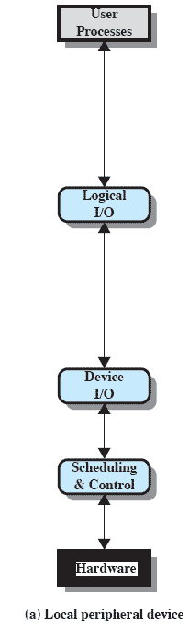
Local peripheral device
Logical I/O:
Deals with the device as a logical resource
Concerned with managing general I/O functions on behalf of user processes, allowing them to deal with the device in terms of a device identifier and simple commands such as open, close, read, write.
Notes:
Logical I/O:
Deals with the device as a logical resource and is not concerned with the details of actually controlling the device.
Concerned with managing general I/O functions on behalf of user processes, allowing them to deal with the device in terms of a device identifier and simple commands such as open, close, read, write.
Device I/O:
The requested operations and data (buffered characters, records, etc.) are converted into appropriate sequences of I/O instructions, channel commands, and controller orders.
Buffering techniques may be used to improve utilization.
Scheduling and control:
The actual queuing and scheduling of I/O operations occurs at this layer, as well as the control of the operations.
Interrupts are handled at this layer and I/O status is collected and reported.
This is the layer of software that actually interacts with the I/O module and hence the device hardware.

Slide 33
Local peripheral device
Device I/O:
The requested operations and data (buffered characters, records, etc.) are converted into appropriate sequences of I/O instructions, channel commands, and controller orders.
Buffering techniques may be used to improve utilization
Notes:
Logical I/O:
Deals with the device as a logical resource and is not concerned with the details of actually controlling the device.
Concerned with managing general I/O functions on behalf of user processes, allowing them to deal with the device in terms of a device identifier and simple commands such as open, close, read, write.
Device I/O:
The requested operations and data (buffered characters, records, etc.) are converted into appropriate sequences of I/O instructions, channel commands, and controller orders.
Buffering techniques may be used to improve utilization.
Scheduling and control:
The actual queuing and scheduling of I/O operations occurs at this layer, as well as the control of the operations.
Interrupts are handled at this layer and I/O status is collected and reported.
This is the layer of software that actually interacts with the I/O module and hence the device hardware.

Slide 34
Local peripheral device
Scheduling and Control
The actual queuing and scheduling of I/O operations occurs at this layer, as well as the control of the operations.
Interrupts are handled at this layer and I/O status is collected and reported.
This is the layer of software that actually interacts with the I/O module and hence the device hardware.
Notes:
Logical I/O:
Deals with the device as a logical resource and is not concerned with the details of actually controlling the device.
Concerned with managing general I/O functions on behalf of user processes, allowing them to deal with the device in terms of a device identifier and simple commands such as open, close, read, write.
Device I/O:
The requested operations and data (buffered characters, records, etc.) are converted into appropriate sequences of I/O instructions, channel commands, and controller orders.
Buffering techniques may be used to improve utilization.
Scheduling and control:
The actual queuing and scheduling of I/O operations occurs at this layer, as well as the control of the operations.
Interrupts are handled at this layer and I/O status is collected and reported.
This is the layer of software that actually interacts with the I/O module and hence the device hardware.

Slide 35
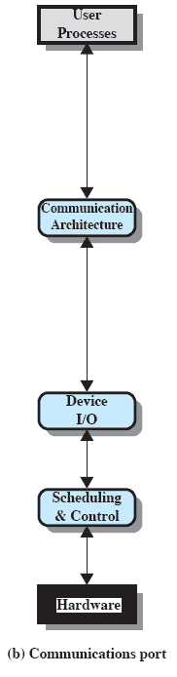
Communications Port
Similar to previous but the logical I/O module is replaced by a communications architecture,
This consist of a number of layers.
An example is TCP/IP,
Notes:
The logical I/O module is replaced by a communications architecture,
which may itself consist of a number of layers.
An example is TCP/IP,.

Slide 36
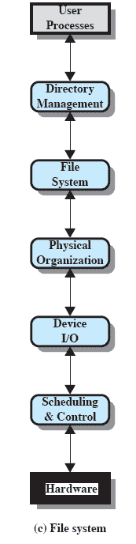
File System
Directory management
At this layer, symbolic file names are converted to identifiers that either reference the file directly or indirectly through a file descriptor or index table.
Concerned with user operations that affect the directory of files, such as add, delete, and reorganize.
Notes:
Directory management:
At this layer, symbolic file names are converted to identifiers that either reference the file directly or indirectly through a file descriptor or index table.
Concerned with user operations that affect the directory of files, such as add, delete, and reorganize.
File system:
This layer deals with the logical structure of files and with the operations that can be specified by users, such as open, close, read, write.
Access rights are also managed at this layer.
Physical organization:
Files and records must be converted to physical secondary storage addresses, taking into account the physical track and sector structure of the secondary storage device.
Allocation of secondary storage space and main storage buffers is generally treated at this layer as well.

Slide 37
File System
File System
This layer deals with the logical structure of files and with the operations that can be specified by users, such as open, close, read, write.
Access rights are also managed at this layer.
Notes:
Directory management:
At this layer, symbolic file names are converted to identifiers that either reference the file directly or indirectly through a file descriptor or index table.
Concerned with user operations that affect the directory of files, such as add, delete, and reorganize.
File system:
This layer deals with the logical structure of files and with the operations that can be specified by users, such as open, close, read, write.
Access rights are also managed at this layer.
Physical organization:
Files and records must be converted to physical secondary storage addresses, taking into account the physical track and sector structure of the secondary storage device.
Allocation of secondary storage space and main storage buffers is generally treated at this layer as well.

Slide 38
File System
Physical organisation]
Files and records must be converted to physical secondary storage addresses, taking into account the physical track and sector structure of the secondary storage device.
Allocation of secondary storage space and main storage buffers is generally treated at this layer as well.
Notes:
Directory management:
At this layer, symbolic file names are converted to identifiers that either reference the file directly or indirectly through a file descriptor or index table.
Concerned with user operations that affect the directory of files, such as add, delete, and reorganize.
File system:
This layer deals with the logical structure of files and with the operations that can be specified by users, such as open, close, read, write.
Access rights are also managed at this layer.
Physical organization:
Files and records must be converted to physical secondary storage addresses, taking into account the physical track and sector structure of the secondary storage device.
Allocation of secondary storage space and main storage buffers is generally treated at this layer as well.

Slide 39
Roadmap
I/O Devices
Organization of the I/O Function
Operating System Design Issues
I/O Buffering
Disk Scheduling
Raid
Disk Cache
UNIX SVR4 I/O
LINUX I/O
Windows I/O

Slide 40
I/O Buffering
Processes must wait for I/O to complete before proceeding
To avoid deadlock certain pages must remain in main memory during I/O
It may be more efficient to perform input transfers in advance of requests being made and to perform output transfers some time after the request is made.
Notes:
To avoid deadlock, the user memory involved in the I/O operation must be locked in main memory immediately before the I/O request is issued, even though the I/O operation is queued and may not be executed for some time.
If a block is being transferred from a user process area directly to an I/O module, then the process is blocked during the transfer and the process may not be swapped out.
To avoid these overheads and inefficiencies, it is sometimes convenient to perform input transfers in advance of requests being made and to perform output transfers some time after the request is made.

Slide 41
Block-oriented Buffering
Information is stored in fixed sized blocks
Transfers are made a block at a time
Can reference data by its block number
Used for disks and USB keys
Notes:
A block-oriented device stores information in blocks that are usually of fixed size, and transfers are made one block at a time.
Generally, it is possible to reference data by its block number.
Disks and USB keys are examples of block-oriented devices.

Slide 42
Stream-Oriented Buffering
Transfer information as a stream of bytes, with no block structure
Used for terminals, printers, communication ports, mouse and other pointing devices, and most other devices that are not secondary storage
Notes:
A stream-oriented device transfers data in and out as a stream of bytes, with no block structure.
Terminals, printers, communications ports, mouse and other pointing devices, and most other devices that are not secondary storage are stream oriented.

Slide 43
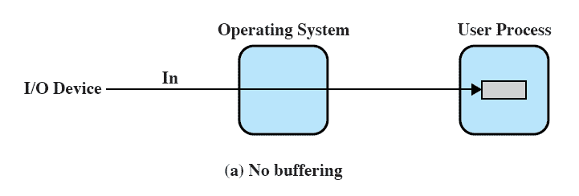
No Buffer
Without a buffer, the OS directly access the device as and when it needs

Slide 44
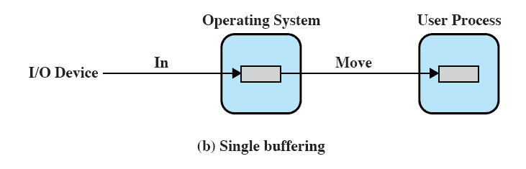
Single Buffer
Operating system assigns a buffer in main memory for an I/O request
Notes:
When a user process issues an I/O request, the operating system assigns a buffer in the system portion of main memory to the operation.

Slide 45
Block Oriented Single Buffer
Input transfers made to the system buffer
When the transfer is complete, the process moves the block into user space and immediately requests another block.
The next block is moved into the buffer
Read ahead or Anticipated Input
Often a reasonable assumption as data is usually accessed sequentially
Notes:
For block-oriented devices,
Input transfers are made to the system buffer.
When the transfer is complete, the process moves the block into user space and immediately requests another block.
Called reading ahead, or anticipated input;
it is done in the expectation that the block will eventually be needed.
Often this is a reasonable assumption most of the time because data are usually accessed sequentially.
Only at the end of a sequence of processing will a block be read in unnecessarily.

Slide 46
Stream-oriented Single Buffer
Line-at-time or Byte-at-a-time
Terminals often deal with one line at a time with carriage return signaling the end of the line
Byte-at-a-time suites devices where a single keystroke may be significant
Also sensors and controllers
Notes:
The single buffering scheme can be used in a line-at-a-time fashion or a byte-at-a-time fashion.
Line-at-a-time operation is appropriate for scroll-mode terminals (sometimes called dumb terminals).
Byte-at-a-time operation is used on where each keystroke is significant, or for peripherals such as sensors and controllers.

Slide 47
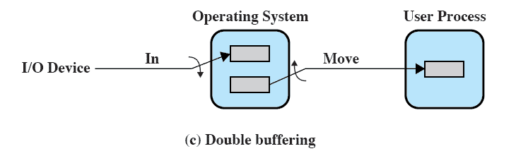
Double Buffer
Use two system buffers instead of one
A process can transfer data to or from one buffer while the operating system empties or fills the other buffer
Notes:
A process transfers data to (or from) one buffer while the operating system empties (or fills) the other.

Slide 48
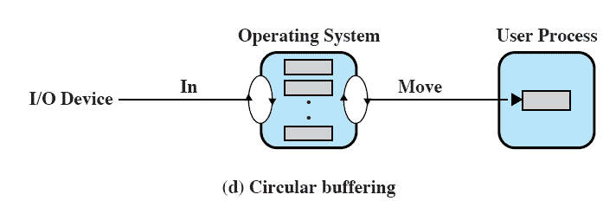
Circular Buffer
Double buffering may be inadequate if the process performs rapid bursts of I/O.
More than two buffers are used
Each individual buffer is one unit in a circular buffer
Used when I/O operation must keep up with process
Notes:
Double buffering may be inadequate if the process performs rapid bursts of I/O.
The problem can often be alleviated by using more than two buffers.
When more than two buffers are used, the collection of buffers is itself referred to as a circular buffer with each individual buffer being one
unit in the circular buffer.

Slide 49
Buffer Limitations
Buffering smoothes out peaks in I/O demand.
Double buffering may be inadequate if the process performs rapid bursts of I/O.
But with enough demand eventually all buffers become full and their advantage is lost, process will have to wait..
However, when there is a variety of I/O and process activities to service, buffering can increase the efficiency of the OS and the performance of individual processes.
Notes:
Buffering is a technique that smoothes out peaks in I/O demand.
However, no amount of buffering will allow an I/O device to keep pace with a process indefinitely when the average demand of the process is greater than the I/O device can service.
Even with multiple buffers, all of the buffers will eventually fill up and the process will have to wait after processing each chunk of data.
However, in a multiprogramming environment, when there is a variety of I/O activity and a variety of process activity to service, buffering is one tool that can increase the efficiency of the operating system and the performance of individual processes.

Slide 50
Roadmap
I/O Devices
Organization of the I/O Function
Operating System Design Issues
I/O Buffering
Disk Scheduling
Raid
Disk Cache
UNIX SVR4 I/O
LINUX I/O
Windows I/O
Notes:
Over the last 40 years, the increase in the speed of processors and main memory has far outstripped that for disk access, with processor and main memory speeds increasing by about two orders of magnitude compared to one order of magnitude for disk.
The result is that disks are currently at least four orders of magnitude slower than main memory.
Thus, the performance of disk storage subsystem is of vital concern.
In this section, we highlight some of the key issues and look at the most important approaches.

Slide 51
Disk Scheduling
Over the last 40 years, the increase in the speed of processors and main memory has far outstripped that for disk access, with processor and main memory speeds increasing by about two orders of magnitude compared to one order of magnitude for disk.
The result is that disks are currently at least four orders of magnitude slower than main memory.
Thus, the performance of disk storage subsystem is of vital concern.

Slide 52
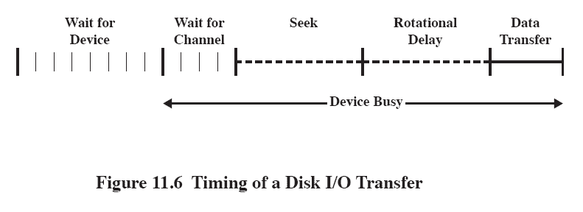
Disk Performance Parameters
The actual details of disk I/O operation depend on many things: Computer Sys, OS, Nature of I/O channel, disk controller
A general timing diagram of disk I/O transfer is shown here.
Notes:
The actual details of disk I/O operation depend on the computer system, the operating system, and the nature of the I/O channel and disk controller hardware.
A general timing diagram of disk I/O transfer is shown in Figure 11.6.

Slide 53
Positioning the Read/Write Heads
When the disk drive is operating, the disk is rotating at constant speed.
To read or write, the head must be positioned at the desired track and at the beginning of the desired sector on that track.
Track selection involves moving the head in a movable-head system or electronically selecting one head on a fixed-head system.
Notes:
When the disk drive is operating, the disk is rotating at constant speed.
To read or write, the head must be positioned at the desired track and at the beginning of the desired sector on that track.
Track selection involves moving the head in a movable-head system or electronically selecting one head on a fixed-head system.

Slide 54
Disk Performance Parameters
When the disk drive is operating, the disk is rotating at constant speed.
To read or write, the head must be positioned at the desired track and at the beginning of the desired sector on that track.
Track selection involves moving the head in a movablehead system or electronically selecting one head on a fixed-head system.
On a movable-head system, the time it takes to position the head at the track is known as seek time.
Notes:
Access Time is the sum of
Seek Time is the time it takes to position the head at the track.
Rotational delay is the time it takes for the beginning of the sector to reach the head
Once the head is in position, the read or write operation is then performed as the sector moves under the head;
this is the data transfer portion of the operation; the time required for the transfer is the transfer time.

Slide 55
Disk Performance Parameters
In either case, once the track is selected, the disk controller waits until the appropriate sector rotates to line up with the head.
The time it takes for the beginning of the sector to reach the head is known as rotational delay, or rotational latency.
The sum of the seek time, if any, and the rotational delay equals the access time, which is the time it takes to get into position to read or write.
Notes:
Access Time is the sum of
Seek Time is the time it takes to position the head at the track.
Rotational delay is the time it takes for the beginning of the sector to reach the head
Once the head is in position, the read or write operation is then performed as the sector moves under the head;
this is the data transfer portion of the operation; the time required for the transfer is the transfer time.

Slide 56
Disk Performance Parameters
Once the head is in position, the read or write operation is then performed as the sector moves under the head;
this is the data transfer portion of the operation; the time required for the transfer is the transfer time.
Transfer Time is the time taken to transfer the data.
Notes:
Access Time is the sum of
Seek Time is the time it takes to position the head at the track.
Rotational delay is the time it takes for the beginning of the sector to reach the head
Once the head is in position, the read or write operation is then performed as the sector moves under the head;
this is the data transfer portion of the operation; the time required for the transfer is the transfer time.

Slide 57
Disk Performance Parameters
In addition to the access time and transfer time, there are several queuing delays normally associated with a disk I/O operation.
When a process issues an I/O request, it must first wait in a queue for the device to be available.
At that time, the device is assigned to the process. If the device shares a single I/O channel or a set of I/O channels with other disk drives, then there may be an additional wait for the channel to be available.At that point, the seek is performed to begin disk access.
Notes:
Access Time is the sum of
Seek Time is the time it takes to position the head at the track.
Rotational delay is the time it takes for the beginning of the sector to reach the head
Once the head is in position, the read or write operation is then performed as the sector moves under the head;
this is the data transfer portion of the operation; the time required for the transfer is the transfer time.

Slide 58
Disk Performance Parameters
When the seek is completed, the device determines when the data will rotate under the head.
As that sector approaches the head, the device tries to reestablish the communication path back to the host.
If either the control unit or the channel is busy with another I/O, then the reconnection attempt fails and the device must rotate one whole revolution before it can attempt to reconnect, which is called an Rotational Positional Sensing (RPS) miss.
This is an extra delay element that must be added to the time line of Figure 11.6.
Notes:
Access Time is the sum of
Seek Time is the time it takes to position the head at the track.
Rotational delay is the time it takes for the beginning of the sector to reach the head
Once the head is in position, the read or write operation is then performed as the sector moves under the head;
this is the data transfer portion of the operation; the time required for the transfer is the transfer time.

Slide 59
Seek Time
Seek time is the time required to move the disk arm to the required track.
It turns out that this is a difficult quantity to pin down.
The seek time consists of two key components:
the initial startup time and
the time taken to traverse the tracks that have to be crossed once the access arm is up to speed.
Unfortunately, the traversal time is not a linear function of the number of tracks but includes a settling time
Notes:
Access Time is the sum of
Seek Time is the time it takes to position the head at the track.
Rotational delay is the time it takes for the beginning of the sector to reach the head
Once the head is in position, the read or write operation is then performed as the sector moves under the head;
this is the data transfer portion of the operation; the time required for the transfer is the transfer time.

Slide 60
Rotational delay
Rotational delay is the time required for the addressed area of the disk to rotate into a position where it is accessible by the read/write head.
Disks, other than floppy disks, rotate at speeds ranging from 3600 rpm (for handheld devices such as digital cameras) up to, 15,000 rpm; at this latter speed, there is one revolution per 4 ms.
Notes:
Access Time is the sum of
Seek Time is the time it takes to position the head at the track.
Rotational delay is the time it takes for the beginning of the sector to reach the head
Once the head is in position, the read or write operation is then performed as the sector moves under the head;
this is the data transfer portion of the operation; the time required for the transfer is the transfer time.

Slide 61
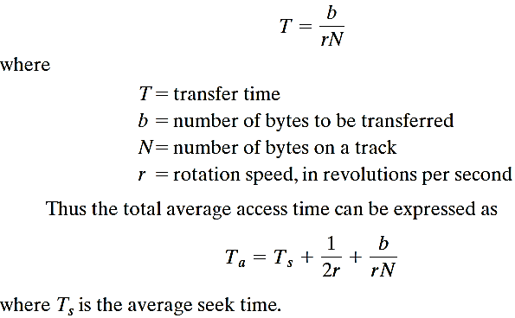
Transfer Time
The transfer time to or from the disk depends on the rotation speed of the disk in the following fashion:
Notes:
Access Time is the sum of
Seek Time is the time it takes to position the head at the track.
Rotational delay is the time it takes for the beginning of the sector to reach the head
Once the head is in position, the read or write operation is then performed as the sector moves under the head;
this is the data transfer portion of the operation; the time required for the transfer is the transfer time.

Slide 62
Comparision
Consider a disk with an advertised average seek time of 4 ms, rotation speed of 7500 rpm, and 512-byte sectors with 500 sectors per track.
Suppose that we wish to read a file consisting of 2500 sectors for a total of 1.28 Mbytes.
We would like to estimate the total time for the transfer.
First, let us assume that the file is stored as compactly as possible on the disk.
That is, the file occupies all of the sectors on 5 adjacent tracks (5 tracks x 500 sectors/track = 2500 sectors).
This is known as sequential organization.
Notes:
Access Time is the sum of
Seek Time is the time it takes to position the head at the track.
Rotational delay is the time it takes for the beginning of the sector to reach the head
Once the head is in position, the read or write operation is then performed as the sector moves under the head;
this is the data transfer portion of the operation; the time required for the transfer is the transfer time.

Slide 63
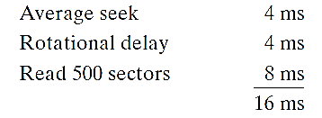
Comparision
Suppose that the remaining tracks can now be read with essentially no seek time.
That is, the I/O operation can keep up with the flow from the disk. Then, at most, we need to deal with rotational delay for each succeeding track.
Thus, each successive track is read in 4 + 8 = 12 ms.
To read the entire file;
Total time = 16 + (4 * 12) = 64 ms = 0.064 seconds
Notes:
Access Time is the sum of
Seek Time is the time it takes to position the head at the track.
Rotational delay is the time it takes for the beginning of the sector to reach the head
Once the head is in position, the read or write operation is then performed as the sector moves under the head;
this is the data transfer portion of the operation; the time required for the transfer is the transfer time.

Slide 64
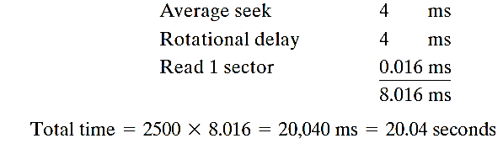
Comparision
Now let us calculate the time required to read the same data using random access rather than sequential access; that is, accesses to the sectors are distributed randomly over the disk.
For each sector, we have
Notes:
Access Time is the sum of
Seek Time is the time it takes to position the head at the track.
Rotational delay is the time it takes for the beginning of the sector to reach the head
Once the head is in position, the read or write operation is then performed as the sector moves under the head;
this is the data transfer portion of the operation; the time required for the transfer is the transfer time.

Slide 65
Disk Scheduling Policies
To compare various schemes, consider a disk head is initially located at track 100.
assume a disk with 200 tracks and that the disk request queue has random requests in it.
The requested tracks, in the order received by the disk scheduler, are
55, 58, 39, 18, 90, 160, 150, 38, 184.

Slide 66
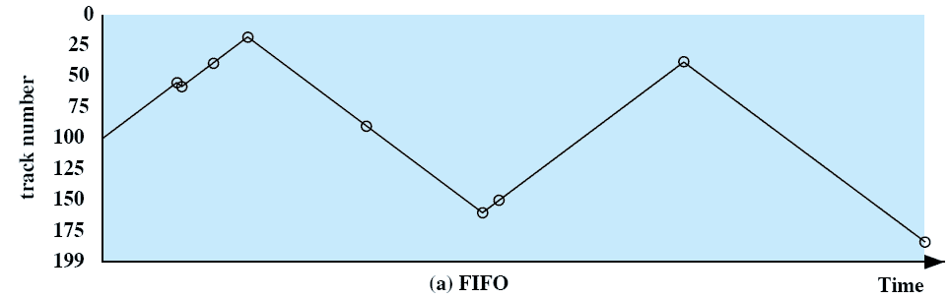
First-in, first-out (FIFO)
Process request sequentially
Fair to all processes
Approaches random scheduling in performance if there are many processes
Notes:
Movie icon jumps to animation at http://gaia.ecs.csus.edu/%7ezhangd/oscal/DiskApplet.html
The simplest form of scheduling is first-in-first-out (FIFO) scheduling, which processes items from the queue in sequential order.
This strategy has the advantage of being fair, because every request is honored and the requests are honored in the order received.
This figure illustrates the disk arm movement with FIFO.
This graph is generated directly from the data in Table 11.2a.
As can be seen, the disk accesses are in the same order as the requests were originally received.
With FIFO, if there are only a few processes that require access and if many of the requests are to clustered file sectors, then we can hope for good performance.
But, this technique will often approximate random scheduling in performance, if there are many processes competing for the disk.

Slide 67
Priority
Goal is not to optimize disk use but to meet other objectives
Short batch jobs may have higher priority
Provide good interactive response time
Longer jobs may have to wait an excessively long time
A poor policy for database systems
Notes:
With a system based on priority (PRI), the control of the scheduling is outside the control of disk management software.
This is not intended to optimize disk utilization but to meet other objectives within the operating system.
Often short batch jobs and interactive jobs are given higher priority than longer jobs that require longer computation.
This allows a lot of short jobs to be flushed through the system quickly and may provide good interactive response time.
However, longer jobs may have to wait excessively long times.
Furthermore, such a policy could lead to countermeasures on the part of users, who split their jobs into smaller pieces to beat the system.
This type of policy tends to be poor for database systems.

Slide 68
Last-in, first-out
Good for transaction processing systems
The device is given to the most recent user so there should be little arm movement moving through a sequential file
Possibility of starvation since a job may never regain the head of the line
Notes:
In transaction processing systems, giving the device to the most recent user should result in little or no arm movement for moving through a sequential file.

Slide 69
Shortest Service Time First (SSTF)
Select the disk I/O request that requires the least movement of the disk arm from its current position
Always choose the minimum seek time
does not guarantee that the average seek time over a number of arm movements will be minimum
better performance than FIFO
Because the arm can move in two directions, a random tie-breaking algorithm may be used to resolve cases of equal distances.
Notes:
Select the disk I/O request that requires the least movement of the disk arm from its current position.
Thus, we always choose to incur the minimum seek time.
Always choosing the minimum seek time does not guarantee that the average seek time over a number of arm movements will be minimum.
However, this should provide better performance than FIFO.
Because the arm can move in two directions, a random tie-breaking algorithm may be used to resolve cases of equal distances.

Slide 70
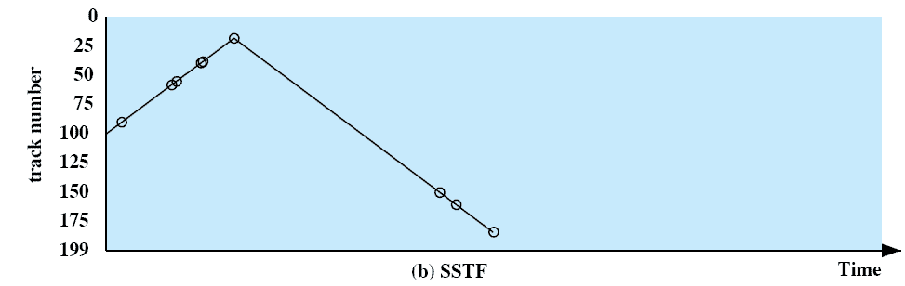
Shortest Service Time First (SSTF)
Notes:
Select the disk I/O request that requires the least movement of the disk arm from its current position.
Thus, we always choose to incur the minimum seek time.
Always choosing the minimum seek time does not guarantee that the average seek time over a number of arm movements will be minimum.
However, this should provide better performance than FIFO.
Because the arm can move in two directions, a random tie-breaking algorithm may be used to resolve cases of equal distances.

Slide 71
SCAN
Arm moves in one direction only, satisfying all outstanding requests until it reaches the last track in that direction then the direction is reversed
Favors jobs whose requests are for tracks nearest to both innermost and outermost tracks and favors the latest-arriving jobs.
Notes:
With SCAN, the arm is required to move in one direction only, satisfying all outstanding requests en route, until it reaches the last track in that direction or until there are no more requests in that direction.
The service direction is then reversed and the scan proceeds in the opposite direction, again picking up all requests in order.
This latter refinement is sometimes referred to as the LOOK policy.
The SCAN policy favors jobs whose requests are for tracks nearest to both innermost and outermost tracks and favors the latest-arriving jobs.

Slide 72
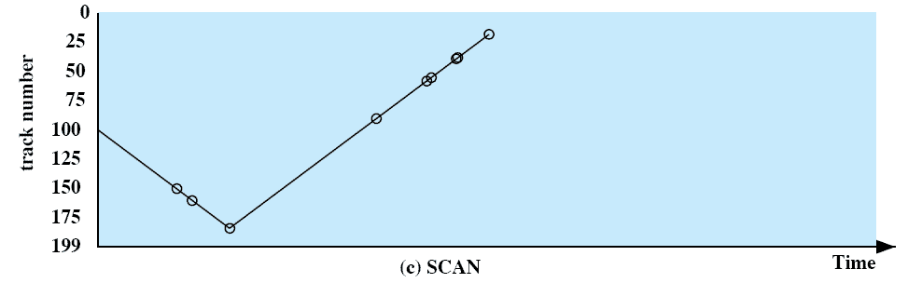
SCAN
Notes:
With SCAN, the arm is required to move in one direction only, satisfying all outstanding requests en route, until it reaches the last track in that direction or until there are no more requests in that direction.
The service direction is then reversed and the scan proceeds in the opposite direction, again picking up all requests in order.
This latter refinement is sometimes referred to as the LOOK policy.
The SCAN policy favors jobs whose requests are for tracks nearest to both innermost and outermost tracks and favors the latest-arriving jobs.

Slide 73
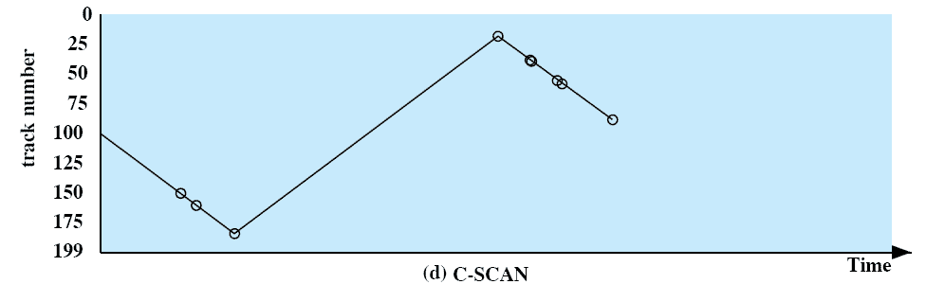
C-SCAN
Restricts scanning to one direction only
When the last track has been visited in one direction, the arm is returned to the opposite end of the disk and the scan begins again
Reduces the maximum delay experienced by new requests
Notes:
The C-SCAN (circular SCAN) policy restricts scanning to one direction only.
Thus, when the last track has been visited in one direction, the arm is returned to the opposite end of the disk and the scan begins again.
This reduces the maximum delay experienced by new requests.

Slide 74
N-step-SCAN
Segments the disk request queue into subqueues of length N
Subqueues are processed one at a time, using SCAN
New requests added to other queue when queue is processed
If fewer than N requests are available at the end of a scan, then all of them are processed with the next scan.
Notes:
The N-step-SCAN policy segments the disk request queue into subqueues of length N.
Subqueues are processed one at a time, using SCAN.
While a queue is being processed, new requests must be added to some other queue.
If fewer than N requests are available at the end of a scan, then all of them are processed with the next scan.

Slide 75
FSCAN
Two subqueues
When a scan begins, all of the requests are in one of the queues, with the other empty.
All new requests are put into the other queue.
Service of new requests is deferred until all of the old requests have been processed.
Notes:
FSCAN is a policy that uses two subqueues.
When a scan begins, all of the requests are in one of the queues, with the other empty.
During the scan, all new requests are put into the other queue.
Thus, service of new requests is deferred until all of the old requests have been processed.

Slide 76
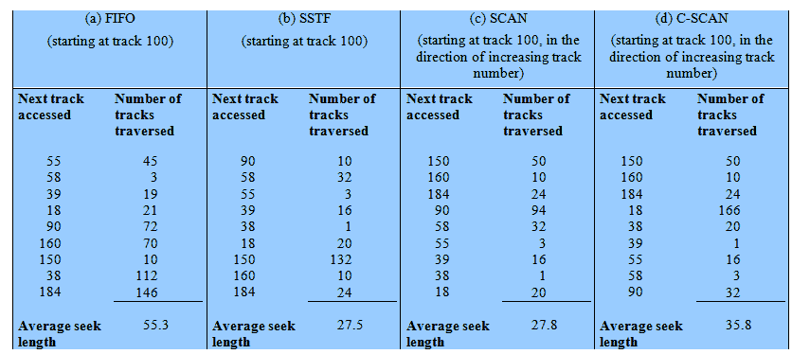
Performance Compared
Comparison of Disk Scheduling Algorithms
Notes:
T

Slide 77
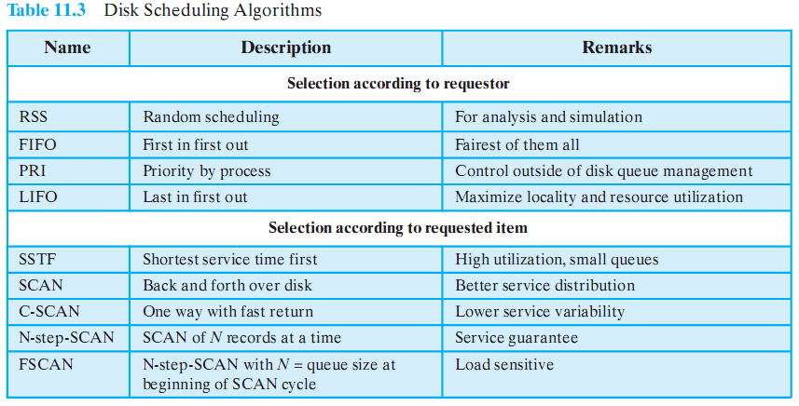
Disk Scheduling Algorithms

Slide 78
Roadmap
I/O Devices
Organization of the I/O Function
Operating System Design Issues
I/O Buffering
Disk Scheduling
Raid
Disk Cache
UNIX SVR4 I/O
LINUX I/O
Windows I/O

Slide 79
Multiple Disks
Disk I/O performance may be increased by spreading the operation over multiple read/write heads
Or multiple disks
Disk failures can be recovered if parity information is stored
Notes:
With multiple disks, separate I/O requests can be handled in parallel, as long as the data required reside on separate disks.
Also, a single I/O request can be executed in parallel if the block of data to be accessed is distributed across multiple disks.

Slide 80
RAID
Redundant Array of Independent Disks
Set of physical disk drives viewed by the operating system as a single logical drive
Data are distributed across the physical drives of an array
Redundant disk capacity is used to store parity information which provides recoverability from disk failure
Notes:
Movie icon links to animation at: http://gaia.ecs.csus.edu/%7ezhangd/oscal/RAIDFiles/RAID.htm
The RAID scheme consists of seven levels, zero through six.
These levels do not imply a hierarchical relationship but designate different design architectures that share three common characteristics:
1. RAID is a set of physical disk drives viewed by the operating system as a single logical drive.
2. Data are distributed across the physical drives of an array in a scheme known as striping, described subsequently.
3. Redundant disk capacity is used to store parity information, which guarantees data recoverability in case of a disk failure.

Slide 81
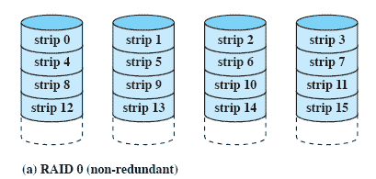
RAID 0 - Stripped
Not a true RAID – no redundancy
Disk failure is catastrophic
Very fast due to parallel read/write
Notes:
RAID level 0 is not a true member of the RAID family, because it does not include redundancy.
The advantage of this layout is that if a single I/O request consists of multiple logically contiguous strips, then up to n strips for that request can be handled in parallel, greatly reducing the I/O transfer time.

Slide 82
RAID 1 - Mirrored
Each logical strip is mapped to two separate physical disks so that every disk in the array has a mirror disk that contains the same data.
A read request can be serviced by either of the two disks that contains the requested data, whichever one involves the minimum seek time plus rotational latency.
Notes:
each logical strip is mapped to two separate physical disks so that every disk in the array has a mirror disk that contains the same data.
A read request can be serviced by either of the two disks that contains the requested data, whichever one involves the minimum seek time plus rotational latency.
A write request requires that both corresponding strips be updated, but this can be done in parallel.
Thus, the write performance is dictated by the slower of the two writes
Recovery from a failure is simple.
When a drive fails, the data may still be accessed from the second drive.

Slide 83
RAID 1 - Mirrored
A write request requires that both corresponding strips be updated, but this can be done in parallel.
Thus, the write performance is dictated by the slower of the two writes
Recovery from a failure is simple.
When a drive fails, the data may still be accessed from the second drive.
Notes:
each logical strip is mapped to two separate physical disks so that every disk in the array has a mirror disk that contains the same data.
A read request can be serviced by either of the two disks that contains the requested data, whichever one involves the minimum seek time plus rotational latency.
A write request requires that both corresponding strips be updated, but this can be done in parallel.
Thus, the write performance is dictated by the slower of the two writes
Recovery from a failure is simple.
When a drive fails, the data may still be accessed from the second drive.

Slide 84
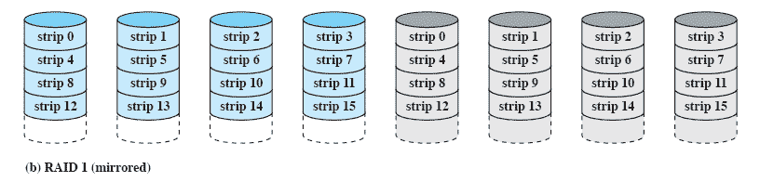
RAID 1 - Mirrored
Redundancy through duplication instead of parity.
Read requests can made in parallel.
Simple recovery from disk failure
Notes:
each logical strip is mapped to two separate physical disks so that every disk in the array has a mirror disk that contains the same data.
A read request can be serviced by either of the two disks that contains the requested data, whichever one involves the minimum seek time plus rotational latency.
A write request requires that both corresponding strips be updated, but this can be done in parallel.
Thus, the write performance is dictated by the slower of the two writes
Recovery from a failure is simple.
When a drive fails, the data may still be accessed from the second drive.

Slide 85
RAID 2 (Using Hamming code)
In a parallel access array, all member disks participate in the execution of every I/O request.
Typically, the spindles of the individual drives are synchronized so that each disk head is in the same position on each disk at any given time.
Notes:
In a parallel access array, all member disks participate in the execution of every I/O request.
Typically, the spindles of the individual drives are synchronized so that each disk head is in the same position on each disk at any given time.
As in the other RAID schemes, data striping is used.
In the case of RAID 2 and 3, the strips are very small, often as small as a single byte or word.
With RAID 2, an error-correcting code is calculated across corresponding bits on each data disk, and the bits of the code are stored in the corresponding bit positions on multiple parity disks.
Typically, a Hamming code is used, which is able to correct single-bit errors and detect double-bit errors.

Slide 86
RAID 2 (Using Hamming code)
As in the other RAID schemes, data striping is used.
In the case of RAID 2 and 3, the strips are very small, often as small as a single byte or word.
With RAID 2, an error-correcting code is calculated across corresponding bits on each data disk, and the bits of the code are stored in the corresponding bit positions on multiple parity disks.
Notes:
In a parallel access array, all member disks participate in the execution of every I/O request.
Typically, the spindles of the individual drives are synchronized so that each disk head is in the same position on each disk at any given time.
As in the other RAID schemes, data striping is used.
In the case of RAID 2 and 3, the strips are very small, often as small as a single byte or word.
With RAID 2, an error-correcting code is calculated across corresponding bits on each data disk, and the bits of the code are stored in the corresponding bit positions on multiple parity disks.
Typically, a Hamming code is used, which is able to correct single-bit errors and detect double-bit errors.

Slide 87
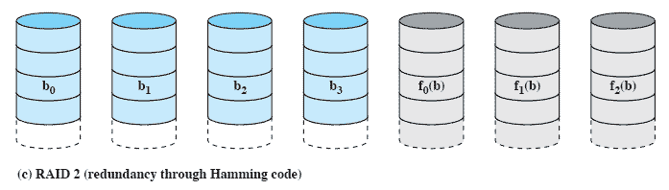
RAID 2 (Using Hamming code)
Synchronised disk rotation
Data stripping is used (extremely small)
Hamming code used to correct single bit errors and detect double-bit errors
Notes:
In a parallel access array, all member disks participate in the execution of every I/O request.
Typically, the spindles of the individual drives are synchronized so that each disk head is in the same position on each disk at any given time.
As in the other RAID schemes, data striping is used.
In the case of RAID 2 and 3, the strips are very small, often as small as a single byte or word.
With RAID 2, an error-correcting code is calculated across corresponding bits on each data disk, and the bits of the code are stored in the corresponding bit positions on multiple parity disks.
Typically, a Hamming code is used, which is able to correct single-bit errors and detect double-bit errors.

Slide 88
RAID 3 bit-interleaved parity
Similar to RAID-2 but uses all parity bits stored on a single drive
RAID 3 requires only a single redundant disk, no matter how large the disk array.
RAID 3 employs parallel access, with data distributed in small strips.
Instead of an error-correcting code, a simple parity bit is computed for the set of individual bits in the same position on all of the data disks.
Notes:
RAID 3 is organized in a similar fashion to RAID 2.
The difference is that RAID 3 requires only a single redundant disk, no matter how large the disk array.
RAID 3 employs parallel access, with data distributed in small strips.
Instead of an error-correcting code, a simple parity bit is computed for the set of individual bits in the same position on all of the data disks.

Slide 89
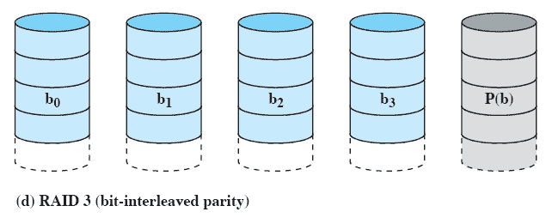
RAID 3 bit-interleaved parity
Similar to RAID-2 but uses all parity bits stored on a single drive
Notes:
RAID 3 is organized in a similar fashion to RAID 2.
The difference is that RAID 3 requires only a single redundant disk, no matter how large the disk array.
RAID 3 employs parallel access, with data distributed in small strips.
Instead of an error-correcting code, a simple parity bit is computed for the set of individual bits in the same position on all of the data disks.

Slide 90
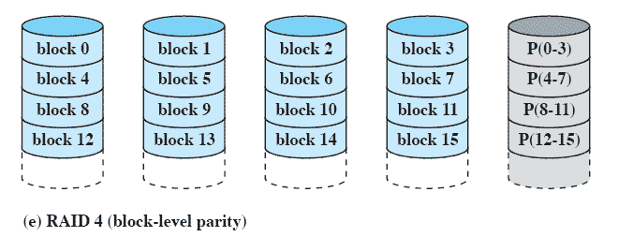
RAID 4 Block-level parity
A bit-by-bit parity strip is calculated across corresponding strips on each data disk
The parity bits are stored in the corresponding strip on the parity disk.
Notes:
A bit-by-bit parity strip is calculated across corresponding strips on each data disk,
and the parity bits are stored in the corresponding strip on the parity disk.

Slide 91
RAID 5 Block-level Distributed parity
Similar to RAID-4 but distributing the parity bits across all drives
It distributes the parity strips across all disks.
A typical allocation is a round-robin scheme
For an n-disk array, the parity strip is on a different disk for the first n stripes, and the pattern then repeats.
The distribution of parity strips across all drives avoids the potential I/O bottleneck of the single parity disk found in RAID 4.
Notes:
RAID 5 is organized in a similar fashion to RAID 4.
RAID 5 distributes the parity strips across all disks.
A typical allocation is a round-robin scheme
For an n-disk array, the parity strip is on a different disk for the first n stripes, and the pattern then repeats.
The distribution of parity strips across all drives avoids the potential I/O bottleneck of the single parity disk found in RAID 4.

Slide 92
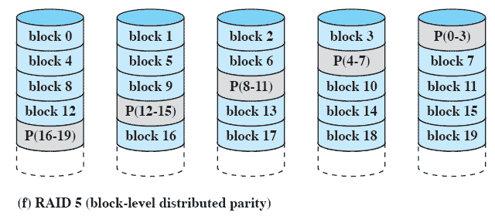
RAID 5 Block-level Distributed parity
Similar to RAID-4 but distributing the parity bits across all drives
Notes:
RAID 5 is organized in a similar fashion to RAID 4.
RAID 5 distributes the parity strips across all disks.
A typical allocation is a round-robin scheme
For an n-disk array, the parity strip is on a different disk for the first n stripes, and the pattern then repeats.
The distribution of parity strips across all drives avoids the potential I/O bottleneck of the single parity disk found in RAID 4.

Slide 93
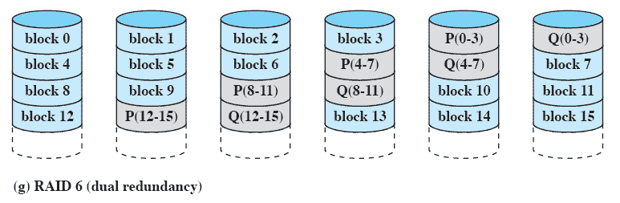
RAID 6 Dual Redundancy
Two different parity calculations are carried out
stored in separate blocks on different disks.
Can recover from two disks failing
Notes:
Two different parity calculations are carried out and stored in separate blocks on different disks.
Thus, a RAID 6 array whose user data require N disks consists of N+2 disks.
P and Q are two different data check algorithms.
One of the two is the exclusive-OR calculation used in RAID 4 and 5.
The other is an independent data check algorithm.
This makes it possible to regenerate data even if two disks containing user data fail.

Slide 94
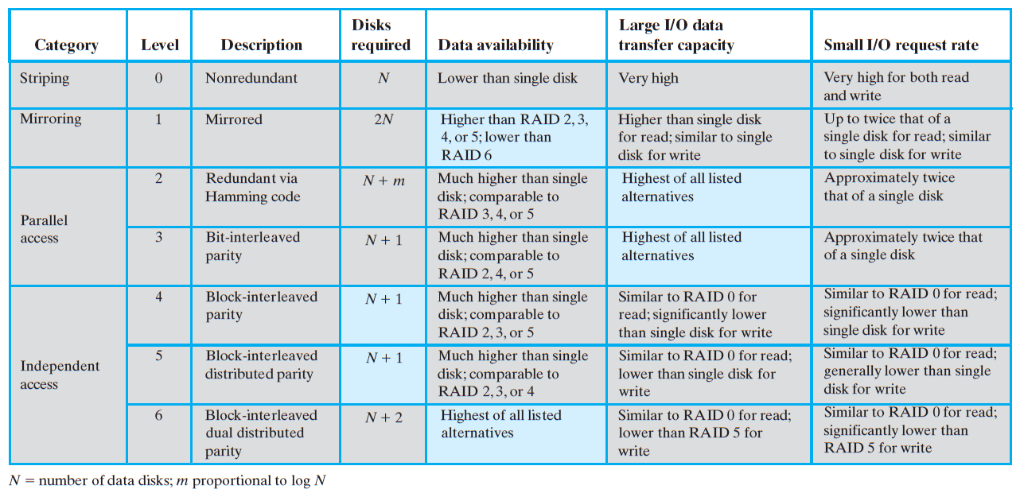
Levels of RAID

Slide 95
Roadmap
I/O Devices
Organization of the I/O Function
Operating System Design Issues
I/O Buffering
Disk Scheduling
Raid
Disk Cache
UNIX SVR4 I/O
LINUX I/O
Windows I/O

Slide 96
Disk Cache
Buffer in main memory for disk sectors
Contains a copy of some of the sectors on the disk
When an I/O request is made for a particular sector,
a check is made to determine if the sector is in the disk cache.
A number of ways exist to populate the cache
Because of the phenomenon of locality of reference, when a block of data is fetched into the cache to satisfy a single I/O request, it is likely that there will be future references to that same block.
Notes:
A disk cache is a buffer in main memory for disk sectors.
The cache contains a copy of some of the sectors on the disk.
When an I/O request is made for a particular sector, a check is made to determine if the sector is in the disk cache.
If so, the request is satisfied via the cache.
If not, the requested sector is read into the disk cache from the disk.
Because of the phenomenon of locality of reference, when a block of data is fetched into the cache to satisfy a single I/O request, it is likely that there will be future references to that same block.

Slide 97
Design Considerations
1. When an I/O request is satisfied from the disk cache, the data in the disk cache must be delivered to the requesting process.
by transferring the block of data within main memory from the disk cache to memory assigned to the user process
simply by using a shared memory capability and passing a pointer to the appropriate slot in the disk cache. It saves the time of a memory-to-memory transfer and also allows shared access by other processes using the readers/writers model

Slide 98
Design Considerations
2. The replacement strategy
When a new sector is brought into the disk cache, one of the existing blocks must be replaced.

Slide 99
Least Recently Used
The block that has been in the cache the longest with no reference to it is replaced
The cache consists of a stack of blocks, with the most recently referenced block on the top of the stack.
When a block in the cache is referenced, it is moved from its existing position on the stack to the top of the stack.
When a block is brought in from secondary memory, remove the block that is on the bottom of the stack and push the incoming block onto the top of the stack.
Notes:
The most commonly used algorithm is least recently used (LRU)
Replace that block that has been in the cache longest with no reference to it.
The cache consists of a stack of blocks, with the most recently referenced block on the top of the stack.
When a block in the cache is referenced, it is moved from its existing position on the stack to the top of the stack.
When a block is brought in from secondary memory, remove the block that is on the bottom of the stack and push the incoming block onto the top of the stack.
It is not necessary actually to move these blocks around in main memory; a stack of pointers can be associated with the cache.

Slide 100
Least Recently Used
it is not necessary actually to move these blocks around in main memory
Cache is a stack of pointers reference the cache
Most recently referenced block is on the top of the stack
When a block is brought in from secondary memory, remove the block that is on the bottom of the stack and push the incoming block onto the top of the stack
Notes:
The most commonly used algorithm is least recently used (LRU)
Replace that block that has been in the cache longest with no reference to it.
The cache consists of a stack of blocks, with the most recently referenced block on the top of the stack.
When a block in the cache is referenced, it is moved from its existing position on the stack to the top of the stack.
When a block is brought in from secondary memory, remove the block that is on the bottom of the stack and push the incoming block onto the top of the stack.
It is not necessary actually to move these blocks around in main memory; a stack of pointers can be associated with the cache.

Slide 101
Least Frequently Used
The block that has experienced the fewest references is replaced
LFU could be implemented by associating a counter with each block.
When a block is brought in, it is assigned a count of 1;
with each reference to the block, its count is incremented by 1.
When replacement is required, the block with the smallest count is selected.
Notes:
Replace that block in the set that has experienced the fewest references.
LFU could be implemented by associating a counter with each block.
When a block is brought in, it is assigned a count of 1;
with each reference to the block, its count is incremented by 1.
When replacement is required, the block with the smallest count is selected.
Intuitively, it might seem that LFU is more appropriate than LRU because LFU makes use of more pertinent information about each block in the selection process.

Slide 102
Least Frequently Used
Intuitively, it might seem that LFU is more appropriate than LRU because LFU makes use of more pertinent information about each block in the selection process.
Certain blocks are referenced relatively infrequently overall
They are referenced, there are short intervals of repeated references due to locality, thus building up high reference counts.
After such an interval is over, the reference count may be misleading and not reflect the probability that the block will soon be referenced again.
Notes:
Replace that block in the set that has experienced the fewest references.
LFU could be implemented by associating a counter with each block.
When a block is brought in, it is assigned a count of 1;
with each reference to the block, its count is incremented by 1.
When replacement is required, the block with the smallest count is selected.
Intuitively, it might seem that LFU is more appropriate than LRU because LFU makes use of more pertinent information about each block in the selection process.

Slide 103
Frequency-based replacement
The blocks are logically organized in a stack, as with the LRU algorithm. (Next Figure)
A certain portion of the top part of the stack is designated the new section.
When there is a cache hit, the referenced block is moved to the top of the stack.
If the block was already in the new section, its reference count is not incremented;
otherwise it is incremented by 1.

Slide 104
Given a sufficiently large new section, this results in the reference counts for blocks that are repeatedly re-referenced within a short interval remaining unchanged.
On a miss, the block with the smallest reference count that is not in the new section is chosen for replacement;
The least recently used such block is chosen in the event of a tie.

Slide 105
A further refinement (Figure 11.9b):
Divide the stack into three sections: new, middle, and old.
As before, reference counts are not incremented on blocks in the new section.
However, only blocks in the old section are eligible for replacement.
Assuming a sufficiently large middle section, this allows relatively frequently referenced blocks a chance to build up their reference counts before becoming eligible for replacement.

Slide 106
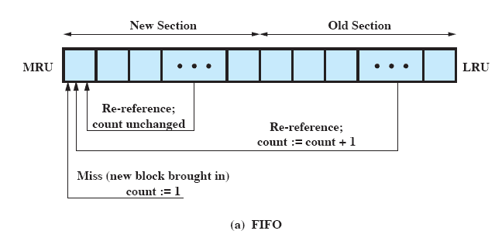
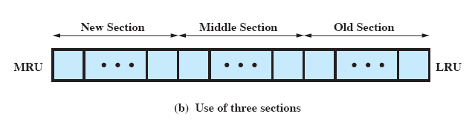
Frequency-Based Replacement
Notes:
The blocks are logically organized in a stack, as with the LRU algorithm.
A certain portion of the top part of the stack is designated the new section.
When there is a cache hit, the referenced block is moved to the top of the stack.
If the block was already in the new section, its reference count is not incremented;
otherwise it is incremented by 1.
Given a sufficiently large new section, this results in the reference counts for blocks that are repeatedly re-referenced within a short interval remaining unchanged.
On a miss, the block with the smallest reference count that is not in the new section is chosen for replacement;
the least recently used such block is chosen in the event of a tie.
A further refinement (Figure 11.9b):
Divide the stack into three sections: new, middle, and old.
As before, reference counts are not incremented on blocks in the new section.
However, only blocks in the old section are eligible for replacement.
Assuming a sufficiently large middle section, this allows relatively frequently referenced blocks a chance to build up their reference counts before becoming eligible for replacement.

Slide 107
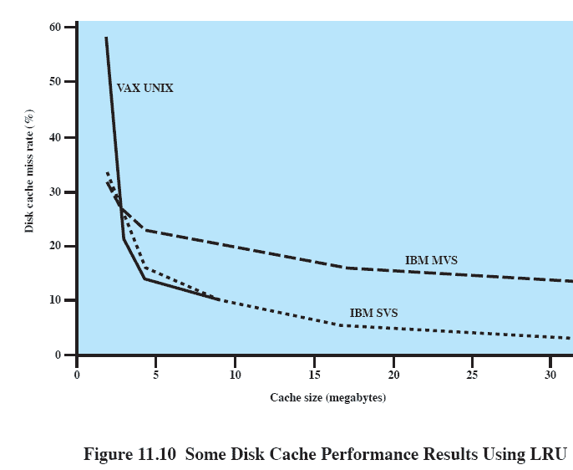
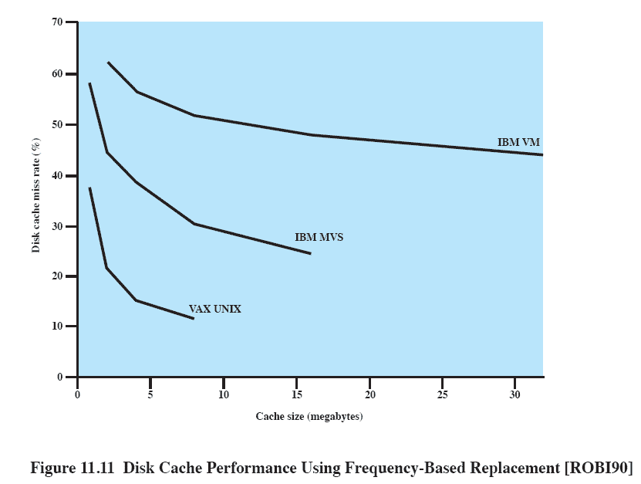
LRU Disk Cache Performance
Notes:
Figure 11.10 summarizes results from several studies using LRU, one for a UNIX system running on a VAX
Figure 11.11 shows results for simulation studies of the frequency-based replacement algorithm.
A comparison of the two figures points out one of the risks of this sort of performance assessment.
The figures appear to show that LRU outperforms the frequency-based replacement algorithm.
However, when identical reference patterns using the same cache structure are compared, the frequency-based replacement algorithm is superior.
Thus, the exact sequence of reference patterns, plus related design issues such as block size, will have a profound influence on the performance achieved.

Slide 108
Roadmap
I/O Devices
Organization of the I/O Function
Operating System Design Issues
I/O Buffering
Disk Scheduling
Raid
Disk Cache
UNIX SVR4 I/O
LINUX I/O
Windows I/O

Slide 109
Devices are Files
Each I/O device is associated with a special file
Managed by the file system
Provides a clean uniform interface to users and processes.
To access a device, read and write requests are made for the special file associated with the device.
Notes:
In UNIX, each individual I/O device is associated with a special file.
These are managed by the file system and are read and written in the same manner as user data files.
This provides a clean, uniform interface to users and processes.
To read from or write to a device, read and write requests are made for the special file associated with the device.

Slide 110
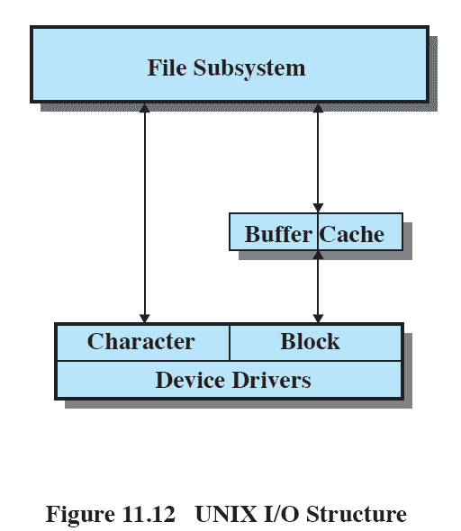
UNIX SVR4 I/O
Each individual device is associated with a special file
Two types of I/O
Buffered
Unbuffered
Notes:
There are two types of I/O in UNIX:
buffered and
unbuffered.
Buffered I/O passes through system buffers,
Whereas unbuffered I/O typically involves the DMA facility, with the transfer taking place directly between the I/O module and the process I/O area.
For buffered I/O, two types of buffers are used:
system buffer caches and
character queues.

Slide 111
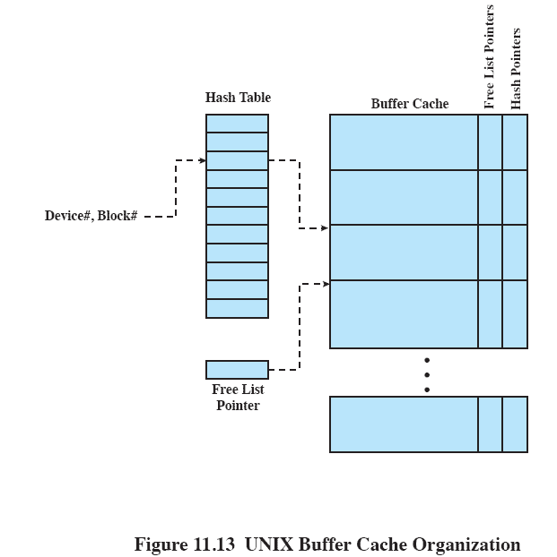
Buffer Cache
Three lists are maintained
Free List
Device List
Driver I/O Queue
Notes:
The buffer cache in UNIX is essentially a disk cache.
I/O operations with disk are handled through the buffer cache.
The data transfer between the buffer cache and the user process space always occurs using DMA.
Because both the buffer cache and the process I/O area are in main memory, the DMA facility is used to perform a memory-to-memory copy.
This does not use up any processor cycles, but it does consume bus cycles.
To manage the buffer cache, three lists are maintained:
Free list: List of all slots in the cache (a slot is referred to as a buffer in UNIX; each slot holds one disk sector) that are available for allocation
Device list: List of all buffers currently associated with each disk
Driver I/O queue: List of buffers that are actually undergoing or waiting for I/O on a particular device

Slide 112
Character Cache
Used by character oriented devices
E.g. terminals and printers
Either written by the I/O device and read by the process or vice versa
Producer/consumer model used
Notes:
Block-oriented devices, such as disk and USB keys, can be effectively served by the buffer cache.
A different form of buffering is appropriate for character-oriented devices, such as terminals and printers.
A character queue is either written by the I/O device and read by the process or written by the process and read by the device.
In both cases, the producer/consumer model introduced in Chapter 5 is used.
Thus, character queues may only be read once; as each character is read, it is effectively destroyed.
This is in contrast to the buffer cache, which may be read multiple times and hence follows the readers/writers model

Slide 113
Unbuffered I/O
Unbuffered I/O is simply DMA between device and process
Fastest method
Process is locked in main memory and can’t be swapped out
Device is tied to process and unavailable for other processes
Notes:
Unbuffered I/O, which is simply DMA between device and process space, is always the fastest method for a process to perform I/O.
A process that is performing unbuffered I/O is locked in main memory and cannot be swapped out.
This reduces the opportunities for swapping by tying up part of main memory, thus reducing the overall system performance.
Also, the I/O device is tied up with the process for the duration of the transfer, making it unavailable for other processes.

Slide 114
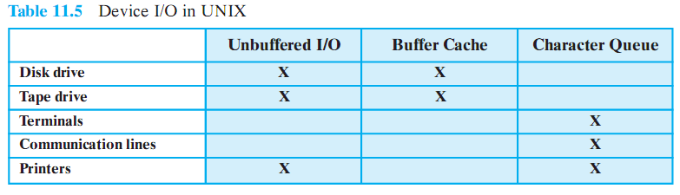
I/O for Device Types
Notes:
This figure shows the types of I/O suited to each type of device.
Disk drives are block oriented, and have the potential for reasonable high throughput.
Thus, I/O for these devices tends to be unbuffered or via buffer cache.
Tape drives are functionally similar to disk drives and use similar I/O schemes.
Because terminals involve relatively slow exchange of characters, terminal I/O typically makes use of the character queue.
Similarly, communication lines require serial processing of bytes of data for input or output and are best handled by character queues.
The type of I/O used for a printer will generally depend on its speed.

Slide 115
Roadmap
I/O Devices
Organization of the I/O Function
Operating System Design Issues
I/O Buffering
Disk Scheduling
Raid
Disk Cache
UNIX SVR4 I/O
LINUX I/O
Windows I/O

Slide 116
Linux/Unix Similarities
Linux and Unix (e.g. SVR4) are very similar in I/O terms
The Linux kernel associates a special file with each I/O device driver.
Block, character, and network devices are recognized.
Notes:
In general terms, the Linux I/O kernel facility is very similar to that of other UNIX implementation, such as SVR4.
The Linux kernel associates a special file with each I/O device driver.
Block, character, and network devices are recognized.
In this section, we look at several features of the Linux I/O facility.

Slide 117
The Elevator Scheduler
Maintains a single queue for disk read and write requests
Keeps list of requests sorted by block number
Drive moves in a single direction to satisfy each request
Notes:
The elevator scheduler maintains a single queue for disk read and write requests and performs both sorting and merging functions on the queue.
The elevator scheduler keeps the list of requests sorted by block number.
As the disk requests are handled, the drive moves in a single direction, satisfying each request as it is encountered.

Slide 118
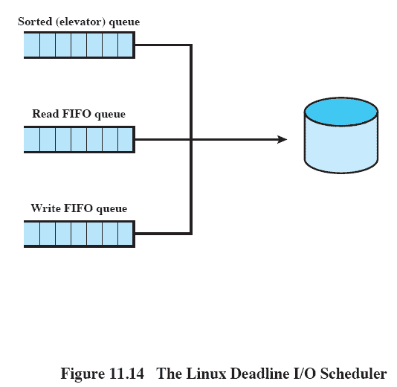
Deadline scheduler
Uses three queues
Incoming requests
Read requests go to the tail of a FIFO queue
Write requests go to the tail of a FIFO queue
Each request has an expiration time
Notes:
Each incoming request is placed in the sorted elevator queue.
In addition, the same request is placed at the tail of a read FIFO queue for a read request or a write FIFO queue for a write request.
The read and write queues maintain a list of requests in the sequence in which the requests were made.
Associated with each request is an expiration time, with a default value of 0.5 seconds for a read request and 5 seconds for a write request.
Ordinarily, the scheduler dispatches from the sorted queue.
When a request is satisfied, it is removed from the head of the sorted queue and also from the appropriate FIFO queue.
However, when the item at the head of one of the FIFO queues becomes older than its expiration time, then the scheduler next dispatches from that FIFO queue, taking the expired request, plus the next few requests from the queue.
As each request is dispatched, it is also removed from the sorted queue.

Slide 119
Anticipatory I/O scheduler
Elevator and deadline scheduling can be counterproductive if there are numerous synchronous read requests.
Delay a short period of time after satisfying a read request to see if a new nearby request can be made
Notes:
In Linux, the anticipatory scheduler is superimposed on the deadline scheduler.
When a read request is dispatched, the anticipatory scheduler causes the scheduling system to delay for up to 6 milliseconds, depending on the configuration.
During this small delay, there is a good chance (principal of locality) that the application that issued the last read request will issue another read request to the same region of the disk.
If so, that request will be serviced immediately.
If no such read request occurs, the scheduler resumes using the deadline scheduling algorithm.

Slide 120
Linux Page Cache
Linux 2.4 and later, a single unified page cache for all traffic between disk and main memory
Benefits:
Dirty pages can be collected and written out efficiently
Pages in the page cache are likely to be referenced again due to temporal locality
Notes:
In Linux 2.2 and earlier releases, the kernel maintained a page cache for reads and writes from regular file system files and for virtual memory pages, and a separate buffer cache for block I/O.
For Linux 2.4 and later, there is a single unified page cache that is involved in all traffic between disk and main memory.
The page cache confers two benefits.
When it is time to write back dirty pages to disk, a collection of them can be ordered properly and written out efficiently.
Second, because of the principle of temporal locality, pages in the page cache are likely to be referenced again before they are flushed from the cache, thus saving a disk I/O operation.
Dirty pages are written back to disk in two situations:
When free memory falls below a specified threshold, the kernel reduces the size of the page cache to release memory to be added to the free memory pool.
When dirty pages grow older than a specified threshold, a number of dirty pages are written back to disk.

Slide 121
Roadmap
I/O Devices
Organization of the I/O Function
Operating System Design Issues
I/O Buffering
Disk Scheduling
Raid
Disk Cache
UNIX SVR4 I/O
LINUX I/O
Windows I/O

Slide 122
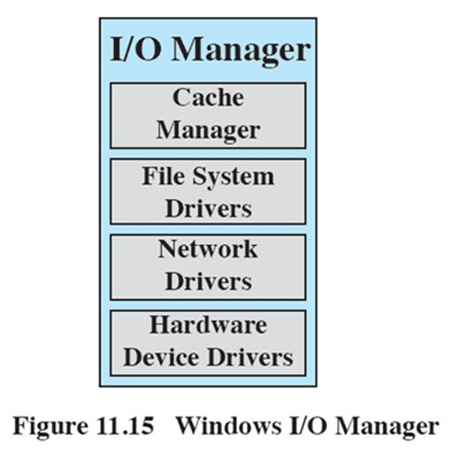
Windows I/O Manager
The I/O manager is responsible for all I/O for the operating system
It provides a uniform interface that all types of drivers can call.
Notes:
The I/O manager is responsible for all I/O for the operating system and provides a uniform interface that all types of drivers can call.

Slide 123
Windows I/O
The I/O manager works closely with:
Cache manager – handles all file caching
File system drivers - routes I/O requests for file system volumes to the appropriate software driver for that volume.
Network drivers - implemented as software drivers rather than part of the Windows Executive.
Hardware device drivers
Notes:
The I/O manager works closely with four types of kernel components:
Cache manager:
The cache manager handles file caching for all file systems.
A kernel thread, the lazy writer, periodically batches the updates together to write to disk which allows the I/O to be more efficient.
The cache manager works by mapping regions of files into kernel virtual memory and then relying on the virtual memory manager to do most of the work to copy pages to and from the files on disk.
File system drivers:
The I/O manager treats a file system driver as just another device driver and routes I/O requests for file system volumes to the appropriate software driver for that volume.
The file system, in turn, sends I/O requests to the software drivers that manage the hardware device adapter.
Network drivers:
Windows includes integrated networking capabilities and support for remote file systems.
The facilities are implemented as software drivers rather than part of the Windows Executive.
Hardware device drivers:
These software drivers access the hardware registers of the peripheral devices using entry points in the kernel’s Hardware Abstraction Layer.
A set of these routines exists for every platform that Windows supports; because the routine names are the same for all platforms, the source code of Windows device drivers is portable across different processor types.

Slide 124
Asynchronous and Synchronous I/O
Windows offers two modes of I/O operation:
asynchronous and synchronous.
Asynchronous mode is used whenever possible to optimize application performance.

Slide 125
Software RAID
Windows implements RAID functionality as part of the operating system and can be used with any set of multiple disks.
RAID 0, 1 and RAID 5 are supported.
In the case of RAID 1 (disk mirroring), the two disks containing the primary and mirrored partitions may be on the same disk controller or different disk controllers.

Slide 126
Volume Shadow Copies
Shadow copies are implemented by a software driver that makes copies of data on the volume before it is overwritten.
Designed as an efficient way of making consistent snapshots of volumes to that they can be backed up.
Also useful for archiving files on a per-volume basis
Notes:
Shadow copies are an efficient way of making consistent snapshots of volumes to that they can be backed up.
They are also useful for archiving files on a per-volume basis.
If a user deletes a file, he or she can retrieve an earlier copy from any available shadow copy made by the system administrator.
Shadow copies are implemented by a software driver that makes copies of data on the volume before it is overwritten.

