Slide 1
Process Description and Control
Chapter 3

Slide 2
Requirements of an
Operating System
Interleave the execution of multiple processes to maximize processor utilization while providing reasonable response time
Allocate resources to processes
Support interprocess communication and user creation of processes

Slide 3
Concepts
Computer platform consists of a collection of hardware resources
Computer applications are developed to perform some task
Inefficient for applications to be written directly for a given hardware platform
Operating system provides a convenient to use, feature rich, secure, and consistent interface for applications to use
OS provides a uniform, abstract representation of resources that can be requested and accessed by application

Slide 4
Manage Execution of Applications
Resources made available to multiple applications
Processor is switched among multiptle application
The processor and I/O devices can be used efficiently

Slide 5
Process
A program in execution
An instance of a program running on a computer
The entity that can be assigned to and executed on a processor
A unit of activity characterized by the execution of a sequence of instructions, a current state, and an associated set of system instructions

Slide 6
Process Elements
Identifier
State
Priority
Program counter
Memory pointers
Context data
I/O status information
Accounting information

Slide 7
Process Control Block
Contains the process elements
Created and manage by the operating system
Allows support for multiple processes

Slide 8
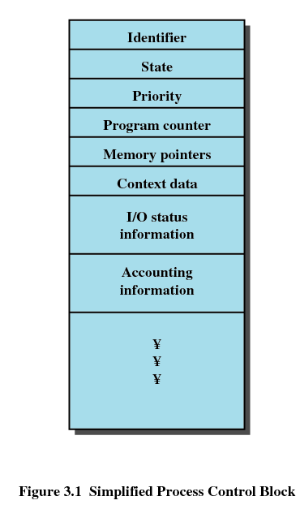
Process Control Block

Slide 9
Trace of Process
Sequence of instruction that execute for a process
Dispatcher switches the processor from one process to another

Slide 10
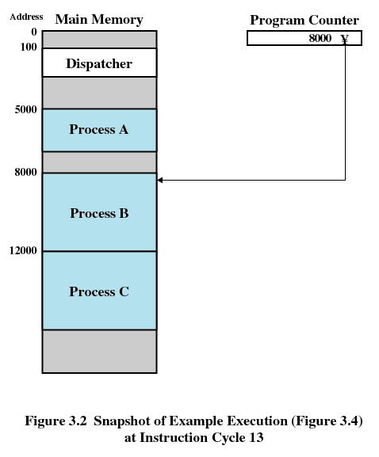
Example Execution

Slide 11
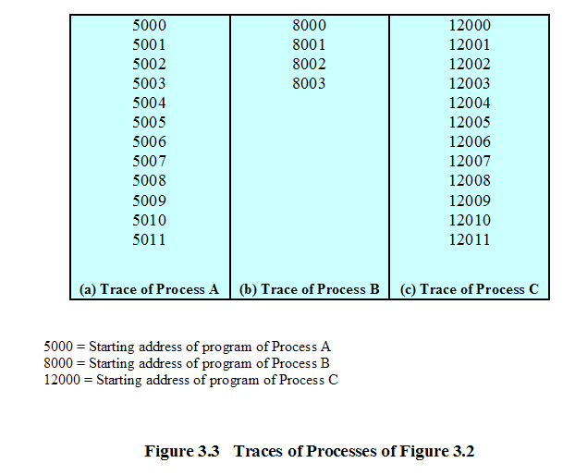
Trace of Processes

Slide 12
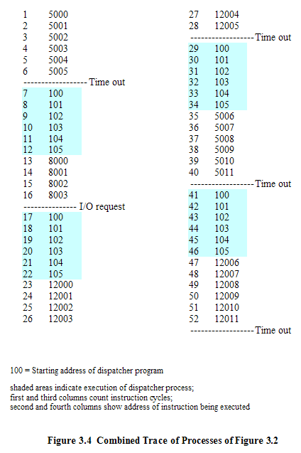

Slide 13
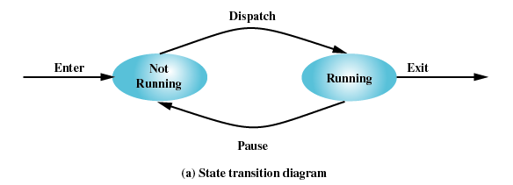
Two-State Process Model
Process may be in one of two states
  Running
  Not-running

Slide 14
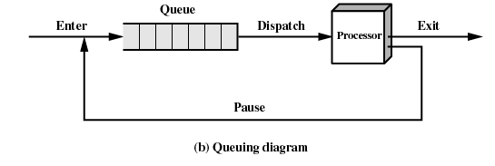
Not-Running Process in a Queue

Slide 15
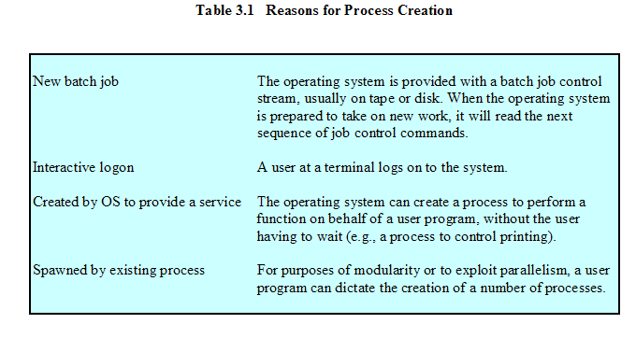
Process Creation

Slide 16
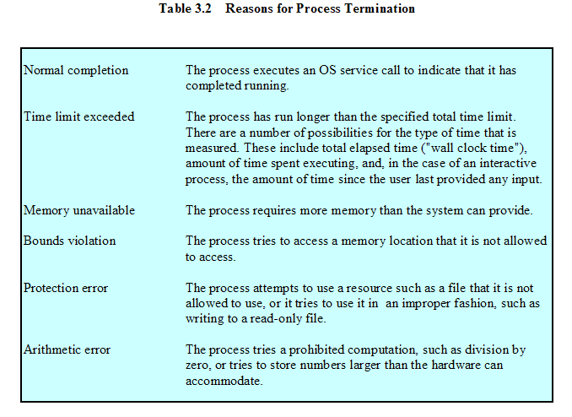
Process Termination

Slide 17
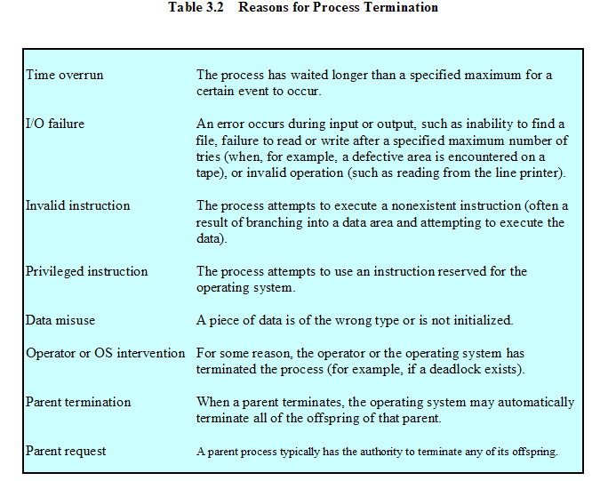
Process Termination

Slide 18
Processes
Not-running
  ready to execute
Blocked
  waiting for I/O
Dispatcher cannot just select the process that has been in the queue the longest because it may be blocked

Slide 19
A Five-State Model
Running
Ready
Blocked
New
Exit

Slide 20
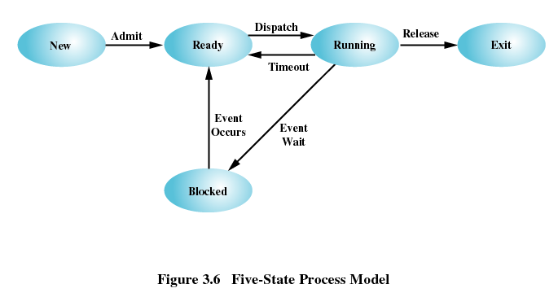
Five-State Process Model

Slide 21
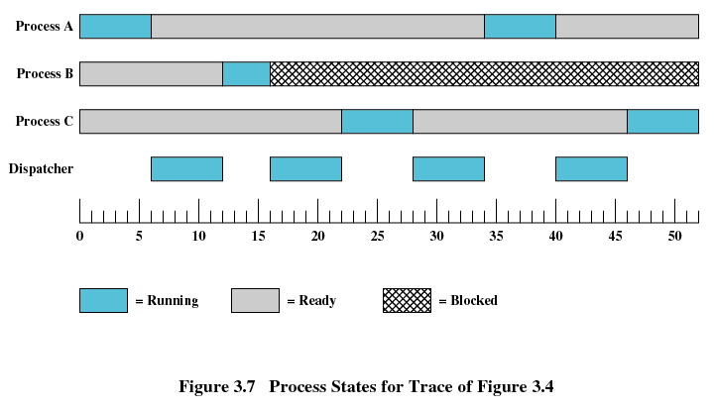
Process States

Slide 22
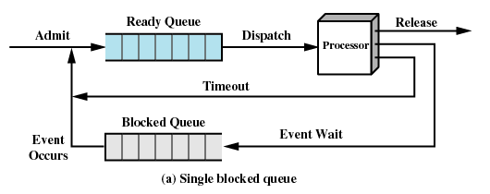
Using Two Queues

Slide 23
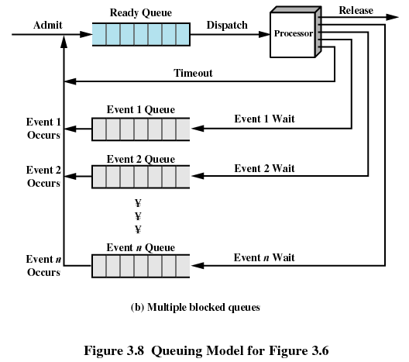
Multiple Blocked Queues

Slide 24
Suspended Processes
Processor is faster than I/O so all processes could be waiting for I/O
Swap these processes to disk to free up more memory
Blocked state becomes suspend state when swapped to disk
Two new states
  Blocked/Suspend
  ReadySuspend

Slide 25
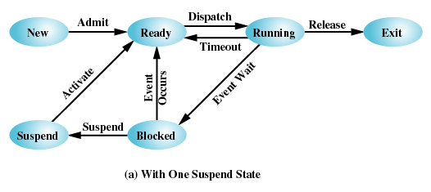
One Suspend State

Slide 26
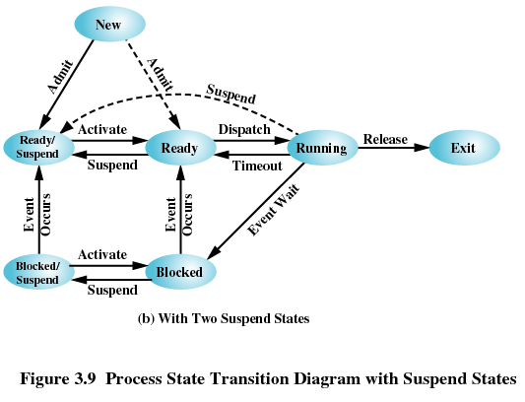
Two Suspend States

Slide 27
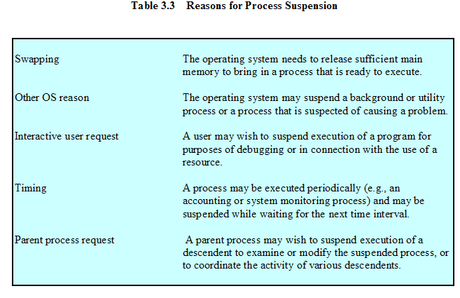
Reasons for Process Suspension

Slide 28
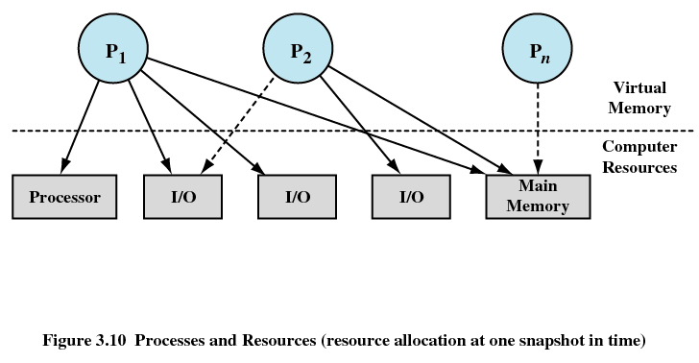
Processes and Resources

Slide 29
Operating System Control Structures
Information about the current status of each process and resource
Tables are constructed for each entity the operating system manages

Slide 30
Memory Tables
Allocation of main memory to processes
Allocation of secondary memory to processes
Protection attributes for access to shared memory regions
Information needed to manage virtual memory

Slide 31
I/O Tables
I/O device is available or assigned
Status of I/O operation
Location in main memory being used as the source or destination of the I/O transfer

Slide 32
File Tables
Existence of files
Location on secondary memory
Current Status
Attributes
Sometimes this information is maintained by a file management system

Slide 33
Process Table
Where process is located
Attributes in the process control block
  Program
  Data
  Stack

Slide 34
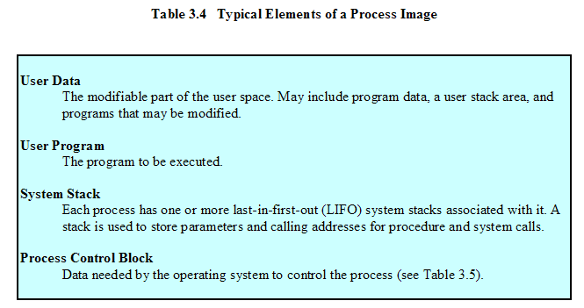
Process Image

Slide 35
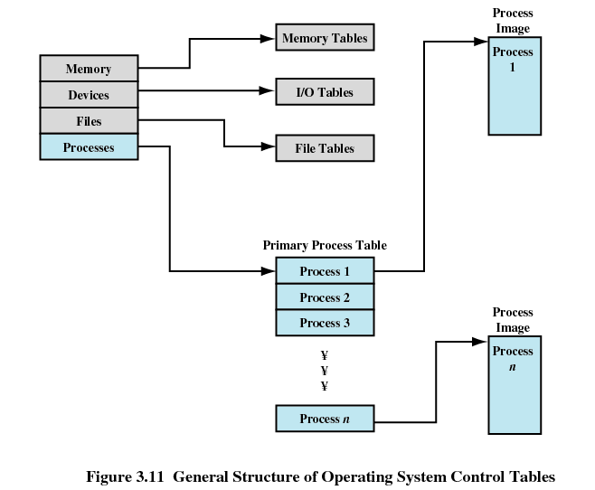

Slide 36
Process Control Block
Process identification
  Identifiers
    Numeric identifiers that may be stored with the process control block include
      Identifier of this process
      Identifier of the process that created this process (parent process)
      User identifier

Slide 37
Process Control Block
Processor State Information
  User-Visible Registers
    A user-visible register is one that may be referenced by means of the machine language that the processor executes while in user mode. Typically, there are from 8 to 32 of these registers, although some RISC implementations have over 100.

Slide 38
Process Control Block
Processor State Information
  Control and Status Registers
    These are a variety of processor registers that are employed to control the operation of the processor. These include
    Program counter: Contains the address of the next instruction to be fetched
    Condition codes: Result of the most recent arithmetic or logical operation (e.g., sign, zero, carry, equal, overflow)
    Status information: Includes interrupt enabled/disabled flags, execution mode

Slide 39
Process Control Block
Processor State Information
  Stack Pointers
    Each process has one or more last-in-first-out (LIFO) system stacks associated with it. A stack is used to store parameters and calling addresses for procedure and system calls. The stack pointer points to the top of the stack.

Slide 40
Process Control Block
Process Control Information
  Scheduling and State Information
    This is information that is needed by the operating system to perform its scheduling function. Typical items of information:
    Process state: defines the readiness of the process to be scheduled for execution (e.g., running, ready, waiting, halted).
    Priority: One or more fields may be used to describe the scheduling priority of the process. In some systems, several values are required (e.g., default, current, highest-allowable)
    Scheduling-related information: This will depend on the scheduling algorithm used. Examples are the amount of time that the process has been waiting and the amount of time that the process executed the last time it was running.
    Event: Identity of event the process is awaiting before it can be resumed

Slide 41
Process Control Block
Process Control Information
  Data Structuring
    A process may be linked to other process in a queue, ring, or some other structure. For example, all processes in a waiting state for a particular priority level may be linked in a queue. A process may exhibit a parent-child (creator-created) relationship with another process. The process control block may contain pointers to other processes to support these structures.

Slide 42
Process Control Block
Process Control Information
  Interprocess Communication
    Various flags, signals, and messages may be associated with communication between two independent processes. Some or all of this information may be maintained in the process control block.
  Process Privileges
    Processes are granted privileges in terms of the memory that may be accessed and the types of instructions that may be executed. In addition, privileges may apply to the use of system utilities and services.

Slide 43
Process Control Block
Process Control Information
  Memory Management
    This section may include pointers to segment and/or page tables that describe the virtual memory assigned to this process.
  Resource Ownership and Utilization
    Resources controlled by the process may be indicated, such as opened files. A history of utilization of the processor or other resources may also be included; this information may be needed by the scheduler.

Slide 44
Processor State Information
Contents of processor registers
  User-visible registers
  Control and status registers
  Stack pointers
Program status word (PSW)
  contains status information
  Example: the EFLAGS register on Pentium machines

Slide 45
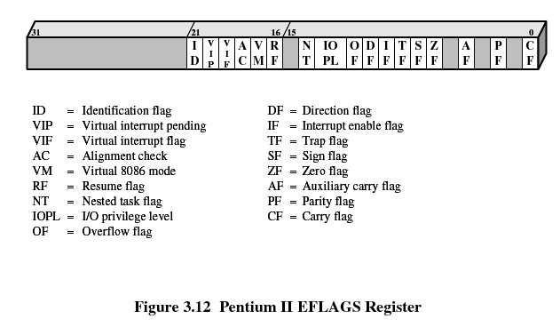
Pentium II EFLAGS Register

Slide 46
Modes of Execution
User mode
  Less-privileged mode
  User programs typically execute in this mode
System mode, control mode, or kernel mode
  More-privileged mode
  Kernel of the operating system

Slide 47
Process Creation
Assign a unique process identifier
Allocate space for the process
Initialize process control block
Set up appropriate linkages
  Ex: add new process to linked list used for scheduling queue
Create of expand other data structures
  Ex: maintain an accounting file

Slide 48
When to Switch a Process
Clock interrupt
  process has executed for the maximum allowable time slice
I/O interrupt
Memory fault
  memory address is in virtual memory so it must be brought into main memory

Slide 49
When to Switch a Process
Trap
  error or exception occurred
  may cause process to be moved to Exit state
Supervisor call
  such as file open

Slide 50
Change of Process State
Save context of processor including program counter and other registers
Update the process control block of the process that is currently in the Running state
Move process control block to appropriate queue – ready; blocked; ready/suspend
Select another process for execution

Slide 51
Change of Process State
Update the process control block of the process selected
Update memory-management data structures
Restore context of the selected process

Slide 52
Execution of the Operating System
Non-process Kernel
  Execute kernel outside of any process
  Operating system code is executed as a separate entity that operates in privileged mode
Execution Within User Processes
  Operating system software within context of a user process
  Process executes in privileged mode when executing operating system code

Slide 53
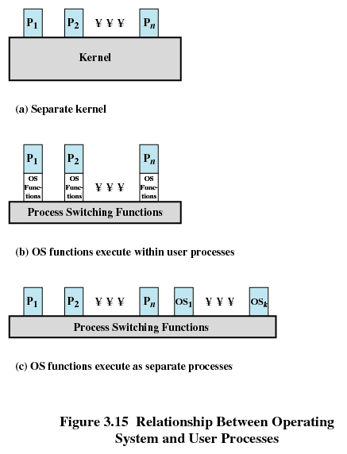

Slide 54
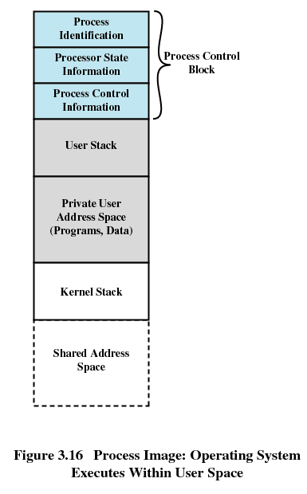

Slide 55
Execution of the Operating System
Process-Based Operating System
  Implement operating system as a collection of system processes
  Useful in multi-processor or multi-computer environment

Slide 56
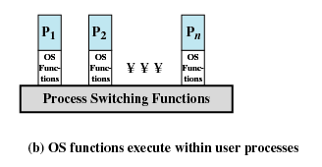
UNIX SVR4 Process Management
Most of the operating system executes within the environment of a user process

Slide 57
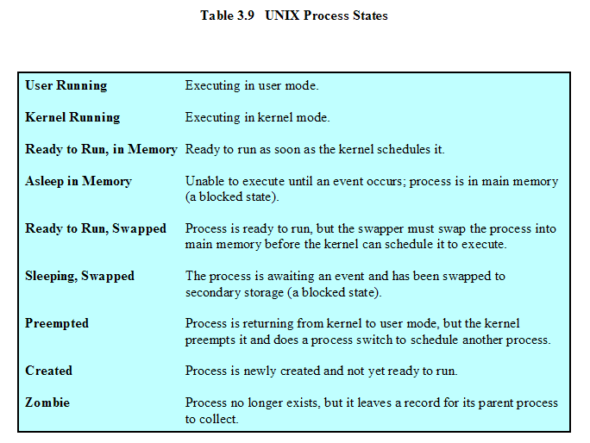
UNIX Process States

Slide 58
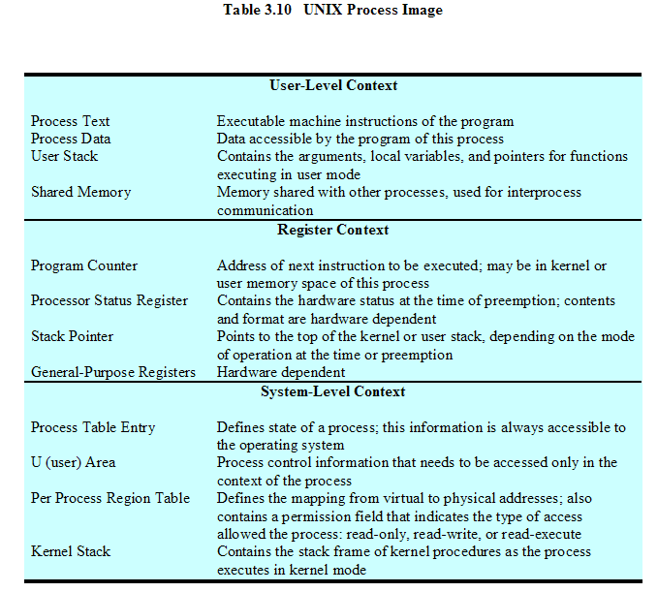
UNIX Process Image

Slide 59
