Slide 1
Uniprocessor Scheduling
Chapter 9

Slide 2
Aim of Scheduling
Assign processes to be executed by the processor(s)
Response time
Throughput
Processor efficiency

Slide 3
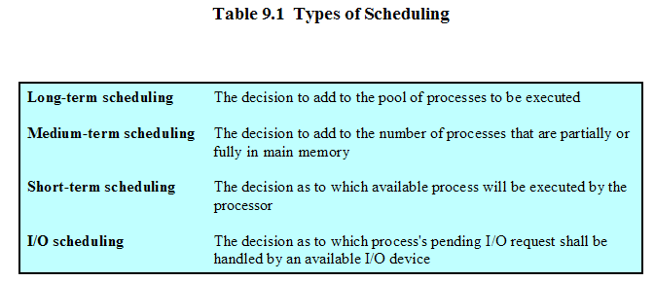

Slide 4
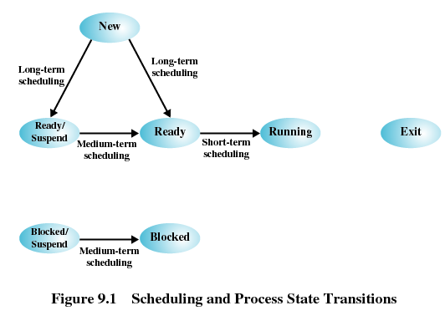

Slide 5
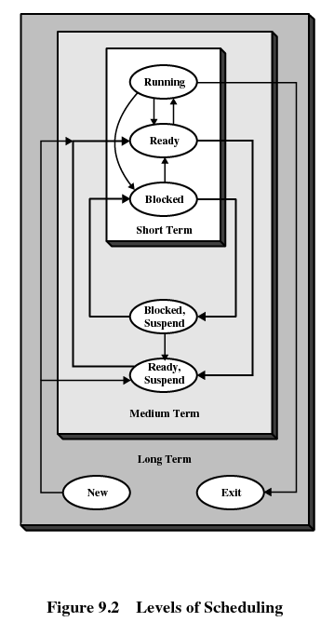

Slide 6
Long-Term Scheduling
Determines which programs are admitted to the system for processing
Controls the degree of multiprogramming
More processes, smaller percentage of time each process is executed

Slide 7
Medium-Term Scheduling
Part of the swapping function
Based on the need to manage the degree of multiprogramming

Slide 8
Short-Term Scheduling
Known as the dispatcher
Executes most frequently
Invoked when an event occurs
  Clock interrupts
  I/O interrupts
  Operating system calls
  Signals

Slide 9
Short-Tem Scheduling Criteria
User-oriented
  Response Time
    Elapsed time between the submission of a request until there is output.
System-oriented
  Effective and efficient utilization of the processor

Slide 10
Short-Term Scheduling Criteria
Performance-related
  Quantitative
  Measurable such as response time and throughput

Slide 11
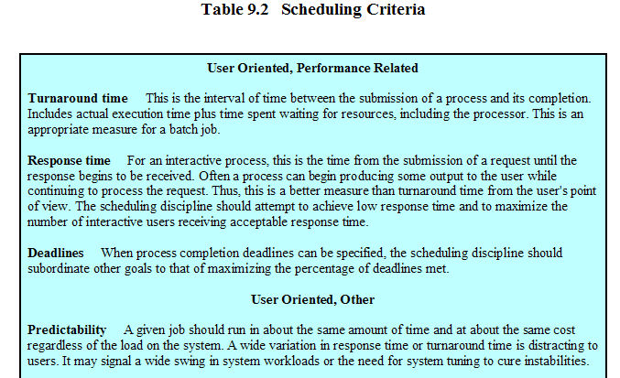

Slide 12
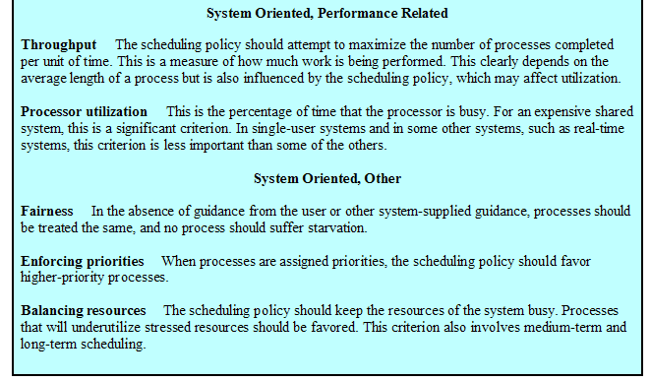

Slide 13
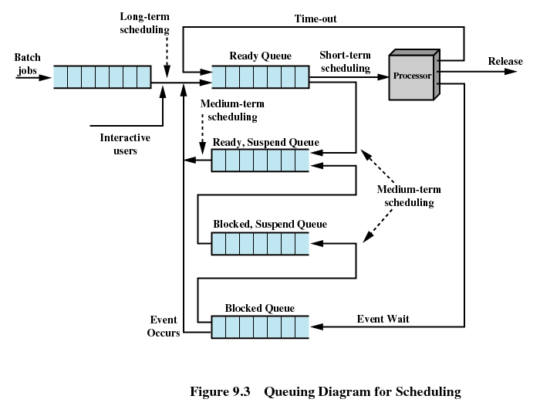

Slide 14
Priorities
Scheduler will always choose a process of higher priority over one of lower priority
Have multiple ready queues to represent each level of priority
Lower-priority may suffer starvation
  Allow a process to change its priority based on its age or execution history

Slide 15
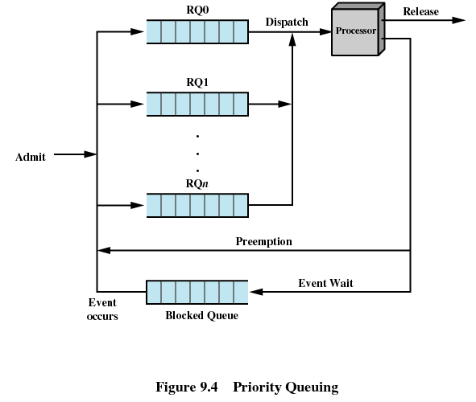

Slide 16
Alternate Scheduling Policies
Selection Function determines which process among ready processes is selected next for execution.
It can be based on priority, resource requirements or the execution characteristics of a process
w=time spent in system so far, waiting and execution
e = time spent in execution so far
s = total service time required by the process including e. It should be supplied by or estimated by the user.

Slide 17
Decision Mode
Nonpreemptive
  Once a process is in the running state, it will continue until it terminates or blocks itself for I/O
Preemptive
  Currently running process may be interrupted and moved to the Ready state by the operating system
  Allows for better service since any one process cannot monopolize the processor for very long

Slide 18
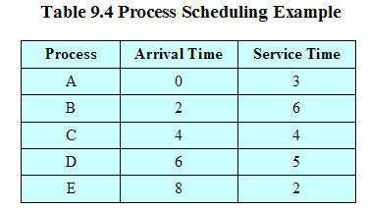
Process Scheduling Example

Slide 19
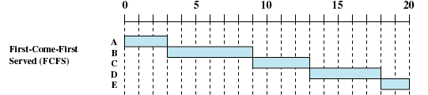
First-Come-First-Served
(FCFS)
Each process joins the Ready queue
When the current process ceases to execute, the oldest process in the Ready queue is selected

Slide 20
First-Come-First-Served
(FCFS)
A short process may have to wait a very long time before it can execute
Favours CPU-bound processes
  I/O processes have to wait until CPU-bound process completes

Slide 21
First-Come-First-Served
(FCFS)
Favours processor-bound processes over I/O-bound processes.
  When a processor-bound process is running, all of the I/O bound processes must wait, even if state is changed after some time
  If the processor-bound process is also blocked, the processor becomes idle. Thus, FCFS may result in inefficient use of both the processor and the I/O devices.
  often combined with a priority scheme to provide an effective scheduler. The scheduler may maintain a number of queues

Slide 22
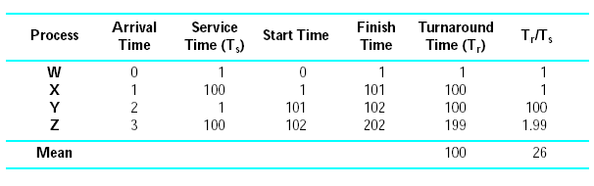
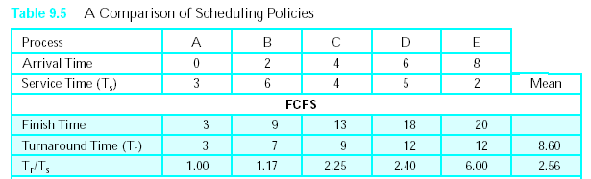

Slide 23
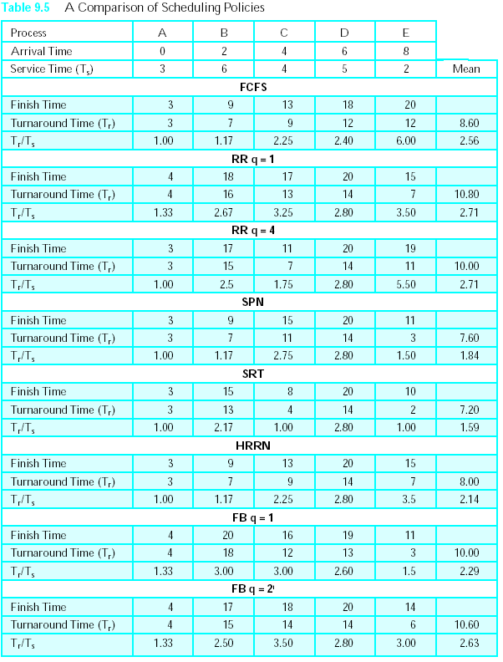

Slide 24


Round-Robin
A clock interrupt is generated at periodic intervals, i.e. time slicing
Uses preemption based on a clock
An amount of time is determined that allows each process to use the processor for that length of time

Slide 25
Round-Robin
When an interrupt occurs, the currently running process is placed in the read queue
  Next ready job is selected
The principal design issue is the length of the time quantum
  should be slightly greater than the time required for a typical interaction or process function
One drawback to round robin is its relative treatment of processor-bound and I/O-bound processes.

Slide 26
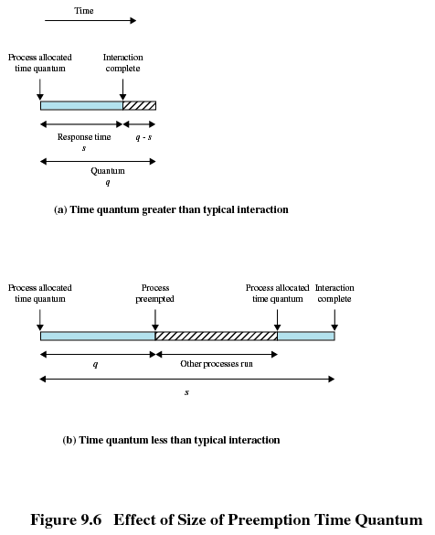

Slide 27
Round-Robin
Auxiliary queue
The new feature is an FCFS auxiliary queue to which processes are moved after being released from an I/O block.
When a dispatching decision is to be made, processes in the auxiliary queue get preference over those in the main ready queue.
It runs no longer than a time equal to the basic time quantum minus the total time spent running since it was last selected from the main ready queue..

Slide 28
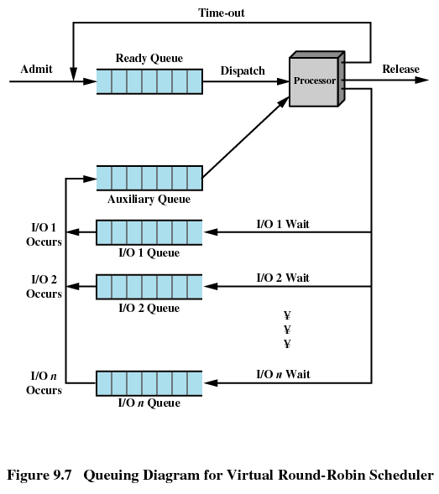

Slide 29
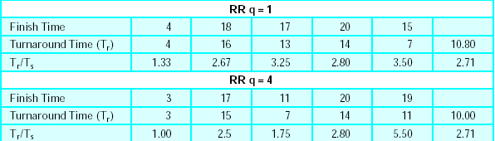

Slide 30

Shortest Process Next
Nonpreemptive policy
Process with shortest expected processing time is selected next
Short process jumps ahead of longer processes

Slide 31


Slide 32
Shortest Process Next
Predictability of longer processes is reduced
If estimated time for process not correct, the operating system may abort it
Possibility of starvation for longer processes, the need to know or at least estimate the required
How to know processing time?
  For batch jobs: the programmer to estimate the value and supply it
  In a production environment: the same jobs run frequently, and statistics may be gathered.
  For interactive processes: the operating system may keep a running average of each “burst” for each process.
SPN reduces the bias in favor of longer jobs, it still is not desirable for a time-sharing or transaction processing environment because of the lack of preemption.

Slide 33
Shortest Process Next
Note that this formulation gives equal weight to each instance.
Typically, we would like to give greater weight to more recent instances, because these are more likely to reflect future behavior.
A common technique for predicting a future value on the basis of a time series of past values is exponential averaging.

Slide 34
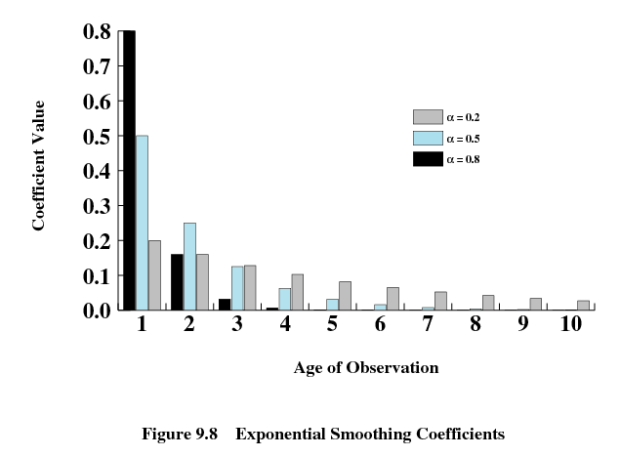

Slide 35
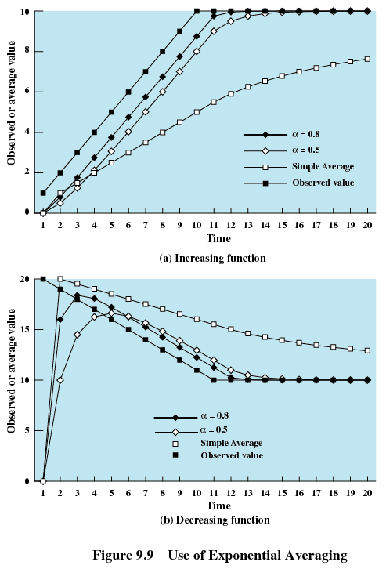

Slide 36

Shortest Remaining Time
Preemptive version of shortest process next policy
When a new process joins the ready queue, it may in fact have a shorter remaining time than the currently running process.
Accordingly, the scheduler may preempt the current process when a new process becomes ready.
Must estimate processing time

Slide 37

SRT does not have the bias in favor of long processes found in FCFS. Unlike round robin, no additional interrupts are generated, reducing overhead.
On the other hand, elapsed service times must be recorded, contributing to overhead.
SRT should also give superior turnaround time performance to SPN, because a short job is given immediate preference to a running longer job.

Slide 38

Highest Response Ratio Next (HRRN)
R = ( w + s) / s
R = response time
w= time spent waiting for the processor
s = executed service time.
For each process, minimize the ratio and the average value over all processes.

Slide 39
Highest Response Ratio Next (HRRN)
Choose next process with the greatest ratio
When the current process completes or is blocked, choose the ready process with the greatest value of R.
The expected service time must be estimated to use highest response ratio next (HRRN).

Slide 40


Slide 41
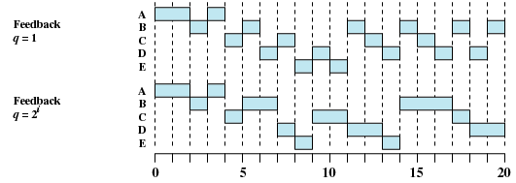
Feedback
If we have no indication of the relative length of various processes, then none of SPN, SRT, and HRRN can be used.
Penalize jobs that have been running longer
Don’t know remaining time process needs to execute

Slide 42
Feedback
if we cannot focus on the time remaining to execute, let us focus on the time spent in execution so far.
Scheduling is done on a preemptive (at time quantum) basis, and a dynamic priority mechanism is used.

Slide 43
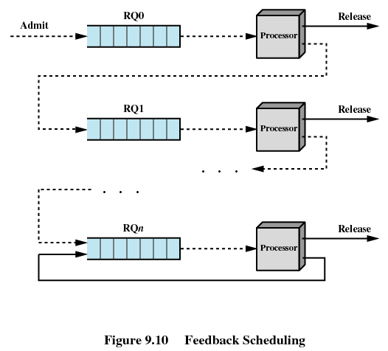

Slide 44
Feedback
Multilevel feedback: operating system allocates the processor to a process and, when the process blocks or is preempted, feeds it back into one of several priority queues.
Turnaround time of longer processes be alarmingly.
Possibility of starvation, if new jobs are entering the system frequently.
To compensate for this, we can vary the preemption times according to the queue, i.e. RQ0 can be given 1 unit of time, RQ2 can be given 2 unit of time and so on, before it is preempted.

Slide 45
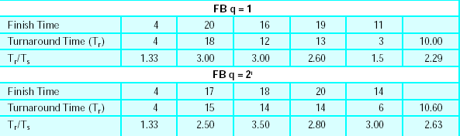
A longer process may still suffer starvation.
  A possible remedy is to promote a process to a higher-priority queue after it spends a certain amount of time waiting for service in its current queue.

Slide 46
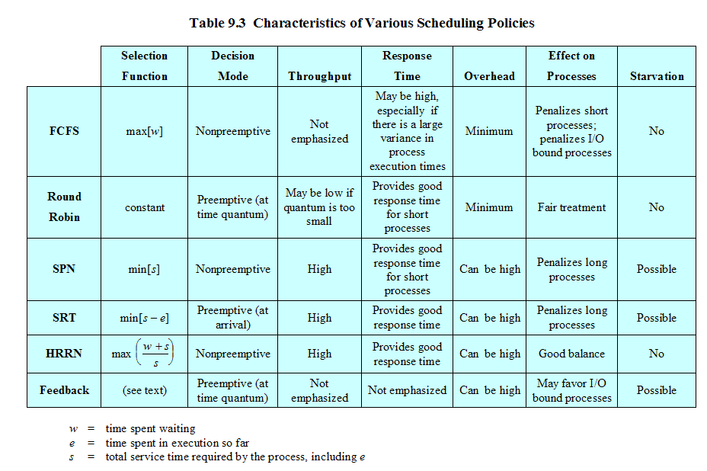

Slide 47
Performance Comparison
Performance of various scheduling policies is a critical factor in the choice of a scheduling policy.
Relative performance will depend on a variety of factors
  The probability distribution of service times of the various processes,
  the efficiency of the scheduling and context switching mechanisms, and
  the nature of the I/O demand and the performance of the I/O subsystem.

Slide 48
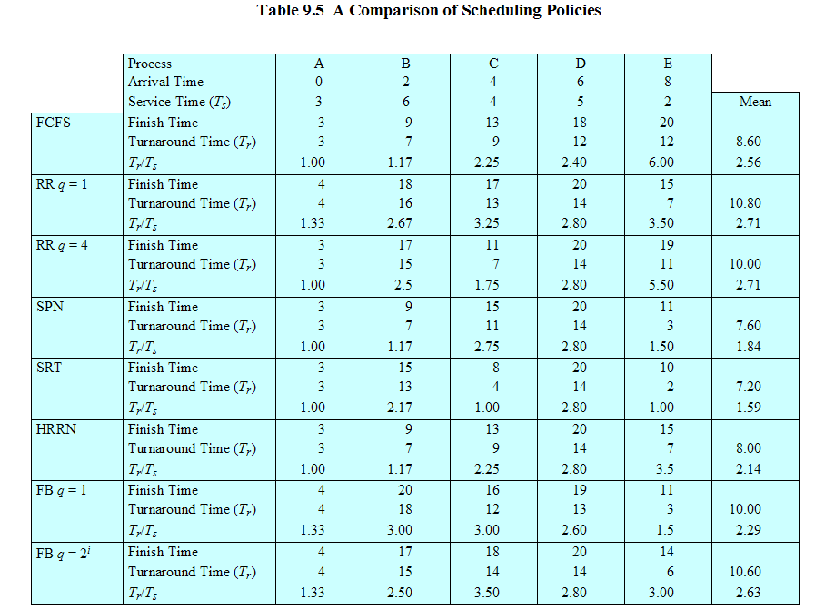

Slide 49
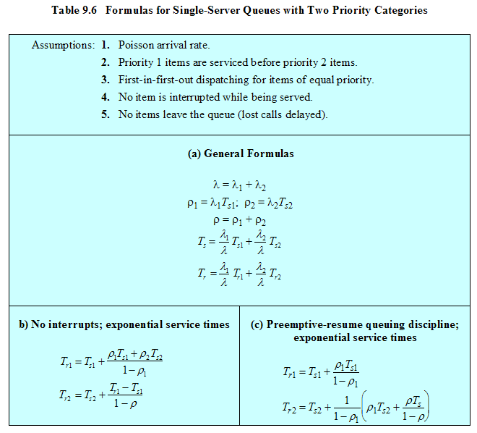

Slide 50
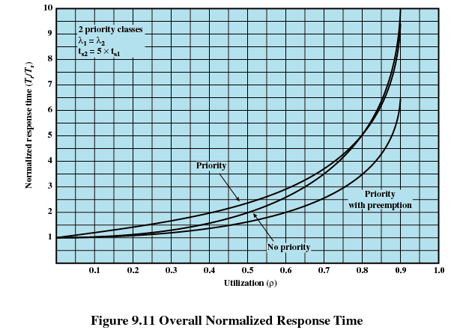

Slide 51
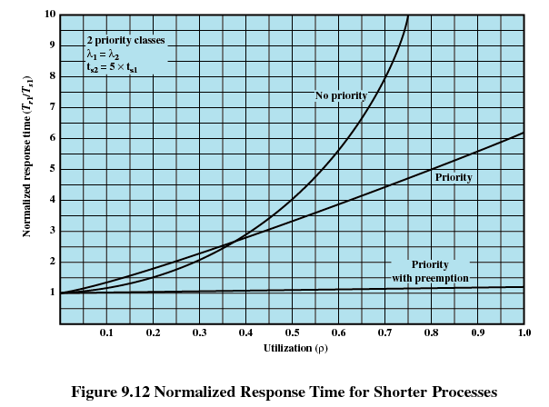

Slide 52
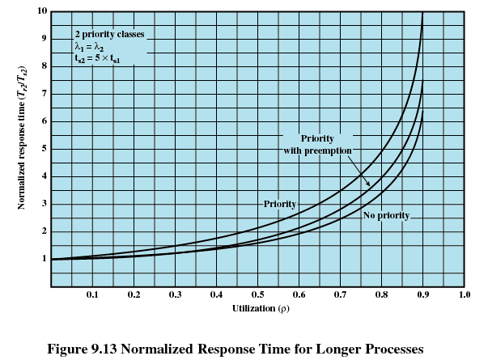

Slide 53
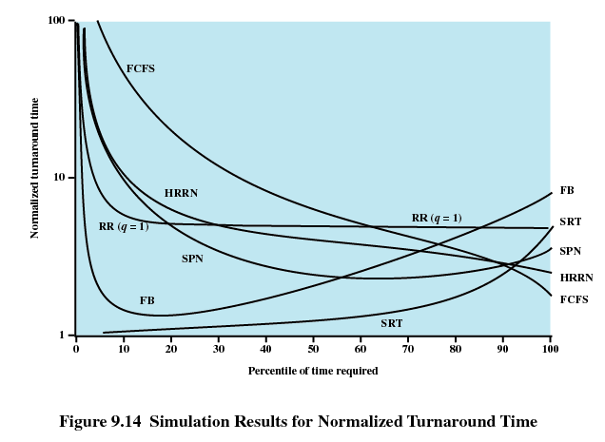

Slide 54
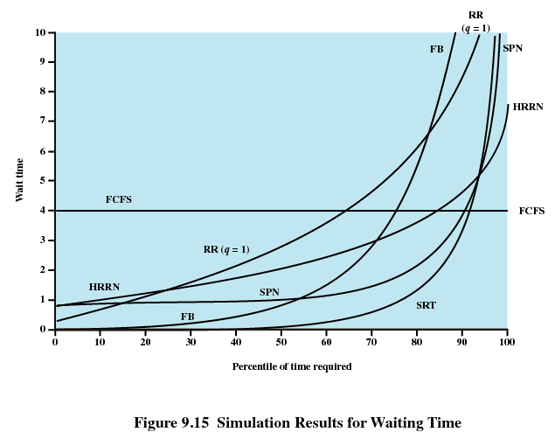

Slide 55
Fair-Share Scheduling
User’s application runs as a collection of processes (threads)
User is concerned about the performance of the application and not with individual processes or threads
Need to make scheduling decisions based on process sets
The concept can be extended to groups of users, provide similar services to each group.

Slide 56
Fair-Share Scheduling
Each user is assigned a weighting of some sort that defines that user’s share of system resources as a fraction of the total usage of those resources.
If user A has twice the weighting of user B, then in the long run, user A should be able to do twice as much work as user B.
The objective of a fair-share scheduler is to monitor usage to give fewer resources to users who have had more than their fair share and more to those who have had less than their fair share.
Fair-share schedulers (FSS) on Unix

Slide 57
Fair-share schedulers (FSS)
FSS considers the execution history of a related group of processes, along with the individual execution history of each process in making scheduling decisions.
The system divides the user community into a set of fair-share groups and allocates a fraction of the processor resource to each group, e.g. four groups, each with 25% of the processor usage.
Each fair-share group is provided with a virtual system that runs proportionally slower than a full system.
Scheduling is done on the basis of priority, which takes into account the underlying priority of the process, its recent processor usage, and the recent processor usage of the group to which the process belongs. The higher the numerical value of the priority, the lower the priority.

Slide 58
Fair-share schedulers (FSS)
Each process is assigned a base priority.
The priority of a process drops as the process uses the processor and as the group to which the process belongs uses the processor.
In the case of the group utilization, the average is normalized by dividing by the weight of that group. The greater the weight assigned to the group, the less its utilization will affect its priority.

Slide 59
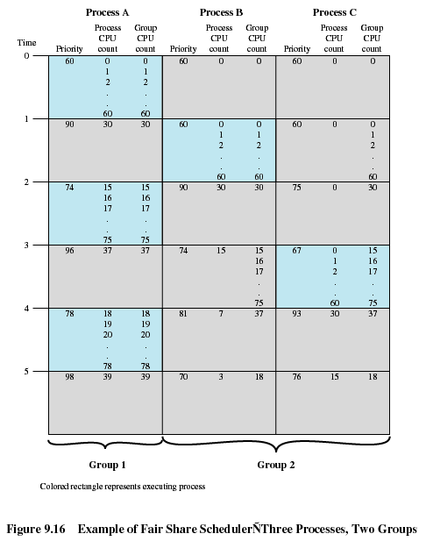

Slide 60
Traditional
UNIX Scheduling
Multilevel feedback using round robin within each of the priority queues
If a running process does not block or complete within 1 second, it is preempted
Priorities are recomputed once per second
Base priority divides all processes into fixed bands of priority levels

Slide 61
Bands
These bands are used to optimize access to block devices (e.g., disk) and to allow the operating system to respond quickly to system calls.
Decreasing order of priority
  Swapper
  Block I/O device control
  File manipulation
  Character I/O device control
  User processes

Slide 62
