Slide 1

Tulsiramji Gaikwad-Patil College of Engineering and Technology
Wardha Road, Nagpur-441 108
Year 2019-2020
NAAC Accredited
Department Of Computer Science & Engineering
Topic Name : -
AUSPICIOUS AUDIT TO ENHANCE AGRICULTURE
AFFILIATED WORK
Presented by
Group Members :-
1) Ms. Avanti Jadhao 2) Ms. Manaswi Thakare
3) Mr. Aditya Tarale 4) Mr. Nimish Nagapure
5) Mr. Pankaj Raut
Under the Guidance of:-
Prof. Rajesh Babu

Slide 2
Contents
Abstract
Introduction
Literature Review
Existing System
Proposed System
Software and Hardware Requirement
System Architecture
System Architecture Work In Pictorial Format
Algorithm and technique
Project Screenshot
Conclusion
Reference

Slide 3
ABSTRACT
Agriculture is believed to be as backbone of Indian economic system. For the past few decades, agriculture field has seen lots of technological changes to improve better productivity.
The world population grows steadily but the resources for crop production continuously diminish.
Therefore there have been considerable efforts to develop innovative approaches for sustainable crop production. Using prediction methods, farmers can enhance the productivity of crops.
These methods are used to find the required quantity of crops, seeds, humidity, water level and other supplements.
KEY WORDS :- Precision Agriculture, Weka, ZeroR Algorithm, Matplotlib, Predictive Analysis.

Slide 4
INTRODUCTION
Predictive Analysis Agricultural systems are very successful in increasing productivity and efficiency of crop production.
However, population grows steadily, while the resource for crop production diminishes day by day.
Precision agriculture involves in collecting realtime data on weather, air quality, soil, crop maturity, equipment, labor costs and availability of existing data .
This predictive analytics can be used to make smarter decisions in agricultural field.

Slide 5
LITERATURE REVIEW
Precision agriculture follows recognizing the previous year yield values, understanding the current requirement of environment and exploiting information that quantifies variations in soil and crops within agricultural fields.
The prediction farming concept is based on the recognition of what happened in past, analyzing what is happening in current situation and controlling the future data need in agriculture.
Previous few year data are believed to be as input for the algorithm and predicted value is shown as graph using matplotlib .

Slide 6
The precise crop variety selection, exact types and doses of fertilizers, pesticides and herbicides, and proper irrigation meet the demands of crops for optimum growth and development .
Prediction of advanced technologies, including machinery, tools and information about input, helps the farmers to increase the efficiency of labor, land and farming time.
Here prediction parameters includes previous year crop yield,cultivated area, irrigation types, humidity in particular area, usage of pesticides, fertilizers and labor cost.
The Prediction of exact quantities of yield at the appropriate time reduces the cost of agrochemical in crop production and also reduces the overall cost per unit Because of prediction, better decision-making is done at right time.

Slide 7
EXISTING SYSTEM
In the existing system, only a few of many factors available are considered for the agricultural data classification.
Many of the existing systems are implemented using Data Mining techniques where the accuracy of classifying the data is lower when compared to the big data analytics.
The existing systems do not consider the dependency between the various factors affecting the crop production.
And more over the existing does use the old data which is not up to date.
Thus the classification and prediction of data can’t be true and accurate.

Slide 8
PROPOSED SYSTEM
Data are collected for different weather conditions, soil, humidity, air quality, crop maturity,and statistics of previous few year data have taken under consideration and future will be predicted by using machine learning algorithm .
Though previous monitoring techniques gathers the crop conditions properly, prediction results have not yet been optimized. First of all, researchers do not have clear idea about crop condition and crop monitoring methods .
They should know how to monitor crop condition on different circumstances. So crop characteristics should be well monitored by researchers to deliver good results in prediction methods.
Basically problems in predictions are finding proper algorithm for prediction methods and assuming different location results for predictions.

Slide 9
SOFTWARE & HARDWARE REQUIREMENT
Hardware Requirements: -
Core i5/i7 processor
At least 4 GB RAM
Hard Disk
Software Requirements: -
Python 3.x
Anaconda Distribution
Jupyter Notebook
Weka Data
Windows operating system

Slide 10
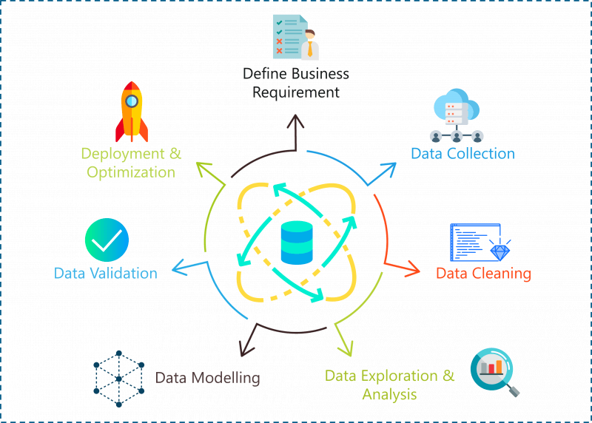

SYSTEM ARCHITECTURE
DATA COLLECTING
DATA READING
DATA CLEANING
DATA IMPUTATION OR MANIPULATION
DATA ANALYSIS
DATA VISUALIZATION

Slide 11
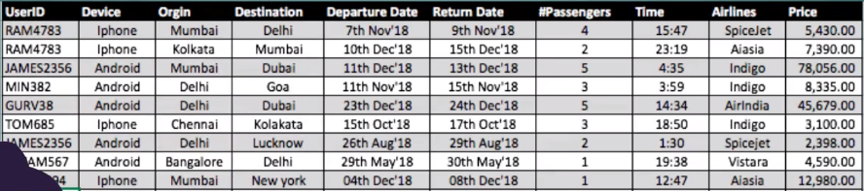
SYSTEM ARCHITECTURE WORK IN PICTORIAL FORMAT Data Collection
Data Reading

Slide 12
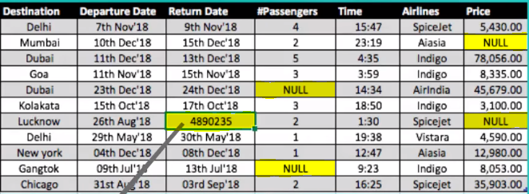
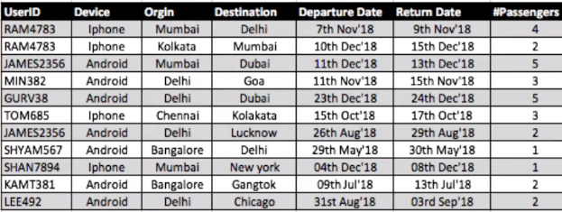
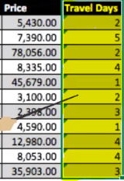
Data Cleaning
Data Imputation and Manipulation

Slide 13
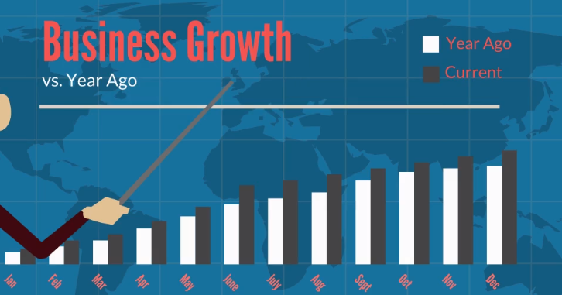
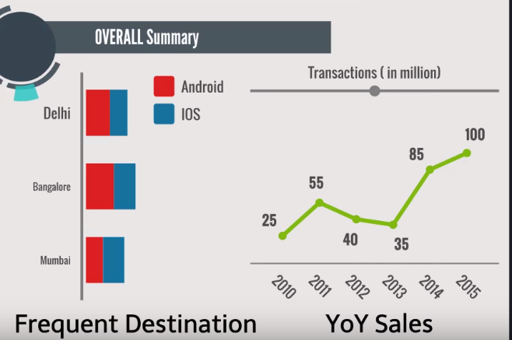
Data Visualization
Data Analysis

Slide 14
ALGORITHM & TECHNIQUE
Prediction based On Machine Learning Algorithms.
1. Linear Regression
It is used to estimate real values (cost of houses, number of calls, total sales etc.) based on continuous variable(s). Here, we establish relationship between independent and dependent variables by fitting a best line. This best fit line is known as regression line and represented by a linear equation Y= a *X + b.
In this equation:
Y – Dependent Variable
a – Slope
X – Independent variable
b – Intercept

Slide 15
2. Logistic Regression
Don’t get confused by its name! It is a classification not a regression algorithm. It is used to estimate discrete values ( Binary values like 0/1, yes/no, true/false ) based on given set of independent variable(s). In simple words, it predicts the probability of occurrence of an event by fitting data to a logit function. Hence, it is also known as logit regression. Since, it predicts the probability, its output values lies between 0 and 1 (as expected).
3. Decision Tree
This is one of my favorite algorithm and I use it quite frequently. It is a type of supervised learning algorithm that is mostly used for classification problems. Surprisingly, it works for both categorical and continuous dependent variables. In this algorithm, we split the population into two or more homogeneous sets. This is done based on most significant attributes/ independent variables to make as distinct groups as possible.

Slide 16
4. kNN (k- Nearest Neighbors)
It can be used for both classification and regression problems. However, it is more widely used in classification problems in the industry. K nearest neighbors is a simple algorithm that stores all available cases and classifies new cases by a majority vote of its k neighbors. The case being assigned to the class is most common amongst its K nearest neighbors measured by a distance function.
5. Random Forest
Random Forest is a trademark term for an ensemble of decision trees. In Random Forest, we’ve collection of decision trees (so known as “Forest”). To classify a new object based on attributes, each tree gives a classification and we say the tree “votes” for that class. The forest chooses the classification having the most votes (over all the trees in the forest).

Slide 17
1. Skeleton of python script :-
def train ( args ):
# code for training model
def test ( args , model ):
# code for running model on new instances
def describe ( args , model ):
# textual representation of model

Slide 18
2. Python Implementations Of Algorithm :-
Check here for the implementation of project
click here

Slide 19
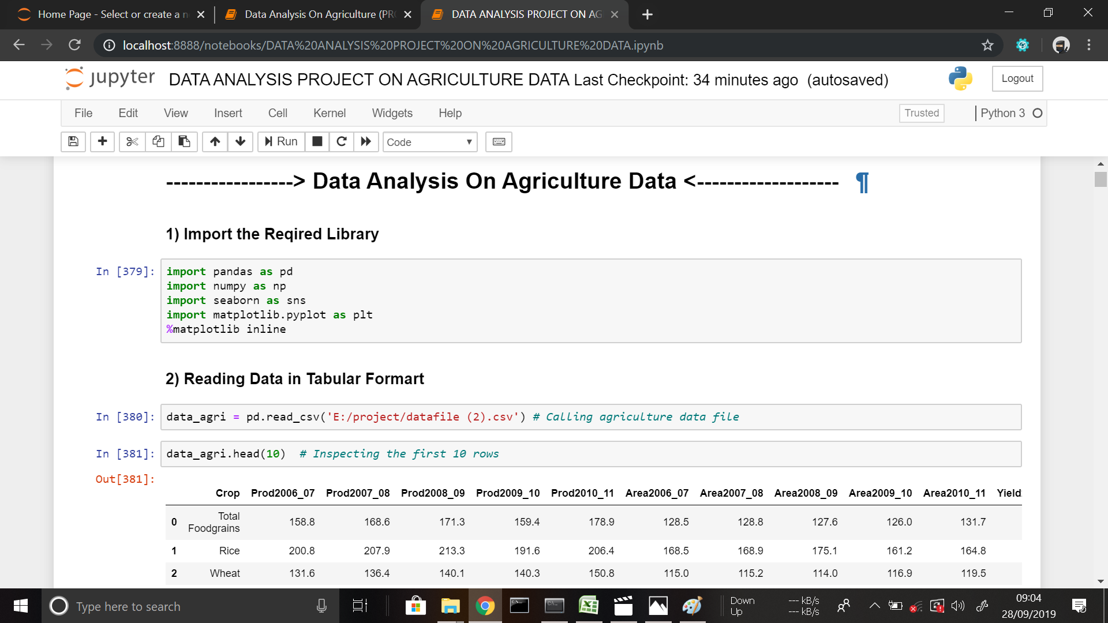
PROJECT SCREENSHOTS

Slide 20
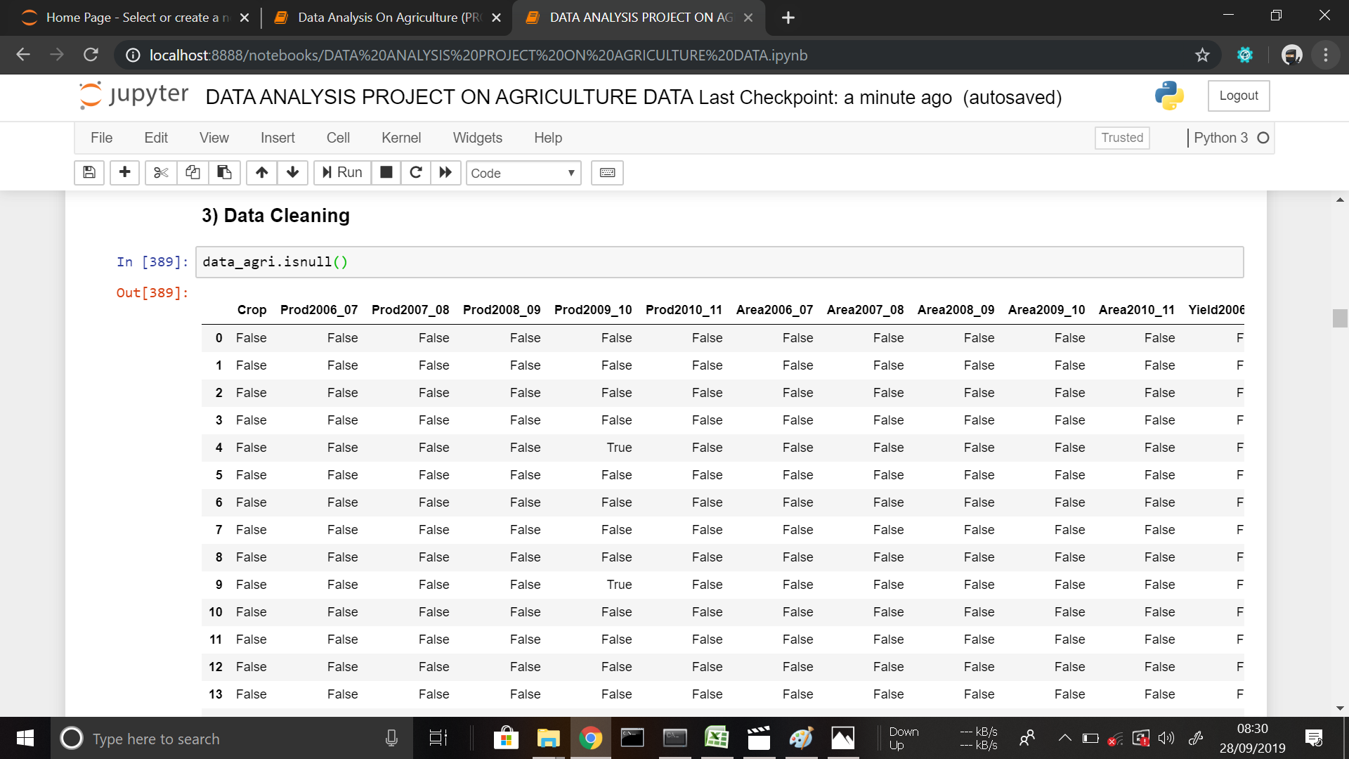

Slide 21
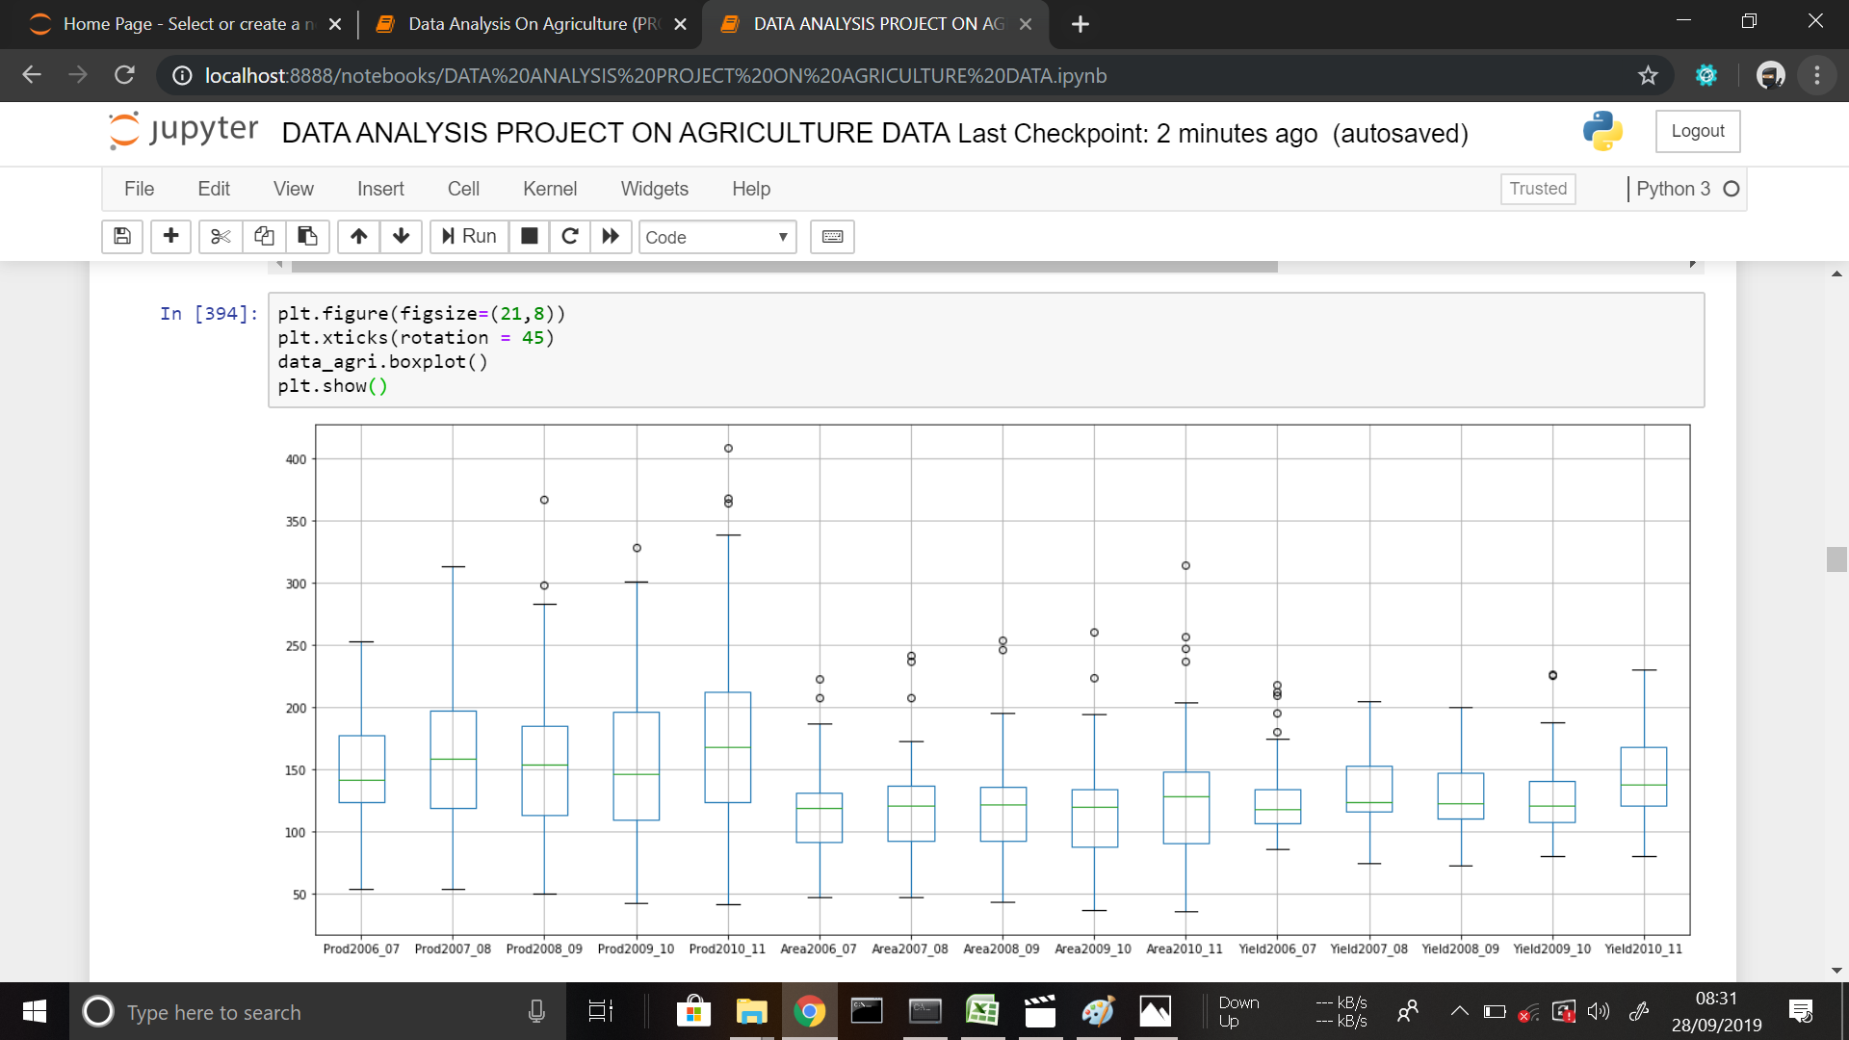

Slide 22
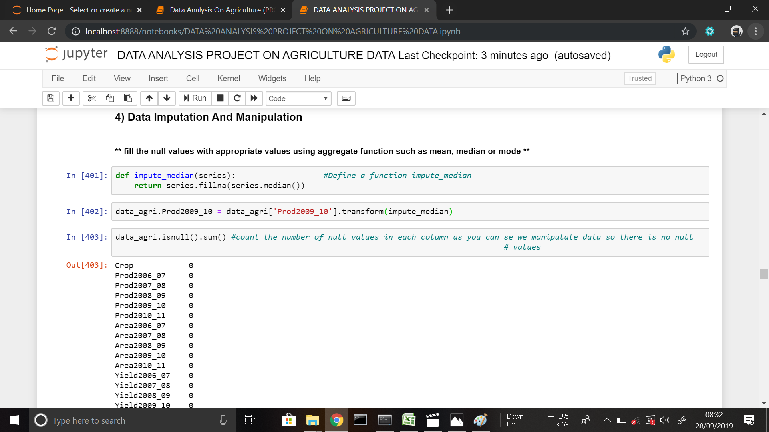

Slide 23
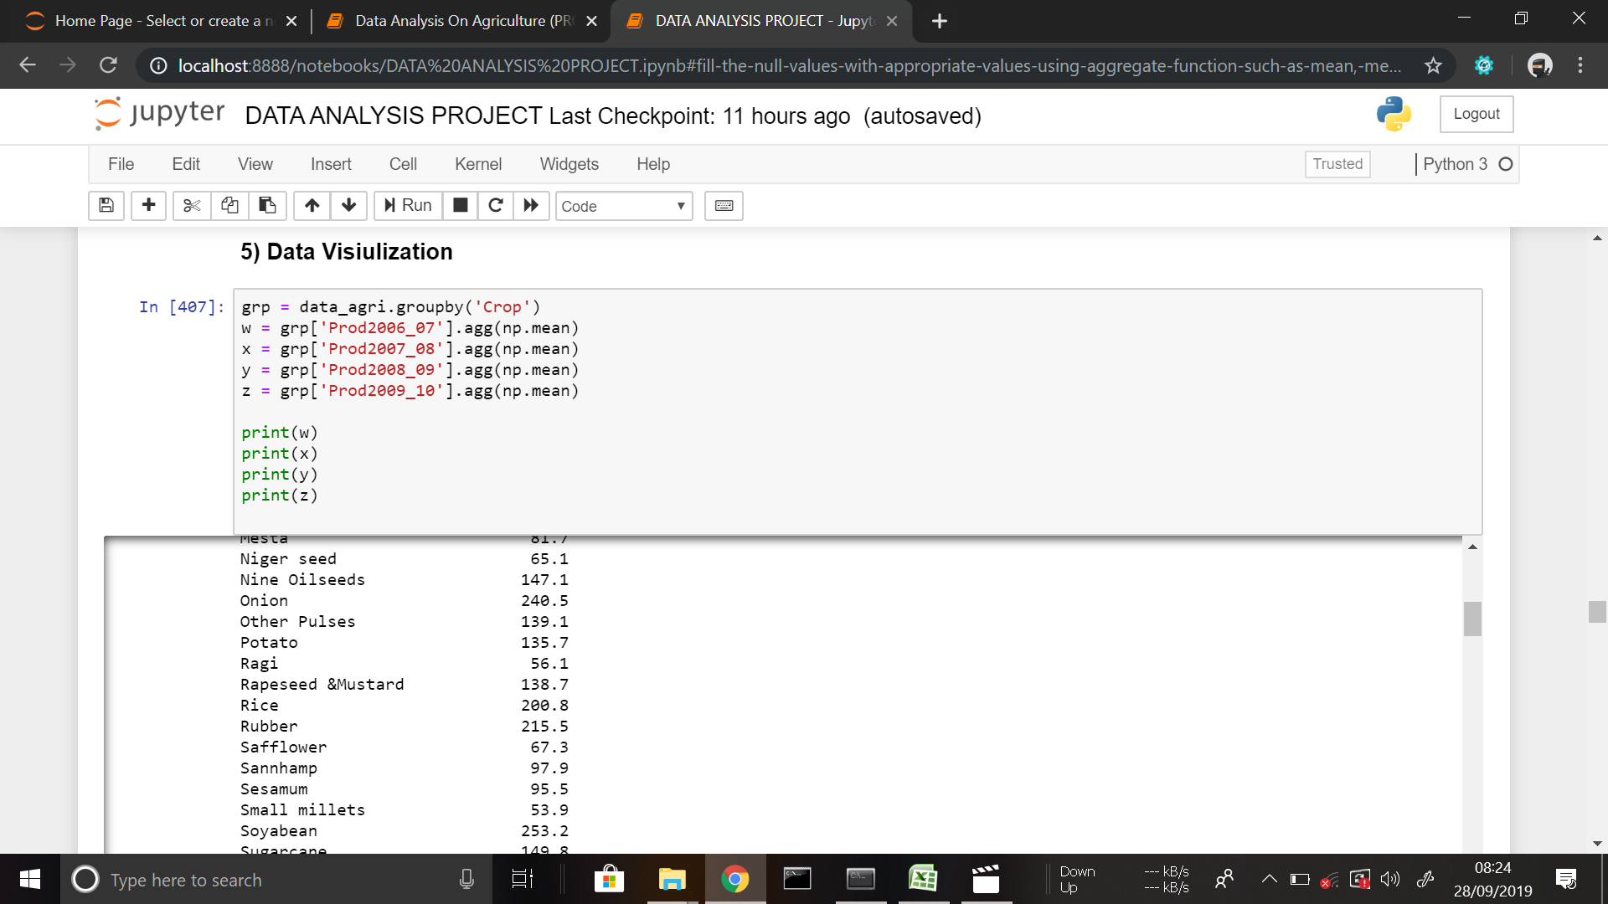

Slide 24
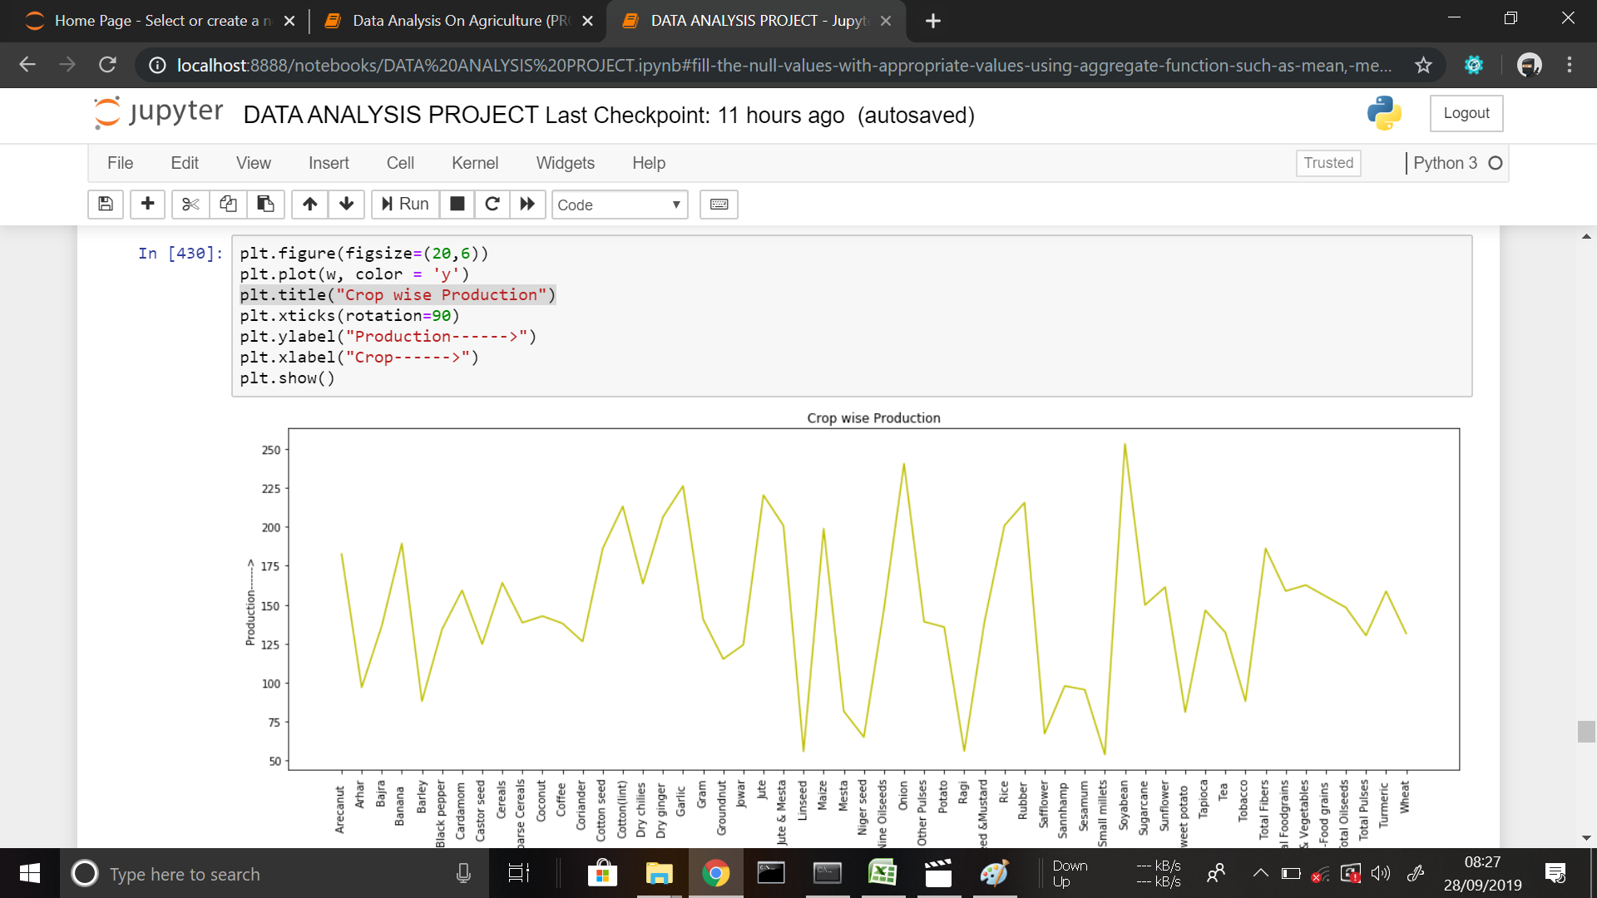

Slide 25
CONCLUSION
Hereby we will conclude that all the data results which we were given (or analysed) were solely done based on the previous year's data and we have kept some good amount of work in order to find the inner relationships between the agriculture parameters and we are hoping that we have done that.
The main objective of this paper is to help the farmers or agriculture workers such that they can do agriculture more smartly in a much better calculated way.

Slide 26
REFERENCES
Analysis of Agricultural Data Using Big Data Analysis, K.Ravi Shankar, July 2017.
Using technology of data collection and data processing in precision farming, Sber a vyhodnoceni.
A review on data mining techniques for fertilizer recommendation. Jignasha M. Jethva, Feb 2018.
Effective use of Big Data Analytics in Crop planning to increase Agriculture Production in India,Ch. Chandra shekhar,J. Uday Kumar,B. Kishor Kumar and Ch. Sekhar, Jan 2018.
Big Data and Climate Smart Agriculture-Status and Implications for Agriculture Research and Innovation in India KL Rao,12 Feb 2018.

Slide 27

REFERENCES

