Slide 1

CSE1002 Operators and Expressions
Dr.B.Saleena
School of Computer Science and Engineering
VIT, Chennai Campus

Slide 2
Operators and Expressions
Operator:
An operator is a symbol, which instructs the computer to perform the specified manipulation over some data.
Types of Operator:
Depending upon the type of operation, the operators are classified as follows:

Slide 3
Operators and Expressions
Assignment Operator:
=
Arithmetic Operators:
+ - * / % unary+ unary-
Relational Operators:
< <= > >= == !=
Logical Operators:
&& || !

Slide 4
Operators and Expressions
Increment / Decrement Operators:
++ --
Shorthand arithmetic assignment operators:
+= -= *= /= %=
Conditional Operator:
?:
Bitwise Operator:
& | ^ << >>
sizeof() operator:
Comma operator

Slide 6
Precedence of Arithmetic Operators and Associativity:
If we have more than one arithmetic operator in an expression then we have to follow the “precedence” and “associativity”.
Example:
int a = 4, b = 5, c = 6,d;
d=a + b * c

Slide 7
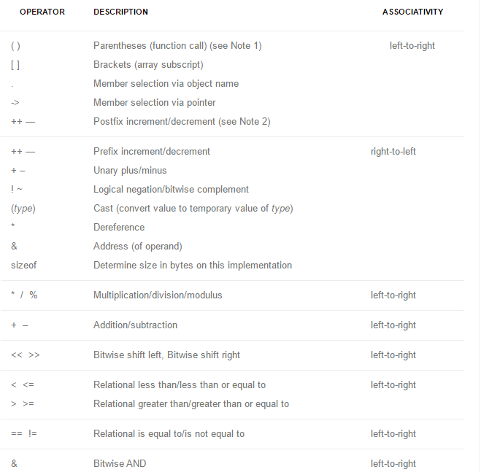

Slide 8
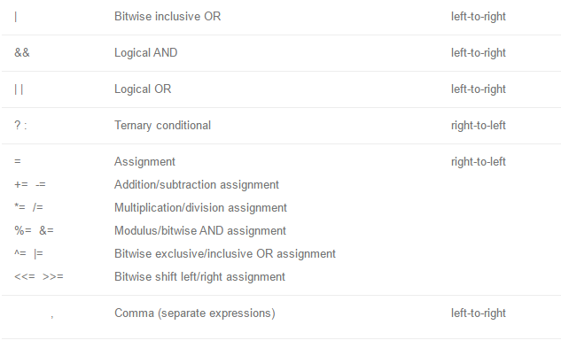

Slide 9
Precedence level | Operators | Associativity
I II III | Unary+, Unary – *,/,% +,- | Right to Left Left to Right Left to Right

Slide 10
Examples:
int a = 4, b = 12, c = 6, d = 7;
a + b / c * d
…….
Note:
We can also override the default order of evaluation by using pairs of parenthesis. In this case, sub expression within the parenthesis are given top priority.

Slide 11
Example:
int a = 4, b = 5, c = 6;
(a + b) * c
(4 + 5) * 6
= 9 * 6
=54

Slide 12
Example Program (Operator precedence):
#include<stdio.h>
int main( )
{
int a = 4, b = 6, c = 3, d, e, f, g;
d = -a + b * c;
e = (a + b) * c;
f = a * b / c;
g = a * (b / c);
printf(“ a = %d b = %d c = %d \n\n”, a, b, c);
printf(“-%d + %d * %d = %d\n”, a, b, c, d);
printf(“ (%d + %d) * %d = %d \n”, a, b, c, e);
printf(“ %d * %d / %d = %d\n”, a, b, c, f);
printf(“ %d * (%d / %d) = %d \n”, a, b, c, g);
return 0;
}

Slide 13
Input – Output:
a = 4 b = 6 c = 3
-4 + 6 * 3 = 14
(4 + 6) * 3 = 30
4 * 6 / 3 = 8
4 * (6 / 3) = 8

Slide 14
Relational Operators
< <= > >= == != | Less than Less than or equal to Greater than Greater than or equal to Equal to Not equal to | 4 < 5 4 <= 5 4 > 5 4 >= 5 4 == 5 4 != 5 | 1 1 0 0 0 1

Slide 15
Precedence Level and Associativity:
Precedence level | Operators | Associativity
I II | <, <=, >, >= ==, != | Left to Right Left to Right

Slide 16
Logical Operators [&&, ||, !]:
These are used to construct compound conditional expressions.
Logical AND [&&]:
The general form of compound conditional expression using && is
c1 && c2
where,
c1 & c2 are conditional expressions.

Slide 17
Truth Table:
c1 | c2 | C1 && c2
T T F | T F - | T F F

Slide 18
Logical OR [||]:
The general form of compound conditional expression using || is c1 || c2
where,
C1 & c2 are conditional expressions.

Slide 19
Truth Table:
C1 | C2 | C1 || C2
T F F | - T F | T T F

Slide 20
Logical NOT [!]:
The general form of compound conditional expression using ! Is as follows:
!c
Truth Table:
C1 | !C1
T F | F T

Slide 21
Sample Program to illustrate logical operators:
#include<stdio.h>
int main(void)
{
int a = 5, b = 6, c = 7, d;
printf(“\n Working of logical && \n\n”);
d = (a < b) && (b < c);
printf(“%d”, d);
d = (a < b) && (b > c);
printf(“%d”, d);
d = (a > b) && (b < c);
printf(“%d”, d);
d = (a > b) && (b > c);
printf(“%d”, d);
return 0;
}

Slide 22
Precedence levels:
Precedence Level | Operators | Associativity
I II III | ! && || | Right to Left Left to Right Left to Right

Slide 23
Shorthand Arithmetic Assignment Operator:
[+=,-=,*=,/=,%=]
The operator enable us to perform both arithmetic and assignment operations.
Syntax:
operand1 operator operand2;
Example:
a -= 5, same as a = a – 5
a *= 7, same as a = a * 7
a += 10;
a += b;
a += (b + c)

Slide 24
Sample Program:
#include<stdio.h>
int main(void)
{
int a, b, c, d, e;
a = b = c = d = e = 10;
a += 5;
b -= 5;
c *= 5;
d /= 5;
e %= 5;
printf(“%d%d%d%d%d”, a,b,c,d,e);
return 0;
}

Slide 26
Increment / Decrement Operators [++, --]:
Increment operator ++ is to increment the value by 1 and the decrement operator – is to decrement the value by 1.
Syntax:
operand ++
++operand
operand—
--operand
Example:
a++;
b—;
b = ++a;

Slide 27
Conditional Operator [?:]:
The conditional operator is an unusual operator provided by ‘C’ which helps in two-way decision-making.
Syntax:
(Expr1) ? (Expr2) : (Expr3);
Expr1 is evaluated, if it is true then Expr2 becomes the value otherwise Expr3 becomes the value.

Slide 28
Sample Program:
#include<stdio.h>
int main(void)
{
int a, b, c, n;
printf(“Enter two numbers…\n”);
scanf(“%d%d”, &a, &b);
printf(“a = %d b = %d \n\n”, a, b);
c = (a > b) ? a : b;
printf(“Largest = %d\n”, c);
printf(“Enter a number \n”);
scanf(“%d”, &n);
(n % 2) ? printf(“Odd”); : printf(“Even”);
return 0
}

Slide 29
Input-Output:
Enter two numbers
5
6
a = 5 b = 6
Largest = 6
Enter a number
5
odd

Slide 30
Precedence levels & Associativity among all operators:
Precedence | Operators | Description | Associativity
1 | ( ) [ ] -> . | Function call Array indexing Structure pointer Structure member | Left to Right

Slide 31
Precedence | Operators | Description | Associativity
2 | + - ++ -- ~ ! & * (type) Sizeof | Unary+ Unary- Increment Decrement 1’s comp Logical negation Address of Value at address Type casting Size in bytes | Right to left

Slide 32
Precedence | Operators | Description | Associativity
3 4 5 | * / % + - << >> | Multiplication Division Remainder Addition Subtraction Left shift Right shift | Left to right Left to right Left to Right

Slide 33
Precedence | Operator | Description | Associativity
6 7 8 9 10 | < <= > >= == != & ^ | | Less than Less than equal Greater than Greater than equal Equal to Not equal to Bitwise AND Bitwise xclusive OR Bitwise inclusive OR | Left to Right Left to Right Left to Right

Slide 34
Precedence | Operator | Description | Associativity
11 12 13 14 15 | && || ?: = *= /= %= += -= &= ^= |= , | Logical AND Logical OR Conditional Assignment comma | Left to Right Left to Right Right to Left Right to Left Left to Right

Slide 35
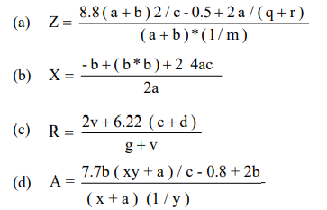
Convert the following equations into corresponding C statements

Slide 36
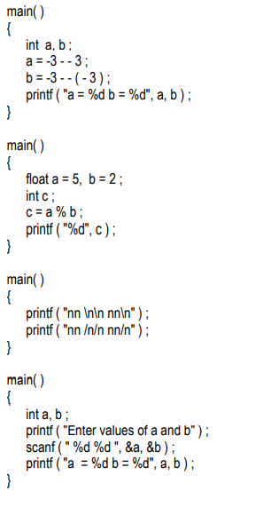
Find the output for the following code segments

Slide 37
Find the output of the following code segments
main() { char a = 273; char b = 25; int c = a%b; printf("%d",c); }
main() { char a = 27; char b = 25; char c = a -b; printf("%c",c); }
void main() { char a = 65; char b = 100; int c = a%b; printf("%c",c); }
main() { int a, b,c; a = 4; b = 2; c = -a+--b; printf ( "c = %d", c) ; }
main() { int a, b,c; a = 4; b = 2; c = -a+ b--; printf ( "c = %d", c) ;
printf ( "b = %d", b) ; }

Slide 38
Exercise Problems
1) A General Service company hired you to calculate the labour cost and total charge for the services rendered to their client based on the formula given below:
Rate per hour : Rs.45/- Labour cost : Rate * hours work
Total Charge : Labour cost + Cost of Materials.
Write a program to implement the above.
2) Mr.Bennet bought a new house and he wishes to paint the both sides of rectangular shaped compound wall of that house. He is having the following details: length, breadth, height and cost per square feet to paint the compound wall. Help him out to calculate the cost for painting work.
3) A farm produces several food grains, namely wheat, barley, oats and flax. The monthly production details (in Kg) and price per Kg (in INR) received during the year are recorded. Read the production details and price of the food grains and print its details through your C program.
4) ABC company Ltd. is interested to computerize the pay calculation of their employee in the form of Basic Pay, Dearness Allowance (DA) and House Rent Allowance (HRA). DA and HRA are calculated as certain % of Basic pay(For example, DA is 80% of Basic Pay, and HRA is 30% of Basic pay). They have the deduction in the salary as PF which is 12% of Basic pay. Propose a computerized solution for the above said problem.

