Slide 1
COVID Tracking System Using Distributed OS Techniques
Nimish Paradkar - 20MCA1067
Arpit Ayush - 20MCA1018
Ayush Tiwary - 20MCA1052

Slide 2
-Content-
Abstract
Objective
Simulator Description
Modules
Modules Description
Network Diagram
Datasets used
Coding
Snippets

Slide 3
-Abstract-
Currently the world is facing a dire problem of COVID-19 disease which can spread by a person coming in contact with another person affected by it.
Even after implementing various safety measures, it is difficult for authorities to contain the disease which puts other non-infected people in a high risk situation.
Our project aims to develop a simulated environment in which this issue is resolved by using a Distributed Operating System environment using mainly Peer-To-Peer architecture.
Our project includes various scenarios which are partitioned into different modules to help the authorities come up with a more comprehensive plan for minimizing the spread of the disease.

Slide 4
-Objective-
To develop a simulation of our system using Cisco packet tracer simulator.
To develop a system in which information can be easily shared in an efficient manner.
To manage redundancy of data and acquire consistency.
To develop a failsafe, reliable and robust networking system for data sharing.
To help the authorities acquire detailed info. about the patients, which will help them in backtracking to the sources which can spread the COVID-19 virus.

Slide 5
-Simulator Description-
Packet tracer gives a real world experience with the powerful network simulation tool built by Cisco.
It is used in building complex networks across a variety of devices and extend beyond routers and switches.
Used to create solutions that are interconnected for smart cities, homes, and enterprises.
Packet Tracer is a cross-platform visual simulation tool designed by Cisco Systems that allows users to create network topologies and imitate modern computer networks.
The software allows users to simulate the configuration of Cisco routers and switches using a simulated command line interface.
Packet Tracer makes use of a drag and drop user interface, allowing users to add and remove simulated network devices as they see fit.

Slide 6
-Modules-
General Public
Patients
Hospitals in client-server network
Law enforcement in client-server network
Hospitals and law enforcement in peer-to-peer network

Slide 7
-Modules Description-
General Public
Are the non-infected population of people in our database who are continuously taking precautionary measures as stated by our health care experts. We recommend the non-infected people to take the self-assessment test available on the system frequently. Until now, these group of people are marked “Safe”.
Patients
Consists of the unfortunate group of people who came in contact with the COVID 2019 virus and are now infected. Patients are marked “Infected”, while any non-infected people coming in the radius of 50 meters are marked “Risky”. Data of Patients further goes to hospitals and healthcare centers where they are admitted.
Hospitals in client-server network
The data of any patient coming to hospitals are stored on the computers directly and further shared with concerning departments within the hospitals using client-server network. A single server is used filtering the raw data coming directly from the users.

Slide 8
-Modules Description-
Law enforcement in client-server network
After analyzing patient data, it is sent over to law enforcement and government agencies for precautionary measures. Similarly, this data is stored in data servers for further evaluation and can be shared with a range of systems as and when needed.
Hospitals and law enforcement in peer-to-peer network
Communication is made possible between hospital systems and law enforcement systems using peer-to-peer networks where N number of hospital systems are connected to all N number of law enforcement systems, to and fro so that the law enforcement agencies can perform contact tracing in an efficient and effective manner

Slide 9
-Block Diagram-
Hand held devices
Hand held devices
Hospital
Hospital server
Law enforce 3
Law enforce1
Law enforce 2

Slide 10
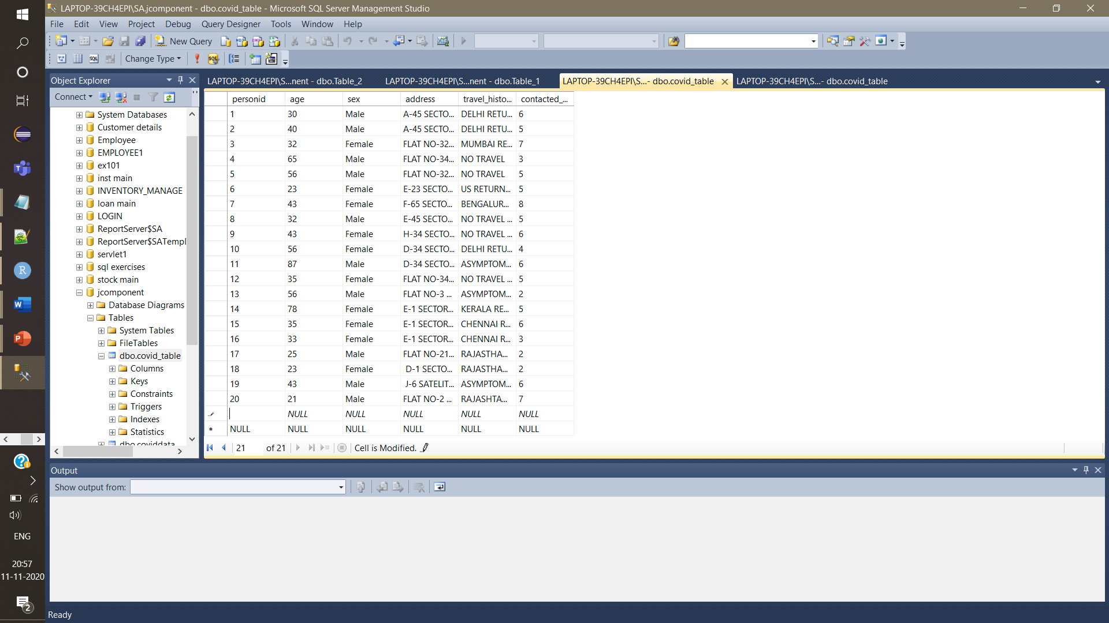
-Dataset-

Slide 11
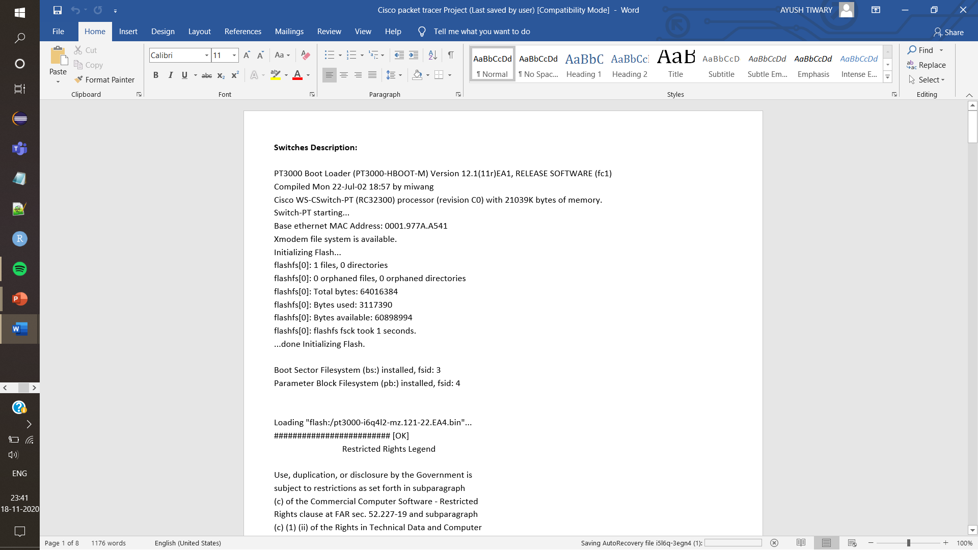
-Coding-

Slide 12
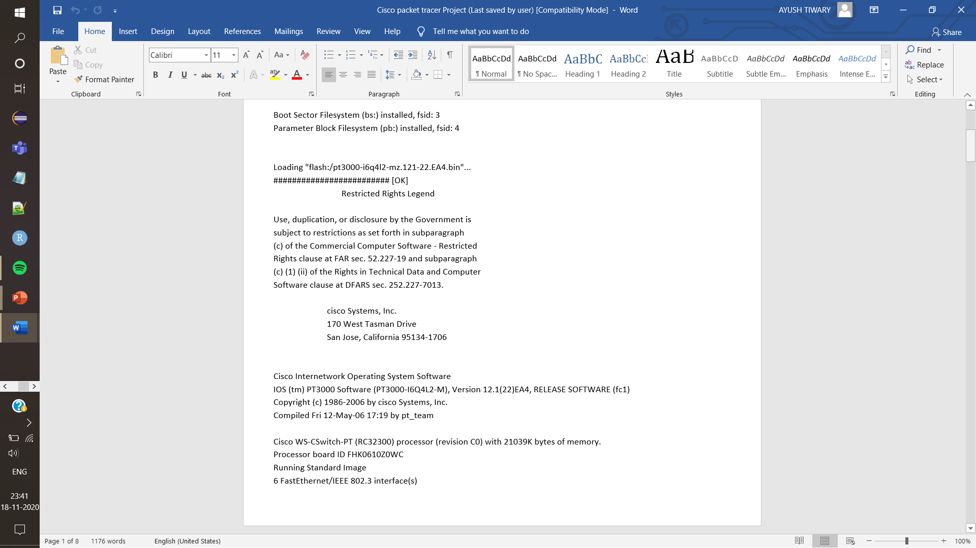

Slide 13
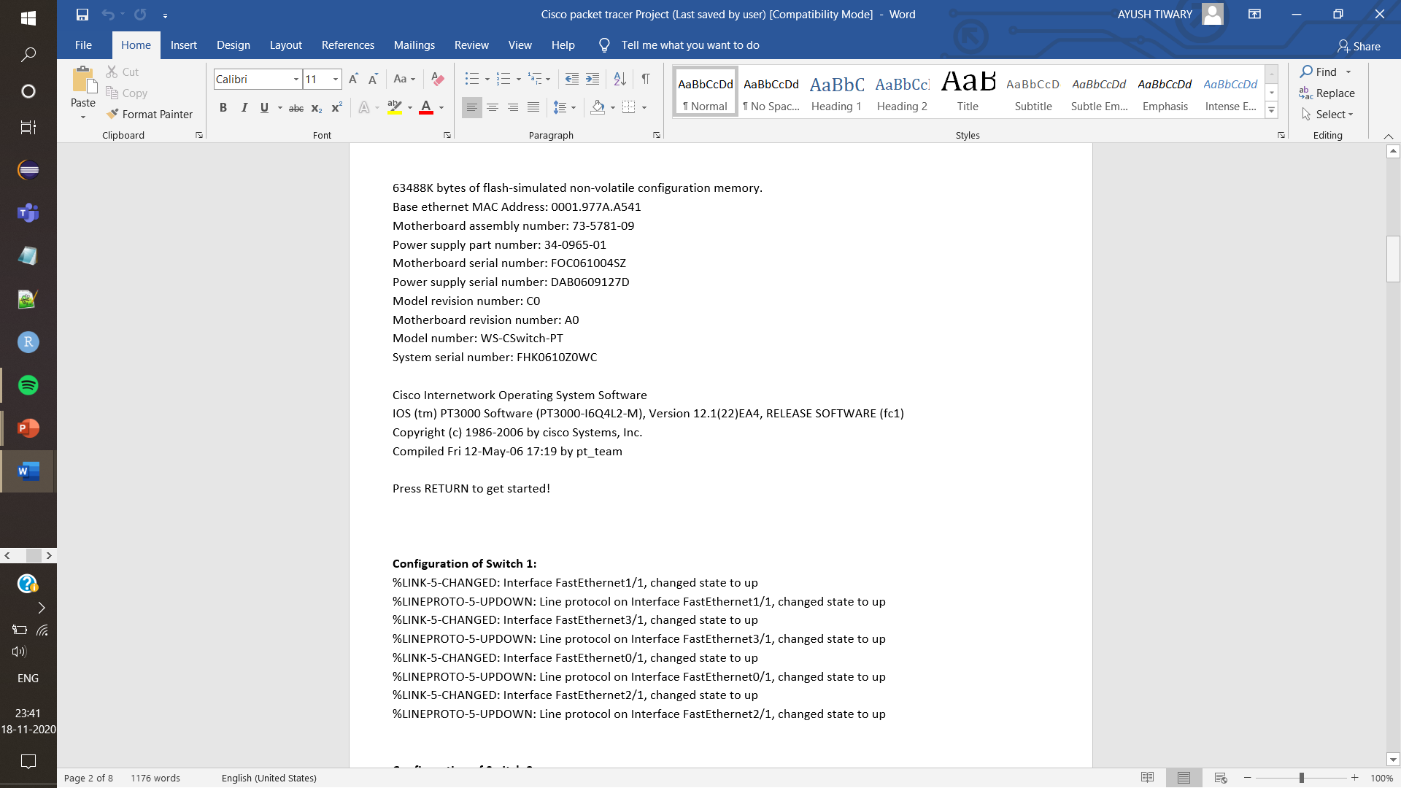

Slide 14
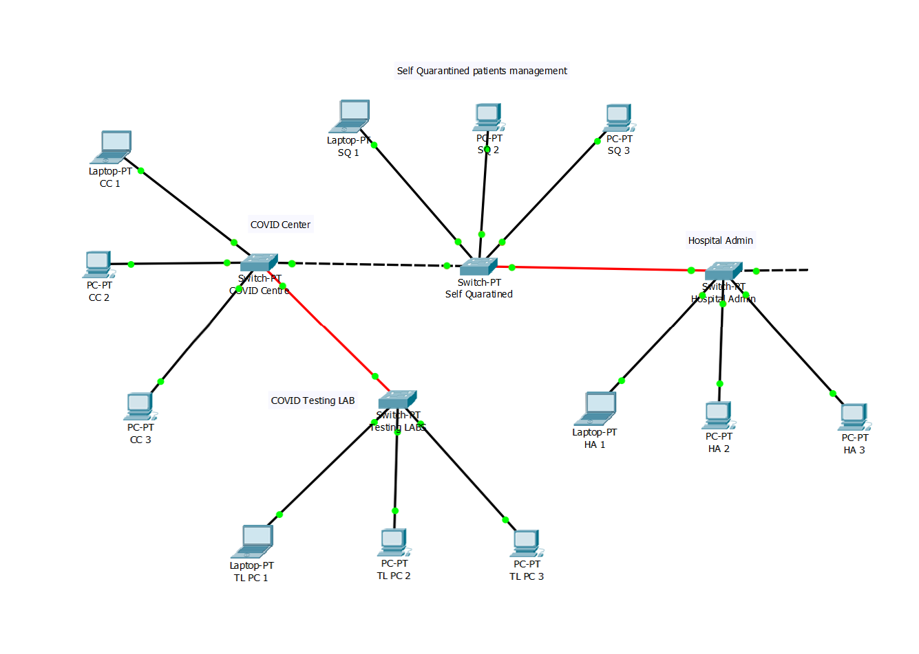
-Snippets-

Slide 15
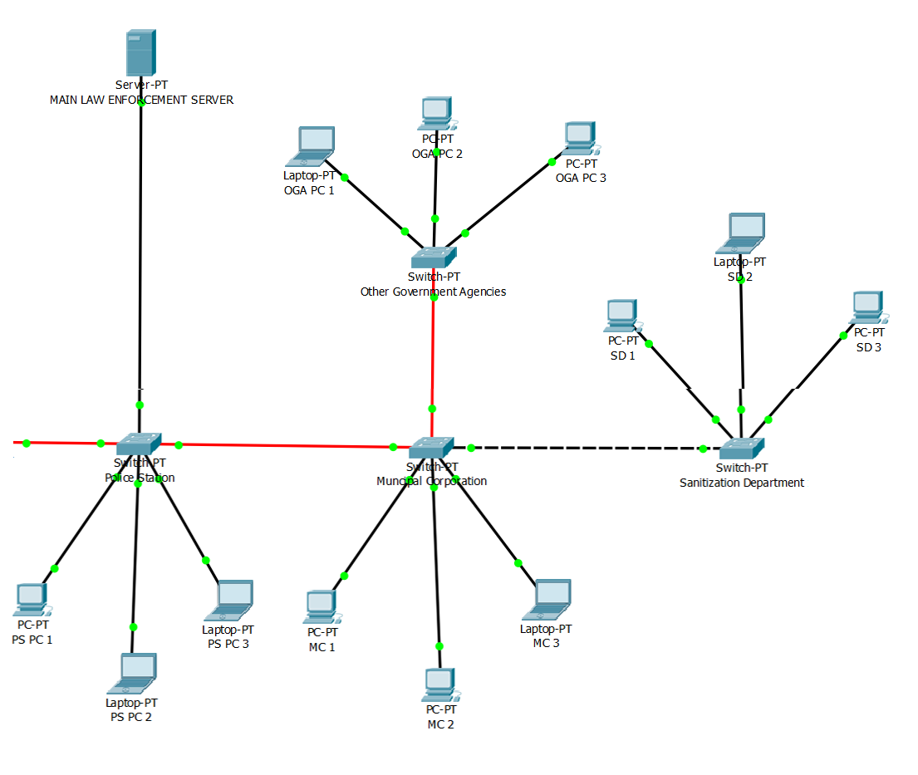

Slide 16
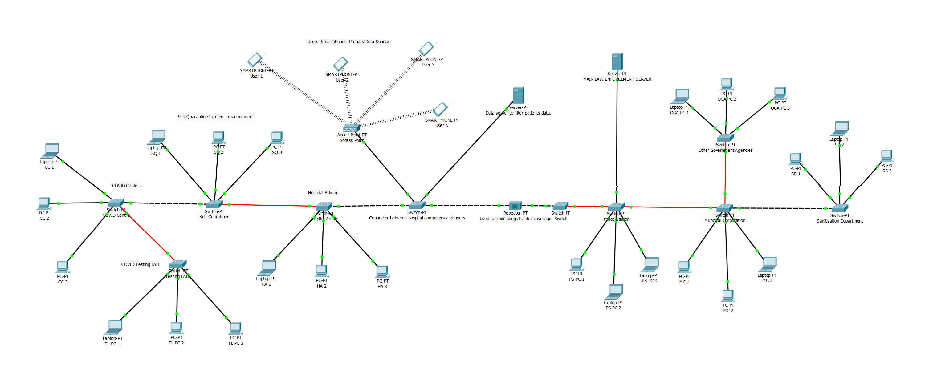

Slide 17
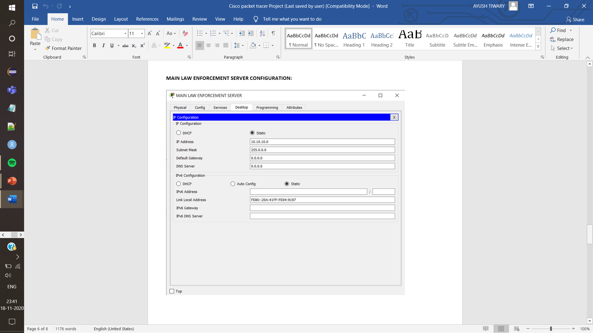

Slide 18
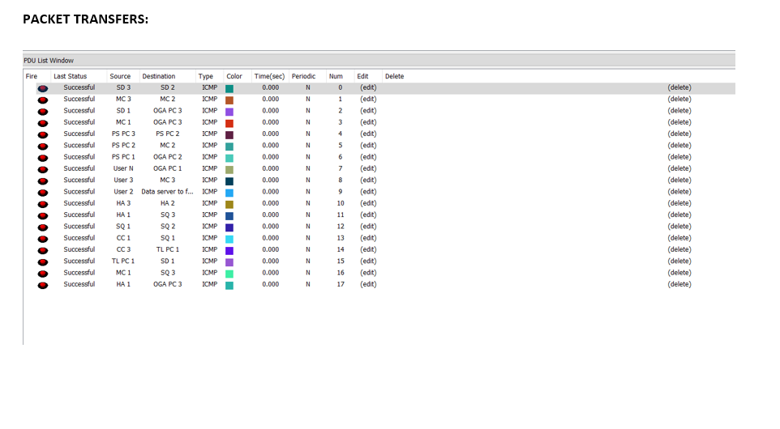

Slide 19
Thank you!

