Slide 1
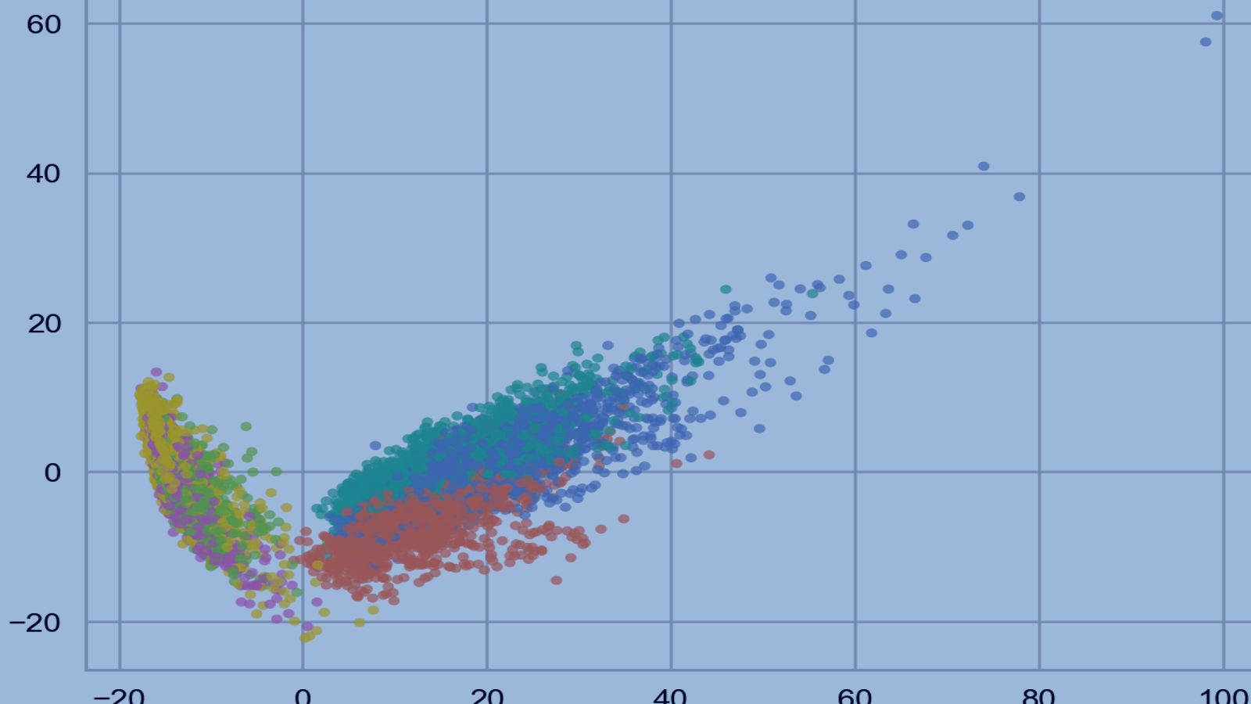
Understanding Human
Activity Patterns with PCA
Dimension reduction in the UCI Human Activity Recognition Using Smartphones dataset
10,299 windows
561 features
6 activities
PCA reduces 561 engineered sensor features to a readable 2D map without throwing away the main structure.
Data Visualization & Data Mining
UCI HAR dataset • PCA / dimension reduction
Notes:
Open with the problem statement: we have thousands of smartphone activity windows, each described by 561 engineered features. The goal is to show how PCA compresses that space into something we can actually see and explain. [Sources] - User-provided notebook: human_activity_pca_analysis.ipynb (title, dataset framing, and PCA scatter output used as background). - Figure asset extracted from notebook output: 2D PCA scatter plot.

Slide 2
Why This Dataset Is a Good PCA Example
Human activity recognition is a realistic, messy sensor problem — and that makes it a strong test case for dimension reduction.
50 Hz
2.56 sec
Each observation is a short smartphone sensor window, not a simple tabular record.
sensor sampling rate
window per row
The feature space is large enough to be hard to interpret directly (561 columns).
30
6
The classes are meaningful and intuitive: walking, stairs, sitting, standing, laying.
volunteers
activity labels
If PCA works here, it gives us a compact view of broad activity structure.
Why PCA matters here
The dataset already contains engineered summaries from accelerometer and gyroscope signals. That means many features are related, partially redundant, and hard to picture mentally — exactly where PCA can help.
Practical goal
Turn a 561-dimensional table into a 2D map that is easy to show live and easy to interpret.
2
Notes:
Use this slide to motivate the problem before showing any formulas or charts. The point is not that PCA magically solves HAR; the point is that it gives a clear exploratory view of a high-dimensional, realistic sensor dataset. [Sources] - User-provided notebook: human_activity_pca_analysis.ipynb (dataset description: 30 volunteers, 50 Hz smartphone sensors, 2.56-second windows, six activities).

Slide 3
What One Row in UCI HAR Represents
Observation unit
10,299
561
One 2.56-second sliding window of smartphone motion data from a Samsung Galaxy S II worn on the waist. The notebook analyzes the engineered feature table, not the raw inertial signal files.
observations
engineered features
30
6
participants
activity classes
Sensor sources
Accelerometer
Gyroscope
Why the feature engineering matters
The 561 columns summarize time-domain behavior, frequency content, jerk, and magnitudes. Those summaries are informative, but they also create a space that is far too wide to visualize directly.
Feature mix
265 time-domain
289 frequency-domain
7 angle
Activities
WALKING
UPSTAIRS
DOWNSTAIRS
SITTING
STANDING
LAYING
3
Notes:
This slide gives the audience a concrete mental model of the dataset. Emphasize that each row is already a processed summary window, so PCA is compressing an engineered feature space rather than raw time series. [Sources] - User-provided notebook: human_activity_pca_analysis.ipynb (dataset overview table and feature group summary).

Slide 4
How the 561 Features Were Built
They are not 561 raw channels. Each 2.56-second window starts with raw accelerometer and gyroscope traces, then the dataset authors engineer multiple derived signals and summarize each one with statistics.
Exact final mix
Raw
Filter
Derive
FFT
Stats
265
time-domain features
accel + gyro
body vs gravity
derived signals
frequency view
window summaries
289
frequency-domain features
7
angle features
One window = 128 samples per sensor axis
Why PCA can compress this
Waist-mounted phone records accelerometer and gyroscope signals at 50 Hz for 2.56 seconds.
Filtering separates body motion from gravity; derivatives and magnitudes create additional signal families.
The final feature table stores summaries of those processed signals, not the raw waveform itself.
Many features are related because they come from the same underlying motion signal.
Multiple statistics describe the same window from different angles, so redundancy builds up.
4

Slide 5
What Some Feature Names Mean
Feature names follow a pattern: domain → signal family → statistic → axis. Once you decode the pieces, the 561 columns become much less mysterious.
How to read one feature
tBodyAcc-mean()-X
tBodyAccJerk-std()-Y
Example:
f
BodyGyro
energy()
Z
Average body acceleration along the X axis during the 2.56-second window.
How much the rate of change of acceleration varies along the Y axis.
f
frequency-domain version of the signal (after FFT)
BodyGyro
body rotation measured by the gyroscope
energy()
total power / intensity over the window
fBodyGyro-energy()-Z
tBodyAccMag-mean()
Z
vertical or spin-related axis
Total rotational power around the Z axis, measured in the frequency domain.
Average overall movement strength; no axis suffix because magnitude already combines X, Y, and Z.
No X/Y/Z suffix
means the feature is a magnitude that already combines axes
Quick dictionary:
t = time
f = FFT
Jerk = Δ signal
Mag = vector norm
5

Slide 6
PCA Compresses the Dataset into a 2D View
The rows stay the same. PCA only changes how many columns we use to describe each window.
Why reduce?
Before PCA
After PCA (2 PCs)
• 561 dimensions cannot be visualized directly
• correlated engineered features make interpretation messy
• a 2D map lets us inspect clusters and overlap live
• PCA is unsupervised, so labels are added afterward to interpret the map
10,299 × 561
10,299 × 2
full standardized feature space
PCA visualization space
same rows
far fewer columns
Column reduction: 561 → 2 (about 280× fewer dimensions)
6
Notes:
This is the clearest way to explain dimension reduction in the notebook: the number of observations never changes, only the feature representation changes. That is what makes the scatter plot possible. [Sources] - User-provided notebook: human_activity_pca_analysis.ipynb (dimension comparison table: original standardized feature space vs PCA visualization space).

Slide 7
The Analytical Question
Can PCA compress the high-dimensional smartphone activity dataset into a small number of components while still preserving enough structure to visually distinguish major human activities?
What we need to check
What we need to see
What we need to interpret
How much variance do the first PCs explain?
Do the six activities form useful patterns in 2D PCA space?
What kinds of activity differences seem to define PC1 and PC2?
This turns the project from “run PCA” into “judge whether the low-dimensional view still tells a meaningful story.”
7
Notes:
Pause here and make the evaluation criteria explicit. The audience should know what success means before the results appear. [Sources] - User-provided notebook: human_activity_pca_analysis.ipynb (analytical question markdown cell).

Slide 8
How We Standardized Before PCA
PCA is scale-sensitive, so the notebook standardizes each feature column independently with StandardScaler before fitting PCA.
Column-wise z-score
Why that matters
zᵢⱼ = (xᵢⱼ − μⱼ) / σⱼ
Feature type
Raw scale
After scaling
PCA impact
Small-range feature
tiny variance
mean 0, std 1
not drowned out
For each feature column j separately:
Compute that column's mean μⱼ and standard deviation σⱼ across all rows.
Subtract μⱼ from every value in the column.
Divide by σⱼ so the transformed column has comparable scale.
Large-range feature
large variance
mean 0, std 1
cannot dominate by scale alone
Comparable footing
No global mean
Notebook check
Important: this is per-feature scaling, not one global mean for the whole matrix.
Every one of the 561 columns is centered and rescaled before PCA.
We do not use one mean/std for the entire matrix because that would let large-range features dominate.
After scaling, the notebook reports an overall mean ≈ 0 and standard deviation ≈ 1.
8

Slide 9
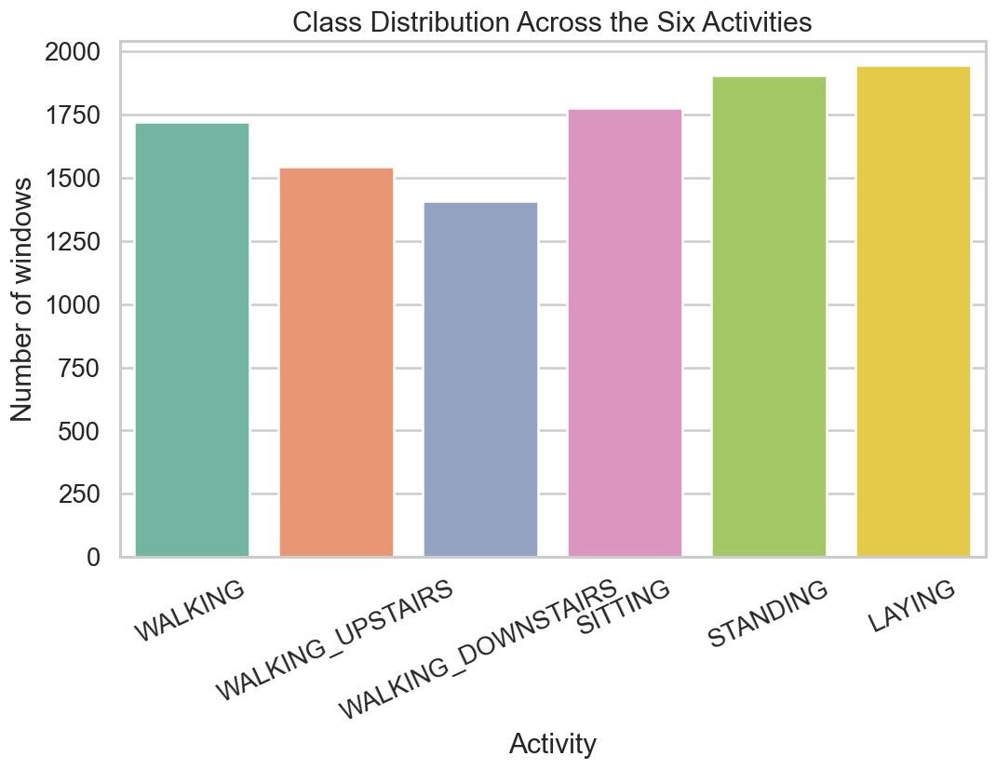
Preparing the Data for PCA
Preprocessing decisions
• merged train and test splits because the goal is exploration, not classifier evaluation
• checked the merged table for missing values (none found)
• kept the six human-readable activity labels
• standardized all 561 numeric features before PCA
Why scale first?
After standardization, the notebook reports mean ≈ 0 and standard deviation ≈ 1 across the scaled matrix, so no feature dominates PCA just because it uses bigger numbers.
Class counts are fairly balanced, so the PCA picture is not being driven by one overwhelmingly large class.
7,352 train rows
2,947 test rows
0 missing values
9
Notes:
Keep this slide practical. The big message is that the notebook used a clean, analysis-ready matrix and standardized it so PCA reflects structure rather than scale artifacts. [Sources] - User-provided notebook: human_activity_pca_analysis.ipynb (initial checks table, scaling check, and class distribution figure).

Slide 10
PCA in Plain English
PCA creates new axes called principal components.
A simple mental model
PC1 is the single direction with the most variation in the dataset.
Think of PCA as turning the camera so the data cloud is viewed from the most informative angle.
PC2
PC1
PC2 captures the next biggest pattern while staying different from PC1.
Using only the first two PCs gives a simplified map that humans can actually see.
2D view
Important limit
A 2D PCA plot is a summary for visualization. It keeps the biggest broad patterns, not every detail in the original 561-feature space.
10
Notes:
This is the intuition slide. Keep it light: PCA rotates the data to find informative directions, and the first two components are used because they make a readable picture, not because they capture everything. [Sources] - User-provided notebook: human_activity_pca_analysis.ipynb (plain-English PCA explanation and standardization rationale).

Slide 11
From Sensor Windows to a PCA Map
The raw signals were already turned into engineered features. This notebook starts from that table, scales it, then projects it into a smaller coordinate system.
Sensor windows
561 engineered
features
Standardize
Fit PCA
2D PCA scores
Visual
interpretation
Notebook starting point
Transformation
Output
Merged train + test table with labels and subject IDs attached.
StandardScaler puts every feature on the same footing before PCA is fit.
Two PCA coordinates per row, used for variance diagnostics and the main scatter plot.
11
Notes:
This workflow slide helps the audience see the full pipeline at a glance. It also reinforces that the project starts after feature engineering, not before it. [Sources] - User-provided notebook: human_activity_pca_analysis.ipynb (pipeline summary markdown and preprocessing/PCA steps).

Slide 12
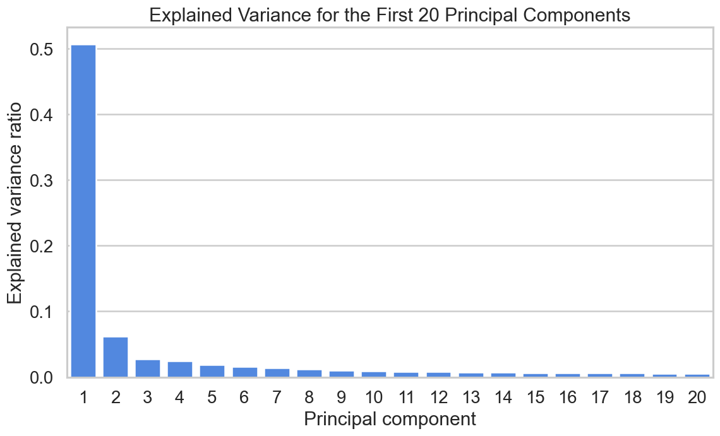
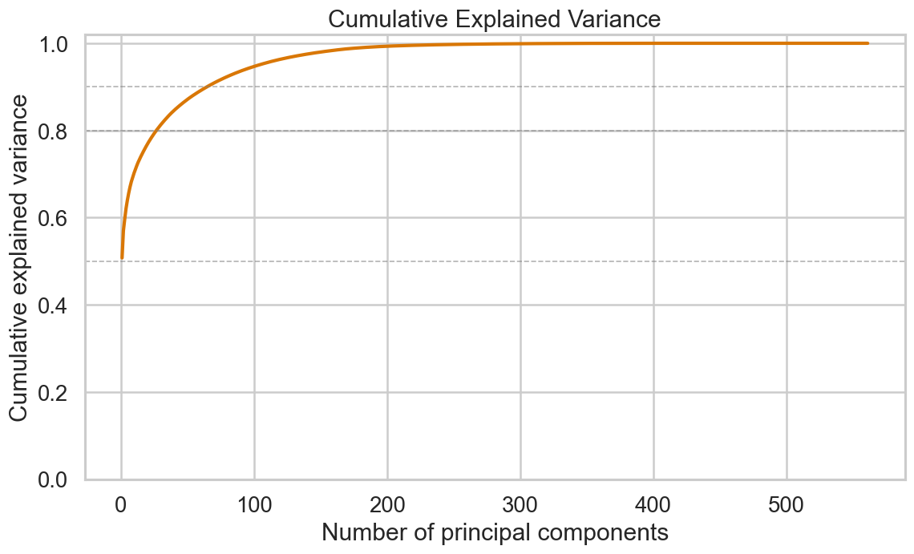
Most Variation Is Captured Early — But Not All in 2 PCs
How to read the plots
Key numbers
Interpretation
2 PCs → 56.98%
90% variance → 65 PCs
95% variance → 104 PCs
PC1 alone explains 50.7% of the variance, and PC2 raises the cumulative total to 57.0%. After that, each added component contributes less.
Two PCs are enough for visualization, but not enough if the goal is to retain almost all original information. The elbow-shaped curve shows diminishing returns after the first few PCs.
12
Notes:
This slide explains the compression tradeoff. The first two components are genuinely informative here, but the notebook also shows that a faithful high-variance representation still needs many more PCs. [Sources] - User-provided notebook: human_activity_pca_analysis.ipynb (explained variance plots, component variance summary, and variance target summary).

Slide 13
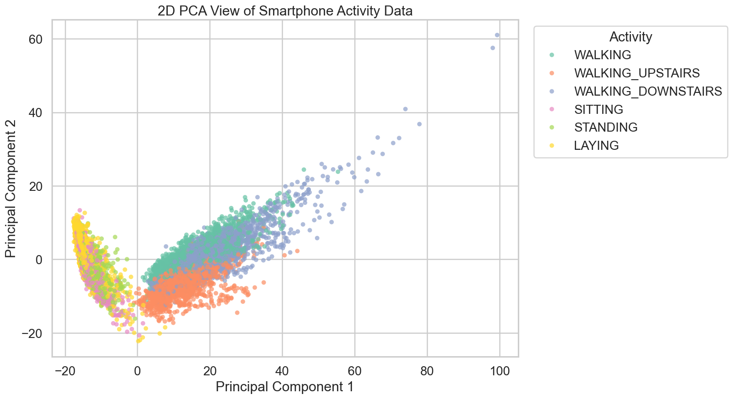
Broad Activity Patterns Emerge in PCA Space
PC1 cleanly splits moving vs mostly stationary windows, so movement intensity drives the first axis
Walking upstairs drops lower on PC2, indicating a distinct motion style even within walking
Sitting and standing overlap the most, which is why they are hardest to separate in 2D
13
Notes:
Let the audience look at the plot. The main story is that PCA preserves a broad motion-vs-posture split. The fine-grained story is weaker: similar stationary activities still overlap. [Sources] - User-provided notebook: human_activity_pca_analysis.ipynb (2D PCA scatter plot with activity labels).

Slide 14
Interpreting PC1 and PC2 in Plain English
Grouped loading summary (top 40 absolute loadings)
PC1: a broad movement-intensity axis
Component | Dominant signal | Dominant style
PC1 | Body acceleration (75.0%) | Magnitude / intensity (75.1%)
PC2 | Gyroscope (35.6%) | Frequency / coefficient pattern (93.5%)
Average PC1 for the three walking classes is +17.3, versus −14.1 for the mostly stationary classes. The notebook’s grouped loadings say PC1 is dominated by body-acceleration and overall-intensity features.
Activity centroids in the 2D PCA space
Activity | Mean PC1 | Mean PC2
LAYING | -14.56 | 2.13
SITTING | -14.23 | 0.83
STANDING | -13.63 | -0.19
WALKING | 15.82 | 1.24
WALKING_DOWNSTAIRS | 23.32 | 2.13
WALKING_UPSTAIRS | 12.65 | -6.72
PC2: a finer movement-style axis
WALKING_UPSTAIRS has a much lower mean PC2 (−6.7) than WALKING and WALKING_DOWNSTAIRS together (+1.7). PC2 leans more on time-domain gyroscope and frequency/coefficient-style features.
14
Notes:
This is the interpretation slide. Stay honest: these are useful, defensible labels for the first two PCs, not perfect semantic truths. The centroid table and grouped loading summaries are the notebook’s evidence for those labels. [Sources] - User-provided notebook: human_activity_pca_analysis.ipynb (component profile table, activity centroid table, and interpretation markdown based on grouped loadings and class centroids).

Slide 15
Answer to the Question: Yes — With Clear Limits
What PCA does well here
What PCA does not solve
Compresses 561 features into a 2D picture that is easy to explain.
Two PCs still leave out 43% of the variance.
Preserves the broad split between dynamic movement and posture-based activities.
SITTING and STANDING overlap, so separation is not perfect.
Shows that different walking styles are related, but not identical.
PCA is linear, so curved or more complex structure can be missed.
Works well as an exploratory and communication tool.
PCA is not a classifier; it summarizes structure but does not assign labels by itself.
Best use case here: structure discovery and visualization, not final decision-making on its own
15
Notes:
This is the honest conclusion slide. PCA clearly works for structure discovery in this notebook, but the overlap and the variance tradeoff show why a 2D view is not the whole story. [Sources] - User-provided notebook: human_activity_pca_analysis.ipynb (final interpretation and limitation sections, variance summary, and PCA scatter plot interpretation).

Slide 16
Takeaway
1. The dataset
UCI HAR converts short smartphone sensor windows into 561 engineered motion features.
2. The method
Standardization + PCA turns that high-dimensional feature space into a much smaller coordinate system.
3. The result
In 2D, PCA preserves a strong movement-versus-posture split and reveals meaningful activity structure.
4. The lesson
PCA is excellent for visualization and intuition building, but finer separation still needs more dimensions or a predictive model.
Questions?
16
Notes:
Close by connecting the method back to the analytical goal: PCA did what we needed for communication and broad structure discovery, while also showing its own limits. [Sources] - User-provided notebook: human_activity_pca_analysis.ipynb (overall takeaway and limitations sections).

Slide 17
Appendix: Strongest Raw Feature Loadings
These raw feature names are not needed for the main story, but they are useful if you want to discuss exactly which engineered features influence PC1 and PC2 most strongly.
Top 10 loadings for PC1
Top 10 loadings for PC2
Feature | |loading|
fBodyAcc-sma() | 0.0586
fBodyAccJerk-sma() | 0.0586
fBodyGyro-sma() | 0.0586
tBodyAccJerk-sma() | 0.0585
tBodyAccJerkMag-mean() | 0.0585
tBodyAccJerkMag-sma() | 0.0585
fBodyBodyAccJerkMag-mean() | 0.0581
fBodyBodyAccJerkMag-sma() | 0.0581
tBodyAccJerkMag-mad() | 0.0580
tBodyAccJerkMag-std() | 0.0580
Feature | |loading|
fBodyAcc-meanFreq()-Z | 0.1244
tBodyGyroMag-arCoeff()1 | 0.1206
fBodyAccMag-meanFreq() | 0.1197
tGravityAcc-arCoeff()-Z,1 | 0.1196
tBodyAccMag-arCoeff()1 | 0.1195
tGravityAccMag-arCoeff()1 | 0.1195
tGravityAcc-arCoeff()-Z,2 | 0.1193
tGravityAcc-arCoeff()-Z,3 | 0.1176
tGravityAcc-arCoeff()-Z,4 | 0.1144
tBodyGyroMag-arCoeff()2 | 0.1128
Appendix
17
Notes:
Appendix slide for technical discussion. These are the top absolute loadings reported by the notebook for PC1 and PC2. [Sources] - User-provided notebook: human_activity_pca_analysis.ipynb (optional appendix: raw top-loading features table).

