Slide 1
PCA Across Three Sampling Regimes
on the UCI HAR Dataset
Full dataset
10,299 × 561
n > p
Reference baseline
Comparing a full n > p setting with two 500-row p > n subsets - and showing why sampling strategy matters as much as dimensionality.
First 500 rows
500 × 561
p > n
Only 2 subjects
Full dataset
First 500 rows
Random 500 rows
UCI Human Activity Recognition (HAR)
10,299 rows × 561 features
6 activities, 30 subjects
Random 500 rows
500 × 561
p > n
30 subjects covered
Core question:
If PCA changes, is it because of p > n - or because the sample itself is biased?
1
Notes:
[Sources] - Uploaded notebook: human_activity_pca_high_dimensional_comparison.ipynb - All values, conclusions, and adapted figures in this slide were taken from or derived directly from the notebook outputs. - Title framing adapted from notebook Sections 1, 2, 10, and 11. [/Sources]

Slide 2
Why this comparison matters
PCA is not just about the algorithm; it is also about the data you feed into it.
HAR data has many features, so direct visualization is hard.
PCA reduces many correlated variables into a smaller set of components.
We often look at PC1 and PC2 to get a 2D picture of high-dimensional structure.
But PCA results can change when the sample size changes and when the subset is not representative.
Same algorithm
Different data shape
Different coverage
PCA
n > p vs p > n
biased vs broader sample
We are asking: how much of the PCA story is dimensionality, and how much is sampling?
2
Notes:
[Sources] - Uploaded notebook: human_activity_pca_high_dimensional_comparison.ipynb - All values, conclusions, and adapted figures in this slide were taken from or derived directly from the notebook outputs. - Motivation adapted from notebook Sections 1 and 11. [/Sources]

Slide 3
Dataset overview
UCI Human Activity Recognition using Smartphones
Rows
10,299 observation
windows
Feature engineering
Activity label
Features
561 engineered
numeric signals
Sensor
window
Time-domain + frequency-domain summaries
561 features
Subject ID
Labels
6 activities
Subjects
30 volunteers
Each row is one window of phone-sensor data, summarized into 561 numbers.
Activities
Walking, Walking Upstairs,
Walking Downstairs,
Sitting, Standing, Laying
3
Notes:
[Sources] - Uploaded notebook: human_activity_pca_high_dimensional_comparison.ipynb - All values, conclusions, and adapted figures in this slide were taken from or derived directly from the notebook outputs. - Dataset facts adapted from notebook Section 2 and dataset checks table. [/Sources]

Slide 4
Quick refresher: what PCA does
Keep the intuition simple: PCA finds the strongest patterns of variation.
PCA rotates the feature space into new orthogonal directions called principal components.
PC1 captures the largest remaining variance; PC2 captures the next largest, and so on.
Using only the first 2 PCs gives a simplified view of a much larger feature space.
PC1
most
variance
Many
correlated
features
PCA
PC2
next
variance
4
Notes:
[Sources] - Uploaded notebook: human_activity_pca_high_dimensional_comparison.ipynb - All values, conclusions, and adapted figures in this slide were taken from or derived directly from the notebook outputs. - PCA explanation adapted from notebook Sections 4 and 5. [/Sources]

Slide 5
What high-dimensional means here
The key comparison is between n > p and p > n.
Full dataset
500-row subsets
n = 10,299 rows
p = 561 features
So n > p
n = 500 rows
p = 561 features
So p > n
PCA can use the full 561-dimensional feature space after standardization.
After centering, PCA can have at most min(n − 1, p) = 499 non-zero PCs.
Non-zero PC cap: 561
Forced zero directions: 62
Why this matters: both 500-row subsets share the same mathematical rank limit, so if their PCA results differ, dimensionality alone cannot explain the difference.
5
Notes:
[Sources] - Uploaded notebook: human_activity_pca_high_dimensional_comparison.ipynb - All values, conclusions, and adapted figures in this slide were taken from or derived directly from the notebook outputs. - Dimensionality and rank-limit facts adapted from notebook Sections 5, 10, and 11. [/Sources]

Slide 6
Experimental setup: the three scenarios
Same dataset family, same preprocessing logic, different sample definitions.
1. Full dataset
2. First 500 rows
3. Random 500 rows
10,299 × 561
n > p
500 × 561
p > n
500 × 561
p > n
Selection rule
Selection rule
Selection rule
All rows from merged train + test HAR table
Take the first 500 rows in row order
Random 500-row sample
(random_state = 42)
30 subjects
train + test
reference baseline
2 subjects only
train only
order-dependent
30 subjects
352 train + 148 test
broader coverage
The critical comparison is not just “full vs small”; it is “small but biased” vs “small but more representative.”
6
Notes:
[Sources] - Uploaded notebook: human_activity_pca_high_dimensional_comparison.ipynb - All values, conclusions, and adapted figures in this slide were taken from or derived directly from the notebook outputs. - Scenario definitions adapted from notebook Section 2 and dataset summary tables. [/Sources]

Slide 7
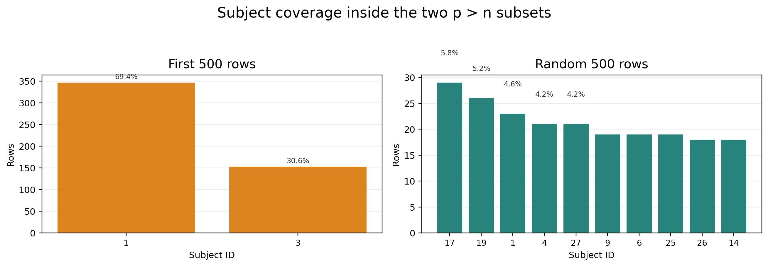
Why the “first 500 rows” subset is risky
It is a real p > n example - but not a neutral one.
The first 500 rows are selected by row order, not by representativeness.
They contain only 2 subjects, while the random 500-row sample covers all 30 subjects.
One subject contributes 69.4% of the first-500 subset.
The top two subjects together account for 100.0% of that subset.
So differences from the full dataset are partly about narrow subject coverage - not just about p > n.
2 subjects
69.4% one subject
100% top two
Subject concentration is the warning sign: the first 500 rows are dominated by just two people, while the random 500 rows are spread across many subjects.
7
Notes:
[Sources] - Uploaded notebook: human_activity_pca_high_dimensional_comparison.ipynb - All values, conclusions, and adapted figures in this slide were taken from or derived directly from the notebook outputs. - Representativeness warning adapted from notebook Section 3 and subject coverage outputs. [/Sources]

Slide 8
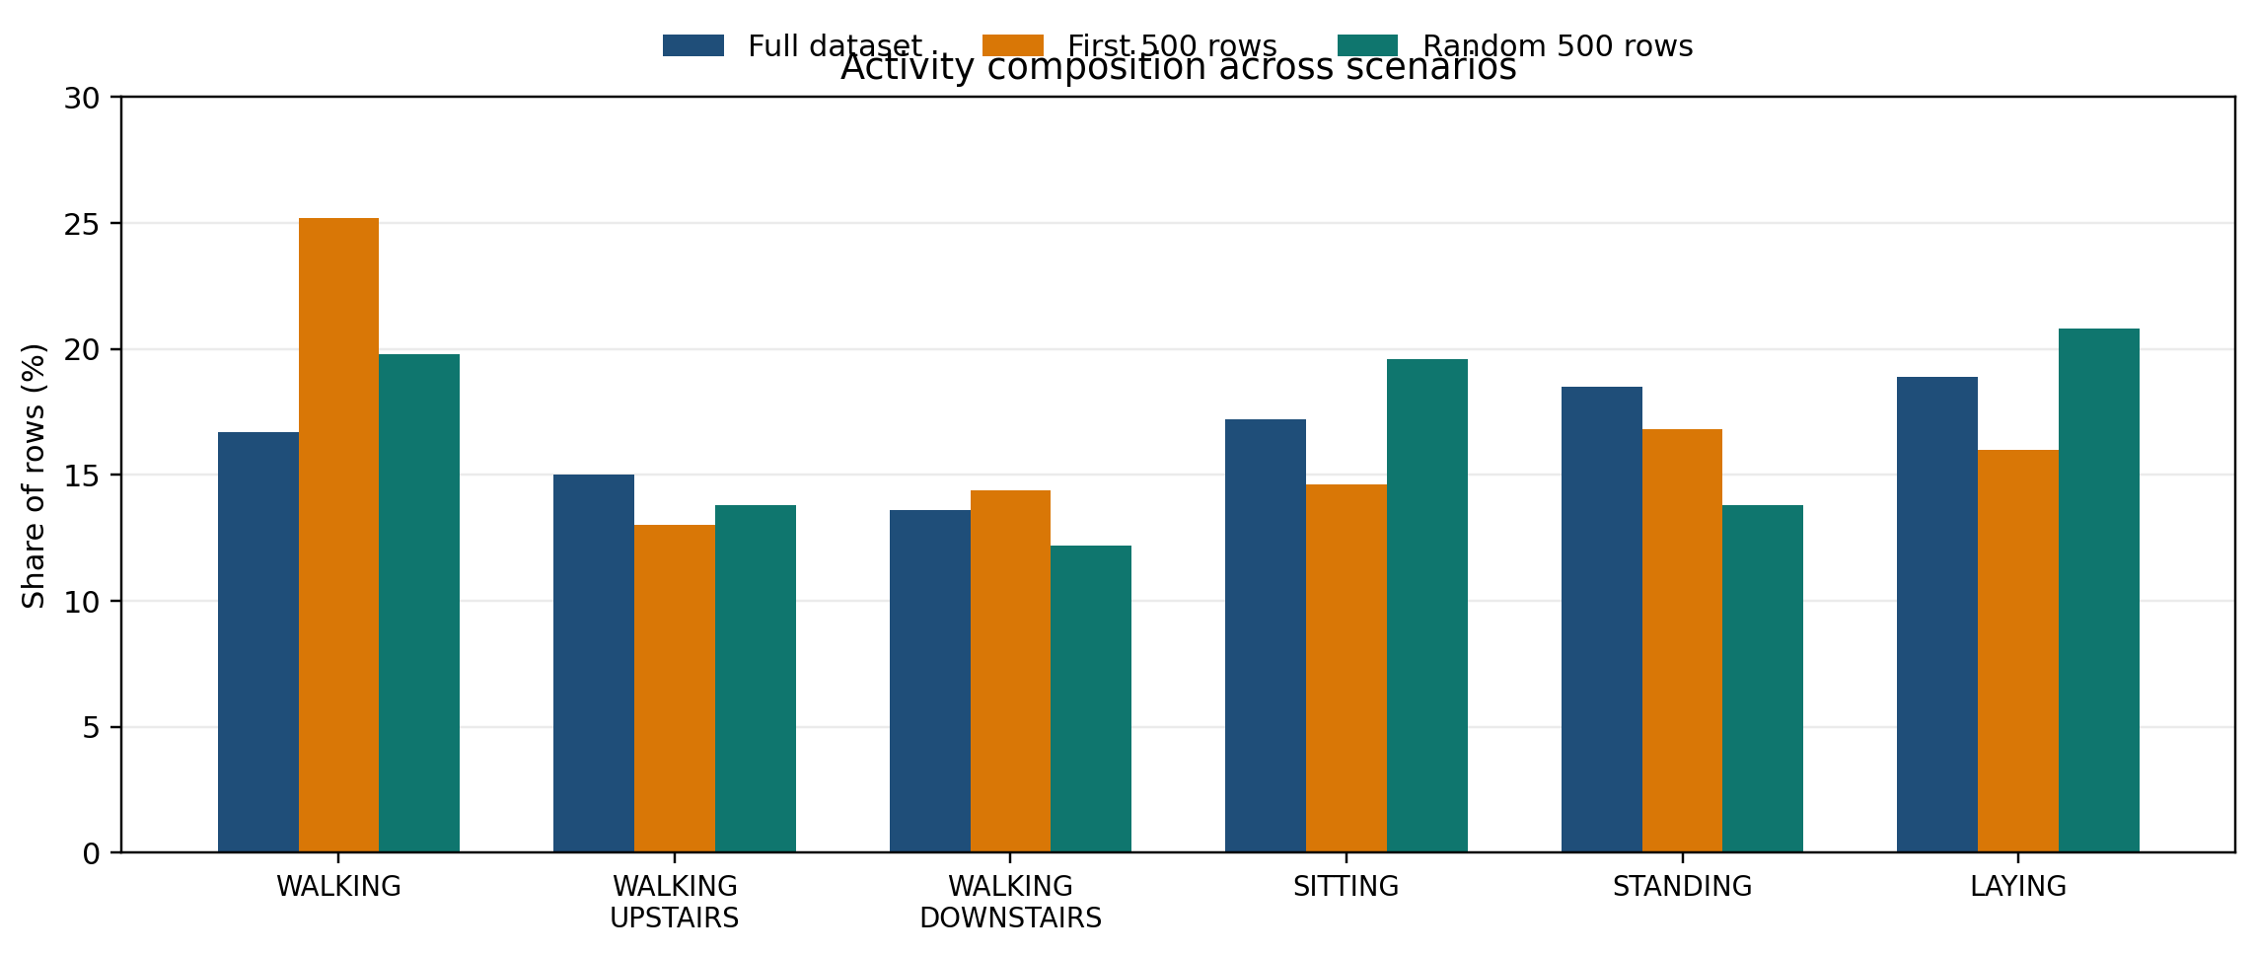
Subject and activity composition across scenarios
This slide separates subject coverage from activity balance.
Subject composition summary
Metric
Full
First 500
Random 500
Unique subjects
30
2
30
Dominant subject share
4.0%
69.4%
5.8%
Top-two subject share
7.9%
100.0%
11.0%
Train / test rows
7352 / 2947
500 / 0
352 / 148
Activity classes present
6
6
6
The big distortion is subject coverage, not the number of activity classes: all three scenarios still contain all 6 activities.
Activity share changes exist, but they are much less dramatic than the subject imbalance in the first-500 subset.
8
Notes:
[Sources] - Uploaded notebook: human_activity_pca_high_dimensional_comparison.ipynb - All values, conclusions, and adapted figures in this slide were taken from or derived directly from the notebook outputs. - Subject concentration and activity composition adapted from notebook Section 3 tables. [/Sources]

Slide 9
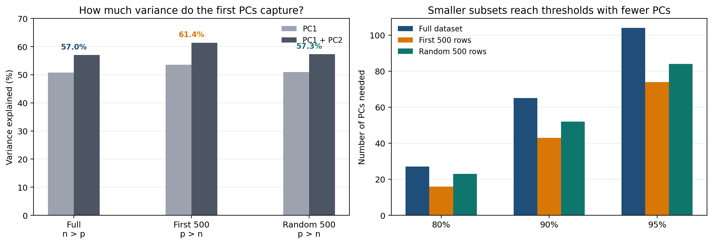
Variance explained comparison
What fraction of the standardized feature-space variance is captured by the leading PCs?
Exact values from the notebook
PC1 explains 50.74% (full), 53.59% (first 500), and 50.94% (random 500).
PC1 + PC2 explain 56.98%, 61.41%, and 57.28%, respectively.
PCs needed for 95% variance: 104 (full), 74 (first 500), 84 (random 500).
The first-500 slice compresses variance fastest, but the random 500-row sample stays much closer to the full dataset.
Interpretation: faster variance concentration in the first-500 slice is not just a p > n effect; narrower coverage is part of the story.
9
Notes:
[Sources] - Uploaded notebook: human_activity_pca_high_dimensional_comparison.ipynb - All values, conclusions, and adapted figures in this slide were taken from or derived directly from the notebook outputs. - Variance values adapted from notebook Section 6. [/Sources]

Slide 10
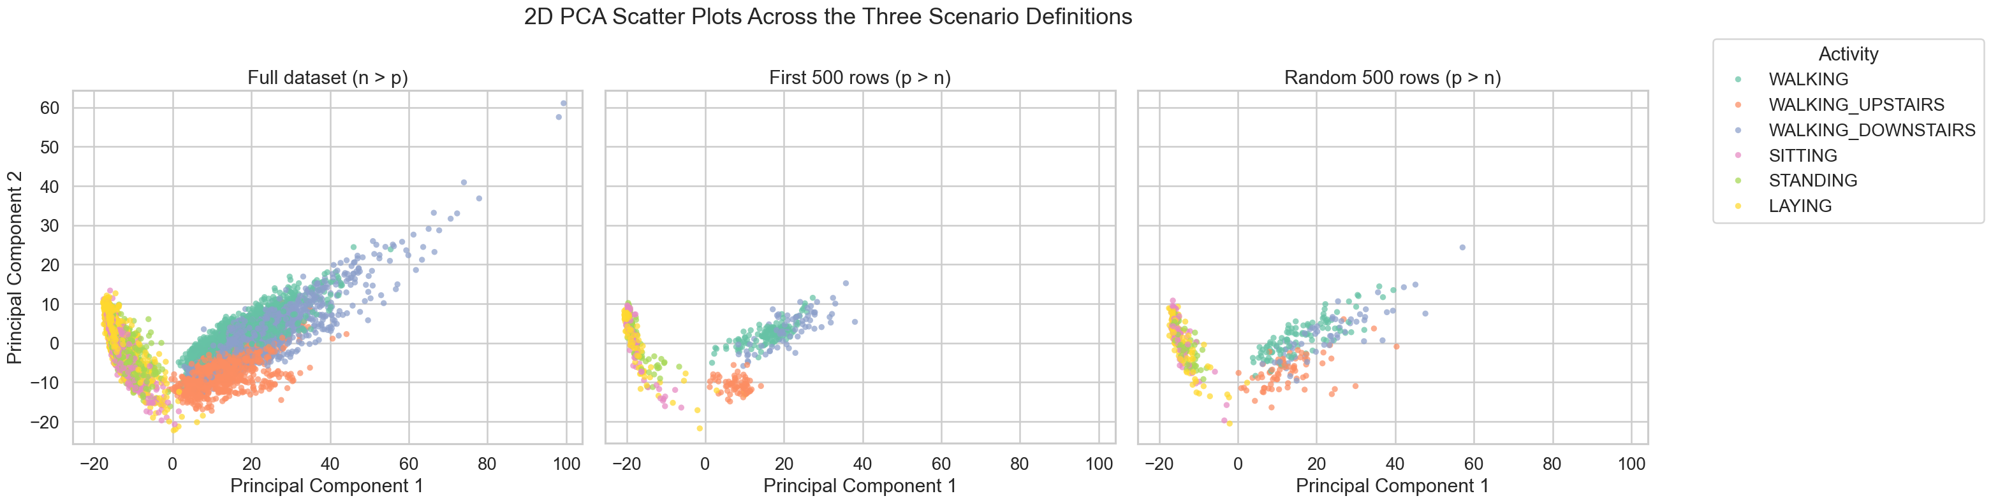
2D PCA scatter plots: visual comparison
Same plotting pipeline, same activity color legend, three different scenario definitions.
10
Notes:
[Sources] - Uploaded notebook: human_activity_pca_high_dimensional_comparison.ipynb - All values, conclusions, and adapted figures in this slide were taken from or derived directly from the notebook outputs. - Scatter plot figure reused from notebook Section 7. [/Sources]

Slide 11
How to interpret the scatter plots responsibly
The visual comparison is useful, but it has to be read carefully.
Reasonable conclusions
What not to conclude
In all three scenarios, PC1 broadly separates dynamic activities from postural ones.
The three walking classes show partial separation along PC2, but they still overlap.
The random 500-row sample preserves the overall full-dataset geometry reasonably well.
WALKING_UPSTAIRS remains somewhat distinct along PC2 relative to the other walking classes.
The full dataset shows more spread and overlap, which is a more realistic summary of the data.
A cleaner-looking first-500 plot does not mean it is the best PCA result.
Better visual separation does not automatically imply better generalizability.
Because the first-500 subset is biased, its neatness can be a sample-selection artifact.
Representativeness matters more than visual neatness.
11
Notes:
[Sources] - Uploaded notebook: human_activity_pca_high_dimensional_comparison.ipynb - All values, conclusions, and adapted figures in this slide were taken from or derived directly from the notebook outputs. - Interpretation adapted from notebook Sections 7, 9, 10, and 11. [/Sources]

Slide 12
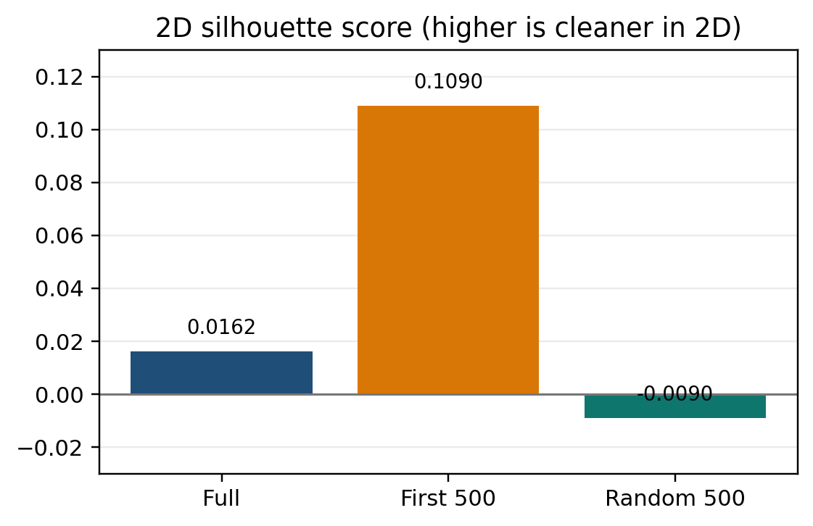
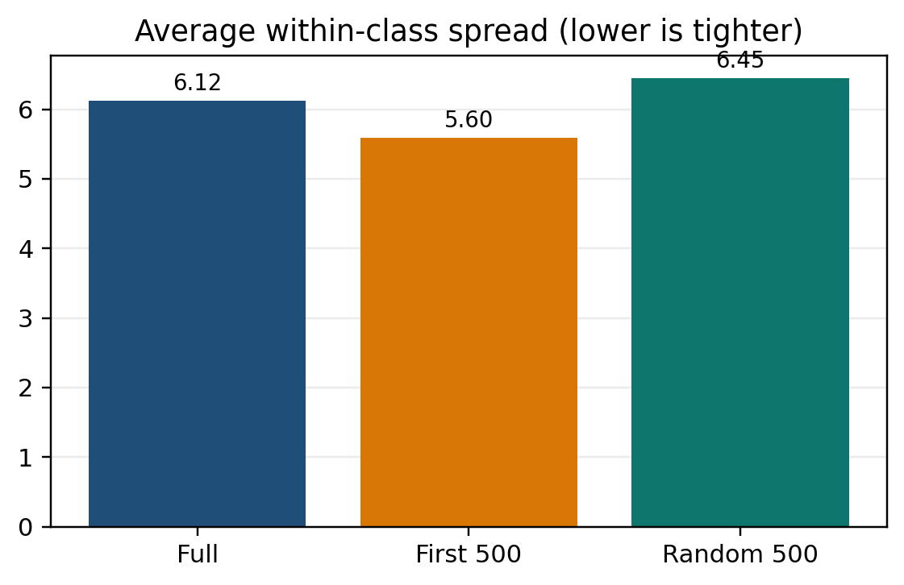
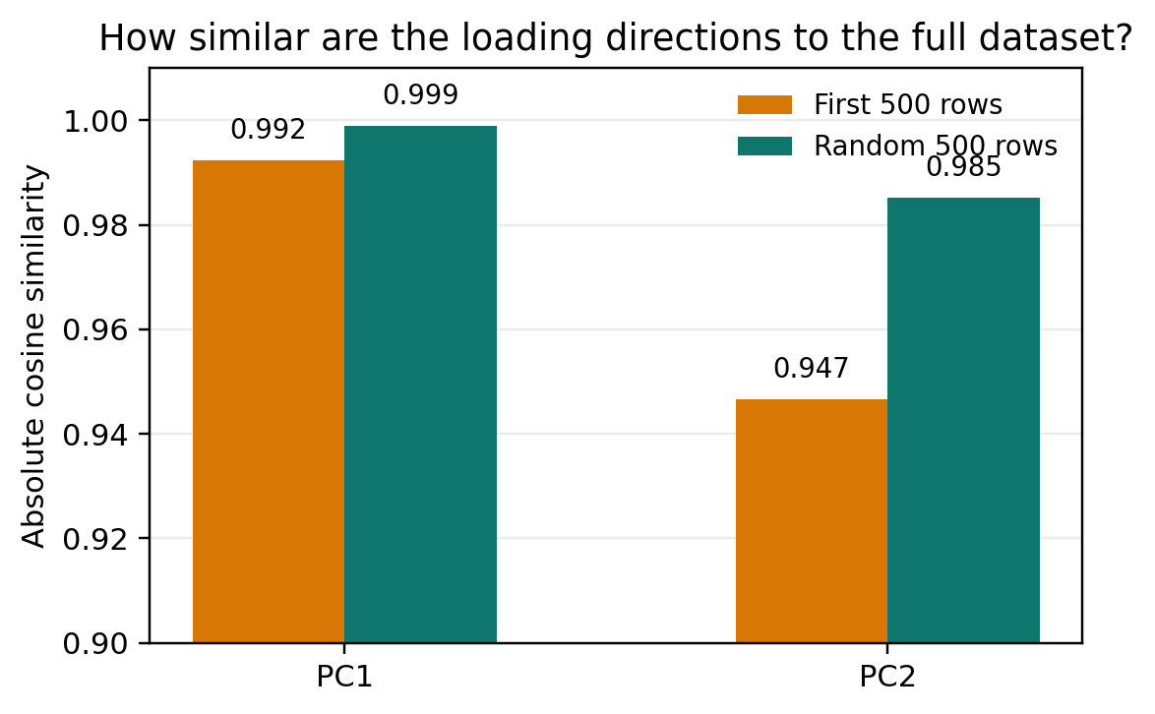
Additional quantitative comparison
These metrics help support the visual story, but they should still be interpreted carefully.
First 500 looks cleanest in 2D
First 500 is tightest in 2D
Random 500 matches full loadings better
Together, these metrics support the notebook’s main caution: the first-500 subset looks cleaner, but the random 500-row sample is the more defensible p > n comparison because it preserves the broader PCA interpretation better.
12
Notes:
[Sources] - Uploaded notebook: human_activity_pca_high_dimensional_comparison.ipynb - All values, conclusions, and adapted figures in this slide were taken from or derived directly from the notebook outputs. - Quantitative metrics adapted from notebook Sections 7 and 9. [/Sources]

Slide 13
Key takeaways
This is the main message of the comparison.
Dimensionality matters
Sampling matters just as much
1
2
Moving from n > p to p > n changes the rank structure of PCA. Both 500-row subsets are capped at 499 non-zero PCs and force 62 directions to zero.
The first 500 rows and random 500 rows have the same 500 × 561 shape, but very different subject coverage and representativeness.
Naive top-slice subsets can mislead
Random sampling is the fairer teaching example
3
4
The first-500 subset is dominated by only 2 subjects, so its cleaner PCA picture is not a safe basis for general conclusions.
The random 500-row sample is still p > n, but it covers 30 subjects and stays closer to the full dataset on variance structure and loading interpretation.
13
Notes:
[Sources] - Uploaded notebook: human_activity_pca_high_dimensional_comparison.ipynb - All values, conclusions, and adapted figures in this slide were taken from or derived directly from the notebook outputs. - Takeaways adapted from notebook Sections 10 and 11. [/Sources]

Slide 14
Limitations and fair interpretation
The notebook makes a strong teaching point, but it is still an exploratory comparison.
What this comparison does show
What it does not prove
A p > n setting changes the PCA geometry and variance profile.
A biased subset can look cleaner than a broader subset.
Representativeness strongly affects how convincing a PCA summary looks.
One random 500-row sample is informative, but it is not the only possible random sample.
A 2D PCA plot does not capture all 561-feature structure.
This is exploratory evidence, not a claim that PCA perfectly separates HAR activities.
Honest conclusion: the notebook supports a careful methodological lesson, not an overconfident claim.
14
Notes:
[Sources] - Uploaded notebook: human_activity_pca_high_dimensional_comparison.ipynb - All values, conclusions, and adapted figures in this slide were taken from or derived directly from the notebook outputs. - Limitations adapted from notebook Section 11 and the notebook framing overall. [/Sources]

Slide 15
Final conclusion
For this HAR example, the best teaching lesson is not “PCA works better on small subsets.”
It is “PCA results depend on both dimensionality and representativeness.”
Remember these three points
Both 500-row cases are p > n.
Only the first 500 rows are severely biased.
Random 500 is the fairer comparison to the full dataset.
So if a classmate asks which p > n example is more trustworthy, the answer is not the one that looks neatest — it is the one that samples the dataset more fairly.
Questions?
Thank you
15
Notes:
[Sources] - Uploaded notebook: human_activity_pca_high_dimensional_comparison.ipynb - All values, conclusions, and adapted figures in this slide were taken from or derived directly from the notebook outputs. - Final conclusion adapted from notebook Sections 10 and 11. [/Sources]

