Slide 1
URL
Malicious URL Dataset
Analysis
An improved presentation built from the notebook workflow: acquisition, understanding, cleaning, exploratory analysis, and statistical interpretation.
Dataset source: Kaggle • sid321axn/malicious-urls-dataset
1
Notes:
[Sources] - User notebook: /mnt/data/file1.ipynb (cells 0-5, 33) - Existing presentation: /mnt/data/MaliciousURL_Analysis.pptx - Kaggle dataset reference noted in the notebook: https://www.kaggle.com/datasets/sid321axn/malicious-urls-dataset

Slide 2
01 / OVERVIEW
What this analysis is doing
Goal: find interpretable URL-text signals before jumping into modeling.
651,191 raw URLs → 640,792 cleaned URLs → 4 final labels
The notebook follows a full, reproducible analysis path: document provenance, understand the raw data, clean it conservatively, explore patterns, and then interpret which results are stable versus fragile.
1
2
3
4
5
Acquire
Understand
Clean
Explore
Interpret
Document source, path, size, and file hash.
Check schema, balance, length, and schemes.
Remove malformed, duplicate, and conflicting rows.
Inspect lexical features, tokens, and domain structure.
Use robust summaries, variability, and uncertainty.
•
Reproducibility is part of the analysis, not an afterthought.
•
The goal here is insight discovery and interpretation—not a finished production detector.
Malicious URL Dataset Analysis
2
Notes:
[Sources] - User notebook: /mnt/data/file1.ipynb (cells 0-6, 12-16, 24-33) - Existing presentation: /mnt/data/MaliciousURL_Analysis.pptx

Slide 3
02 / DATA
Where the dataset came from and what the labels mean
Kaggle hosts a merged table built from several upstream security feeds.
Upstream sources
Labels used in the analysis
ISCX-URL-2016
Benign
Normal, non-malicious websites.
Base benign/phishing/malware/defacement collection
Malware Domain Blacklist
Phishing
Deceptive URLs meant to steal credentials or personal data.
Additional phishing and malware URLs
Faizan repository
Malware
URLs tied to payload delivery or malicious hosting.
Additional benign URLs
PhishTank
Defacement
Compromised pages whose content has been altered.
Additional phishing URLs
PhishStorm
Additional phishing URLs
These are descriptive categories. Later results explain how URL structure differs across them—but not why a single URL was created.
Final analysis schema: 2 columns (`url`, `type`).
Malicious URL Dataset Analysis
3
Notes:
[Sources] - User notebook: /mnt/data/file1.ipynb (cells 3-4, 7) - Existing presentation: /mnt/data/MaliciousURL_Analysis.pptx - Kaggle dataset reference noted in the notebook: https://www.kaggle.com/datasets/sid321axn/malicious-urls-dataset

Slide 4
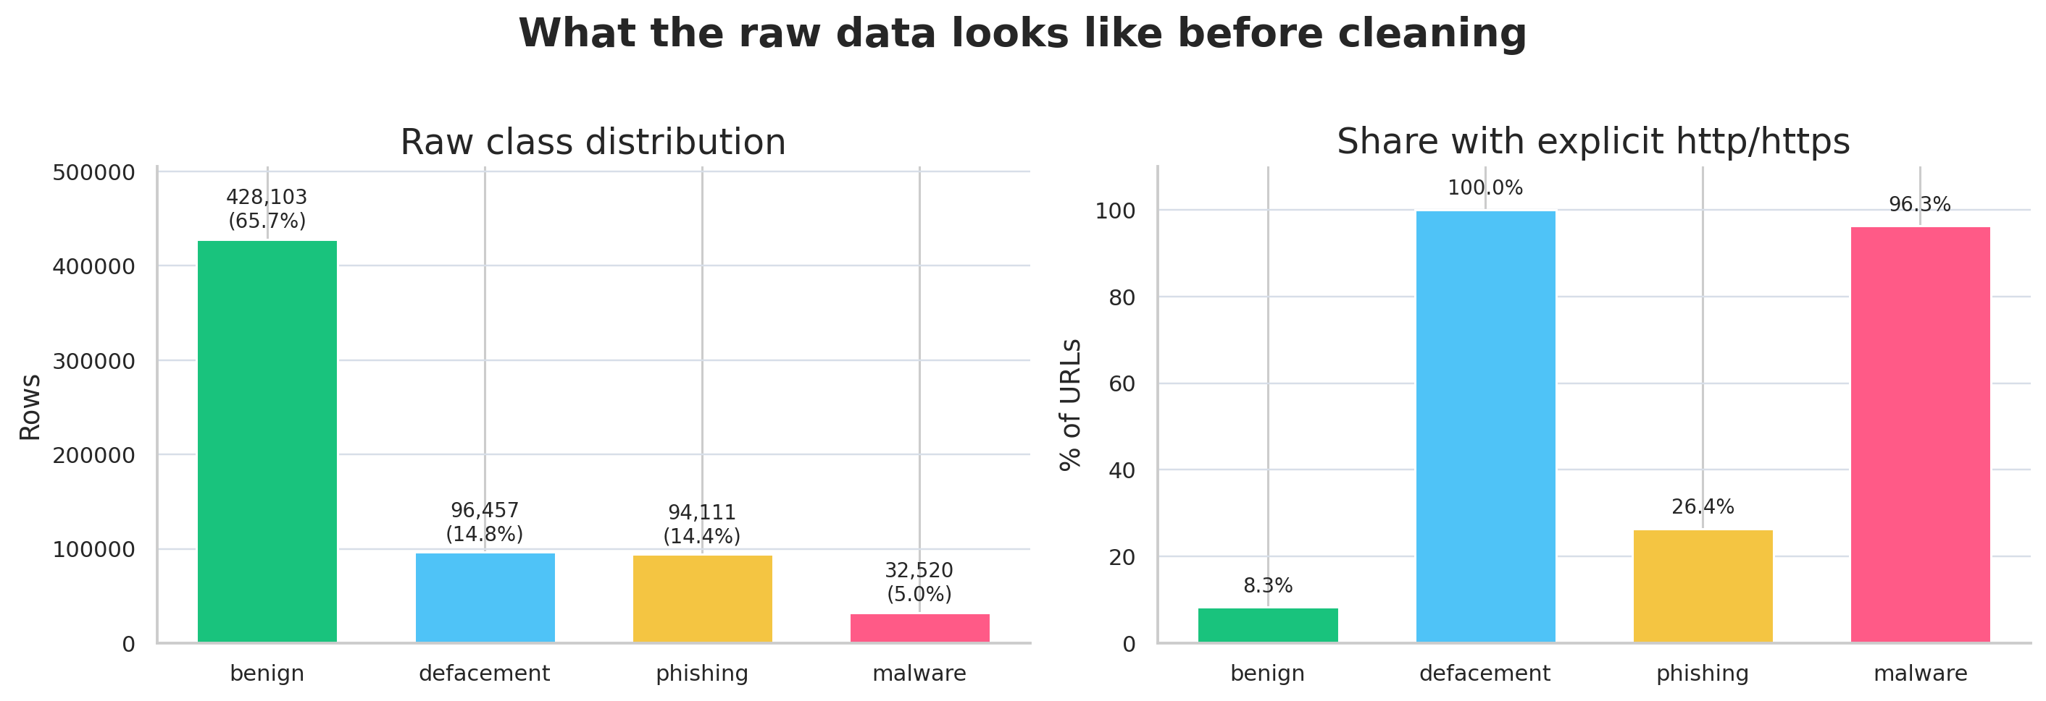
03 / UNDERSTANDING
What the raw data looks like
Before cleaning, the notebook checks class balance, uniqueness, and whether URL schemes are even present.
651,191 rows • 641,119 unique URLs • 13.16:1 largest-to-smallest class ratio
13.16:1
Raw imbalance ratio
•
Benign URLs dominate the raw file, so a naive accuracy score would flatter a weak model.
•
Scheme usage is inconsistent: defacement and malware almost always include http/https, benign often does not.
•
Length differences are visible even before feature engineering or modeling starts.
Malicious URL Dataset Analysis
4
Notes:
[Sources] - User notebook: /mnt/data/file1.ipynb (cells 8-11) - Chart recreated from notebook outputs and tables.

Slide 5
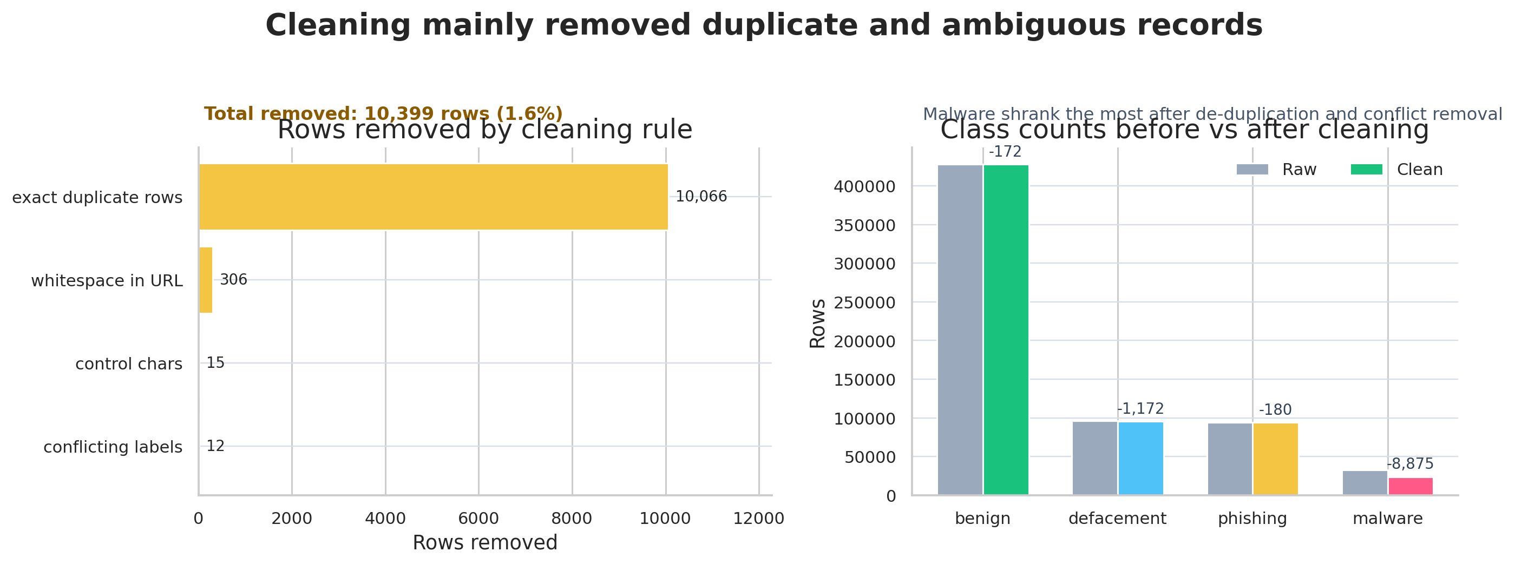
04 / CLEANING
How the data was cleaned—and what changed
The pipeline is conservative: remove rows that are malformed, duplicated, or label-ambiguous, but keep the URL text intact otherwise.
10,399
Rows removed in total (1.6%)
Rules applied
•
Trim whitespace and normalize labels to lowercase.
•
Drop missing or empty URL/label values.
•
Keep only the four expected labels.
•
Remove URLs containing whitespace or control characters.
•
Drop exact duplicate rows.
•
Remove exact duplicate URLs that carry conflicting labels.
Post-cleaning checks: 0 missing URLs, 0 exact duplicates, 0 duplicate URLs with conflicting labels.
Malicious URL Dataset Analysis
5
Notes:
[Sources] - User notebook: /mnt/data/file1.ipynb (cells 12-15) - Chart recreated from notebook outputs and tables.

Slide 6
05 / EDA
Exploratory Data Analysis
EDA
After cleaning, the notebook explores class balance, length behavior, lexical cues, suspicious tokens, and domain structure.
Malicious URL Dataset Analysis
6
Notes:
[Sources] - User notebook: /mnt/data/file1.ipynb (cells 16-32)

Slide 7
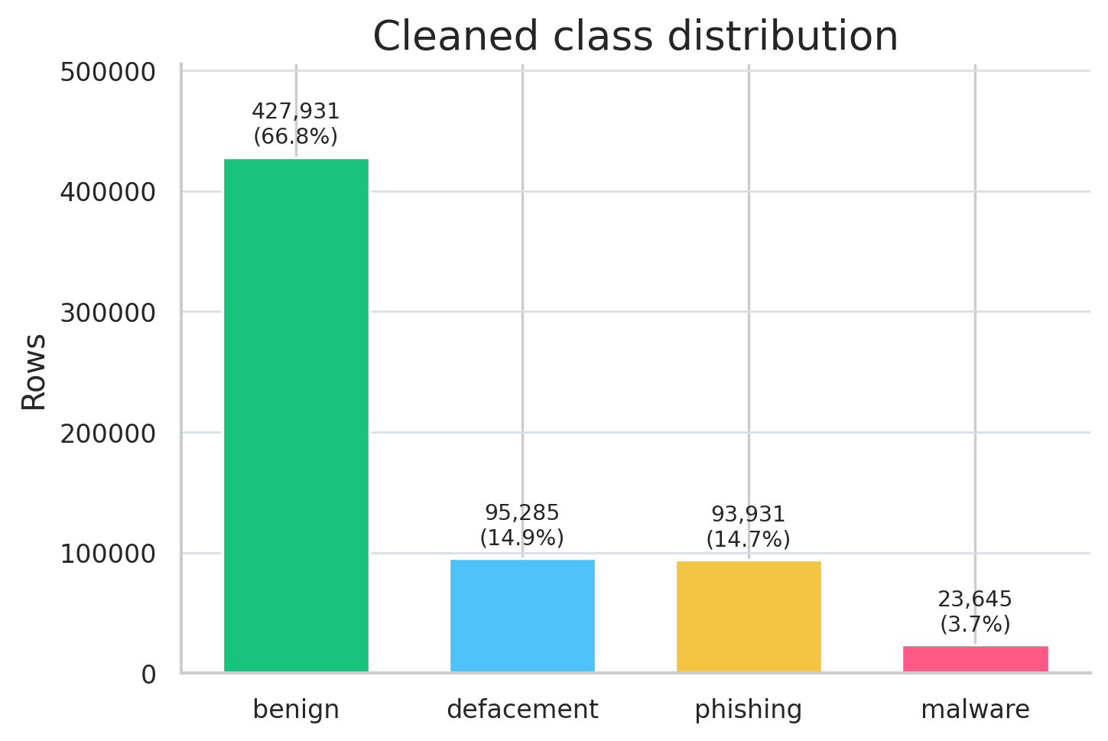
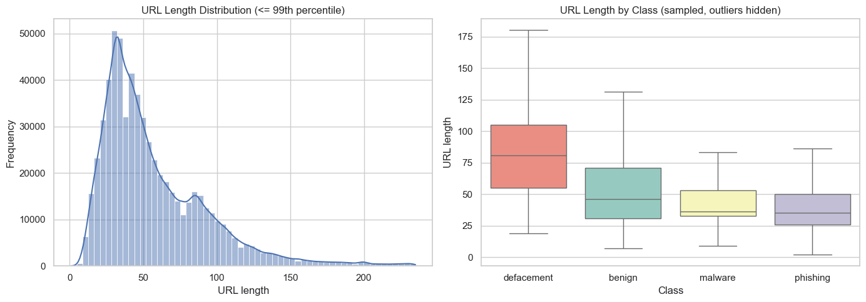
05A / EDA
Class balance and URL length behavior
All EDA results below are computed on the cleaned dataset (640,792 rows).
•
Benign remains the majority class after cleaning (66.8%), so class-aware evaluation is essential.
•
URL length is clearly right-skewed, so the median is often a better picture of a “typical” URL than the mean.
•
Defacement has the highest median length, while phishing is shorter on average but still produces a long tail.
Malicious URL Dataset Analysis
7
Notes:
[Sources] - User notebook: /mnt/data/file1.ipynb (cells 19-21) - Left chart recreated from notebook outputs and tables; right chart uses notebook figure output.

Slide 8
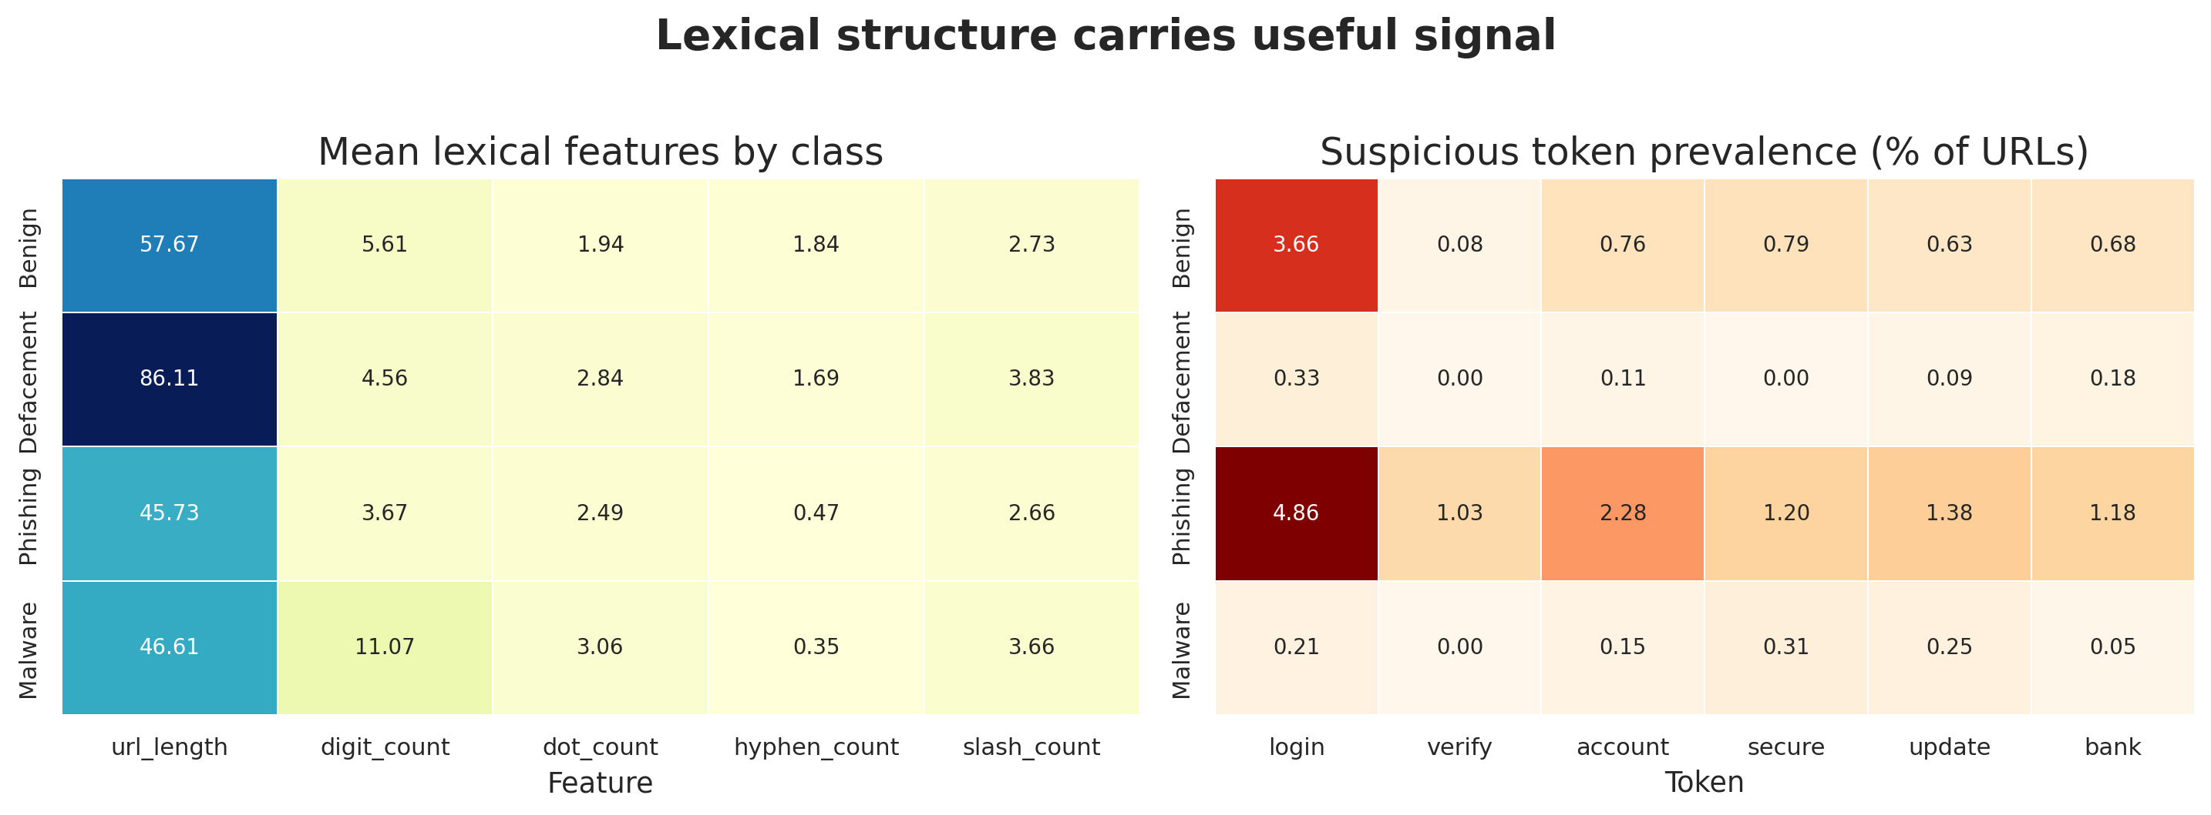
05B / EDA
Lexical structure and suspicious tokens
Simple string features already separate the classes surprisingly well.
Read this as signal—not proof
•
Defacement URLs are the longest and most slash-heavy.
•
Malware shows the most digits and dots, consistent with more IP-like or structured paths.
•
Phishing contains the highest rates of login/account/secure-style tokens.
These token cues are interpretable, but many malicious URLs still contain no obvious keywords at all.
Malicious URL Dataset Analysis
8
Notes:
[Sources] - User notebook: /mnt/data/file1.ipynb (cells 23, 29-30) - Chart recreated from notebook outputs and tables.

Slide 9
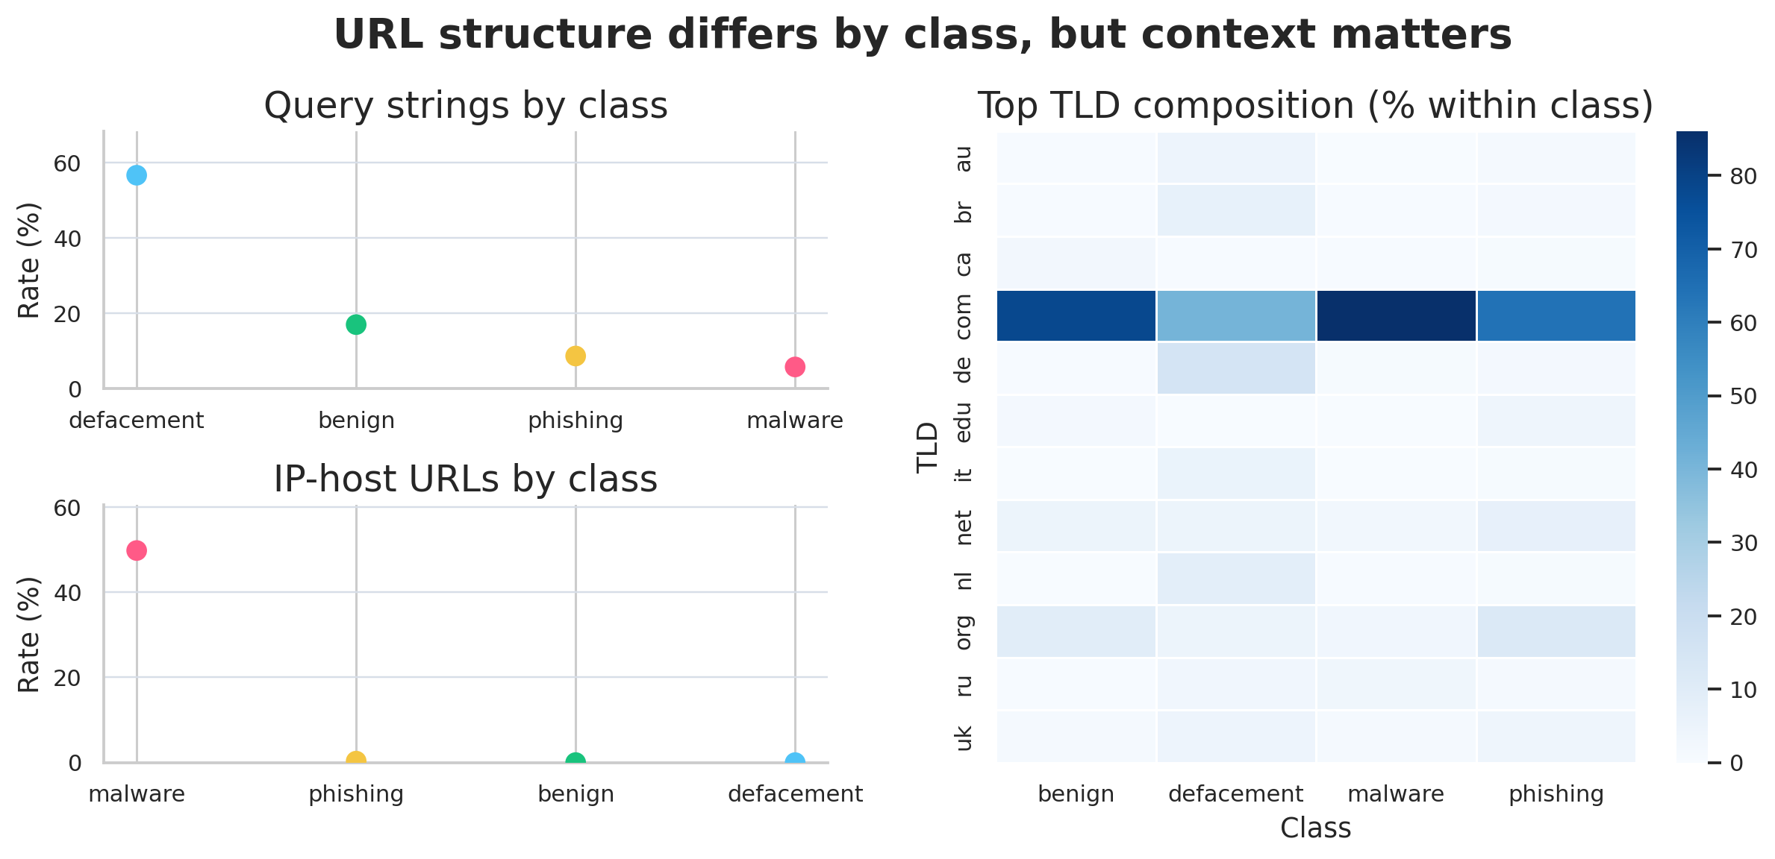
05C / EDA
Query strings, IP-host URLs, and TLD composition
Some patterns are strong, but they must be interpreted in context.
Interpret carefully
•
Defacement URLs are far more likely to include query strings (56.6%).
•
IP-host URLs stand out as a malware cue (49.8%) and are rare elsewhere.
•
TLD mix differs across classes, but it is contextual evidence—not proof that a TLD is good or bad.
Large sample sizes make these class-level intervals narrow, but source mix and registration patterns still influence what you see.
Malicious URL Dataset Analysis
9
Notes:
[Sources] - User notebook: /mnt/data/file1.ipynb (cells 27-32) - Chart recreated from notebook outputs and tables.

Slide 10
06 / STATISTICS
Statistical Reasoning & Interpretation
95% CI
This section moves from point estimates to variability, confidence intervals, uncertainty, and interpretation boundaries.
Malicious URL Dataset Analysis
10
Notes:
[Sources] - User notebook: /mnt/data/file1.ipynb (cells 24-28, 33)

Slide 11
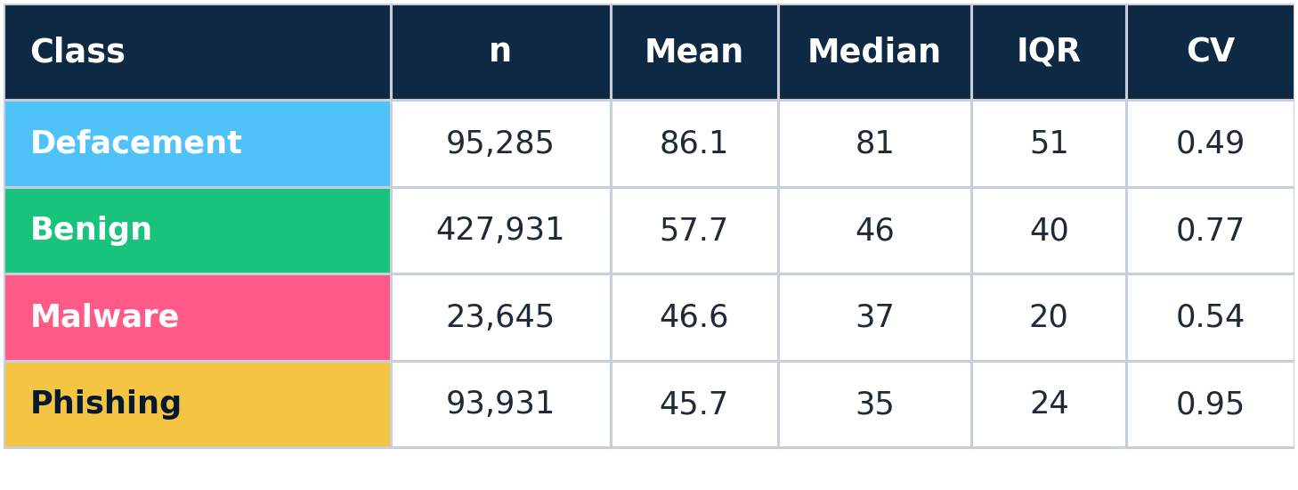
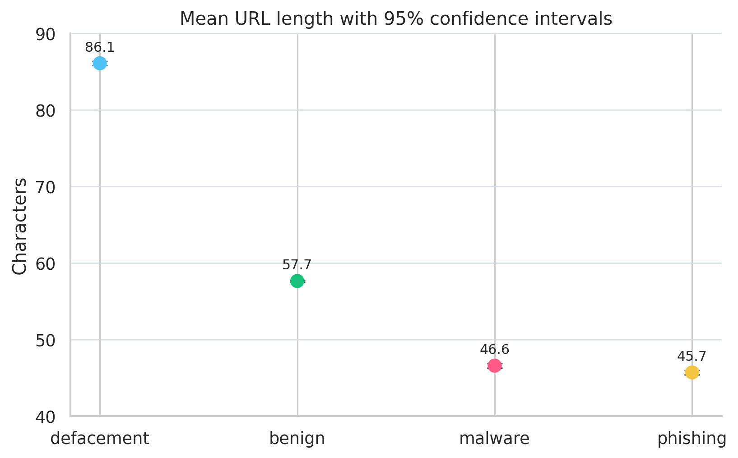
06A / STATISTICS
Robust summaries of URL length by class
Mean, median, IQR, coefficient of variation, and confidence intervals tell different parts of the story.
•
Means exceed medians in every class, which confirms right-skew instead of tidy symmetric distributions.
•
Phishing has the highest relative variability (CV = 0.95), while defacement is the most stable (CV = 0.49).
•
The 95% CI bars are narrow because the sample sizes are large—not because URLs within a class are all similar.
Malicious URL Dataset Analysis
11
Notes:
[Sources] - User notebook: /mnt/data/file1.ipynb (cells 24-26) - Chart recreated from notebook tables; table values taken from notebook output.

Slide 12
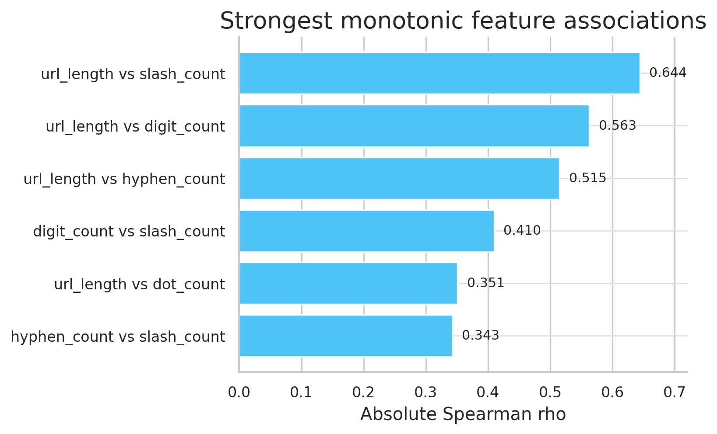
06B / STATISTICS
Interpretation, feature redundancy, and uncertainty
The results are informative, but they do not justify overclaiming.
What the results actually mean
•
URL text alone contains meaningful signal: length, query structure, IP-host usage, and phishing-style words all vary by class.
•
Some signals overlap. For example, longer URLs naturally accumulate more slashes and digits, so correlated features are not independent evidence.
Uncertainty and limitations
•
Confidence intervals here quantify within-dataset precision; they do not guarantee real-world performance.
•
These are descriptive patterns, not causal explanations. Label noise, source bias, and time drift can all change what “typical” looks like.
Bottom line: useful for feature discovery; weak as proof of future generalization.
Malicious URL Dataset Analysis
12
Notes:
[Sources] - User notebook: /mnt/data/file1.ipynb (cells 27-28, 33) - Chart recreated from notebook output table of Spearman correlations.

Slide 13
07 / WRAP UP
What to take forward from this analysis
This deck surfaces interpretable signals, but it also makes the caveats explicit.
URL strings alone carry useful signal—but those signals need class-aware evaluation and careful interpretation.
Recommended next step
Build a simple lexical baseline and report results honestly:
•
Most promising cues: length profile, query strings, IP-host usage, and phishing-oriented tokens.
1.
Use the cleaned dataset and keep the preprocessing deterministic.
2.
Evaluate with class-aware metrics and show per-class errors.
•
Model evaluation should emphasize macro F1, per-class recall, and stratified splits—not accuracy alone.
3.
Validate on fresher or differently sourced URLs before trusting deployment claims.
•
Operationally, retrain and re-check drift because attacker behavior and source coverage can change over time.
NEXT
Malicious URL Dataset Analysis
13
Notes:
[Sources] - User notebook: /mnt/data/file1.ipynb (cells 33 and prior outputs) - Existing presentation: /mnt/data/MaliciousURL_Analysis.pptx

