Slide 1
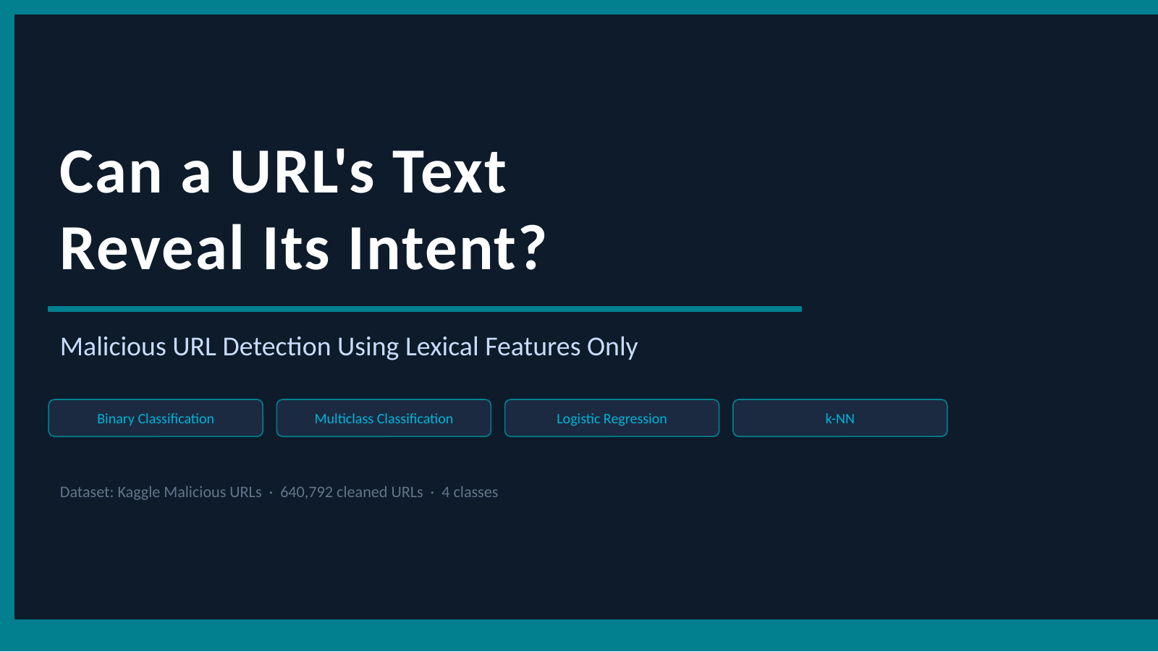
Notes:
[Sources] - User-provided deck: malicious_url_detection.pptx, slide 1 (used as the preserved visual template for this slide) [/Sources]

Slide 2
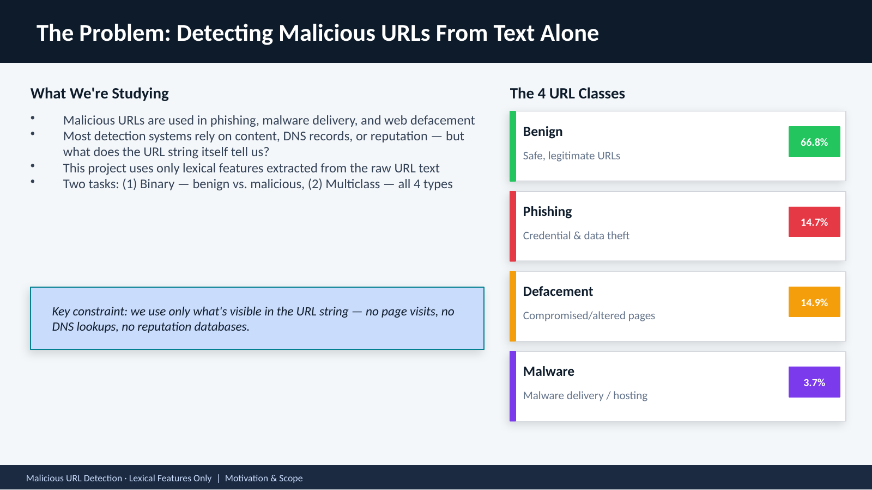
Notes:
This slide sets the stage. Emphasize that lexical features only is the key constraint. Establish the 4 classes and two tasks before moving to the data. [Sources] - User-provided deck: malicious_url_detection.pptx, slide 2 (used as the preserved visual template for this slide) [/Sources]

Slide 3
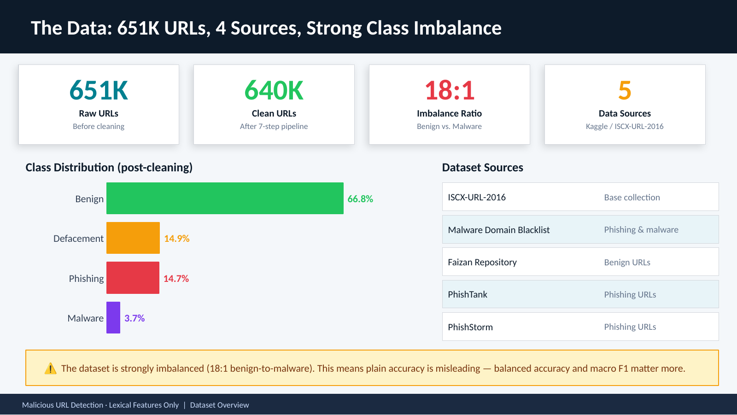
Notes:
Point out the imbalance early. The 18:1 ratio is the single most important data characteristic for understanding why balanced accuracy and macro F1 matter. Mention the Kaggle source if someone asks. [Sources] - User-provided deck: malicious_url_detection.pptx, slide 3 (used as the preserved visual template for this slide) [/Sources]

Slide 4
Why Accuracy Alone Is Misleading Here
Because benign URLs dominate and malware is rare, one overall accuracy number can hide the mistakes that matter.
Plain Accuracy
Balanced Accuracy
Macro F1
Share of all predictions that are correct.
Here, that number can still look strong
if a model predicts benign too often.
Average recall across classes.
Benign and malicious count equally,
so one class cannot hide the other.
Average of the class-level F1 scores.
Useful when we care about precision
and recall for every class.
Why these metrics fit this project
- In the binary task, the majority baseline gets about 66.8% accuracy by always predicting benign, but malicious recall is 0.
- Balanced accuracy checks whether each class is actually being found.
- Macro F1 is especially useful in the 4-class task because phishing, defacement, and malware still count equally in the average.
Malicious URL Detection · Lexical Features Only | Evaluation Metrics
Notes:
Use the majority baseline as the intuition pump. Accuracy alone can look decent because benign dominates. Balanced accuracy averages recall across classes, and macro F1 averages class-wise F1 scores, so the minority malicious classes cannot disappear inside one big headline number. [Sources] - User-provided notebook: file1.ipynb (cleaned class distribution and 18.10:1 imbalance ratio) - User-provided notebook: 02_statistical_modeling.ipynb (binary majority baseline accuracy 0.6678, balanced accuracy emphasis, macro F1 emphasis) - User-provided deck: malicious_url_detection.pptx, slide 3 (visual template and metric motivation) [/Sources]

Slide 5
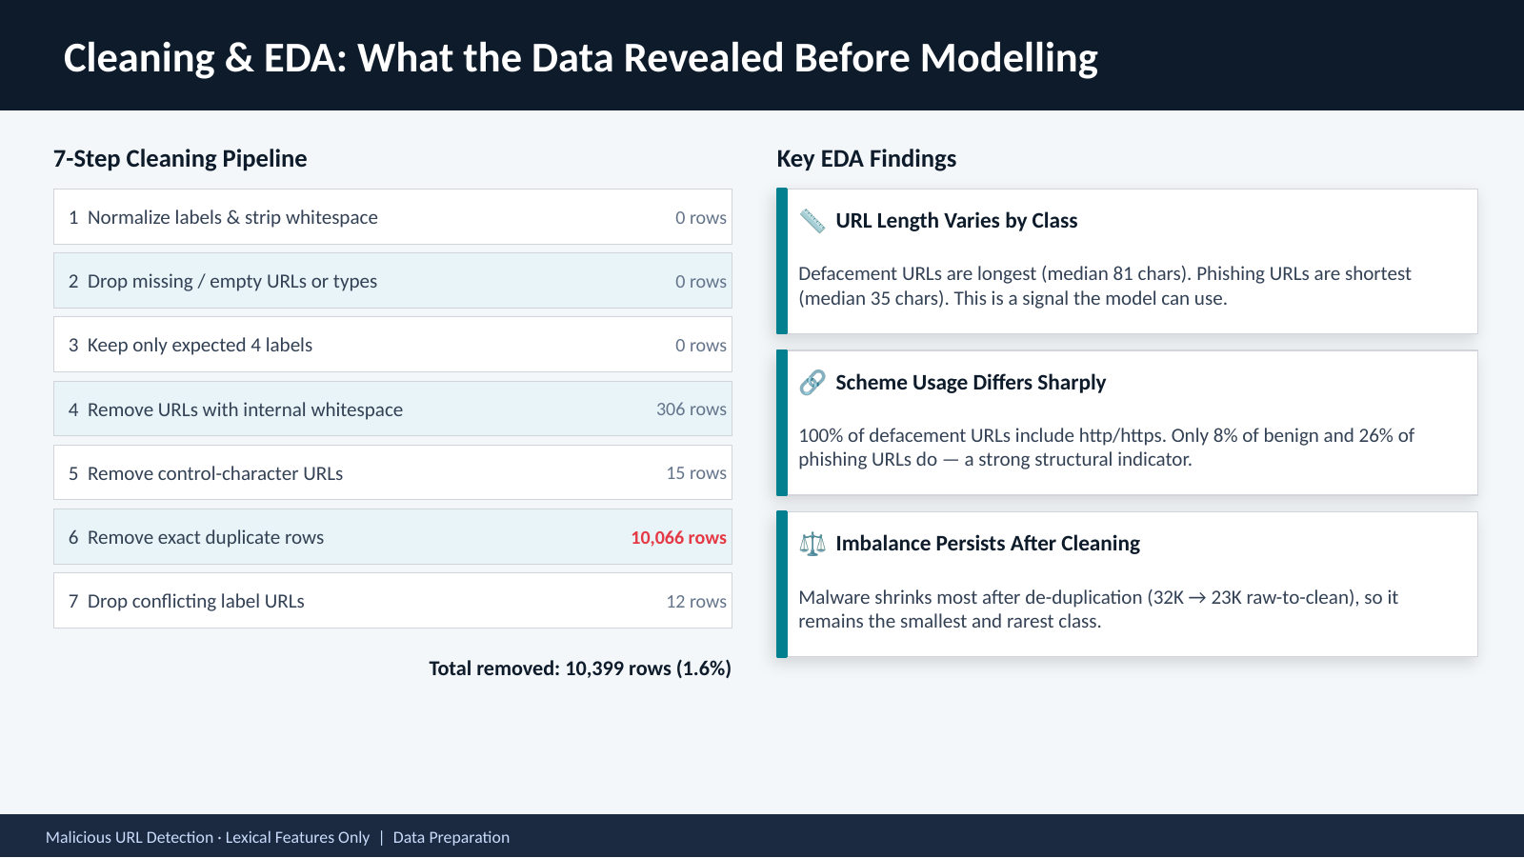
Notes:
Keep this slide brief. The key message is that the cleaning pipeline is transparent and auditable, and nearly all rows survive. Emphasize the URL length and scheme findings because they foreshadow later model behavior. [Sources] - User-provided deck: malicious_url_detection.pptx, slide 4 (used as the preserved visual template for this slide) [/Sources]

Slide 6
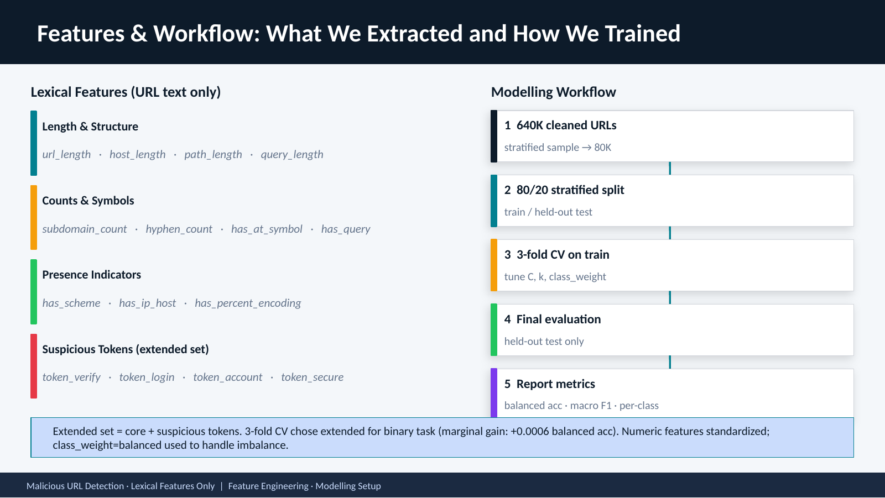
Notes:
Explain the two feature sets: core means structural and count features, while extended adds suspicious token flags such as verify and login. The gain from tokens is marginal, so most signal already lives in the core structure. [Sources] - User-provided deck: malicious_url_detection.pptx, slide 5 (used as the preserved visual template for this slide) [/Sources]

Slide 7
What "3-Fold CV on Train" Means
Cross-validation happens only inside the training split; the held-out test set is saved for the final check.
The idea
Fold rotation
train
val
- Split the training data into 3 stratified parts
- Train on 2 parts and validate on the remaining part
- Rotate the validation part 3 times
- Average the 3 validation scores
Fold 1
Val
Train
Train
Fold 2
Train
Val
Train
Fold 3
Train
Train
Val
Why use it?
- It gives a more stable score than one lucky or unlucky split.
- It lets us compare models and tune C, k, and class_weight fairly.
- It uses the training data efficiently before the test set is touched.
Malicious URL Detection · Lexical Features Only | Cross-Validation
Notes:
Explain that cross-validation happens only on the training data. Each fold takes a turn as validation, and the scores are averaged before any final test-set evaluation happens. The point is fairer tuning and a more stable comparison, not extra complexity for its own sake. [Sources] - User-provided notebook: 02_statistical_modeling.ipynb (80/20 split, 3 CV folds, tuning C, k, and class_weight on training only) - User-provided deck: malicious_url_detection.pptx, slide 5 (workflow wording and visual template) [/Sources]

Slide 8
k-NN Before the Results: How the Model Predicts
For the binary task, the best k-NN setting was k = 5 with Manhattan distance and uniform weights.
What is k-NN?
k = 5
Prediction flow in this project
Predicts a new URL from the most
similar training URLs.
Look at the 5 nearest
training examples.
1
Represent the new URL with standardized lexical features
2
Find the 5 closest training URLs
Manhattan distance
Uniform weights
mal.
mal.
ben.
mal.
ben.
Add the absolute feature-by-
feature differences.
Each of the 5 neighbors gets
one equal vote.
3
3 of the 5 neighbors are malicious -> predict malicious
Important in this project
Similarity comes from URL text features like length, subdomains, and query flags - not page content, DNS, or reputation data.
Malicious URL Detection · Lexical Features Only | Binary Classification - k-NN Concept
Notes:
Keep this intuitive. A new URL is converted into the same standardized lexical features, the 5 closest training URLs are found using Manhattan distance, and each neighbor gets one vote. If most nearby examples are malicious, the prediction is malicious. [Sources] - User-provided notebook: 02_statistical_modeling.ipynb (binary k-NN best setting: k=5, p=1 Manhattan distance, uniform weights) - User-provided deck: malicious_url_detection.pptx, slides 5 and 6 (workflow and binary result context, plus visual style) [/Sources]

Slide 9
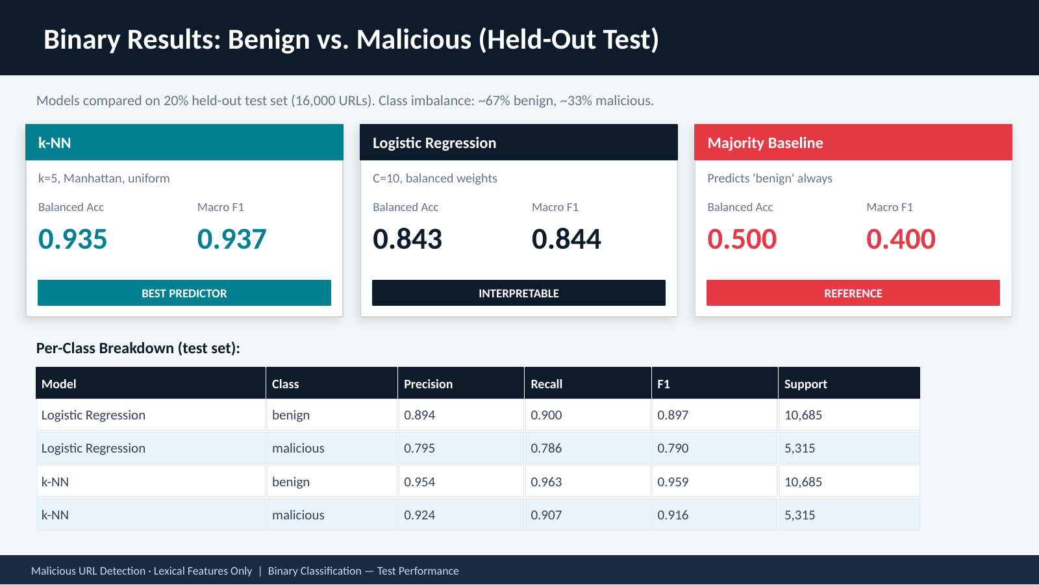
Notes:
k-NN wins on every predictive metric. Keep logistic regression in the story because its coefficients are interpretable, which is why the next slide matters. The baseline proves we cannot simply predict benign all the time. [Sources] - User-provided deck: malicious_url_detection.pptx, slide 6 (used as the preserved visual template for this slide) [/Sources]

Slide 10
How to Read the Binary Results
The previous slide compares all three models on the same 20% held-out test set.
k-NN
Logistic Regression
Majority Baseline
Headline metrics
Per-class table
- Balanced accuracy = average recall of benign and malicious
- Macro F1 = average F1 across the two classes
- Higher is better on both metrics
- Precision = when the model predicts a class, how often it is right
- Recall = how many URLs from that class it finds
- F1 = one-number balance of precision and recall
- Support = number of test URLs in that class; not a score
How to compare the models
Each top card belongs to one model. Read the table row by row to compare Logistic Regression and k-NN on the same class.
Malicious URL Detection · Lexical Features Only | Binary Classification - Reading the Results
Notes:
This slide is here to decode the binary results for a non-expert audience. Stress that support is not a score, and that higher values are better for balanced accuracy, macro F1, precision, recall, and F1. [Sources] - User-provided notebook: 02_statistical_modeling.ipynb (binary test metrics, precision, recall, F1, and support table) - User-provided deck: malicious_url_detection.pptx, slide 6 (binary results layout and terminology) [/Sources]

Slide 11
Logistic Regression Before the Coefficients
This is the main explanatory model in the deck because each feature gets a readable coefficient.
What logistic regression is
C = 10
- A linear classifier that learns one weight per feature
- The weights combine to produce a class probability
- Positive and negative coefficients show which features push the prediction
- That makes the model easier to interpret than k-NN
C controls regularization. A larger C means less penalty on big coefficients, so the model can fit the lexical patterns more freely.
Balanced class weights
Minority-class mistakes count more during training, which helps malicious URLs compete with the dominant benign class.
Why these settings matter here
We need an interpretable model for the report, but we also need the training process to pay attention to rare malicious classes rather than letting benign dominate everything.
Malicious URL Detection · Lexical Features Only | Binary Classification - Logistic Regression Concept
Notes:
Frame logistic regression as the explanatory model. C=10 means lighter regularization than smaller C values, and balanced class weights stop the benign majority from dominating the fit. [Sources] - User-provided notebook: 02_statistical_modeling.ipynb (best logistic regression setting: C=10, class_weight=balanced; coefficient interpretation) - User-provided deck: malicious_url_detection.pptx, slides 6, 7, and 11 (terminology and visual style) [/Sources]

Slide 12
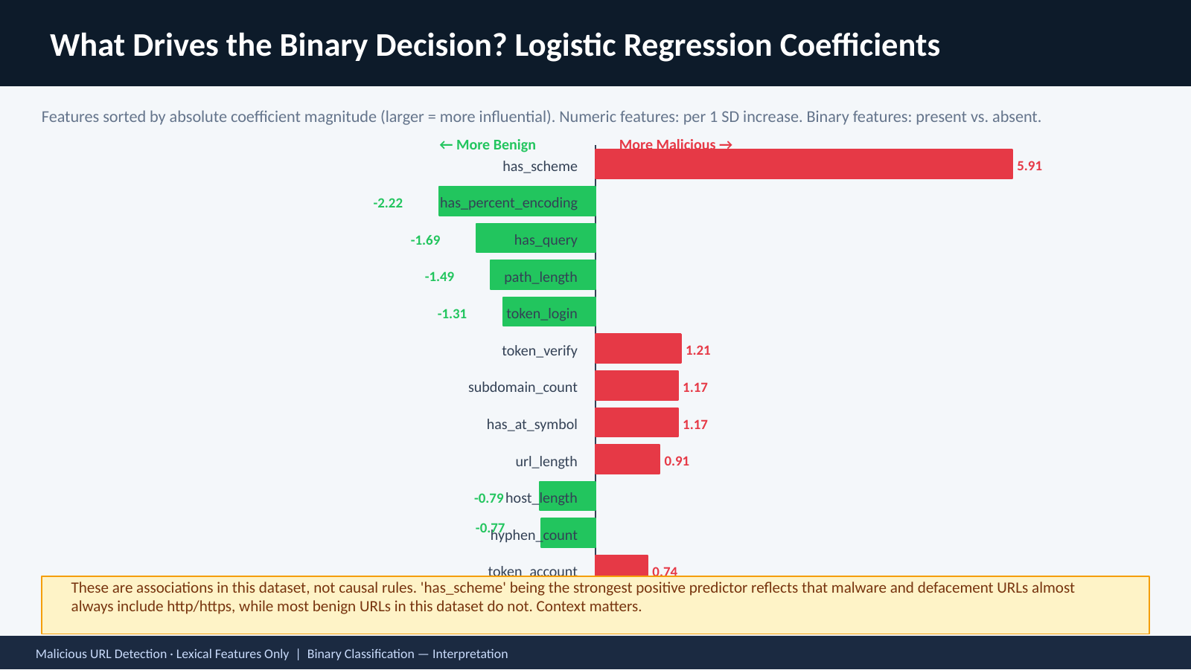
Notes:
This is one of the most important interpretation slides. The large has_scheme coefficient reflects dataset composition, not a universal causal rule. Do not let the audience over-generalize it. [Sources] - User-provided deck: malicious_url_detection.pptx, slide 7 (used as the preserved visual template for this slide) [/Sources]

Slide 13
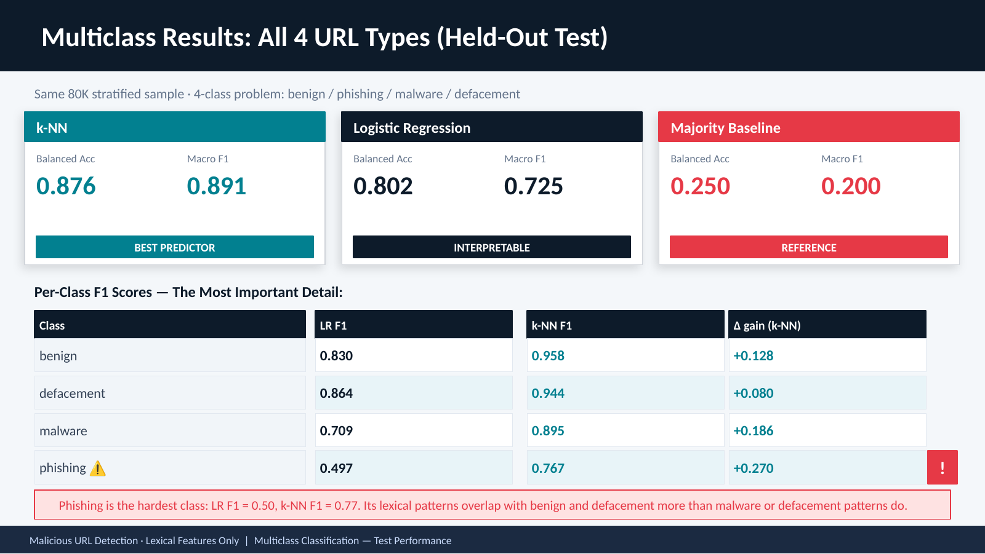
Notes:
The phishing row is the main message. Logistic regression struggles most there because phishing URLs overlap more with benign and defacement URLs in lexical structure. k-NN helps, but the limitation remains honest and important. [Sources] - User-provided deck: malicious_url_detection.pptx, slide 8 (used as the preserved visual template for this slide) [/Sources]

Slide 14
How to Read the Multiclass Results
The top cards summarize overall 4-class performance, and the table underneath breaks F1 out by class.
Balanced Acc
Macro F1
Delta gain (k-NN)
Average recall across benign,
defacement, malware, and phishing.
Average of the 4 class F1 scores.
Each class counts equally.
k-NN F1 minus LR F1 for
the same class.
Table shorthand
How to interpret gain
- LR F1 = Logistic Regression F1 for that class
- k-NN F1 = k-NN F1 for that class
- Higher is better; 1.00 is perfect, 0.00 is poor
- Positive gain means k-NN improved on that class
- Larger gain means a bigger class-specific improvement
- Example: phishing 0.767 - 0.497 = +0.270
Malicious URL Detection · Lexical Features Only | Multiclass Classification - Reading the Results
Notes:
Make sure the audience understands that gain is a difference, not a standalone score. Positive gain means k-NN improved over logistic regression for that class, and phishing shows the biggest class-specific improvement. [Sources] - User-provided notebook: 02_statistical_modeling.ipynb (multiclass macro F1, balanced accuracy, per-class F1 values, and phishing hardest-class finding) - User-provided deck: malicious_url_detection.pptx, slide 8 (multiclass result layout and shorthand labels) [/Sources]

Slide 15
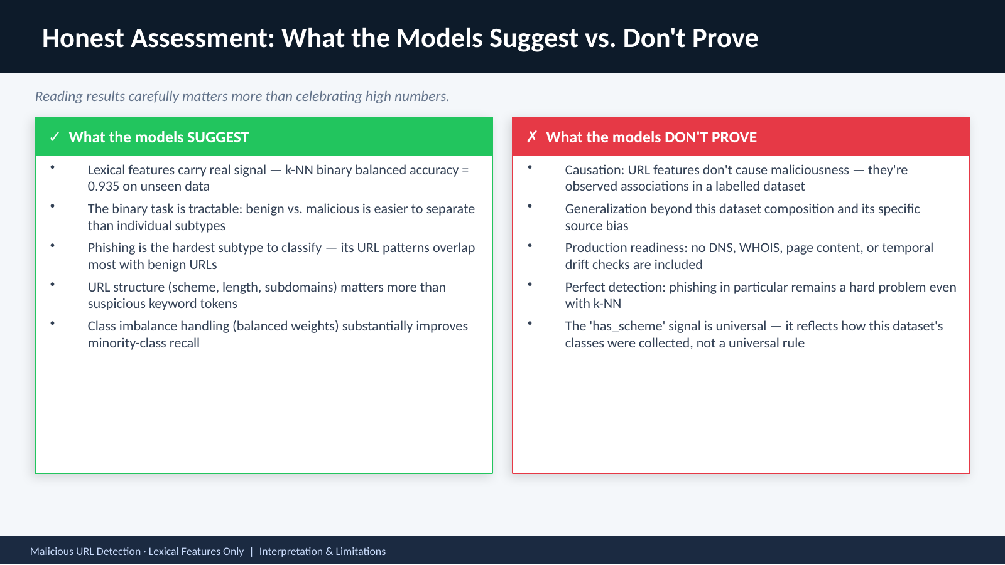
Notes:
This is the intellectual honesty slide. The class should leave understanding that strong balanced accuracy does not mean the problem is solved. Source bias, label quality, and lexical-only scope still matter. [Sources] - User-provided deck: malicious_url_detection.pptx, slide 9 (used as the preserved visual template for this slide) [/Sources]

Slide 16
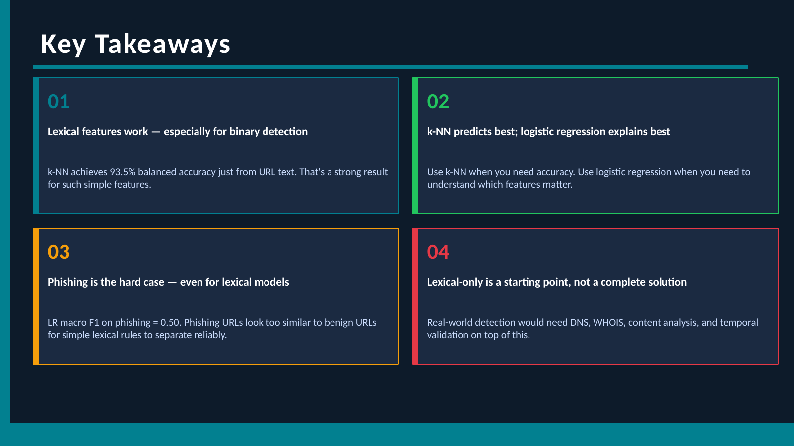
Notes:
Close with confidence. The project did what it set out to do: build a reproducible, interpretable, honest pipeline for lexical URL classification. [Sources] - User-provided deck: malicious_url_detection.pptx, slide 10 (used as the preserved visual template for this slide) [/Sources]

Slide 17
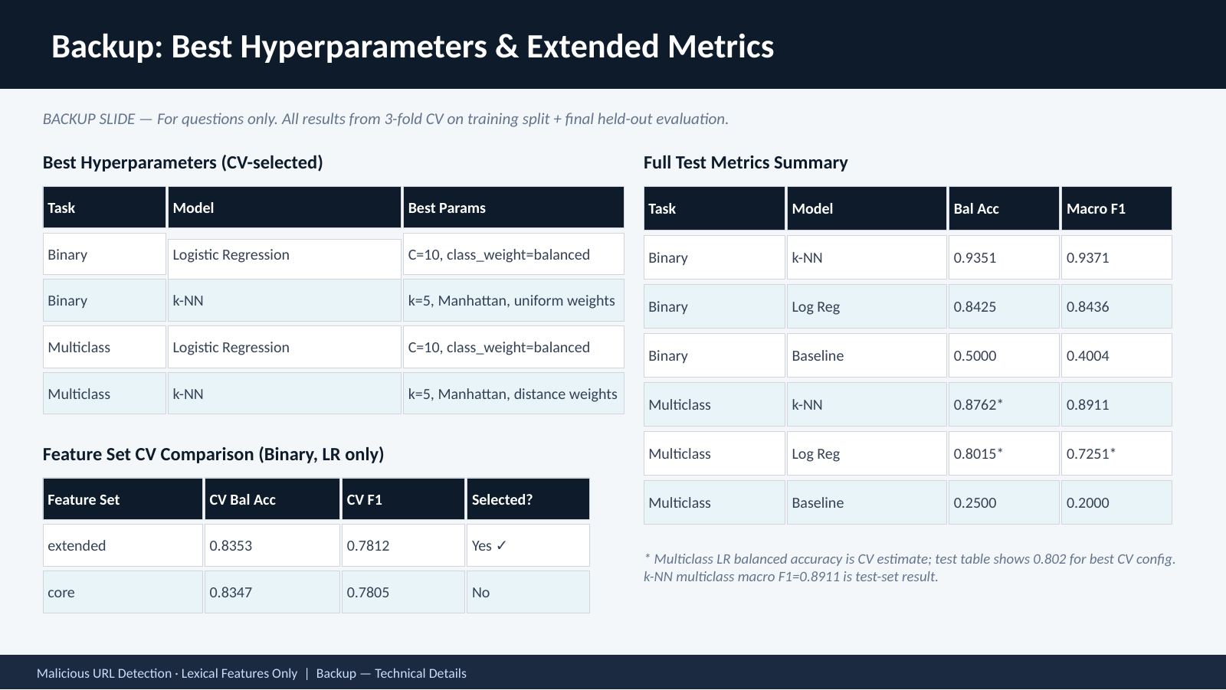
Notes:
Backup only if asked. Use it for exact hyperparameters, the tiny feature-set gain, or any question about how cross-validation picked the final settings. [Sources] - User-provided deck: malicious_url_detection.pptx, slide 11 (used as the preserved visual template for this slide) [/Sources]

