Slide 1
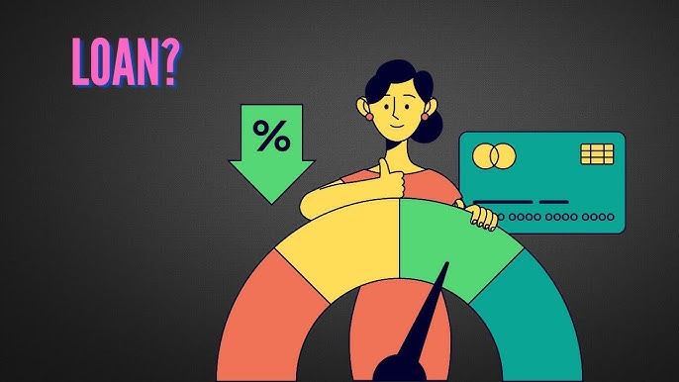
CREDIT SCORE CLASSIFICATION
Nimisha Nooti, MSBA ‘25

Slide 2

Project Introduction and Objectives
Automation of Credit Classification
Operational Benefits
This project intends to assign customers into credit categories such as Good, Standard, and Poor using machine learning.
Reduce manual review workload, speed up decision-making, and enhance credit risk management processes.
Strategic Impact
Enable scalable and consistent credit scoring aligned to business needs and regulatory compliance.

Slide 3
Dataset Description
Core Variables
Derived Features
Demographics: Age, Occupation
Income per Loan ratio
Financials: Annual Income, Monthly Salary, Debt, Credit Limit
Debt-to-Income Ratio
Delay Rate on payments
Behavioral: Loan types, Payment delays, Credit card usage
Log-transformed Income and Debt for normalization
Age groups categorized into bins

Slide 4

Data Preprocessing Techniques
Data Cleaning
Handling Invalid and Missing Values
Normalization and Encoding
Dropped non-informative columns such as ID, SSN, and Customer Name to protect privacy and reduce noise.
Removed malformed numerical entries and replaced missing numeric values with medians; categorical missing values handled via modes or defaults.
Normalized feature scales and utilized CatBoost’s native categorical feature handling to avoid costly one-hot encodings.

Slide 5
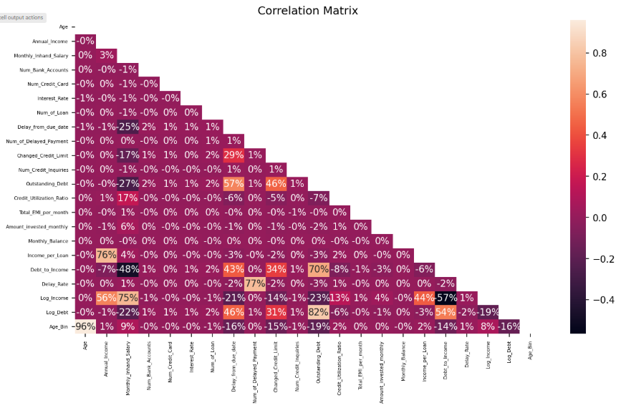
Exploratory Data Analysis (EDA)
Correlation matrix plotted to evaluate multicollinearity
Some columns like Log_Debt and Outstanding_Debt showed strong correlation

Slide 6

Model Selection:
Model 1: CatBoostClassifier
Why CatBoost?
Supports categorical features natively
Robust to missing values
Minimizes overfitting with ordered boosting
Benefits
Reduces preprocessing burden
Provides interpretable feature importance
Efficient training on tabular financial data

Slide 7
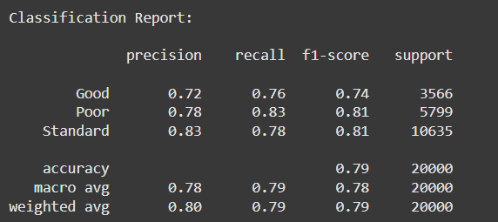
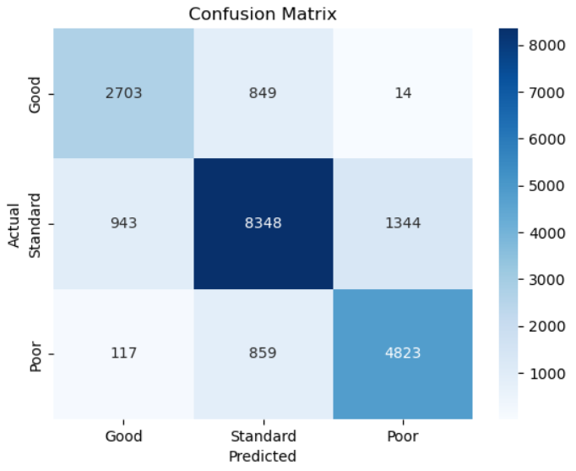
Model Training and Evaluation Results
Evaluation Setup
Used an 80/20 stratified train/test split to ensure balanced class representation.
Performance Metrics
Achieved 79% overall accuracy, with macro F1-score approximately 0.78. Class-specific precision and recall indicate strong performance across classes.
Visualization
Utilized bar charts and confusion matrix heatmaps for insightful performance interpretation and error analysis.

Slide 8

Model 2 : LightGBM Classifier
Categorical columns encoded via astype ('category’)
Fast gradient boosting method
Tuned using stratified train/test split
Same evaluation metrics for fair comparison
Slightly faster but slightly less balanced than CatBoost

Slide 9
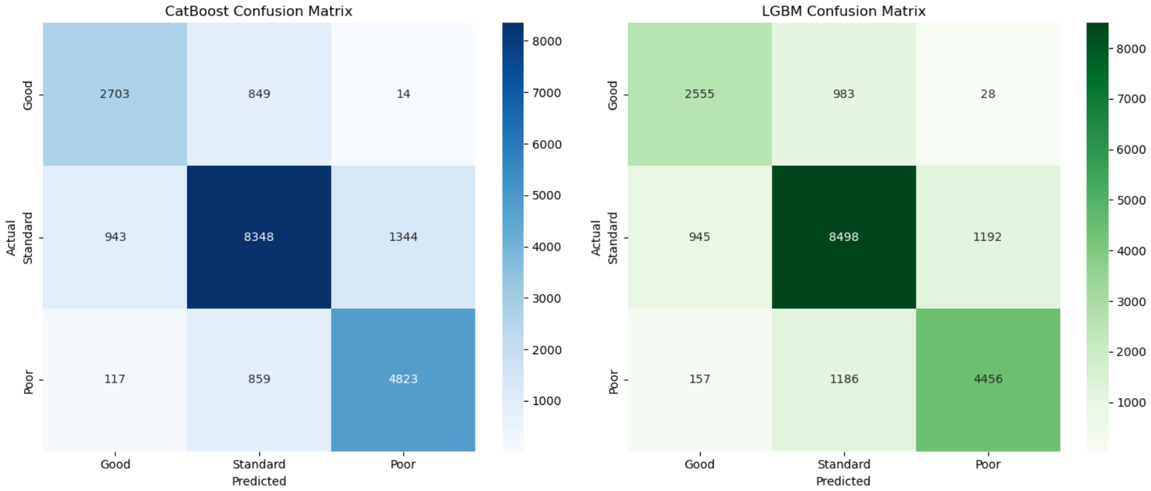
Comparison of CatBoost and LGBM Classifiers
Metric CatBoost LightGBM
Accuracy 82% 81%
Macro F1 0.78 0.75
Training Time Moderate Fast
CatBoost better at classifying "Poor" and "Good" credit groups

Slide 10

Deployment and Prediction Workflow
Model Application
Output Management
Predictions applied to unlabeled test sets to generate credit score classifications.
Results stored in CSV format for integration with downstream systems and reporting tools.
Deployment Options
Supports batch processing and real-time API serving for flexible operational use cases.

Slide 11
Project Impacts
Accurate Classification
Robust Pipeline
The model delivers 79% accuracy, providing reliable credit category predictions.
Comprehensive preprocessing and native categorical handling enhance model stability.
Scalable Implementation
Deployment capabilities enable automation across multiple financial applications.

Slide 12
Conclusion
We focused on how to achieve strong performance with minimal preprocessing.
Model is:
Scalable
Interpretable
Ready for real-time or batch prediction
Reduces manual workload & speeds up credit evaluations.
Cat Boost is preferred for datasets with many categorical variables.
LightGBM excels when training speed is prioritized.
Both models outperform traditional baseline models.

Slide 13
Thank You

