Slide 1
Healthcare Analytics (Hospitals of California)
P363
Group - 4

Slide 2
Presented By -
Shubham Tanawade
Ankita Shelar
Nimisha P J
Chitransh Raikwar
Shreya Sheelvant
Shruti Lahu Harde

Slide 3
Overview
The health care industry is a significant and growing part of California’s economy. Health care related occupations represent over seven percent of California’s total employment.
In the dynamic landscape of healthcare, understanding financial trends is pivotal for informed decision-making and strategic planning. Today, we delve into the comprehensive analysis of the healthcare data of California hospitals spanning the years 2016 to 2020.
This exploration serves as an insightful overview, revealing patterns, fluctuations, and strategic opportunities that hold the key to understanding the financial health of healthcare enterprises.

Slide 4
KPIs
Total Discharge
Patient Days
Patient Stays
Total Patient
Total Hospital
Net Patient Revenue
Revenue Trend
State wise No of hospital /Revenue
Type of hospital Revenue
MTD/QTD/YTD Revenue
Discharges
Bad Debts and Charity Care
Financial Margin

Slide 5
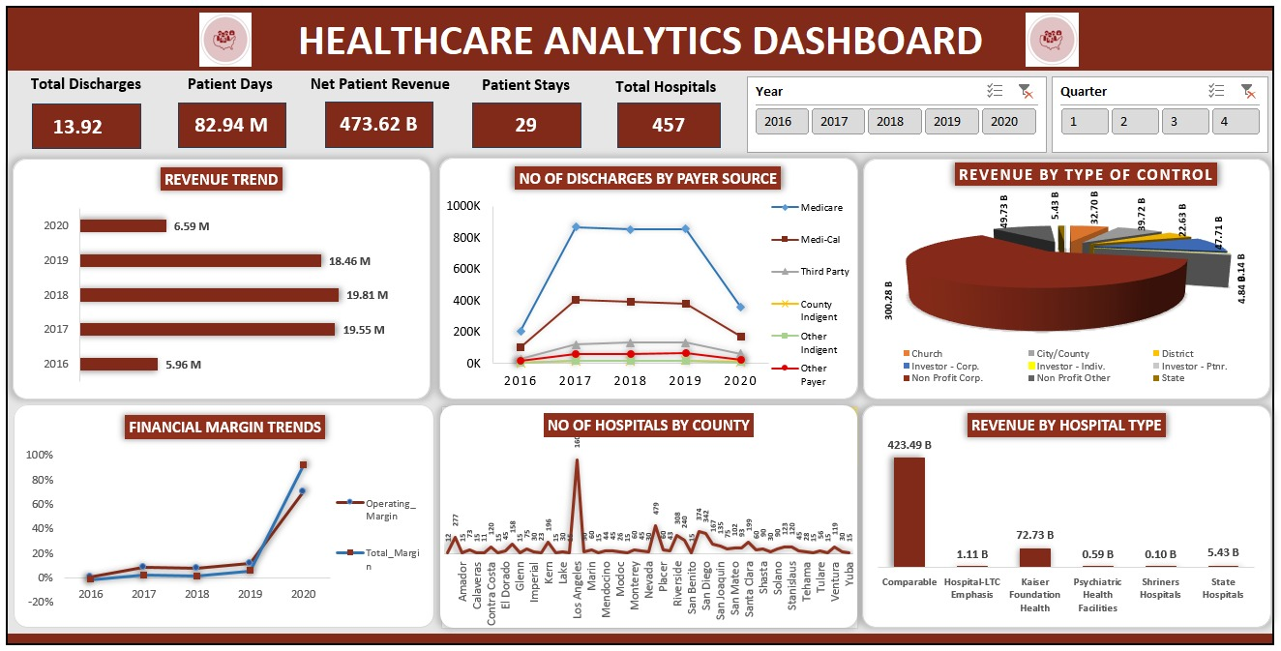
Excel Dashboard

Slide 6
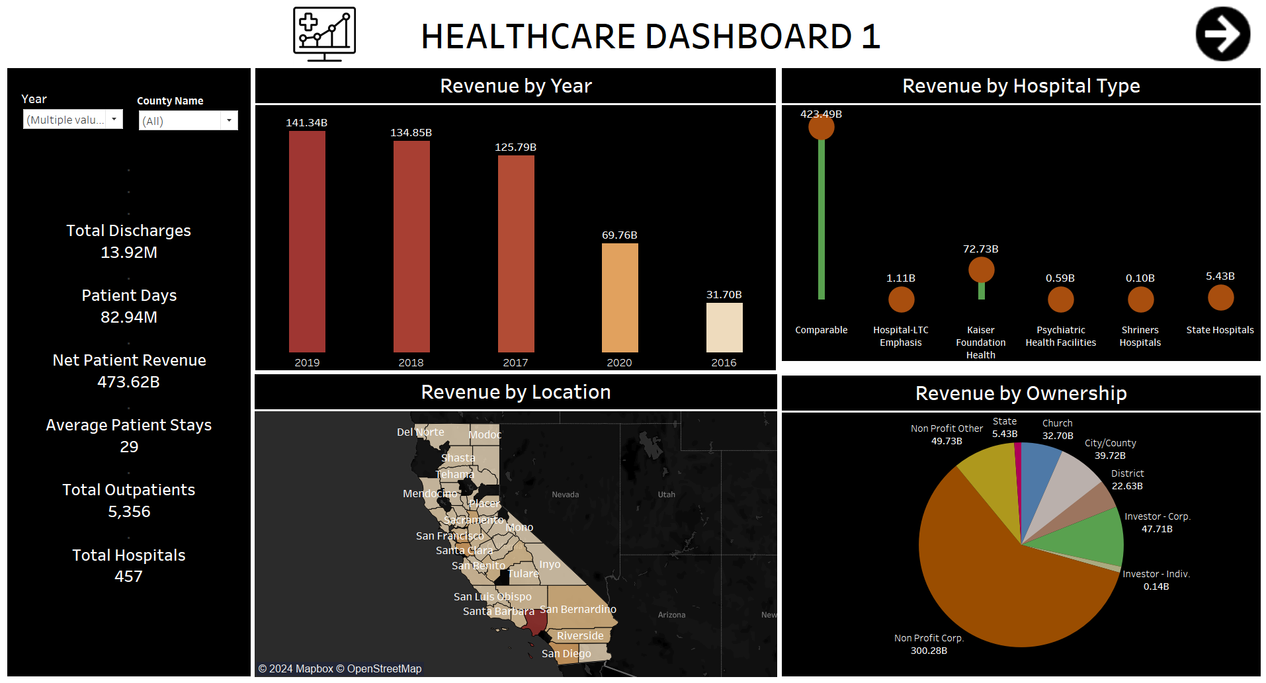
Tableau Dashboard 1

Slide 7
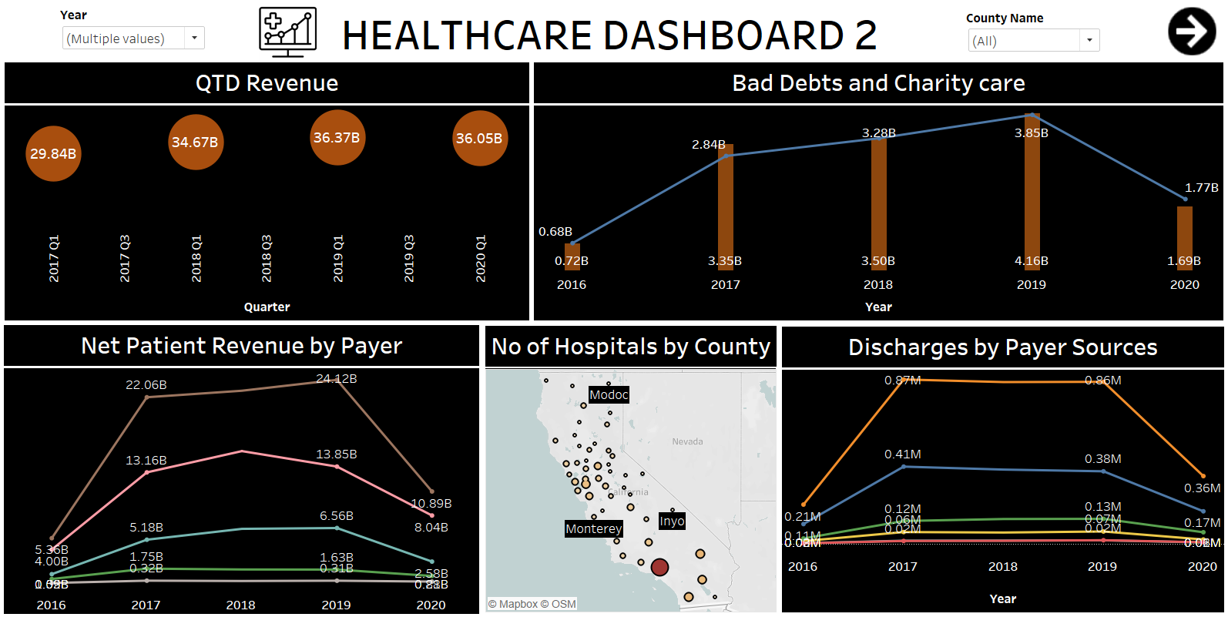
Tableau Dashboard 2

Slide 8
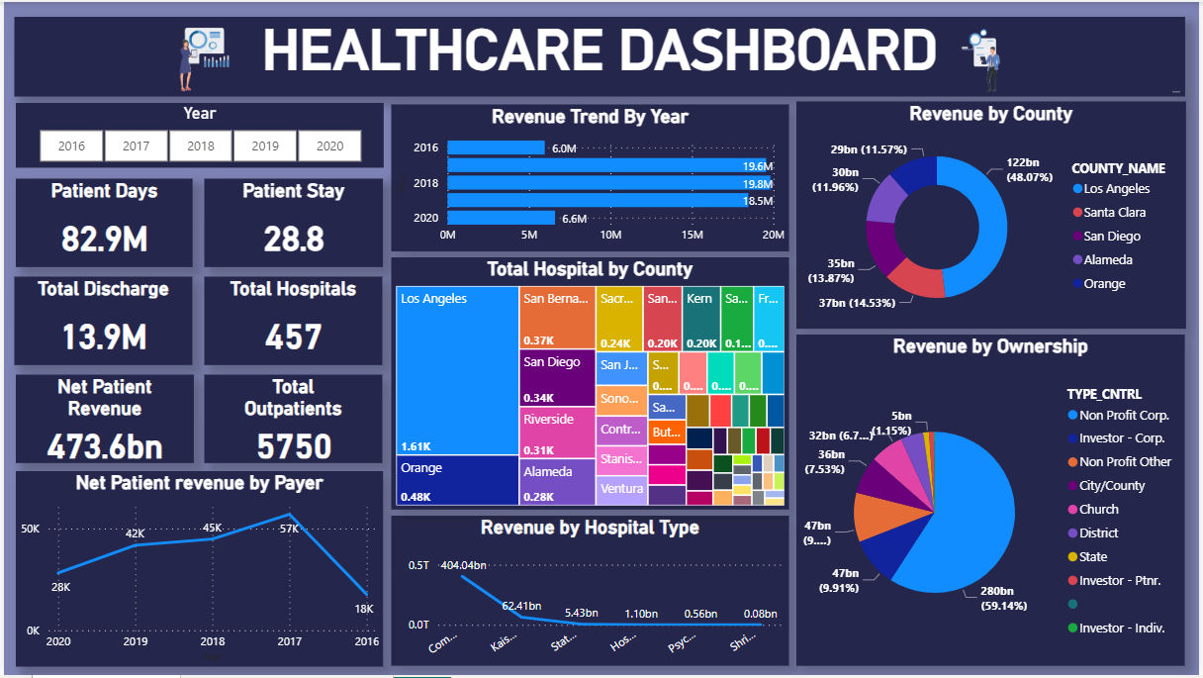
Power BI Dashboard

Slide 9
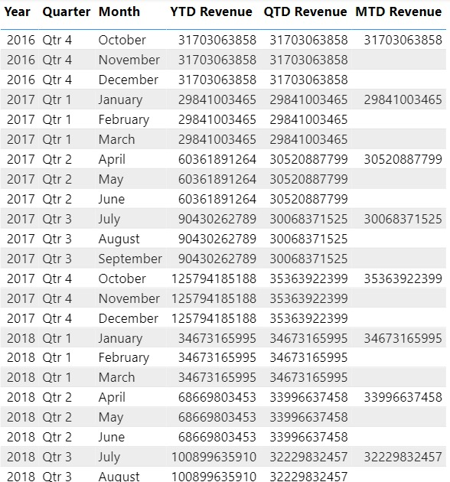
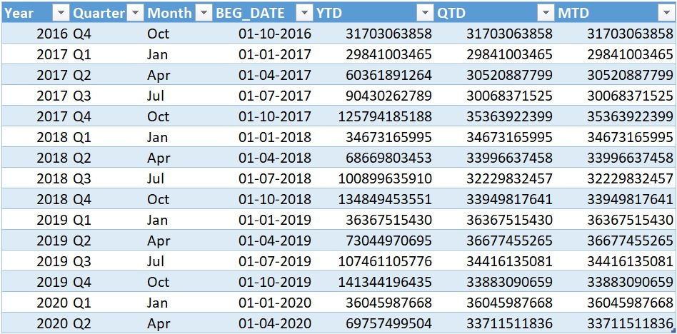
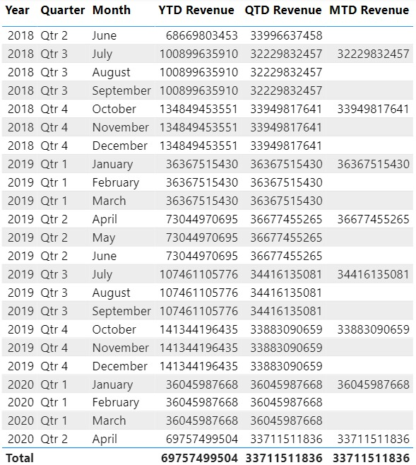
YTD, QTD and MTD Revenue

Slide 10
Key Metrics
Patient Days
Total Hospitals
82.9M
457
Patient Stay
Net Patient Revenue
29
473.6 bn
Total Discharge
Total Outpatients
13.9 M
5356

Slide 11
Business Insights
The YTD revenue demonstrates a consistent growth trajectory over the five-year period from 2016 to 2020. This steady increase suggests a resilient healthcare sector amidst changing economic and industry conditions.
Resilience in 2020:
Despite global challenges in 2020, the healthcare sector showcased resilience with a notable YTD revenue, underscoring its importance and stability during uncertain times.
The peak in 2019 highlights a year of exceptional performance, while 2020, despite global challenges, demonstrates the sector's ability to weather uncertainties.
Peak in 2019:
2019 stands out as a peak year for YTD revenue, indicating robust performance and potentially highlighting factors contributing to that exceptional growth.
County generating highest revenue: Los Angeles (133.16B) and lowest Revenue: Colusa (38.02M) with no of hospitals 112 and 1 respectively.

Slide 12
Business Insights
There is a 65.29% increase in outpatient revenue and 22.56% increase in inpatient revenue both trended up between 2016 and 2020.
The comaparable type of hospitals have 56% of available beds.
Major revenue is generated by the hospitals that are controlled by Non Profit Corp. (60%)
Bad Debt and Charity care has been increased from 2017 to 2019.
Hospitals are benefitted through Medicare payers followed by Medical. Revenue via County Indigent started trending down on 2017, falling by 1.40% in 2 years.
Majority of the hospitals are comparable type (382 out of total 457) so the revenue (84%)

Slide 13
Conclusion
Steady Growth in YTD Revenue: The Year-to-Date (YTD) revenue has exhibited a consistent upward trajectory from 2016 to 2020.
External factors, including regulatory changes and technological advancements should be implemented to improve healthcare revenue.
Sufficient number of facilities should be set up with good quality of patient care and sufficient well trained staff.
Ensure patient satisfaction by conducting feedback and surveys for getting insights into areas for improvement in patient experience, such as communication with healthcare providers, wait times, and facility cleanliness.

Slide 14
Thank You

