Slide 1
Automated Service Case Management
Using Salesforce, OCR & AI
PROGRESS REPORT-2
Nimisha Malleri (EN22IT301062)

Slide 2
Project Overview
This initiative implements end-to-end automation for case processing by combining optical character recognition (OCR) with artificial intelligence classification. The system automatically extracts data from various document formats, classifies cases based on content, and assigns appropriate priorities—dramatically reducing manual intervention while improving processing speed
.

Slide 3
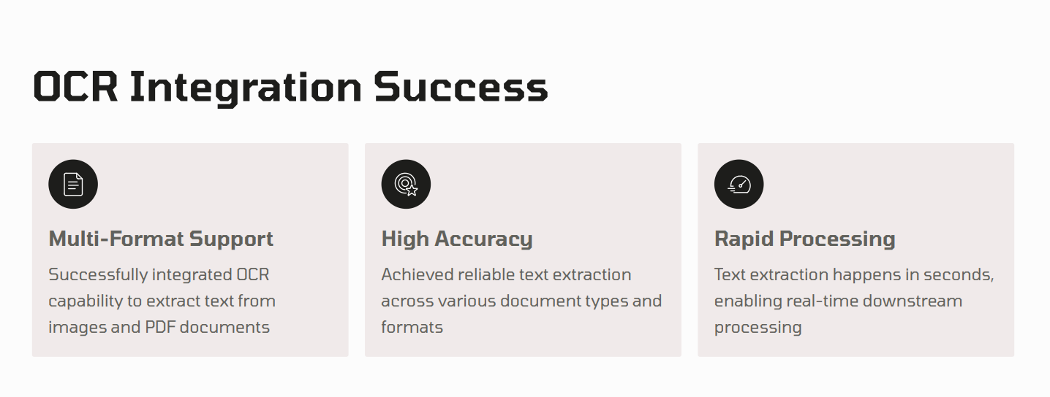
OCR INTEGRATION TEST

Slide 4




AI BASED CASE CLASSIFICATION
Prompt Builder Configuration
Designed intelligent prompts using Prompt Builder framework
OpenAI Integration
Connected to OpenAI's language models for semantic understanding.
Context-Aware Analysis
Classification considers document content and metadata.
Continuous Learning
System improves accuracy with each processed case.

Slide 5

INTELLIGENT PRIORITY ASSIGNMENT
Automatic Priority Determination
The system automatically assigns case priorities based on extracted data patterns, urgency indicators, and business rules. Priority levels are determined through analysis of document content, sender information, and historical resolution patterns.
Urgent cases flagged immediately
Standard cases routed to appropriate queues
Low-priority items batched for later processing

Slide 6
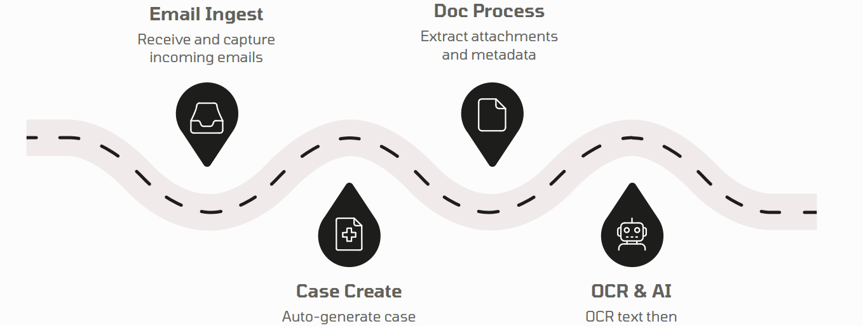
END TO END AUTOMATION FLOW

Slide 7
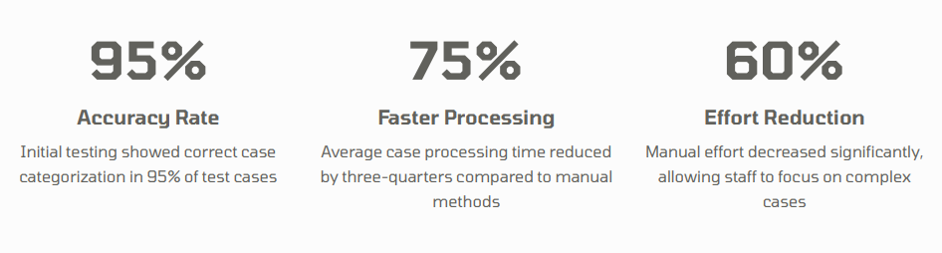
SYSTEM TESTING RESULTS

Slide 8
KEY BENEFITS DELIVERED
Accelerated Processing
Reduced case processing time through automated workflows and intelligent routing.
Consistent Quality
Eliminated human error in case classification and priority assignment.
Scalable Operations
System handles increased case volumes without proportional staffing increases.
Enhanced Visibility
Real-time tracking and analytics provide insights into processing performance.

Slide 9
IMPACT ON OPERATIONS
Time Savings
Processing time per case reduced significantly, allowing teams to handle more cases daily. Staff can now focus on resolution rather than data entry and classification.
Resource Reallocation
Manual effort reduction enables redeployment of resources to higher-value activities. Teams can handle increased volumes without additional headcount.

Slide 10
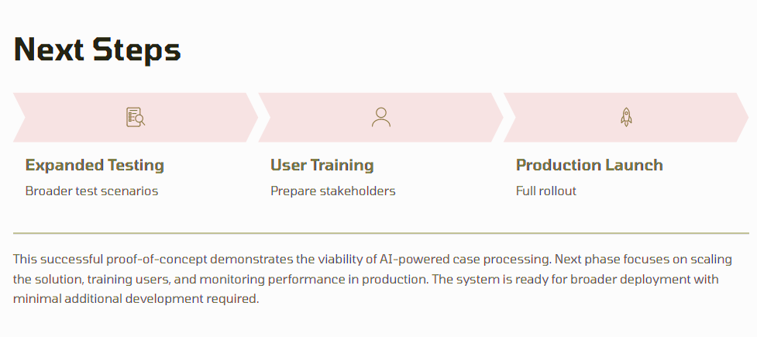
NEXT MONTH PLAN

Slide 11
Thank You!
For any query/suggestions pls mail us at
en22it301062@medicaps.ac.in

