Slide 1
Automated Service Case Management
Using Salesforce, OCR & AI
Nimisha Malleri (EN22IT301062)

Slide 2
Work Completed – Month 1
Salesforce Org Setup: Initial configuration of the Salesforce environment.
Email-to-Case Configuration: Enabled automatic case creation from incoming emails.
Custom Fields and Objects: Defined specific data structures for appliance service cases.
Page Layouts and Record Types: Tailored user interfaces for efficient data entry and viewing
.
Assignment Rules: Established logic for automatically routing cases to the correct team/agent.
.

Slide 3
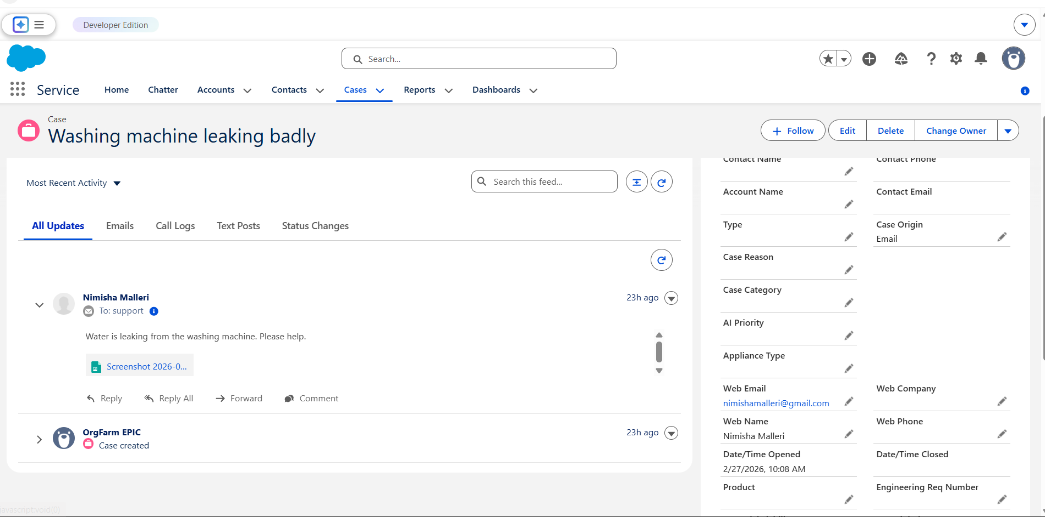

Slide 4
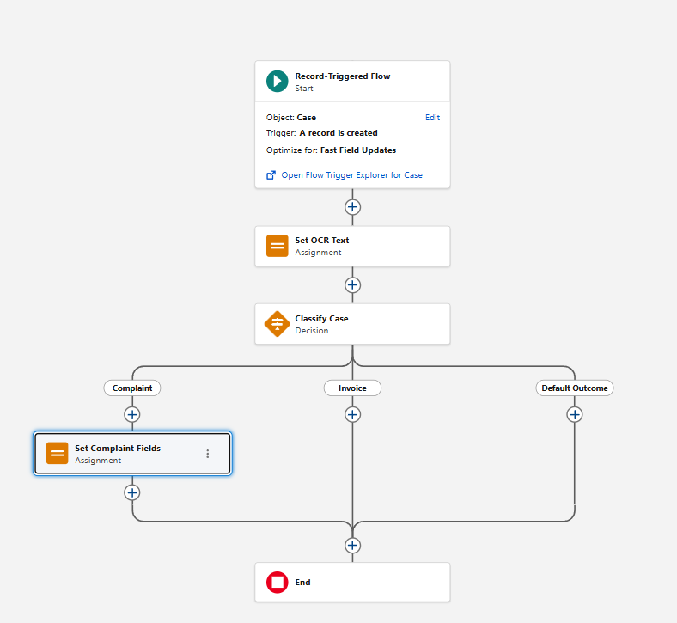

AUTOMATION IMPLEMENTED
Validation Rules: Ensured data integrity by enforcing specific criteria for field inputs.
Basic Flows: Developed foundational automated processes for routine tasks.
User Roles and Profiles: Configured access levels and permissions for different user types.
Case Creation Testing: Conducted thorough tests to validate automated case generation.

Slide 5




LEARNING OUTCOMES
Salesforce Admin Skills
Gained hands-on experience in platform configuration and management.
Case Management Configuration
Learned best practices for setting up and optimizing service cloud features.
Automation Basics
Developed an understanding of process automation using Salesforce Flows.
System Design Understanding
Improved ability to conceptualize and plan robust technical solutions.

Slide 6

NEXT MONTH PLAN
OCR Integration: Implement optical character recognition for attachment processing.
AI Classification: Develop and deploy AI models for intelligent case categorization.
Auto-Priority Tagging: Configure automatic assignment of priority levels to cases.
End-to-End Testing: Conduct comprehensive testing of the complete automated workflow.

Slide 7
Thank You!
For any query/suggestions pls mail us at
en22it301062@medicaps.ac.in

