Slide 1

Basic Details of the Team and Problem Statement
Ministry/Organization Name/Student Innovation: AICTE, MIC-Student Innovation
PS Code: SIH1481
Problem Statement Title: Student Innovation
Team Name: Team United
Team Leader Name: Priyanshu Batham
Institute Code (AISHE):
Institute Name: National Post Graduate College
Theme Name: Fitness and Sports

Slide 2
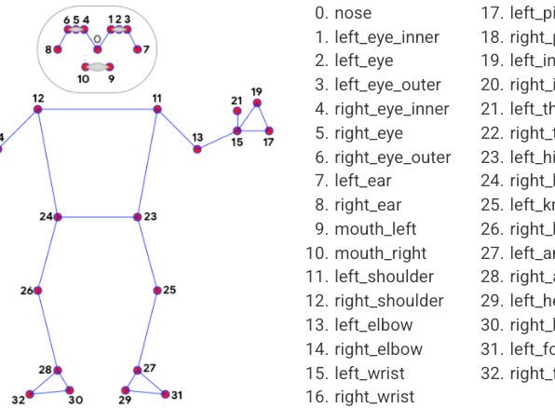
Idea/Approach Details
We aim to provide a solution by developing a computer vision-based application that enables consumers to ensure the correctness of their body posture during specific yoga or exercise routines. The prototype will operate as follows:
Simply turn on the device camera before starting your yoga/exercise session.
Make sure you are completely visible in front of the camera, try not to get out of the cone of camera’s vision.
We are using the AI-ML technologies with the help of python and media-pipe libraries to track and make sure that your posture is correct.
Coupled with the remarkable advancements in computer vision technology, the ESP-32 CamModule helps in analyzing the body posture and its correctness.
Describe your Technology stack here:
ARTIFICIAL INTELLIGENCE
MACHINE LEARNING
PYTHON
COMPUTER VISION
MEDIA PIPE
ESP-32 CAMERA MODULE
ARDUINO / NODE MCU

Slide 3
Idea/Approach Details
Describe your Use Cases here
Describe your Dependencies / Show stopper here
POSTURE CORRECTION : Enables you to maximize your exercise / yoga productivity by correcting your posture.
INJURY PREVENTION : With the help of OpneCV algorithm, we are able to minimize the scope of injuries.
TRACKING BODY MOVEMENTS : All body parts are marked and shown distinctly with the help of our ESP-32 CamModule and Computer Vision algorithm.
PERSONAL GUIDANCE : This machine is not just a tool but also your personal yoga trainer which helps you whenever in need.
OpenCV: The cam module takes input in the form of frames and processes it to generate landmarks(points) on the image. These points are then used by a deep neural network to identify your posture and judge if it is correct or not.
ESP-32 CAM MODULE: This camera module is compact in size and the whole model takes as much space as a mobile phone which includes its batteries and the microcontroller.
PORTABLE : Compact in size and easy to carry anywhere therefore occupies less space.
AI-ML : It uses python programming language along with mediapipe library to implement the artificial intelligence and machine learning technologies in the system.

Slide 4
Team Member Details
Team Leader Name: PRIYANSHU BATHAM
Branch (BCA): Stream (ECE, CSE etc): CS Year (I,II,III,IV): II
Team Member 1 Name: UTKARSH RANA
Branch (BCA): Stream (ECE, CSE etc): CS Year (I,II,III,IV): II
Team Member 2 Name: PRATHAM GUPTA
Branch (BCA): Stream (ECE, CSE etc): CS Year (I,II,III,IV): II
Team Member 3 Name: MAHIMA MANNI
Branch (BCA): Stream (ECE, CSE etc): CS Year (I,II,III,IV): II
Team Member 4 Name: VAIBHAV SHANKAR MISHRA
Branch (BCA): Stream (ECE, CSE etc): CS Year (I,II,III,IV): II
Team Member 5 Name: SRAJAN SAXENA
Branch (BCA): Stream (ECE, CSE etc): CS Year (I,II,III,IV): II
Team Mentor 1 Name: Type Your Name Here
Category (Academic/Industry): Expertise (AI/ML/Blockchain etc): Domain Experience (in years):
Team Mentor 2 Name: Type Your Name Here
Category (Academic/Industry): Expertise (AI/ML/Blockchain etc): Domain Experience (in years):

