Slide 1


Slide 2
What is an OS?
By,
Mansi Saini, Nimitha Ramesh,
Yongcai Huang, Tony Filippo,
Mayank Sachdeva, Jagatdeep Anand
Notes:
1 - Mansi 2 - Jagat 3 - Tony 4 - Mayank 5 - Huang 6 - Nimitha

Slide 3
Table of Contents
Processor
Memory
Software
Input / Output

Slide 4
Processor
GPU / GUI
Real Time Scheduling
Scheduling
Processes
Threads
Thread Scheduling
Useful link: http://www.greenbot.com/article/2095485/android-processors-the-past-present-and-future-of-smartphone-chip-design.html
Notes:
6.

Slide 5
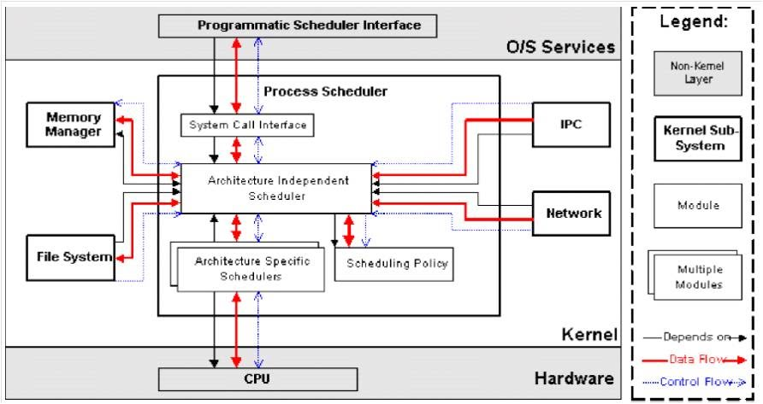
Scheduling
https://sites.google.com/a/itspaclub.com/www/android-linux-kernel/1-kernel-overview/1-4-process-scheduler-architecture

Slide 6
2. Memory / Hardware
Memory management
RAM
Cache
Network chip
MicroSD
Power Supply
Notes:
https://en.wikipedia.org/wiki/Android_(operating_system)#Interface

Slide 7
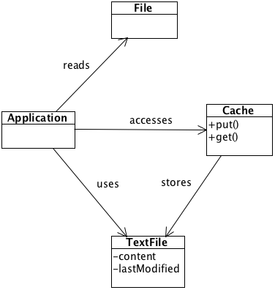
Caching
From - http://www.cacheonix.org/articles/Caching_Files_in_Java_Class_Diagram.png

Slide 8
3. Software
Security
Error / warning messages
CRUD of methods
Drivers
Resolution Compatibility
Version history
Notes:
Security - finger scanner, passcode patterns, sandboxed VM
Error / Warning messages - provide examples
OnCreate(), onPause(), onStart(), onDestroy(), OnResume()
5. Resolution compatibility - Unlike iOS, Android runs on a variety of devices that offer different screen sizes and densities. This can be done by explicitly declaring the screen size in the manifest file, providing different layouts / drawables for different screen sizes and or by using configuration qualifiers / size qualifiers.

Slide 9
CRUD
// From MainActivity.onCreate()
PostDatabase DB = new PostDatabase(MainActivity.this);
SQLiteDatabase sqlDB = DB.getWritableDatabase();
// Execute queries...
sqlDB.close();
http://codetheory.in/working-sqlite-database-crud-operations-android/

Slide 10
5. Input / Output
Camera / Audio
GPS
Peripherals
Sensors
Touchscreen
Vibrations

Slide 11
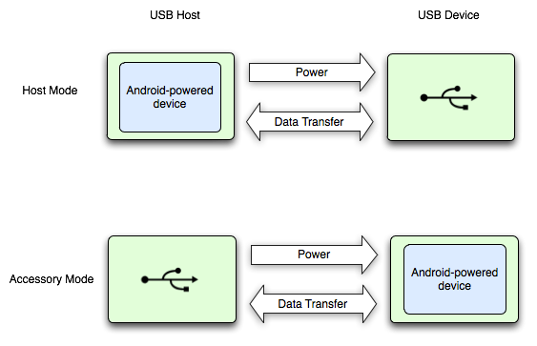
Peripherals
https://developer.android.com/guide/topics/connectivity/usb/index.html

