Slide 1


Slide 2
What is an OS?
By,
Mansi Saini, Nimitha Ramesh,
Yongcai Huang, Tony Filippo,
Mayank Sachdeva, Jagatdeep Anand
Notes:
1 - Mansi 2 - Jagat 3 - Tony 4 - Mayank 5 - Huang 6 - Nimitha

Slide 3
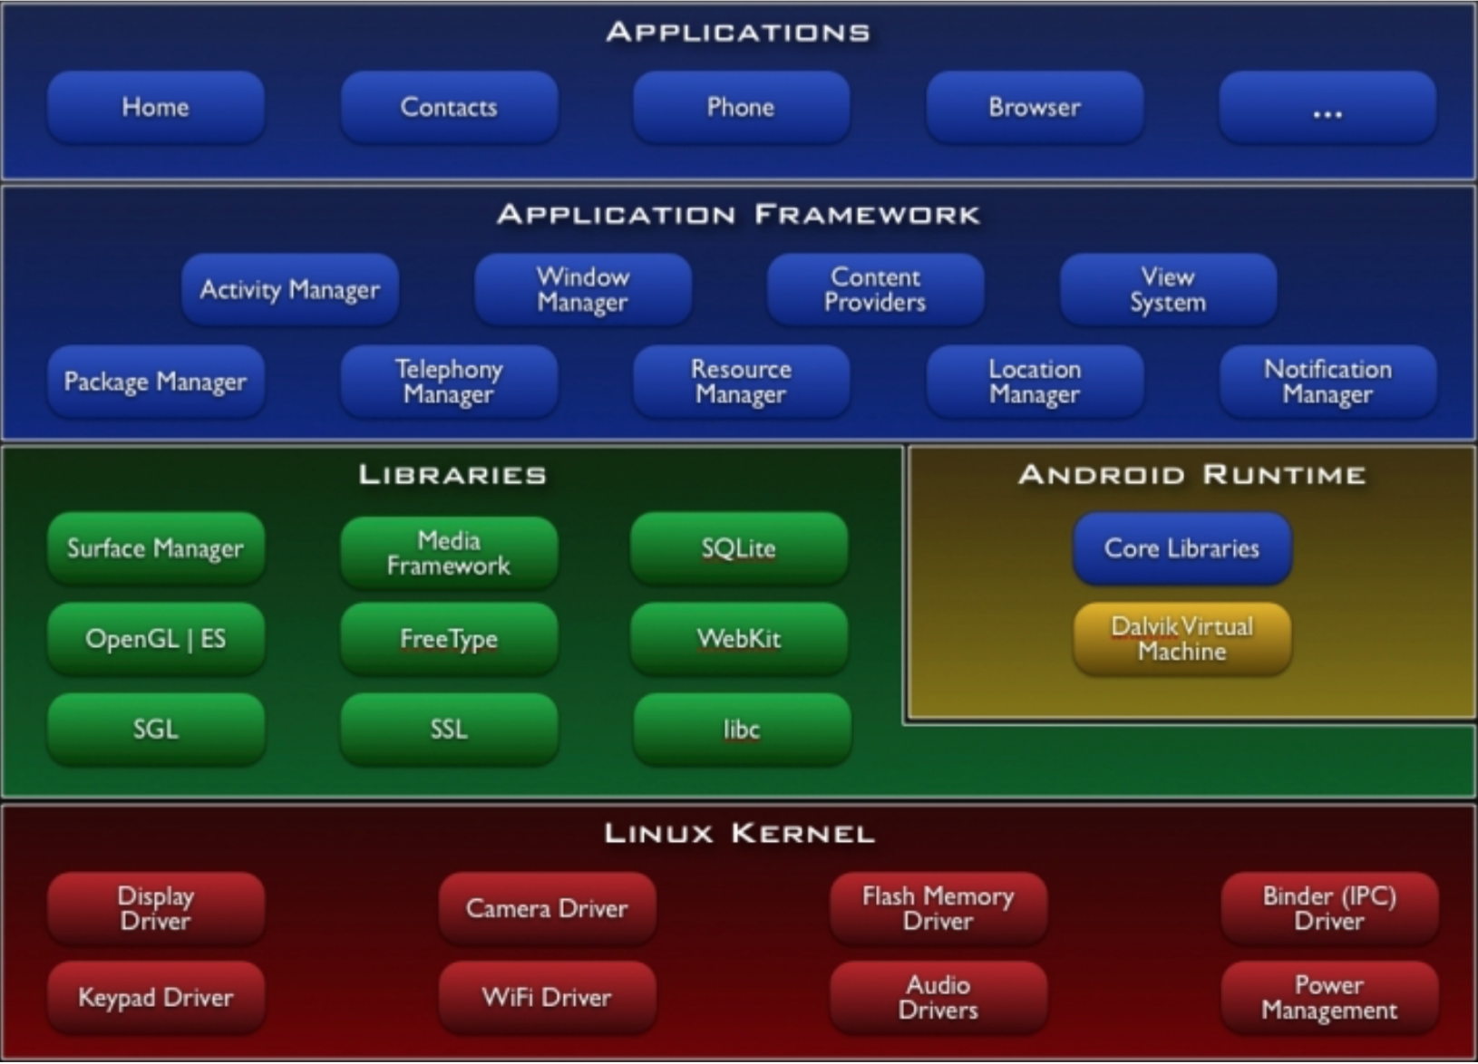

Slide 4
Table of Contents
Processor
Memory
Software
Input / Output

Slide 5
Processor
GPU / GUI
Real Time Scheduling
Scheduling
Processes (By Mayank)
Threads
Thread Scheduling
Useful link: http://www.greenbot.com/article/2095485/android-processors-the-past-present-and-future-of-smartphone-chip-design.html
Notes:
6.

Slide 6
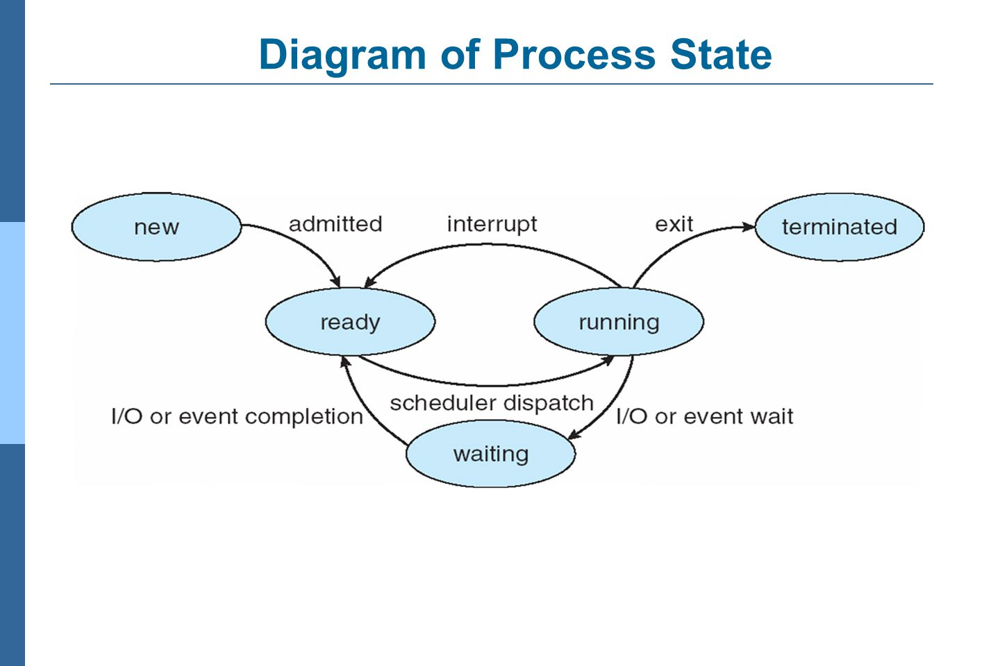
Processes (By Mayank)
From - http://images.slideplayer.com/8/2466335/slides/slide_12.jpg

Slide 7
2. Memory / Hardware
Memory management
RAM
Cache
Network chip (By Mayank)
MicroSD
Power Supply
Notes:
https://en.wikipedia.org/wiki/Android_(operating_system)#Interface

Slide 8
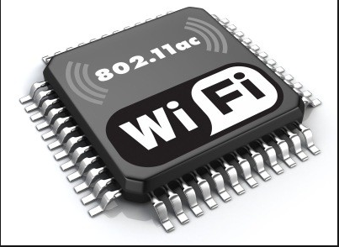
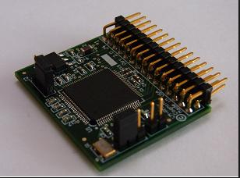
Network Chip (By Mayank)
From: http://bit.ly/246BYSa
From: http://bit.ly/1Ty4irG

Slide 9
3. Software
Security
Error / warning messages
CRUD of methods
Drivers (By Mayank)
Resolution Compatibility
Version history
Notes:
Security - finger scanner, passcode patterns, sandboxed VM
Error / Warning messages - provide examples
OnCreate(), onPause(), onStart(), onDestroy(), OnResume()
5. Resolution compatibility - Unlike iOS, Android runs on a variety of devices that offer different screen sizes and densities. This can be done by explicitly declaring the screen size in the manifest file, providing different layouts / drawables for different screen sizes and or by using configuration qualifiers / size qualifiers.

Slide 10
What is a device driver? (By Mayank)
Program that tells the OS how to communicate with the device.
Device driver

Slide 11
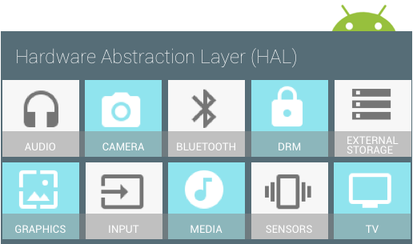
[By Mayank]
https://source.android.com/devices/

Slide 12
Example of HAL code for audio devices (By Mayank)
struct audio_hw_device {
struct hw_device_t common;
* used by audio flinger to enumerate what devices are supported by
* each audio_hw_device implementation.
*
* Return value is a bitmask of 1 or more values of audio_devices_t
*/
uint32_t (*get_supported_devices)(const struct audio_hw_device *dev);
...
};
typedef struct audio_hw_device audio_hw_device_t;

Slide 13
5. Input / Output
Camera / Audio
GPS
Peripherals
Sensors (By Mayank)
Touchscreen
Vibrations

Slide 14
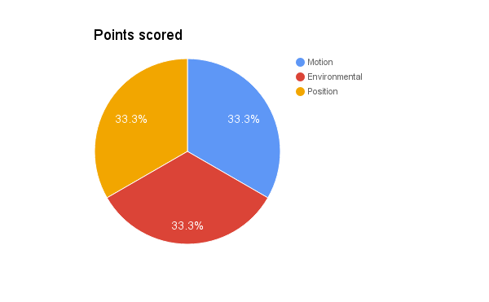
Sensors in Android Devices (By Mayank)

Slide 15


