Slide 1

comprehensiveDigital Marketing Project work
NAME :-N. vikram
ROLL.NO :- 720133405011

Slide 2
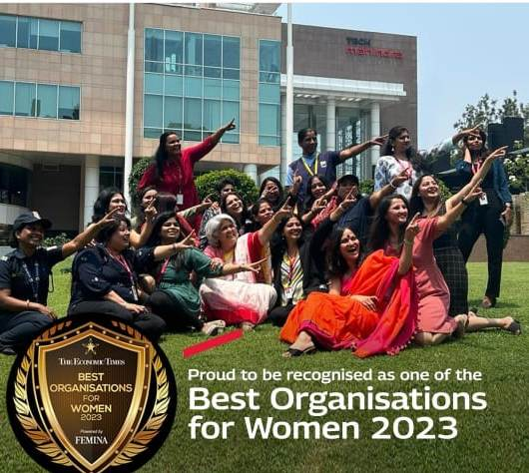

Slide 3
Part 1: Brand study, Competitor Analysis & Buyer’s/Audience’s Persona
Brand identity encompasses various aspects of a company's public image, including its logo, color scheme, typography, tone of voice, and overall visual representation. It's common for companies to refresh or update their brand identity over time to stay relevant, signal growth, or adapt to changing market trends.
As of my last update in September 2021, Tech Mahindra's mission and vision statements were as follows:
Mission:To be the most respected solution provider in the information, communication, and entertainment domains, creating value for customers through innovative technologies and enabling them to achieve business objectives with excellence."
Vision:To be the global leader in providing innovative and world-class IT solutions, adding value to our clients' businesses, creating a fulfilling environment for our people, and generating sustainable returns for our shareholders."

Slide 4
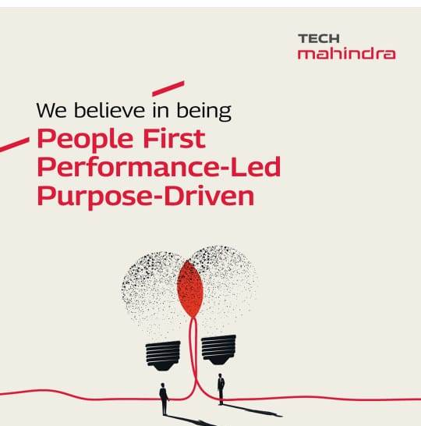

Slide 5
Part 1: Brand study, Competitor Analysis & Buyer’s/Audience’s Persona
Competitor Analysis:
Competitor 1: Tata Consultancy Services (TCS): TCS is one of the largest IT services companies in the world, providing services similar to Tech Mahindra. They offer IT consulting, software development, system integration, and business process outsourcing to various industries
Competitor 2: Infosys: Infosys is another major player in the IT services industry. They focus on delivering IT consulting, application development, and maintenance services, along with system integration and outsourcing solutions.
`Competitor 3:Wipro: Wipro is a multinational IT company that competes with Tech Mahindra in areas such as IT services, consulting, and outsourcing. They cater to various industries, including technology, finance, healthcare, and more.

Slide 6
Table of Contents
1
2
4
3
Tech Mahindra's service offerings and strategic goals, and they might have expanded or evolved their target audience
Tech Mahindra might also cater to the technology needs of smaller businesses seeking scalable IT solutions and digital services.
Tech Mahindra may also target government agencies and public sector orgnizations
Tech Mahindra has a strong presence in the telecommunications sector.

Slide 7
Part 1: Brand study, Competitor Analysis & Buyer’s/Audience’s Persona
Buyer's/Audience's Persona: Tech Mahindra has a strong presence in the telecommunications sector. Telecommunication companies and service providers seeking services like network transformation, managed services, and value-added services have been a significant part of Tech Mahindra's clientele.
Government and Public Sector: Tech Mahindra may also target government agencies and public sector organizations looking for technology solutions to improve citizen services, optimize operations, and enhance data security.
Small and Medium-Sized Businesses (SMBs): While large enterprises are a significant part of their audience, Tech Mahindra might also cater to the technology needs of smaller businesses seeking scalable IT solutions and digital services.
Global Market: Tech Mahindra's audience could be spread across the globe, as the company operates in multiple countries and serves international clients.

Slide 8
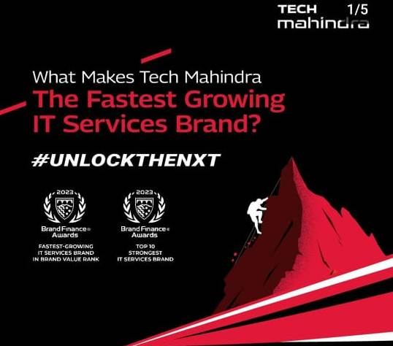
First Section
1
You could enter a subtitle here if you need it

Slide 9
Part 2: SEO & Keyword Research
SEO Audit: I can provide you with a general outline of the steps involved in an SEO (Search Engine Optimization) audit that you can use to evaluate Tech Mahindra's website or any other website. Keep in mind that conducting a comprehensive SEO audit requires access to specific tools and analytics data, which I don't have.
Keyword Research: Keywords Analysis: Review the target keywords and key phrases Tech Mahindra is ranking for, as well as the ones they are targeting. Ensure they are relevant to the business and have sufficient search volume.
On page optimizaeion:On-Page SEO: Check the website's meta tags (title tags, meta descriptions), URL structure, header tags (H1, H2, etc.), keyword usage, and overall content quality and relevance. Ensure the on-page elements are optimized for search engines and user experience.
Keep in mind that each company may have its own specific approach to keyword research and SEO recommendations based on their expertise and goals. To get accurate information about Tech Mahindra's specific strategies, it's best to refer to their official statements or press releases.

Slide 10
You Can Use Two Columns
1
2
Tech
Mahindra
Technology, in this context, refers to the application of scientific knowledge, skills, and tools to create products, systems, or services that solve problems, improve efficiency, and enhance the overall human experience.
The Mahindra Group is an Indian multinational conglomerate with a diverse range of businesses. It was founded in 1945 as a steel trading company and has since expanded into various sectors, including automotive

Slide 11
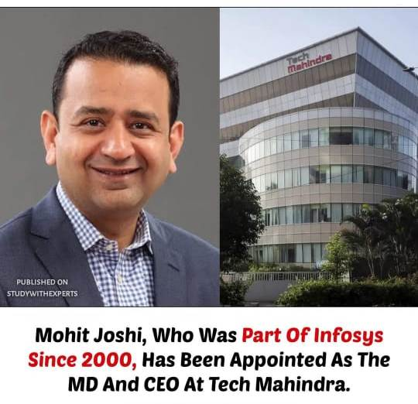
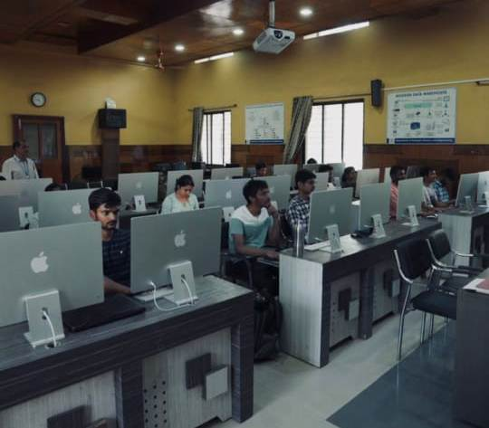

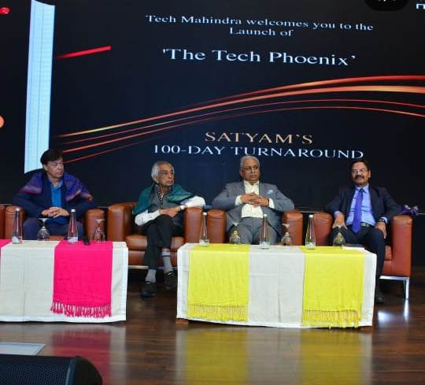
Part 3: Content Ideas and Marketing Strategies
Content Idea Generation & Strategy:
Week 1: July 1st - July 7th Thought Leadership Article: "The Future of 5G: Unlocking Opportunities for Businesses"
Week 2: July 8th - July 14thWebinar: "Data Privacy in the Age of AI: Best Practices for Businesses"
Week 3: July 15th - July 21st Podcast Episode: "Navigating the Cloud: Tips for Seamless Cloud Migration"
Week 4: July 22nd - July 28th Interactive Content: "AI Readiness Quiz: Is Your Business Ready for Artificial Intelligence?"
Week 5: July 29th - July 31st eBook Release: "Digital Transformation Trends 2023: What Lies Ahead?"

Slide 12
You Can Use Three Columns, Why Not?
1
2
3
Major Clients: List some of the significant clients that Tech Mahindra serves
Partnerships: Mention strategic partnerships with other technology companies, software vendors, and industry-specific organizations.
Community Engagement: Participate in relevant online communities, forums, and events to establish Tech Mahindra's

Slide 13
Part 3: Content Ideas and Marketing Strategies
Content Ideas:
Thought Leadership Articles: Create in-depth articles written by subject matter experts within Tech Mahindra on industry trends, emerging technologies, and best practices. Position the company as a thought leader in the IT and technology space.
Case Studies: Showcase successful projects and collaborations with clients, demonstrating how Tech Mahindra's solutions have solved real-world business challenges.
Webinars and Podcasts: Host webinars and podcasts featuring experts from Tech Mahindra and other industry leaders, discussing relevant topics, sharing insights, and engaging with the audience.
Marketing Strategies:
Social Media Engagement: Leverage social media platforms to share content, engage with the audience, participate in industry discussions, and showcase company culture.
SEO Optimization: Ensure content is search engine optimized to improve Tech Mahindra's online visibility and reach a broader audience.
Email Marketing: Build and nurture an email subscriber list to distribute valuable content,

Slide 14
Part 4: Content Creation and Curation (Post creations, Designs/Video Editing, Ad Campaigns over Social Media and Email Ideation and Creation)
Post Creation:
Select Content Categories: Information Technology (IT) Services: Tech Mahindra provides a comprehensive suite of IT services, such as software development, application management, infrastructure management, and cybersecurity solutions.
Format 1 Consulting Services: They offer consulting services to businesses, helping them optimize their operations, adopt new technologies, and improve overall efficiency.
Format 2 Cloud Services: Tech Mahindra helps organizations migrate to the cloud, build cloud-native applications, and optimize their cloud infrastructure.
Format 3 Network Services: Tech Mahindra offers network-related services to businesses and communication service providers, including network planning, integration, and management.

Slide 15

A Picture Is Worth a Thousand Words

Slide 16
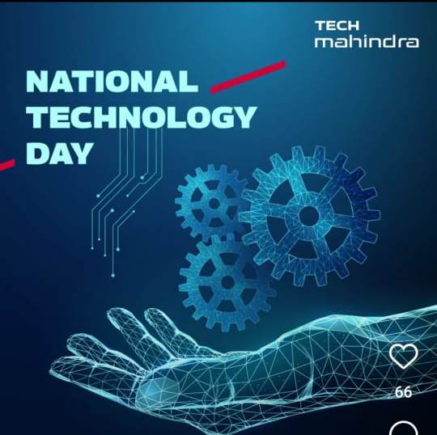
A Picture Always Reinforces the Concept

Slide 17
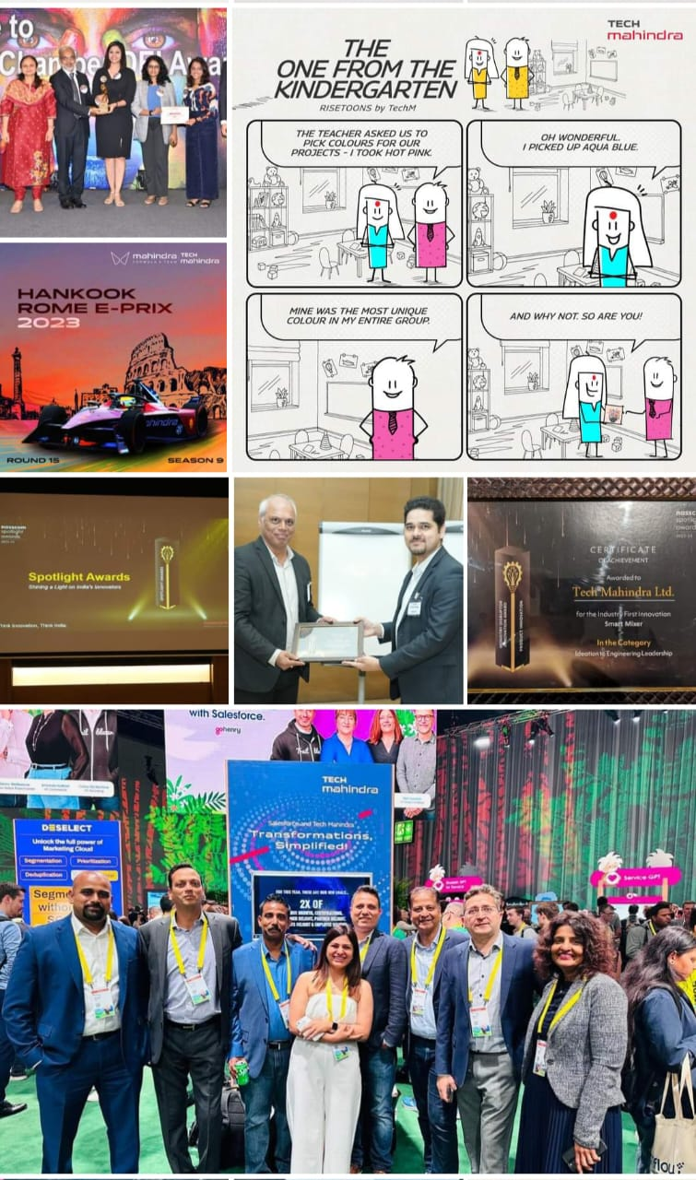
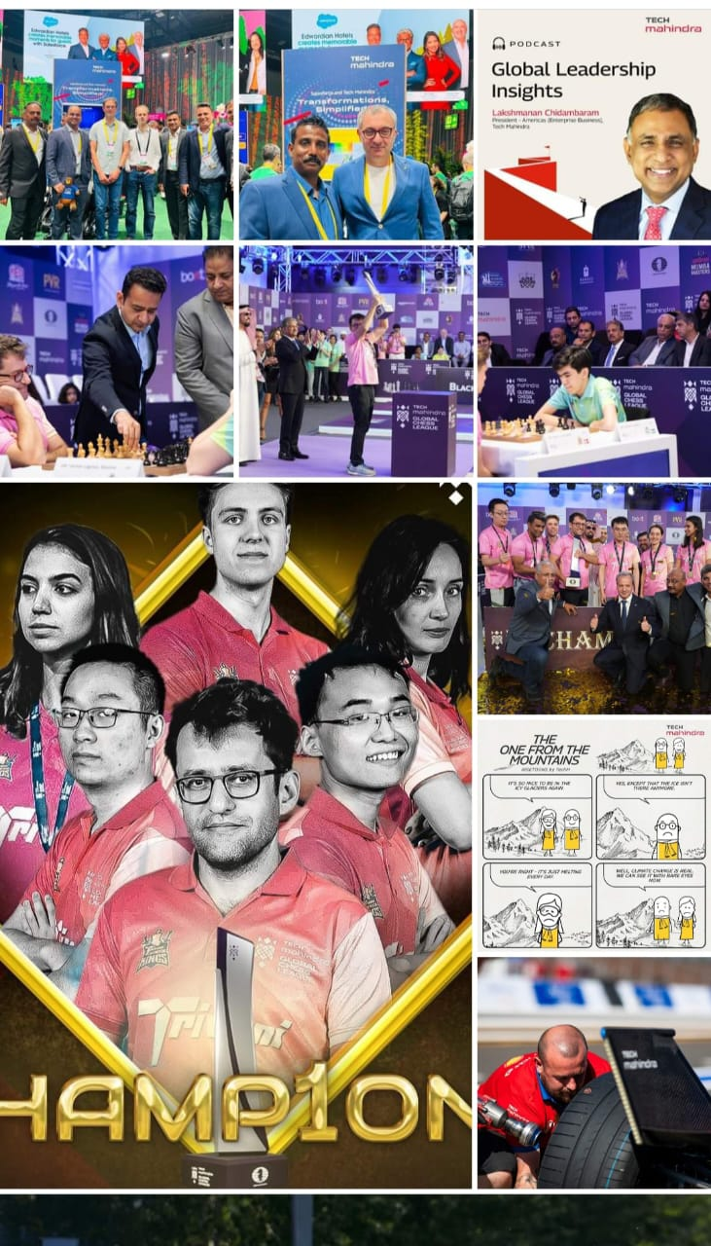
Part 4: Content Creation and Curation (Post creations, Designs/Video Editing, Ad Campaigns over Social Media and Email Ideation and Creation)
Instagram Story
Facebook story

Slide 18
Awesome Words
Please remember that the specifics of the campaigns and social media activities would have evolved over time, and Tech Mahindra's current strategy may include new platforms or different approaches. To get the most up-to-date information, I recommend visiting Tech Mahindra's official social media channels and website.

Slide 19
Thanks!
‘’ Its not just about being better.Its about being drifferent.You need give people a reason to choose your business ‘‘

