Slide 1
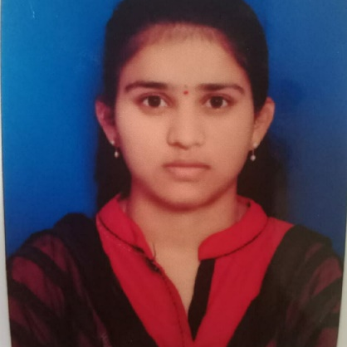

Shravani Nimma
Bachelor of Technology, Electronics and Communication Engineering:2016-2020
Skills:
Analyst/Software Engineer
Bangalore
nimma.shravani@capgemini.com
Spring | Spring Boot, Spring Rest Services
Database | Postgre SQL
UI Tech | HTML 5 & CSS 3,JavaScript, Bootstrap
Tools | Git & GitHub, Eclipse, STS Postman, Visual Studio Code, Pg Admin4.
Add On skills | Immersive learning and Java
+91 9849676177
A4
Hands on experience on Core Java, Postgre SQL, Spring Restful Services.
Proficient in creating Single page Web Application in Angular with Authentication with routing.
Good understanding of developing new Controller and Entity classes in Spring.
Hands on experience in developing web pages using HTML, CSS, JavaScript.
. Ready to learn new technologies and implement them for the future knowledge improvement.
Case study On Interview tracking system is done by using API gateway, Postman, Responsive UI with HTML, CSS, Bootstrap and Angular used as User Interface.

