Slide 1
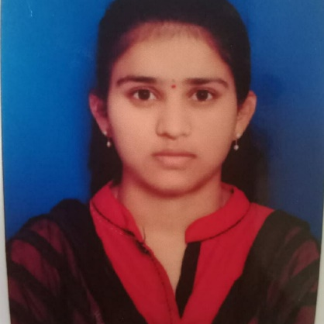

Shravani Nimma
Bachelor of Technology, Electronics and Communication Engineering:2016-2020
Skills:
Analyst/Software Engineer
Bangalore
nimma.shravani@capgemini.com
Java 8 | Java Basics, Oops, Collections, Arrays
Spring | Spring Boot, Spring Rest Services
Angular | Components, Services, Modules, Routing, Forms & Validation
Spring cloud | Eureka
Database | Postgre SQL, MongoDB NO SQL Database
UI Tech | HTML 5 & CSS 3,JavaScript, Bootstrap
Tools | Git & GitHub, Eclipse, STS Postman, Visual Studio Code, Pg Admin4.
Add On skills | Immersive learning and Communication
+91 9849676177
A4
Case study On Interview tracking system is done by using API gateway, Postman, Responsive UI with HTML, CSS, Bootstrap and Angular used as User Interface.
Online Hotel-Management Application
Completed end to end case study of Hotel management Application along with JWT authentication, Swagger and payment testing using Stripe, responsive UI with Tailwind CSS and Angular used for user interface.
https://github.com/Nimmashravani/resume-46219293-shravani-nimma.git
https://github.com/Nimmashravani/video-of-case-study-online-hotel-mgt.git
Full Stack Developer
Hands on experience in creating microservices with Springboot, Spring Security, Spring Cloud API Gateway, Eureka server
Proficient in creating Single page Web Application in Angular with Authentication with route guards, Angular reactive forms, angular routing, Tailwind CSS
Hands on experience in implementing NodeJs & spring boot
Experience in creating documentation with Java docs and swagger and in unit testing using Junit, Mockito

