Slide 1
DATA WAREHOUSE FOR EDUCATIONAL INSTITUTION
PALLAVI CHOUDHARY
MIHIKA NAIK
SWATI KANDARI
NIMMI GHETIA

Slide 2
REQUIREMENTS
1. Purpose
Maximize profit
Attract good quality students and teachers
Better placement statistics
2. OLTP Data sources
Marks uploaded by faculties
Data from admissions department
Placement Statistics
Payroll Data from Accounts Office
Attendance captured (Manually or by RFID Readers)

Slide 3
The Data Warehouse will help us in firing the following queries:
1. Correlation between attendance and performance of a student.
2. Correlation between student performance, attendance and placement secured.
3. Sector wise placement package, Job profile wise package. This will give us highly paid jobs and which profiles students should aim for in future.

Slide 4
STUDENT ACADEMICS INFORMATION PACKAGE
Dimension
Student | Course | Faculty | Date
ID | Course ID | Faculty ID | Day
Name | Name | Name | Week
Degree Admitted | Department | Designation | Month
Department | Credits | Specialization | Year
Contact No. | Resource | Room No. | Term
Email ID |  | Department | Holiday
Account No. |  | Qualification | Semester
Hierarchies
Mid Sem Marks, End Sem Marks, Project Marks, Grace Marks, Total Marks, Grade

Slide 5
STUDENT ACADEMICS
STAR SCHEMA
Student
Student Key
Student ID
Name
Degree Admitted
Department
Contact No.
Email ID
Account No.
Academics – Fact Table
Student Key
Resource Key
Course Key
Faculty Key
Date Key
Application No.(DD)
Mid Semester Marks
End Semester Marks
Evaluative 1
Evaluative 2
Grade
Faculty
Faculty Key
Faculty ID
Faculty Name
Designation
Specialization
Room Number
Department
Qualification
Course
Course Key
Course Code
Course Name
Department
Resource
Credits
Date
Date Key
Day
Week
Month
Year
Term
Holiday
Semester

Slide 6
PAYROLL INFORMATION PACKAGE
Dimension
Faculty | Student | Date
Faculty Key | ID | Day
Faculty ID | Name | Week
Faculty Name | Degree Admitted | Month
Designation | Department | Year
Specialization | Contact No. | Term
Room Number | Email ID | Holiday
Department | Account No. | Semester
Hierarchies
Fact Metrics: Pay, Professional Tax, Income Tax, Arrears, Provident Tax, Net Payment

Slide 7
Faculty
Faculty Key
Faculty ID
Faculty Name
Designation
Specialization
Room Number
Department
Qualification
PAYROLL STAR SCHEMA
Payroll Fact
Faculty Key
Employee Key
Student Key
Wage Key
Date Key
Pay
Arrears
Professional Tax
Provident Fund
Net Payment
Date
Date Key
Day
Week
Month
Year
Term
Holiday
Semester
Student
Student Key
Student ID
Name
Degree Admitted
Department
Contact No.
Email ID
Account No.

Slide 8
ADMISSION INFORMATION PACKAGE
Dimension
Applicant | Degree | Qualifying Exam | Date
Name | Degree Code | Code | Day
Gender | Title | Type | Week
Contact No. | Specialization | Year | Month
Email ID | Department | Cut Off | Year
Address |  | Total Marks | Term
 |  |  | Holiday
 |  |  | Semester
Hierarchies
Fact Metrics : Applied Date, Application Status, Offered Date,Accepted/Rejected Date, Marks.

Slide 9
ADMISSION STAR SCHEMA
Applicant
Applicant Key
Name
Gender
Contact No.
Email ID
Address
Qualifying Exam
Qualifying Exam Key
Code
Type
Year
Cut Off
Total Marks
ADMISSION FACT
Applicant Key
Date Key
Qualifying Exam Key
Degree Key
Marks
Application ID (DD)
Application Status
Applied Date
Offered Date
Accepted/Rejected Date
Officer Key
Degree
Degree Key
Degree Code
Title
Specialization
Department
Date
Date Key
Day
Week
Month
Year
Term
Holiday
Semester

Slide 10
PLACEMENT INFORMATION PACKAGE
Dimension
Student | Company | Date
ID | Company Key | Day
Name | Company ID | Week
Degree Admitted | Name | Month
Department | Sector | Year
Contact No. | Category | Term
Email ID | HR | Semester
Account No. | Company
Hierarchies
Fact Metrics: Package, Job Profile

Slide 11
PLACEMENT STAR SCHEMA
Student
Student Key
Student ID
Name
Degree Admitted
Department
Contact No.
Email ID
Account No.
Company
Company Key
Company ID
Name
Sector
Category
HR
PLACEMENT
Student Key
Company Key
Date Key
Team Key
Job Profile
Package
Date
Date Key
Month
Year
Term

Slide 12
ATTENDANCE INFORMATION PACKAGE
Dimension
Hierarchies
Student | Course | Room | Faculty | Date
ID | Course ID | Block Number | Faculty Key | Day
Name | Name | Room Number | Faculty ID | Week
Degree Admitted | Department | Capacity | Faculty Name | Month
Department | Credits |  | Designation | Year
Contact No. | Resource |  | Specialization | Term
Email ID |  |  | Room Number | Holiday
Account No. |  |  | Department | Semester

Slide 13
ATTENDANCE STAR SCHEMA
Student
Student Key
Student ID
Name
Degree Admitted
Department
Contact No.
Email ID
Account No.
ATTENDANCE FACT
Student Key
Course Key
Faculty Key
Room Key
Date Key
Course
Course Key
Course ID
Name
Department
Resource
Credits
Date
Date Key
Day
Week
Month
Year
Term
Holiday
Semester
Room
Block Number
Room Number
Capacity
Faculty
Faculty Key
Faculty ID
Faculty Name
Designation
Specialization
Room Number
Department
Qualification

Slide 14
ENTERPRISE DW BUS MATRIX
 | Date | Student | Faculty | Course | Qualifying Exam | Applicant | Degree
Academics | x | x | x | x
Admission | x |  |  |  | x | x | x
Payroll | x | x | x
Attendance | x | x |  | x
Placement | x | x

Slide 15
Conformed Dimension
Student, Faculty, Date, Course
Fact less Table
Attendance Fact Table
Accumulated Fact Table
Admission Fact Table
Degenerate Dimension
Application Number
Role Playing Dimension
Date

Slide 16
Implementation
ETL Tool Used: Tableau Prep
BI Tool Used: Tableau Desktop

Slide 17
ETL Operations
Removing Duplicate rows
Splitting columns (Name-> Firstname and lastname)
Completing column description
M -> Male, F-> Female
abcd -> abcd@pilani.bits-pilani.ac.in
cs -> Computer science department )
Extracting information from intelligent key
year of joining
department
UG and PG

Slide 18
Measures
Additive
Salary
Marks(mid sem, end sem, quiz etc.)
Semi-Additive
Placement Package
Non-Additive
10th, 12th % marks

Slide 19
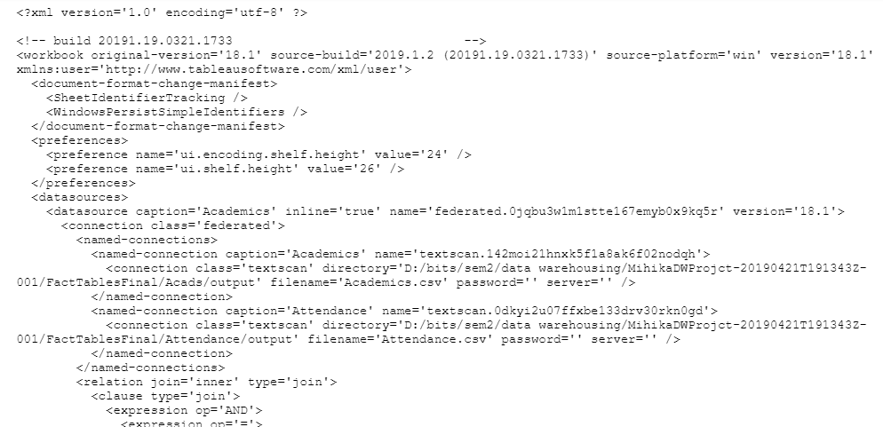
Metadata Files

Slide 20
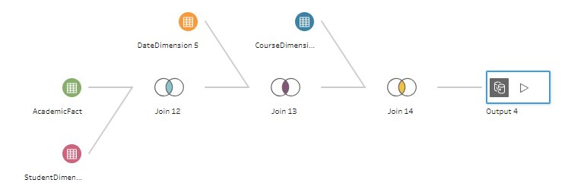
Star Schema : Tableau Flows
Academics

Slide 21
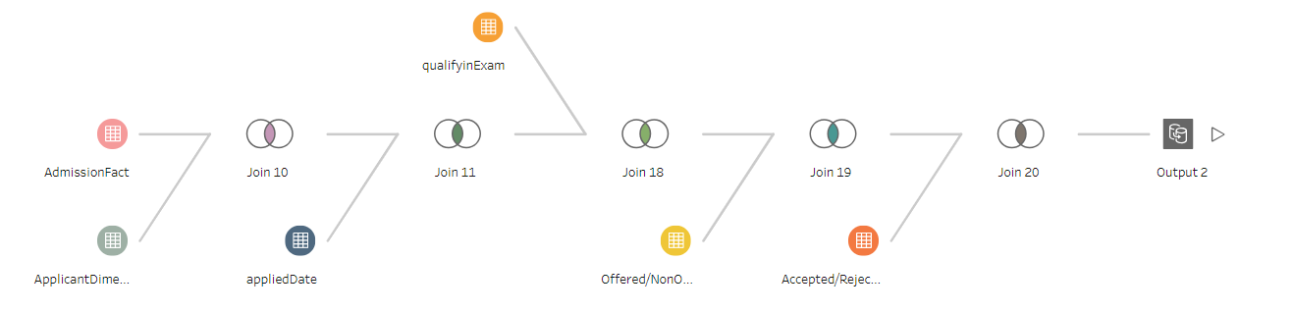
Admission

Slide 22
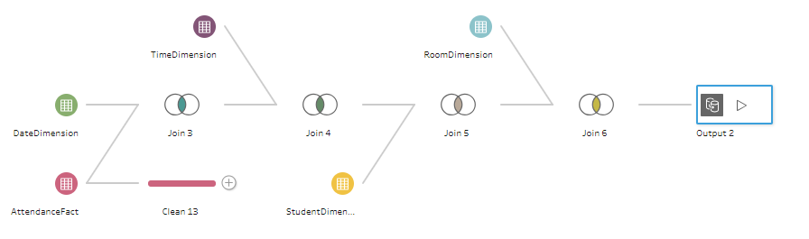
Attendance

Slide 23
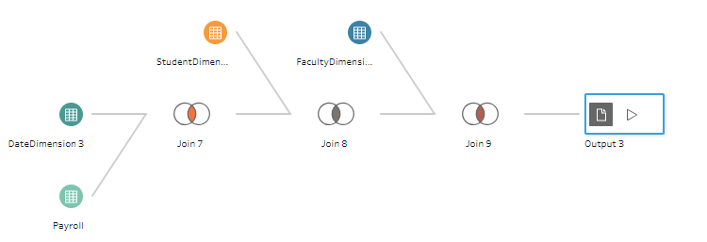
Payroll

Slide 24
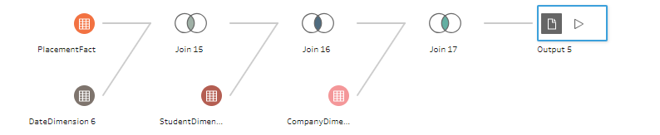
Placement

Slide 25
Dashboards
Students’ attendance vs Placement (Drill Down)
Students’ attendance vs Academics
Marks vs Placement
Avg, Min, Max Marks in all courses
Placement- Slicing, Dicing
Attendance- Pivot
Package distribution across sectors and job profile

Slide 26
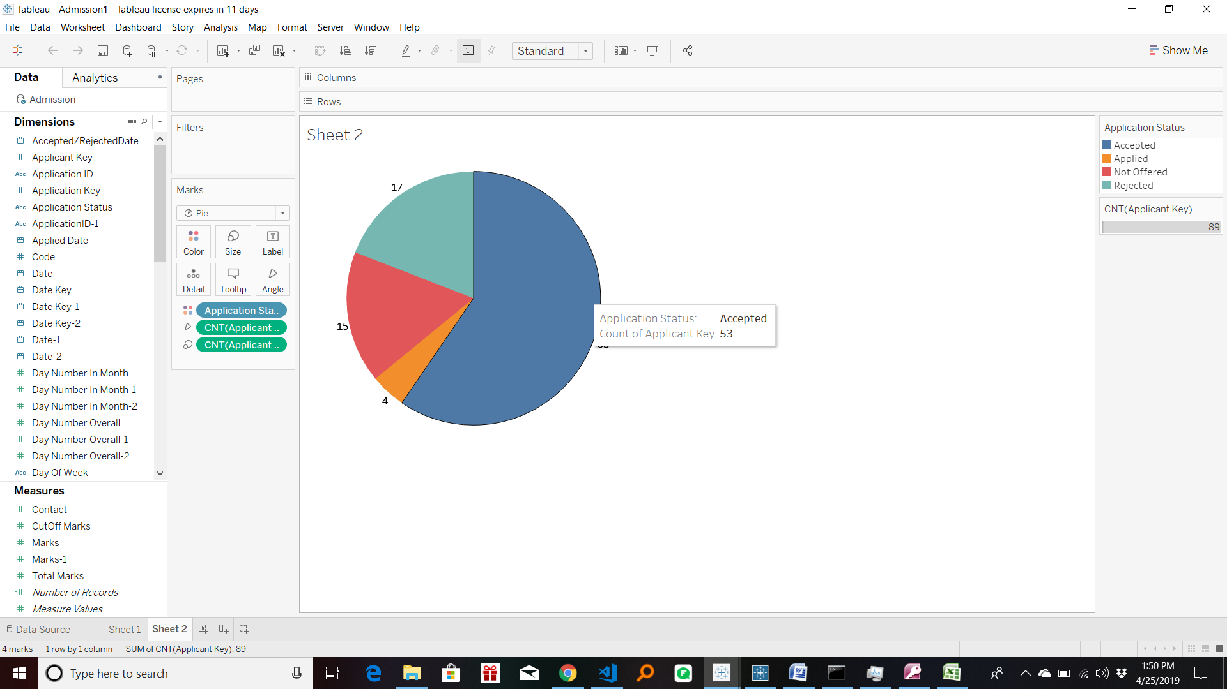
Dashboard: Admission

Slide 27
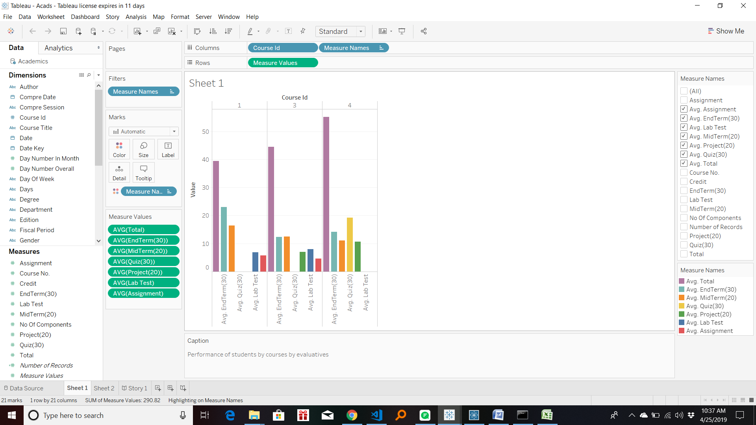
Dashboard : Acads

Slide 28
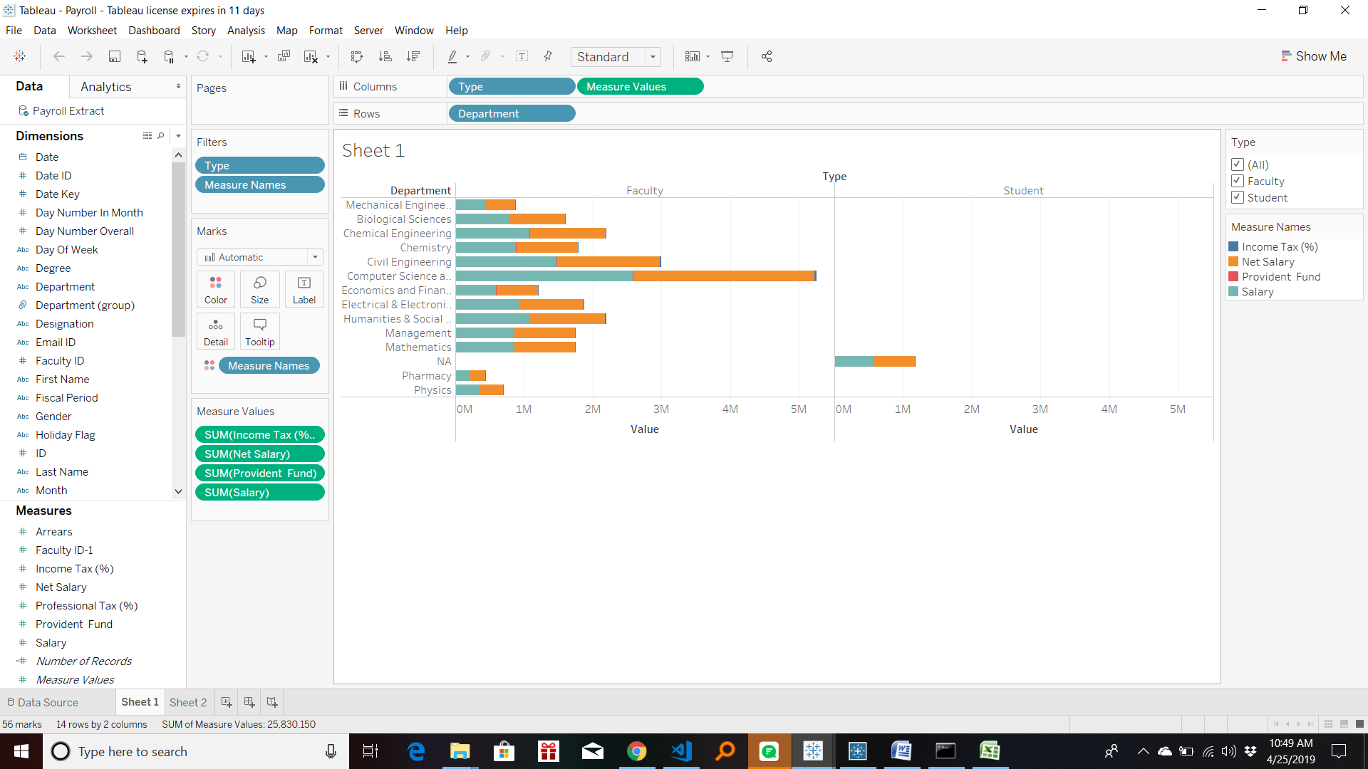
Dashboard: Payroll

Slide 29
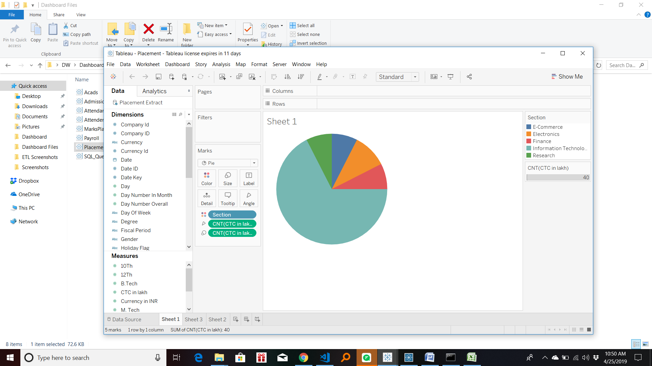
Dashboard : Placement

Slide 30
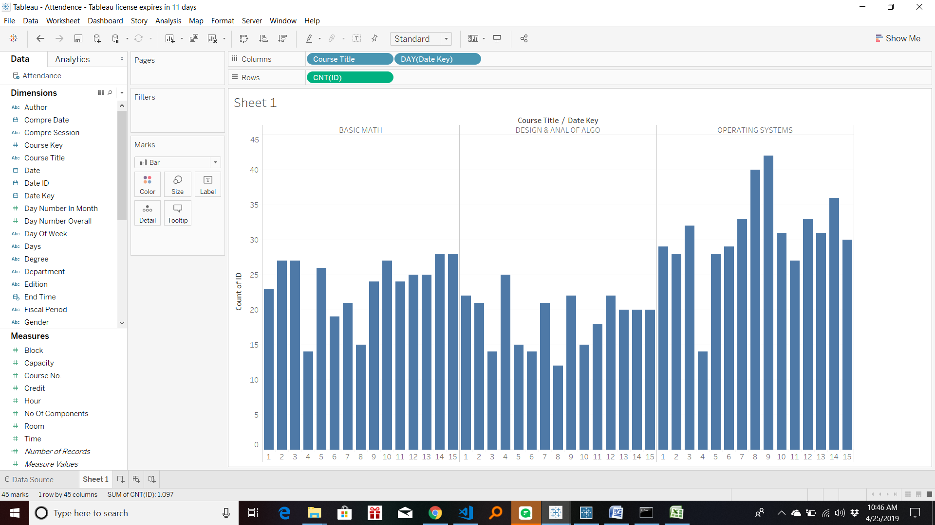
Roll : Attendance

Slide 31
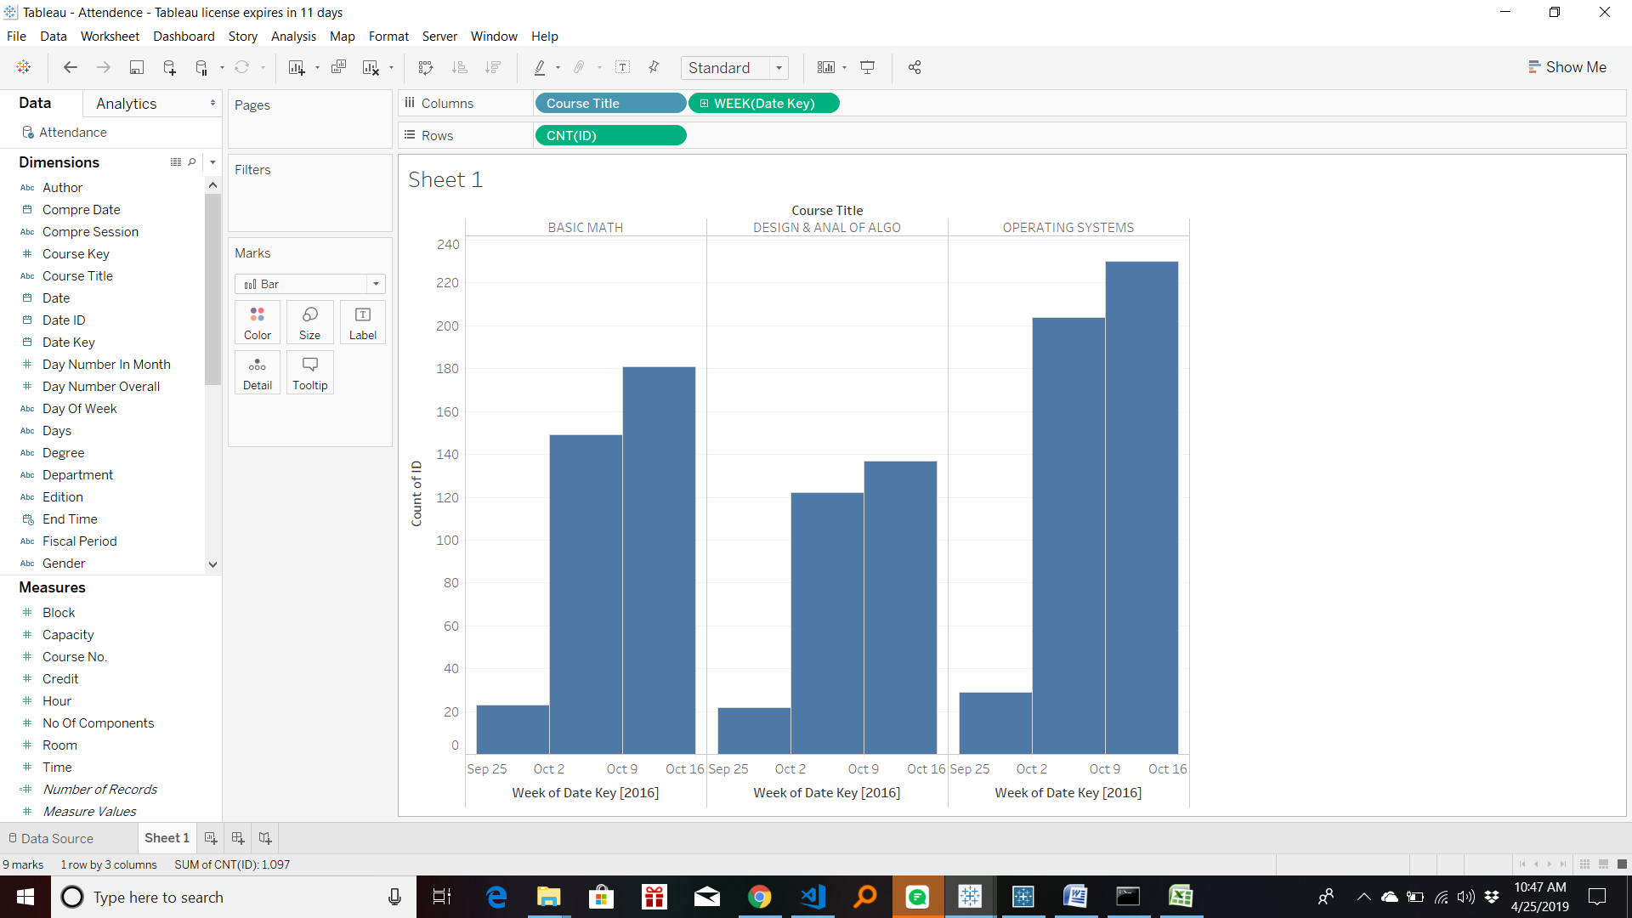

Slide 32
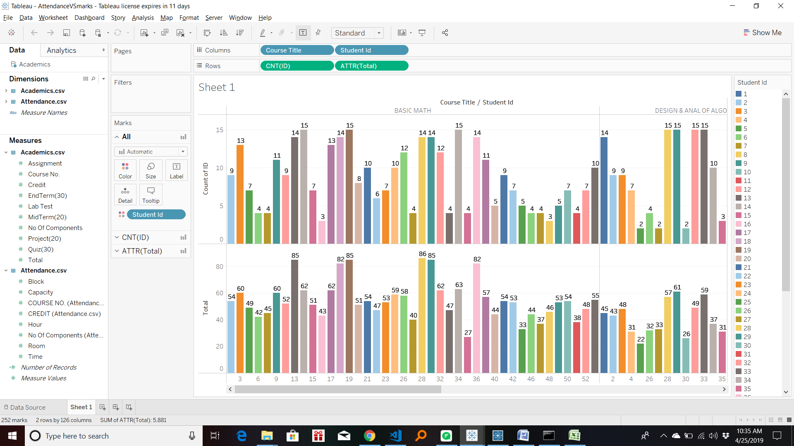
Drill Across: Placement and Acads

Slide 33
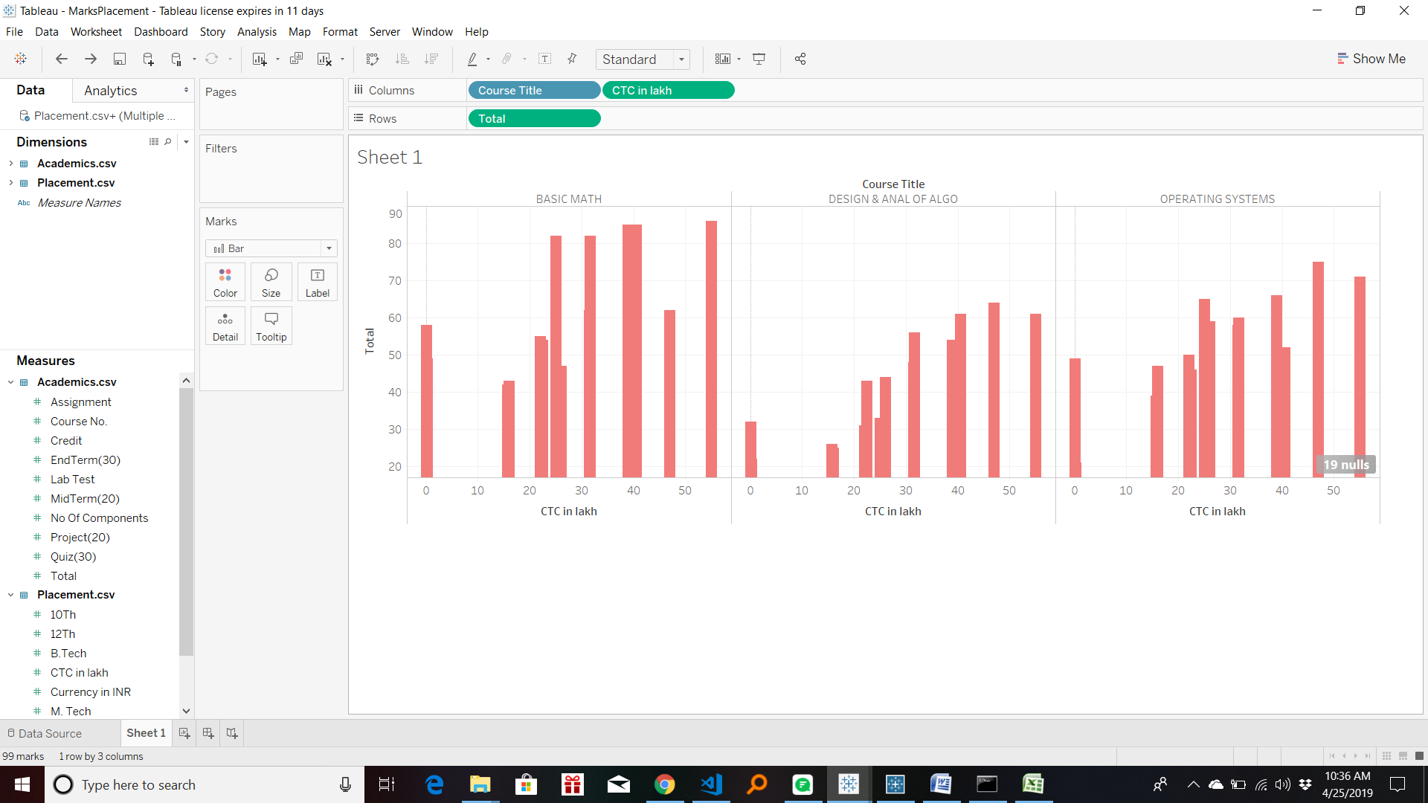
Drill Across: Marks and Placement

Slide 34
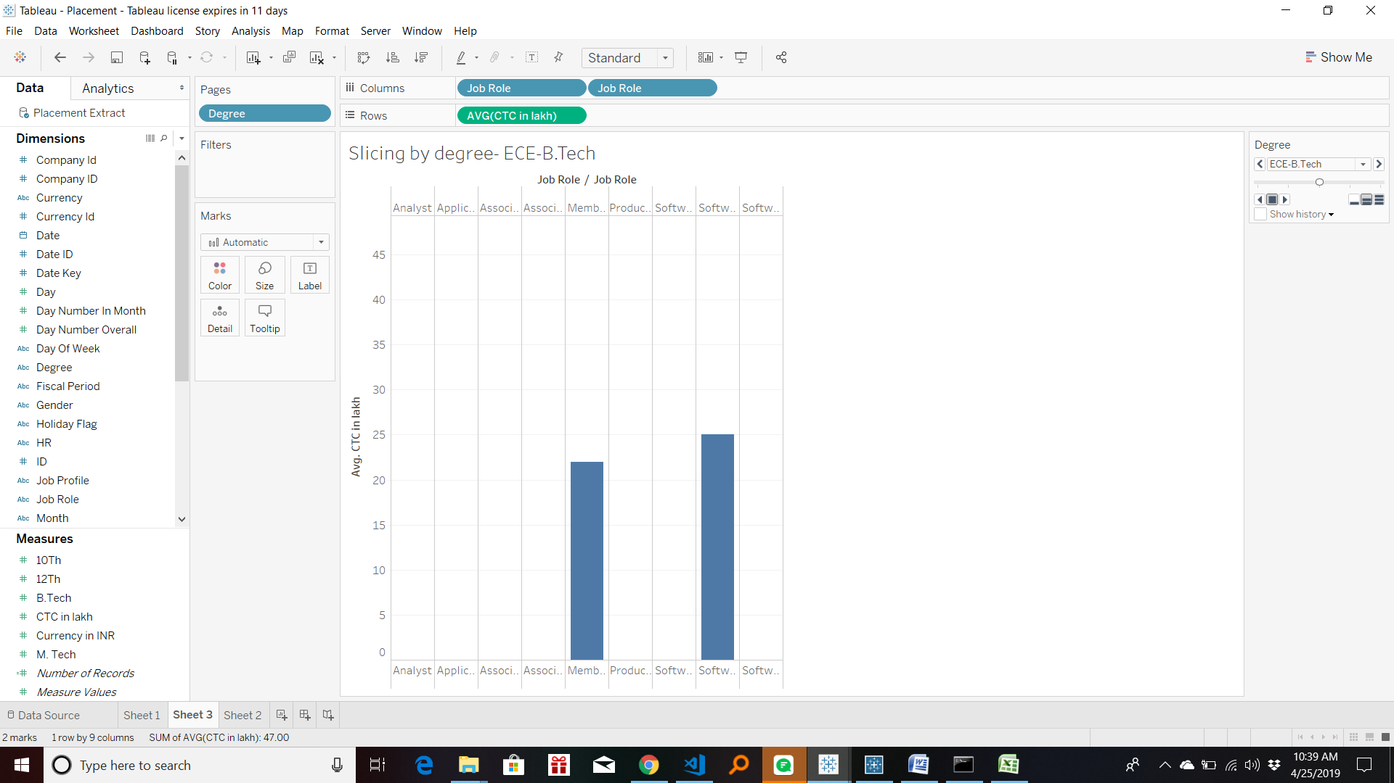
Slicing

Slide 35
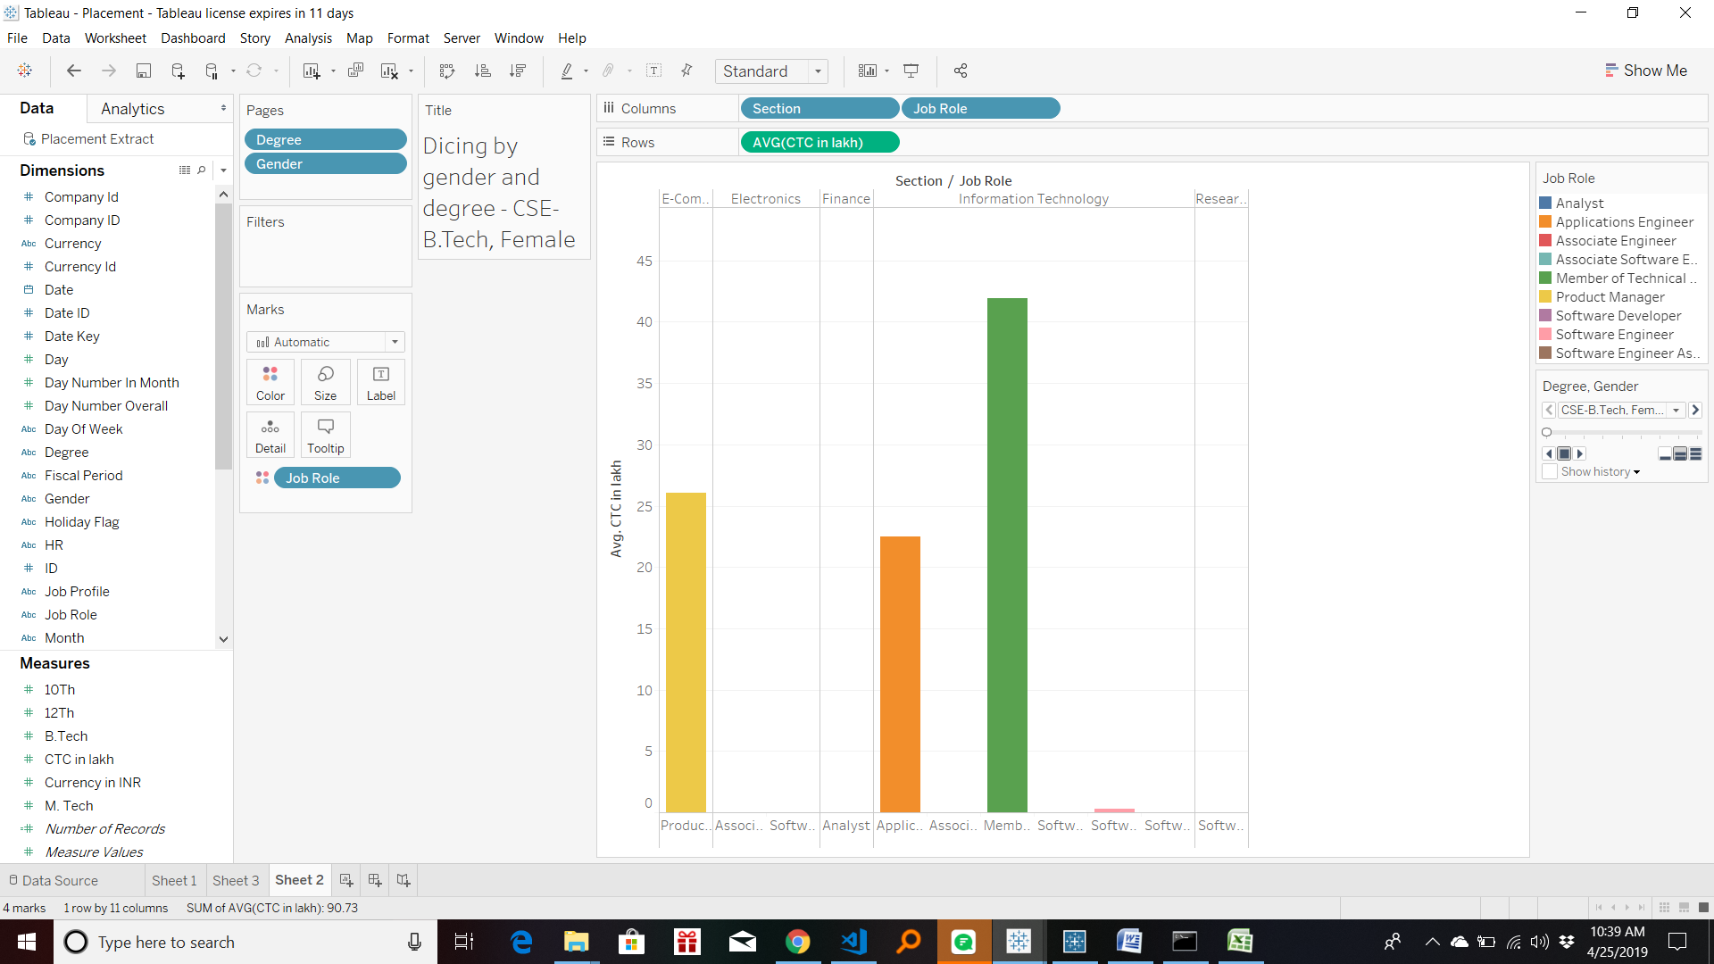
Dicing

Slide 36
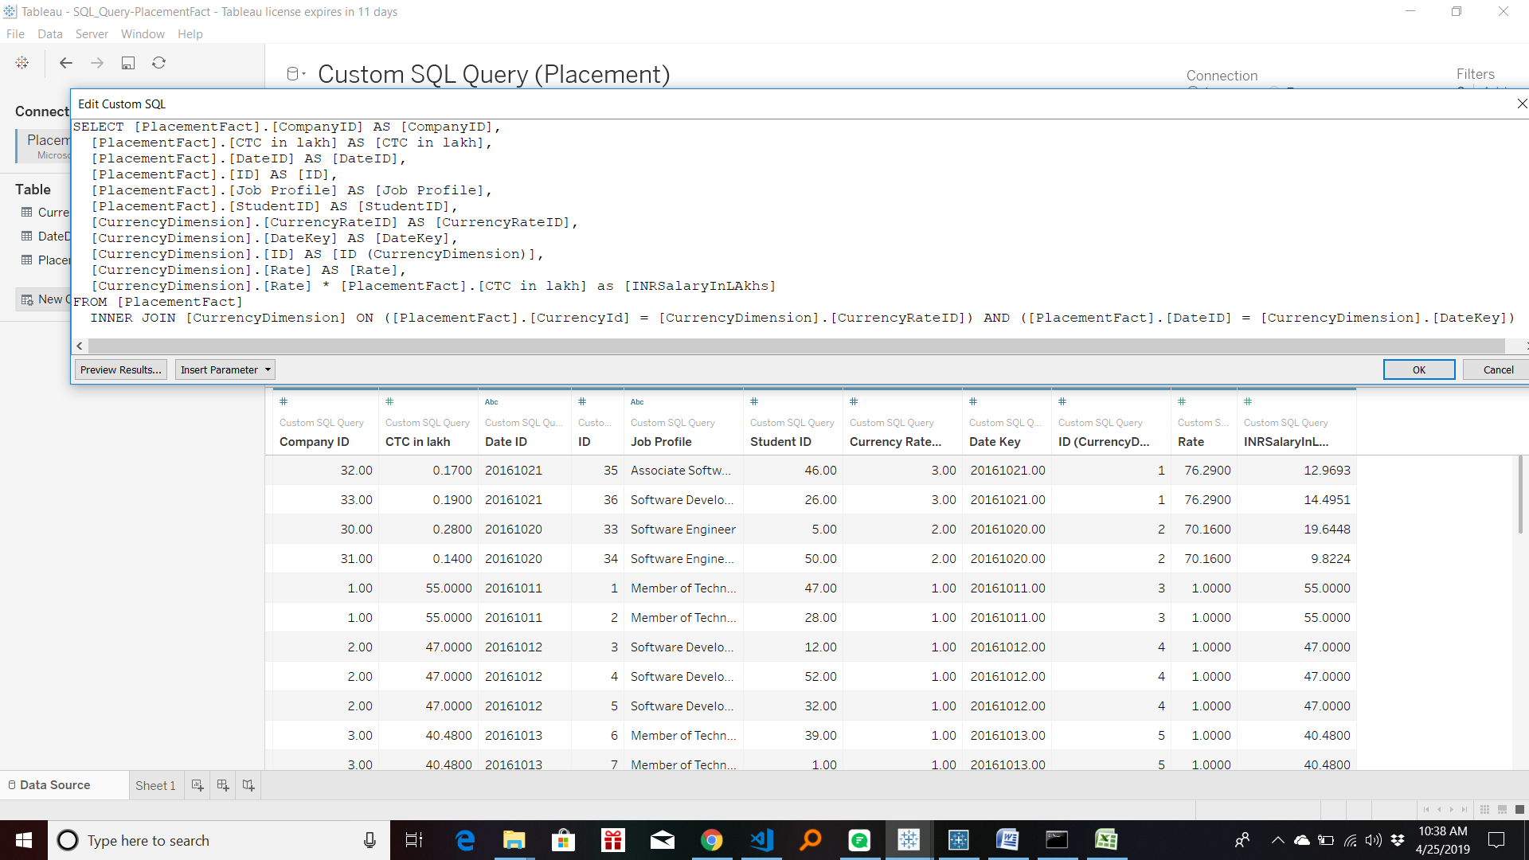
Custom SQL Query

Slide 37
THANK YOU

