Slide 1
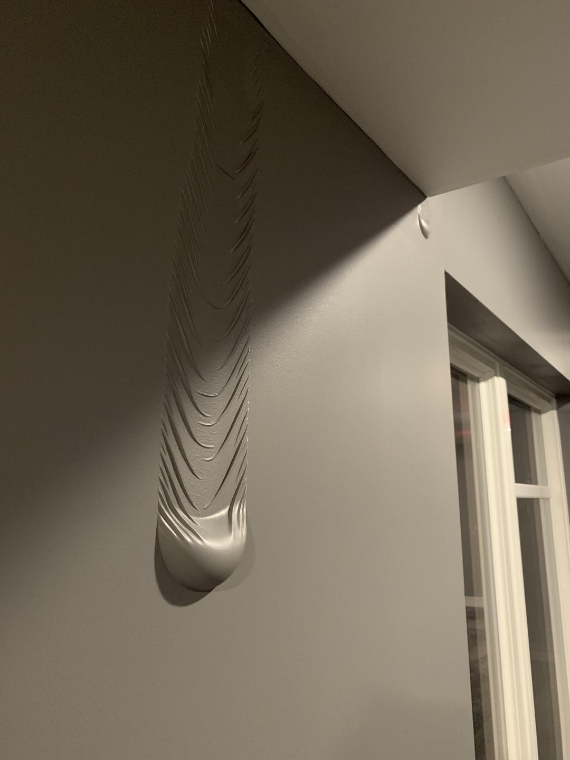
Water leakage detection IN WALLS
M. GOWTHAMI - 99220040401
Y. TEJA SRI – 99220041034
K. PRANAYA – 99220041510
N.MANASA – 9922005309
CH.SRINIVASA REDDY - 99220041761

Slide 2
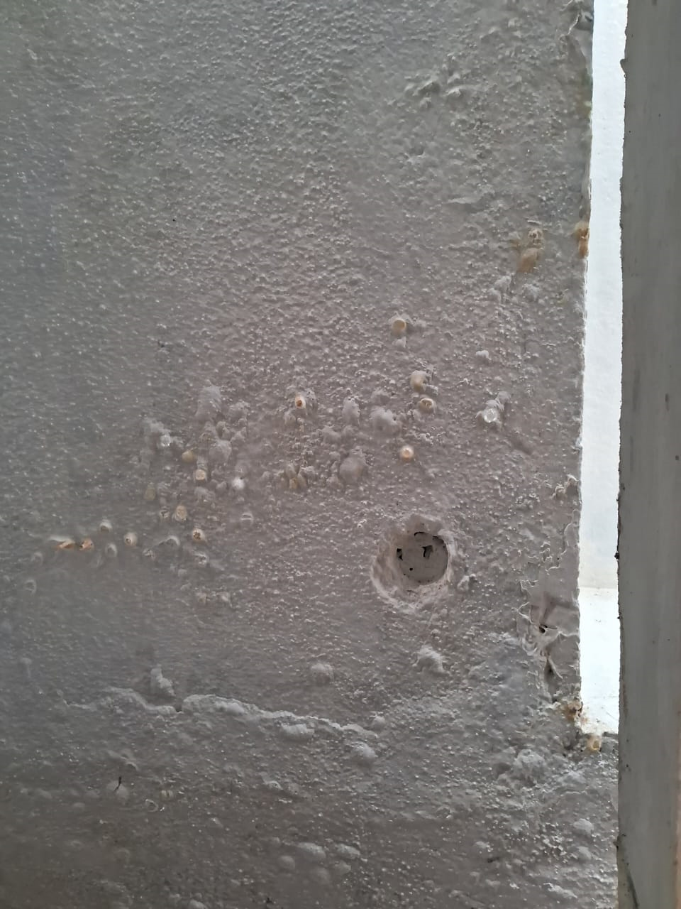
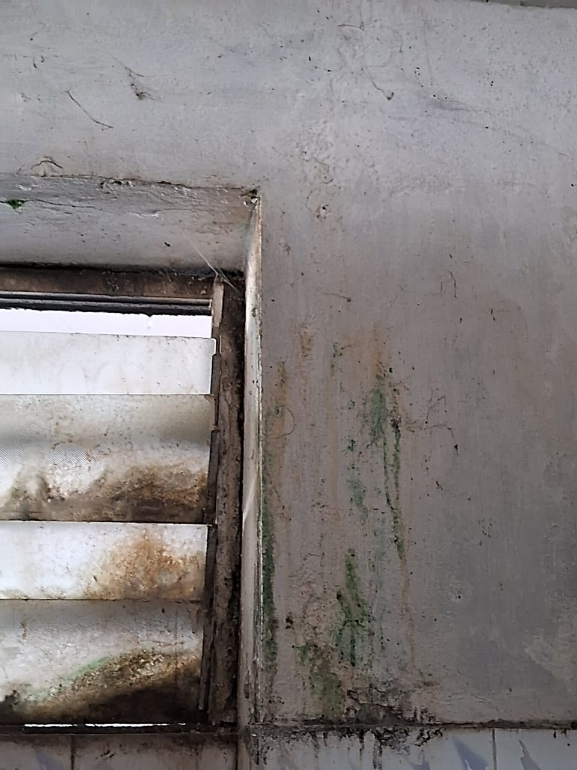
DATA COLLECTION

Slide 3
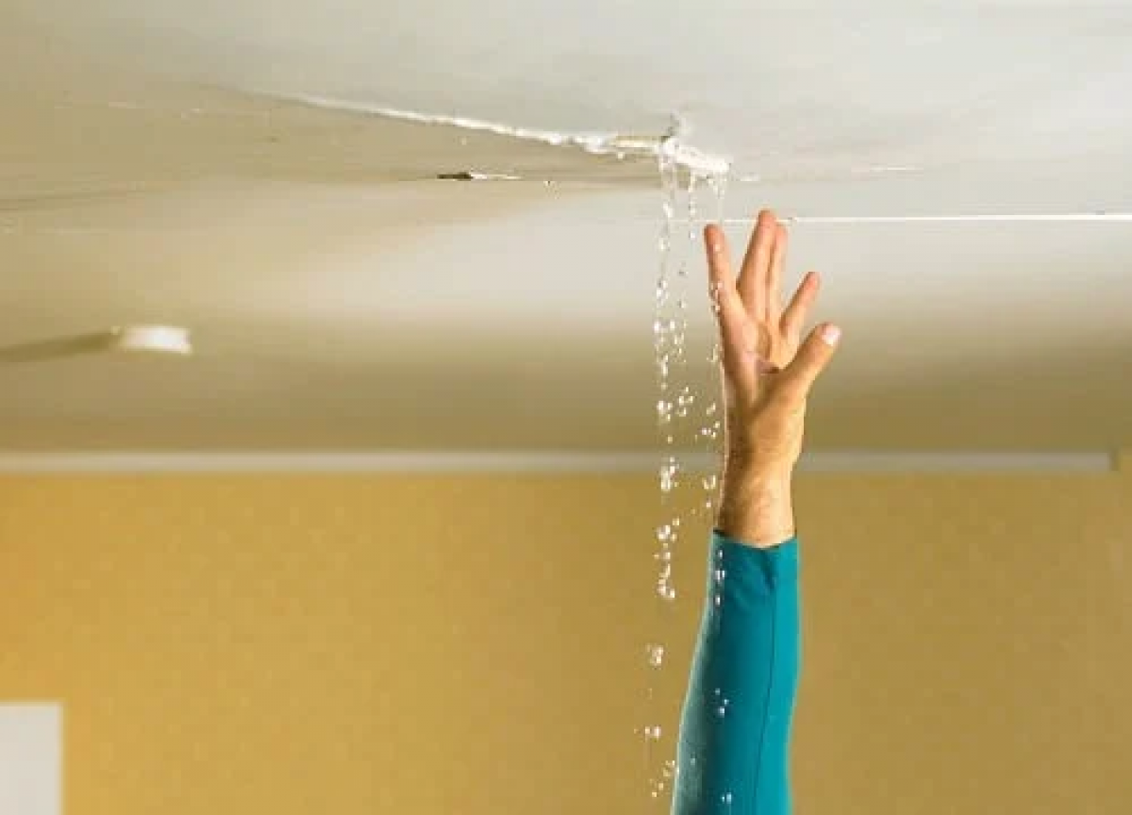
INTRODUCTION
Water leakage in walls is a common problem that can lead to serious damage if left untreated. It occurs when water blocked into walls due to broken pipes, poor construction, or environmental factors like heavy rain. This hidden water can weaken the structure of buildings, cause mold growth, damage paint or plaster, and increase repair costs. Detecting such leaks early is essential to prevent long-term issues.
Modern detection methods use advanced technologies like sensors, infrared cameras, or moisture meters to find water without damaging the walls. By identifying leaks quickly and accurately, these systems help homeowners and builders maintain the integrity of their structures and save on costly repairs.

Slide 4
CAUSES OF WATER LEAKAGE in walls
Water leakage in walls can happen due to several reasons. Leaky pipes inside or behind the walls are a common cause, as well as gaps or cracks around windows and doors that let rainwater in.
Damaged roofs, blocked, and cracks in the wall itself can also allow water to slowly flow through.
High humidity or poor waterproofing can lead to moisture, and plumbing issues like burst pipes can cause leaks too.
Lastly, water from the outside, like heavy rain or poor drainage, can seep into walls from the ground.

Slide 5
OBJECTIVES
Early Detection of Water Leaks
Goal: Find leaks as soon as they happen to stop them from getting worse.
Protect the Structure of the Wall
Goal: Stop water from damaging the wall’s strength.
Why: If water stays in the wall too long, it can weaken it, causing cracks or even bigger problems like foundation damage.
Stop Mold from Growing
Goal: Keep moisture from creating mold or mildew inside the wall.
Why: Mold can damage your walls and is also bad for your health, causing breathing problems and allergies.

Slide 6
methodology
To detect water leakage in walls using moisture sensors, we first place the sensors on the wall where leaks are likely to occur. These sensors measure the moisture levels in the wall, sending the data to a microcontroller like an Arduino or ESP32.
The microcontroller processes the moisture readings and compares them to a preset threshold value. If the moisture level exceeds the threshold, indicating a potential leak, it triggers an alarm or sends a notification to a smartphone. This system continuously monitors the wall, providing real-time alerts to detect leaks early and prevent damage.

Slide 7
BLOCK DIAGRAM
MOISTURE SENSOR
Microcontroller (Arduino/ESP32)
Threshold Comparison
Exceeds Threshold
Alarm/ Notification System
POWER SUPPLY

Slide 8
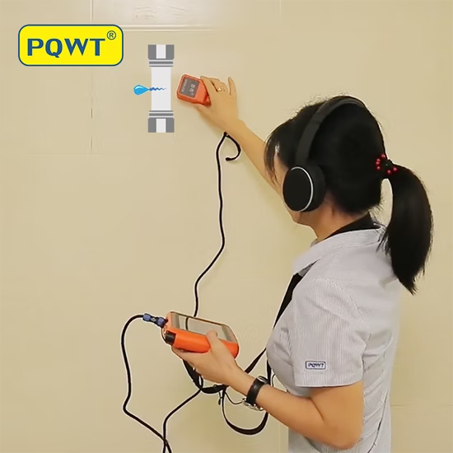
SOLUTION
Detecting water leakage in walls requires a reliable moisture sensor. This sensor detects slight changes in moisture levels. Popular option ESP32. Install the sensor in the wall, near the suspected leak area. Ensure the sensor is securely fastened and protected. Connect the sensor to a microcontroller like Arduino or raspberry pi. Set threshold values for the moisture sensor to trigger alerts. When the sensor reading exceeds the threshold, it sends notifications to your phone or email. This allows you to inspect and repair the leak promptly.

Slide 9
THANK YOU

