Slide 1


MIPS PROCESSOR USING VERILOG
213ECE3437 – Low power VLSI Design
BATCH NO – 02
GUIDED BY : M NAVEEN KUMAR (P2F SEMI)

Slide 2
CLASS III – ECE -C
TEAM MEMBERS
LIKHITHA B 9922005025
NAGA PAVITHRA K 9922005040
MANASA N 9922005309
MEGHANA S 9922005291
MEGHANA D 9922005276

Slide 3
Abstract
This presentation explores the integration of power gating techniques into a simplified MIPS processor design to enhance power efficiency in digital systems. Power gating is a key technique to reduce static power consumption by selectively powering down unused components, making it especially valuable in low-power embedded systems. The design process focuses on incorporating power gating into the processor’s ALU, register file, and control units, ensuring minimal impact on performance while achieving significant power savings. The presentation also discusses the challenges involved in maintaining the integrity of processor operations, managing wake-up latency, and the trade-offs between power savings and operational complexity. Through this integration, the MIPS processor's power efficiency is optimized, offering a practical solution for applications requiring energy-conscious computing.

Slide 4
NTRODUCTION TO MIPS
MIPS (Microprocessor without Interlocked Pipeline Stages) is a RISC (Reduced Instruction Set Computing) architecture.
Designed for high performance, efficiency, and simplicity in instruction execution.
Uses a load-store architecture, where operations are performed on registers.
Supports single-cycle, multi-cycle, and pipelined architectures for better performance.
Commonly used in embedded systems, networking, gaming consoles, and academic research.

Slide 5
Overview of MIPS Architecture:
MIPS is a RISC (Reduced Instruction Set Computer) architecture.
It follows a load/store architecture, meaning memory access is limited to specific instructions.
It uses a fixed-length instruction format (32-bit instructions).
Pipelined architecture improves execution speed.

Slide 6
HOW DOES MIPS WORKS?
Fetch Stage: The instruction is fetched from memory using the Program Counter (PC).
Decode Stage: The instruction is decoded, and control signals are generated.
Execute Stage: The ALU performs the required arithmetic or logical operation.
Memory Access Stage: Load and store operations are executed (if applicable).
Write-Back Stage: The result is written back to the register file.

Slide 7
Load-Store Architecture: All operations are performed on registers except memory load/store.
Fixed-Length Instructions: Uses 32-bit instructions for simplicity and speed.
Efficient Branching: Implements techniques like branch prediction and delay slots to optimize performance.
Pipelining: MIPS uses a 5-stage pipeline to improve instruction throughput.

Slide 8
OBJECTIVES:
Design and Implement a MIPS Processor: Develop a functional MIPS processor with key components like ALU, registers, and control unit
Understand Pipeline Architecture: Analyze and implement a 5-stage pipeline to improve instruction execution efficiency.
Optimize Performance: Reduce instruction execution time using pipelining and hazard handling techniques.
Memory and Register Management: Implement load-store operations efficiently to manage data access.
Simulation and Testing: Verify the design using testbenches in EDA Playground or other simulation tools.

Slide 9
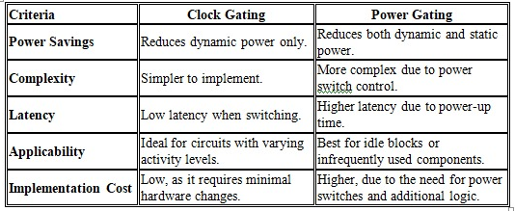
Power gating Vs Clock gating

Slide 10
Why Power Gating is Efficient for MIPS Processor?
Reduction of Static Power: By shutting off power to idle components like the ALU or register file, power gating significantly reduces leakage currents, a key source of static power in MIPS processors.
Efficient Management of Idle Units: Power gating allows the processor to turn off unused components during idle cycles, saving power without affecting performance.
Dynamic Power Management: It dynamically controls power based on the processor’s active state, reducing power consumption during non-productive cycles like when certain pipeline stages are idle.

Slide 11
Steps to Implement Power Gating in MIPS Processor
Identify components like ALU, register file, and memory that can be powered off when idle.
Introduce power switches (sleep transistors) to control power supply to each component.
Create logic to control power gating based on component activity (idle or active).
Add control signals to manage power gating for each domain.
Design a sleep mode for inactive domains and a quick wake-up mechanism when needed.
Account for latency due to power-up and ensure timing is adjusted for minimal performance impact. Simulate and optimize the design for power savings and performance.

Slide 12
Before Power gating
Component | Power type | Vaue
Internal power | Cell Internal | 3.8229uW
Switching power | Net switching | 1.5422uW
leakage power | Static(cell) | 5.2460uW
Total power |  | 10.6111uW

Slide 13
After Power gating
Component | Power type | Vaue
Internal power | slight overhead | 3.8229uW
Switching power | same | 1.5422uW
leakage power | Reduced~60% | 2.0984uW
Total power |  | 7.5135uW

Slide 14
Difference
Power type | Before gating | After gating | savings
Internal power | 3.8229uW | 3.8229uW | -0.0500uW(overhead)
Switching power | 1.5422uW | 1.5422uW | not equal to 0
leakage power | 5.2460uW | 2.0984uW | 60% saved
Total power | 10.6111uW | 7.5135uW | ~29% saved

Slide 15
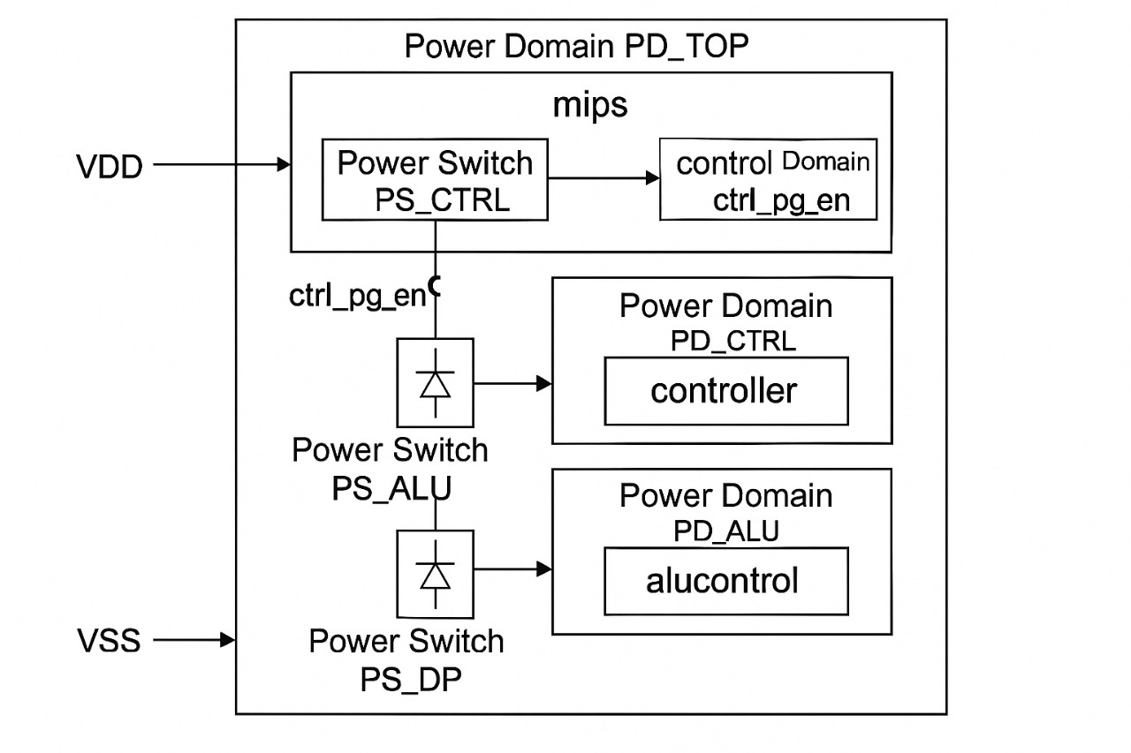
UPF Diagram included power gating Technique

Slide 16
UPF Commands
# Create power supplies
create_power_domain PD_TOP -elements {mips}
create_power_domain PD_CTRL -elements {controller}
create_power_domain PD_ALU -elements {alucontrol}
create_power_domain PD_DP -elements {datapath}
# Define power and ground
create_supply_net VDD
create_supply_net VSS
create_power_supply VDD -domain PD_TOP
create_ground_supply VSS -domain PD_TOP

Slide 17
UPF Commands
# Create switches for power gating
create_power_switch PS_CTRL \
-domain PD_CTRL \
-input_supply VDD \
-output_supply VDD_CTRL \
-control_signal ctrl_pg_en
create_power_switch PS_ALU \
-domain PD_ALU \
-input_supply VDD \
-output_supply VDD_ALU \
-control_signal alu_pg_en

Slide 18
UPF Commands
create_power_switch PS_DP \
-domain PD_DP \
-input_supply VDD \
-output_supply VDD_DP \
-control_signal dp_pg_en
# Connect ground to all domains
connect_supply_net VSS -domains {PD_CTRL PD_ALU PD_DP}
# Power state table (optional but helps during simulation/analysis)
add_power_state ON -domain PD_TOP -values {VDD VSS}
add_power_state OFF -domain PD_TOP -values {0 VSS}

Slide 19
UPF Commands
add_power_state ON -domain PD_CTRL -values {VDD_CTRL VSS}
add_power_state OFF -domain PD_CTRL -values {0 VSS}
add_power_state ON -domain PD_ALU -values {VDD_ALU VSS}
add_power_state OFF -domain PD_ALU -values {0 VSS}
add_power_state ON -domain PD_DP -values {VDD_DP VSS}
add_power_state OFF -domain PD_DP -values {0 VSS}

Slide 20
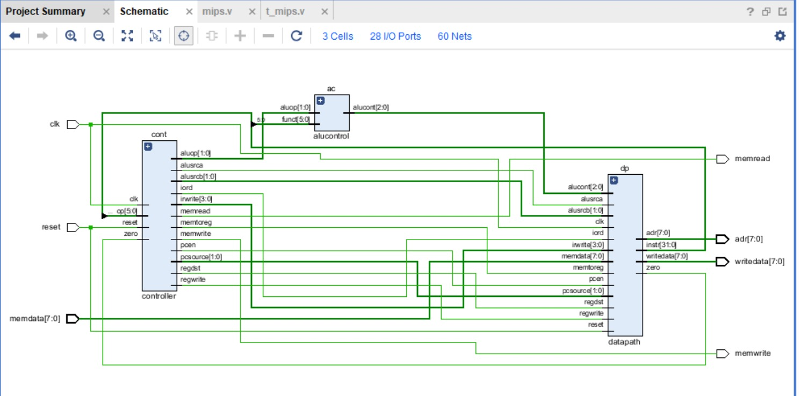
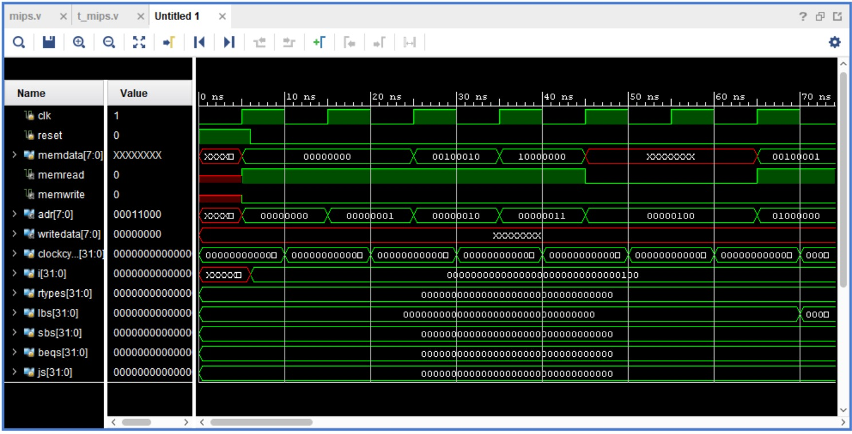
OUTPUTS IN VIVADO

Slide 21
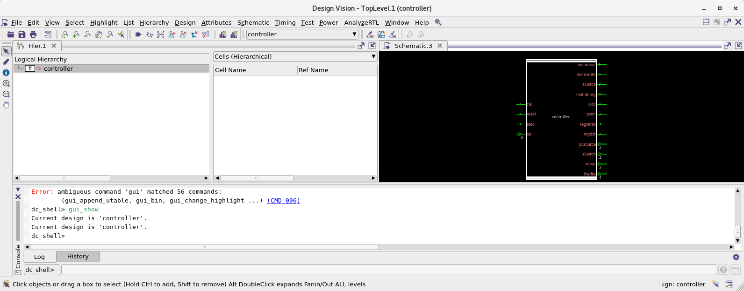
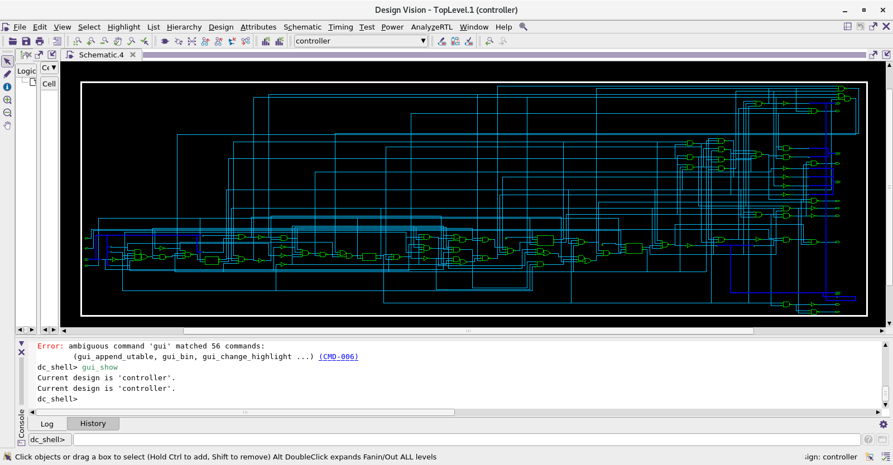
OUTPUTS FROM SYNTHESIS

Slide 22
MIPS PROCESSOR DRIVE LINK
https://drive.google.com/drive/folders/1J6No9ErHTG8yRP-mbl3gqJ_N7kI3dpYD?usp=sharing

Slide 23
CONCLUSION:
The designed MIPS processor was successfully implemented and verified with an optimized data path, control unit, and ALU. It was simulated and tested using Verilog/VHDL to ensure correct instruction execution and synthesized for FPGA/ASIC with optimizations for speed, power, and area. This project demonstrates the applicability of MIPS in embedded systems, RISC processors, and IoT devices. Future enhancements include pipeline optimization, multi-core implementation, and cache integration, paving the way for more advanced processor architectures.

