Slide 1

Time Series Forecast
Nimmy Thomas

Slide 2
Importance of Sales Forecast
Inventory Management
Hire additional Resources
Campaign Sales Effectiveness
Purchase Behavior of Customers
Revenue Forecast
Market Basket Analysis

Slide 3
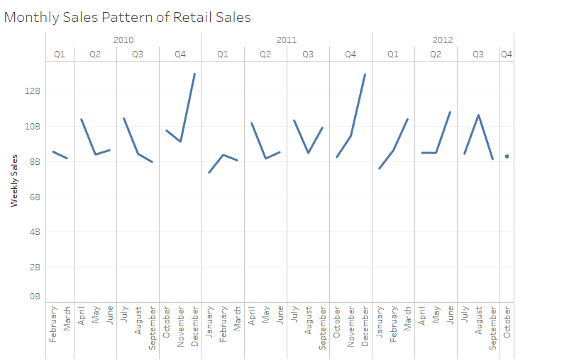
Can you guess sales of 2013???

Slide 4
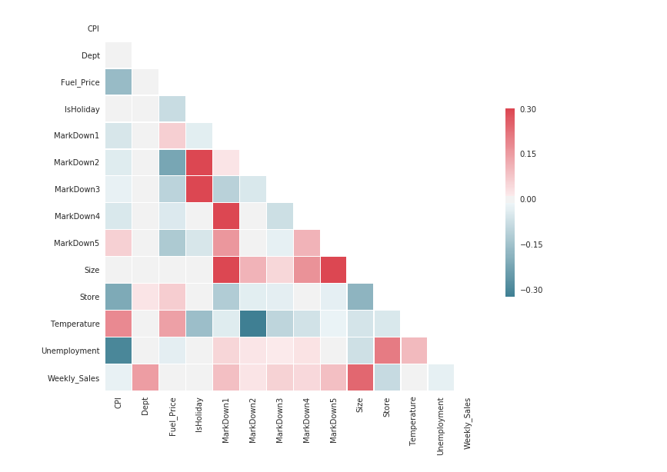

Slide 5
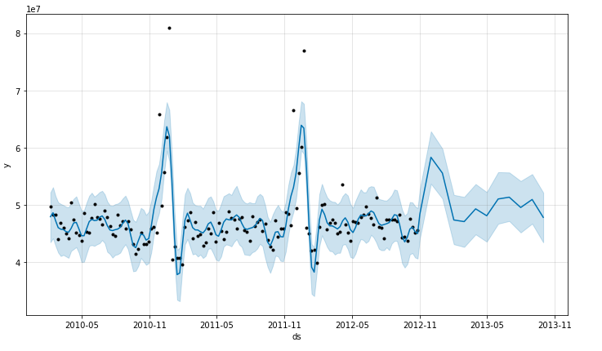
SALES FORECAST MODEL

Slide 6
Evaluation of Base Models
Technique | Accuracy
Random Forest | 94.2%
Extra Trees Regressor | 93.5%
KNN | 91.7%
Linear Regression | 91.6%
XG Boost | 80.7%
Elastic Net | 80.4%
Gradient Boosting | 80.1%

Slide 7
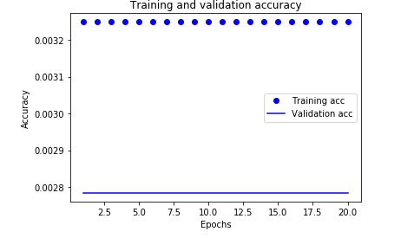
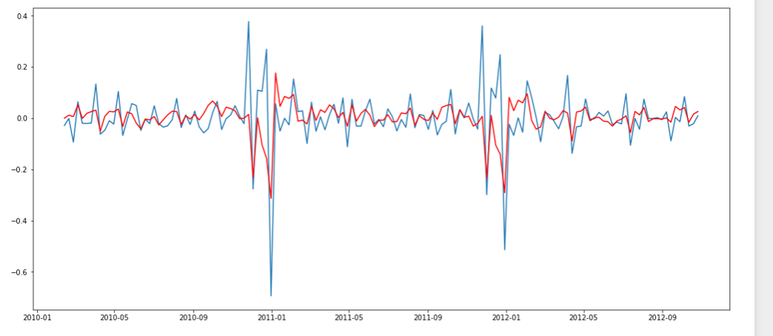
Does Deep Learning Help ?

Slide 8

Final Model Evaluation
The data was modelled using various TS techniques-
Exponential Smoothing
ARIMA
SARIMA
Holts Approach
Vector Auto Regressive approach
fbprophet

Slide 9
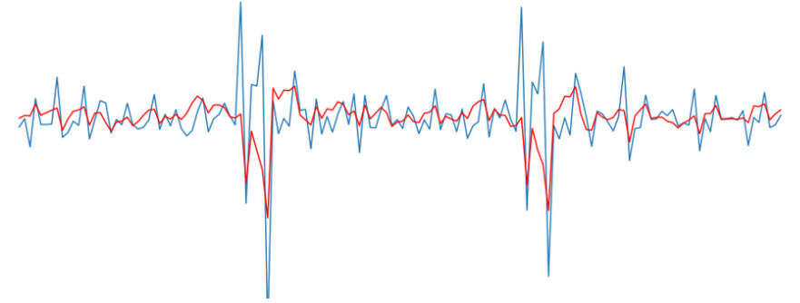
Where are the traditional TS techniques failing ?

Slide 10

fbprohet

Slide 11
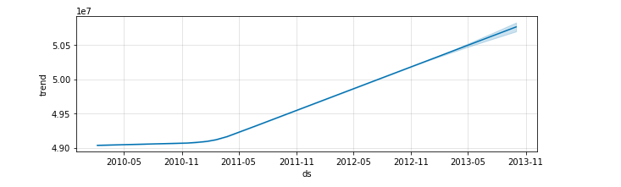
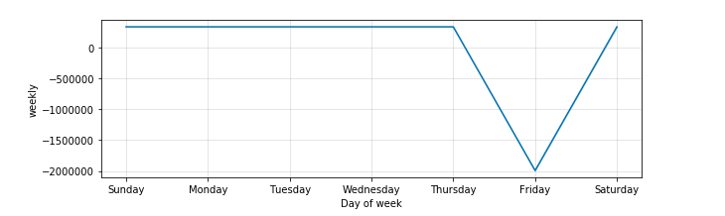
Annual and Weekly Trends

Slide 12
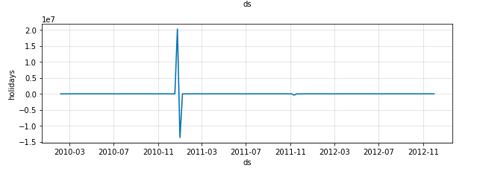
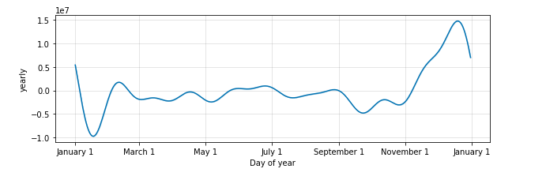
Monthly and Holidays Trend

Slide 13
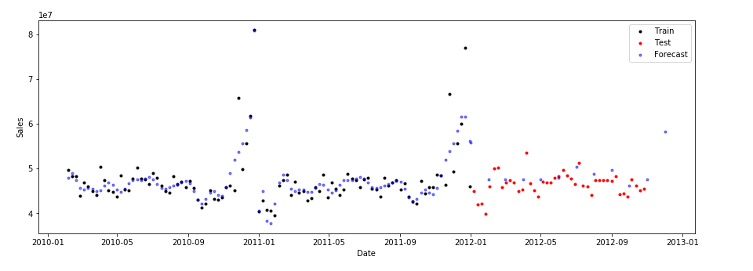
Forecast Validation

Slide 14
Scope of Improvement
Explore more time series techniques which can applied to large datasets which can predict target variable based on past values along with factors affecting the target.
Add more data to make forecast more accurate. Implement market basket analysis and analyzing customer patterns to help inventory management.
Feature Addition-Calendar Holidays.

