Slide 1
Data Management 2 Course Work Presentation
Team members
KGL Sandanimne COHNDSE261F-004
D.D Kandeepan COHNDSE261F-028
Arshath MLM COHNDSE261F-036
JHN Fernando COHNDSE261F-037

Slide 2
Problem and Objectives

Slide 3
The problem
When managing passenger transportations vehicle operations, driver assignments, passenger registrations, route planning, trip scheduling, ticket reservations, payment processing, and customer feedback is highly inefficient when the system handled manually and disjoint system.

Slide 4
The objective
As for the solution our group was decided to built a SmartMove transportation system.
As system capabilities this application can offer real-time trip management, digital ticket booking, and operational oversight.
The system database has hybrid database architecture. Oracle Database for secure transactional data and MongoDB is used for flexible, unstructured multimedia and feedback integration.

Slide 5
System requirements
SmartMove transportation systems follow nine co-operational areas that we can divide into three categories
1 Master Data – driver , route , vehicle, passenger management
2 Transactional Data – trip scheduling , ticket booking, payment, maintenance management
3 Dynamic Data – feedback and review management

Slide 6
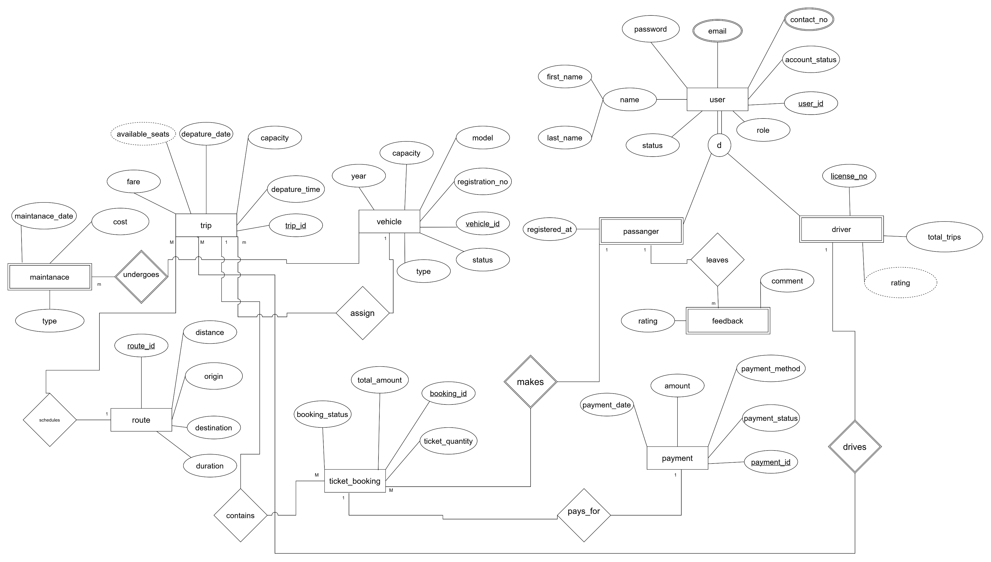
EER

Slide 7
As foundational entities in the er diagram we have passenger , driver , vehicle and route and these tables managed by Oracle sequences.
Transactional entities trip, booking, payment , and maintenance entities are lined to foundational entities using foreign keys.
Security roles restrict to DML operations to ensure the application layer only accesses necessary data securely.

Slide 8
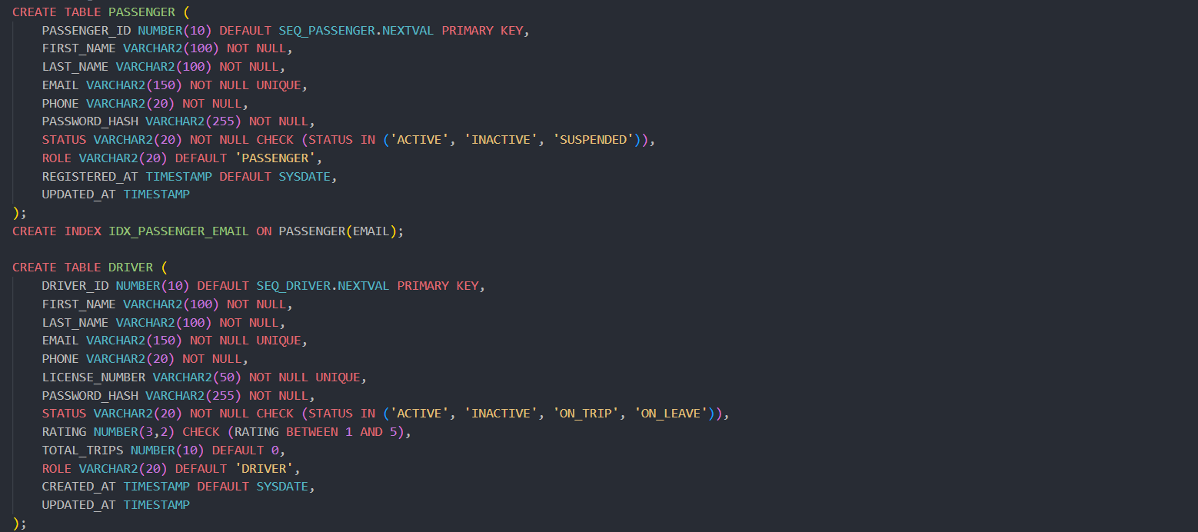
Oracle implementation
This database has built in safety rule that can prevent someone entering fake information or data into the system

Slide 9
Automated logical backups are configured using Oracle Data Pump
This means the database is set up to automatically make a smart, high-performance copy of the data at regular intervals so the database never lose the information if the system crashes.

Slide 10
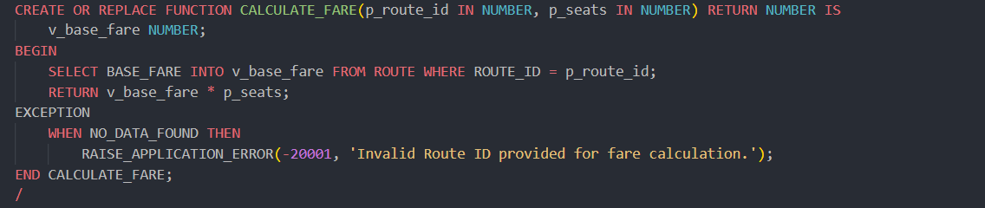
PL SQL Business Logic
Instead of hardcoding a static price, this function calculates the total cost, based on what the user selects.

Slide 11
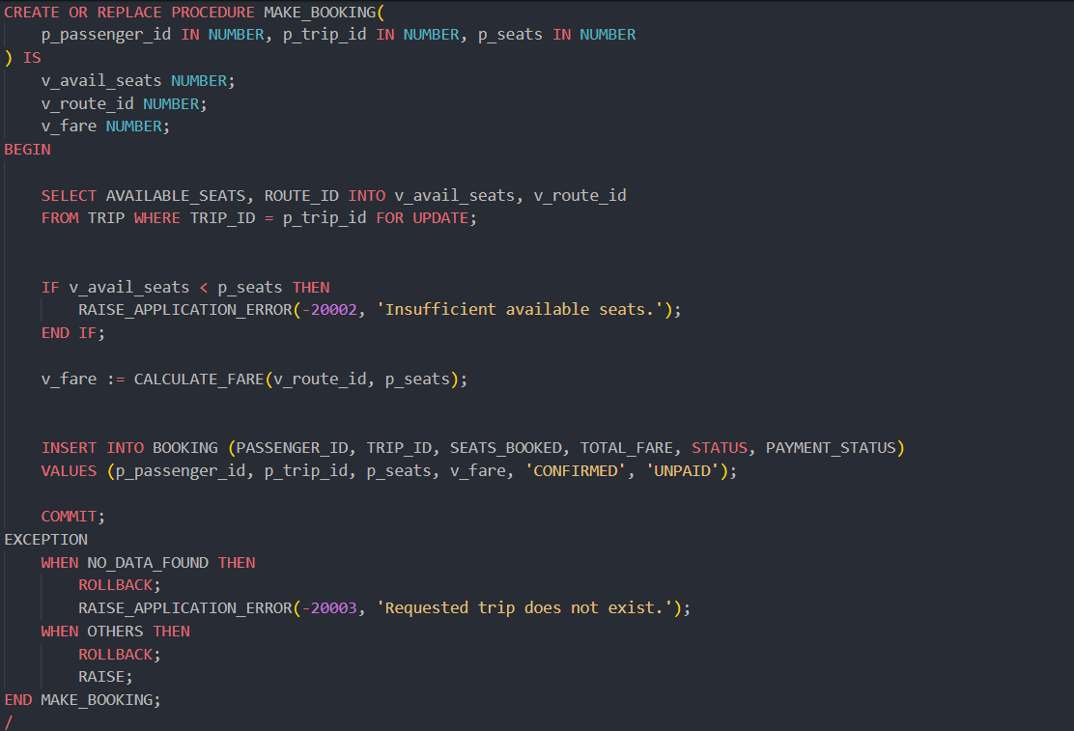
Procedures
procedures are action-oriented execution engines. They are built to modify data, run massive batch updates, and execute complex business workflows directly inside the database.

Slide 12
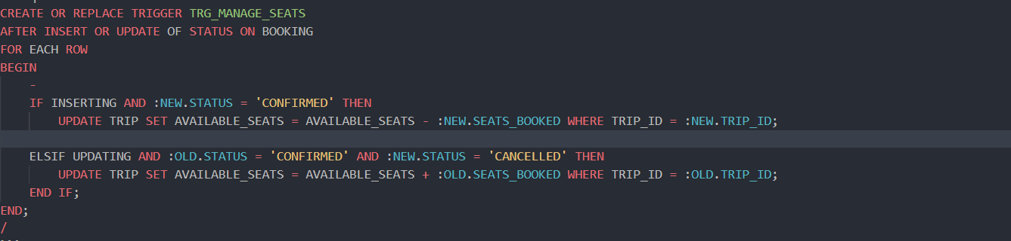
Triggers
A database trigger is a database code that automatically runs in response to a specific event as an example we used it our system database

Slide 13
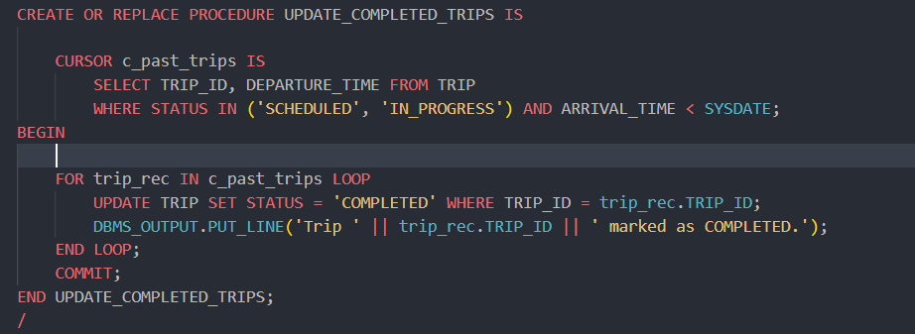
Cursors
In the database we used cursors to process and loop thorough one raw data at time for larger set of queries

Slide 14
Hybrid architecture
Oracle handles all the business data that cannot lead to any mistakes as examples payments , ticket booking and user accounts.
while MongoDB manages all the changing data with time meaning the data that saved doesn’t have an exact same field
the system has added schema flexibility so the users cannot enter empty or broken reviews.

Slide 15
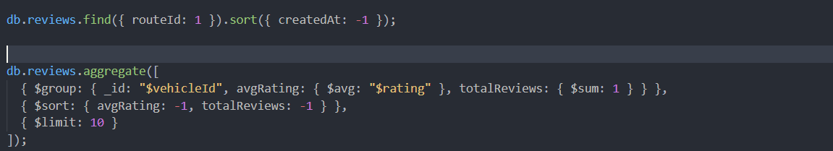
MongoDB Queries
This allows management to check specific routes to check is their any routes get any bad reviews from the passengers so the admins can fix it

Slide 16
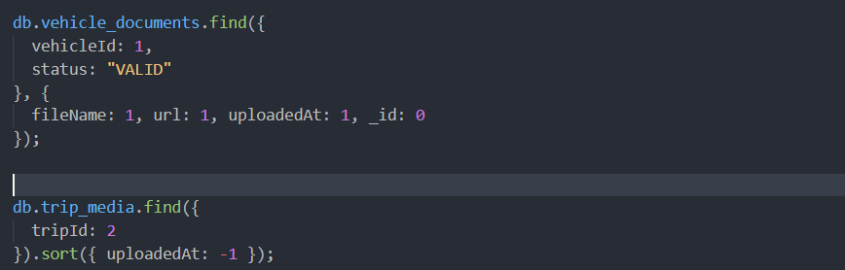
This helps to read thousands of comments instantly without manually reading it all and this this helps management team to get a clear idea about the business showing their best drivers and which vehicles perform best

Slide 17
Integration
To get the all system together the MongoDB records shared identifiers that match with primary keys. Then using frontend application to pull trip information from oracle database and stich this to MongoDB providing optimized experienced to the users.

Slide 18
Conclusion
Smartmove system is a combined architecture(hybrid architecture)
Oracle database handle all the financial and user login and the MongoDB handles all the user communications and the interactions.
The system creates highly efficient , real time transportation platform.

Slide 19
Thank you

