Slide 1

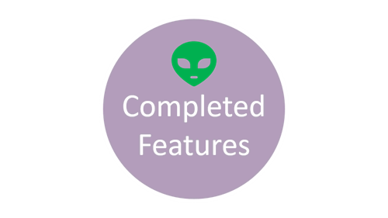
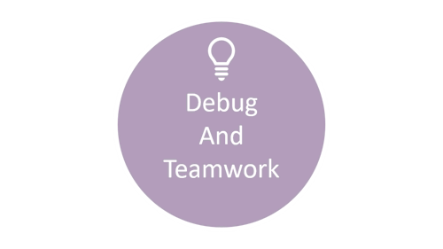

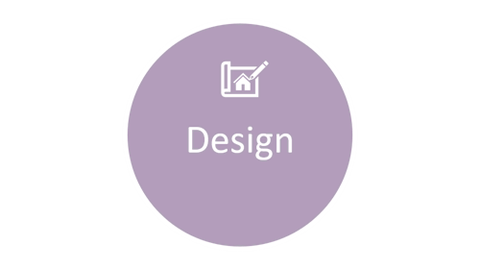
VORTRONTM

Slide 2
Design

Slide 3
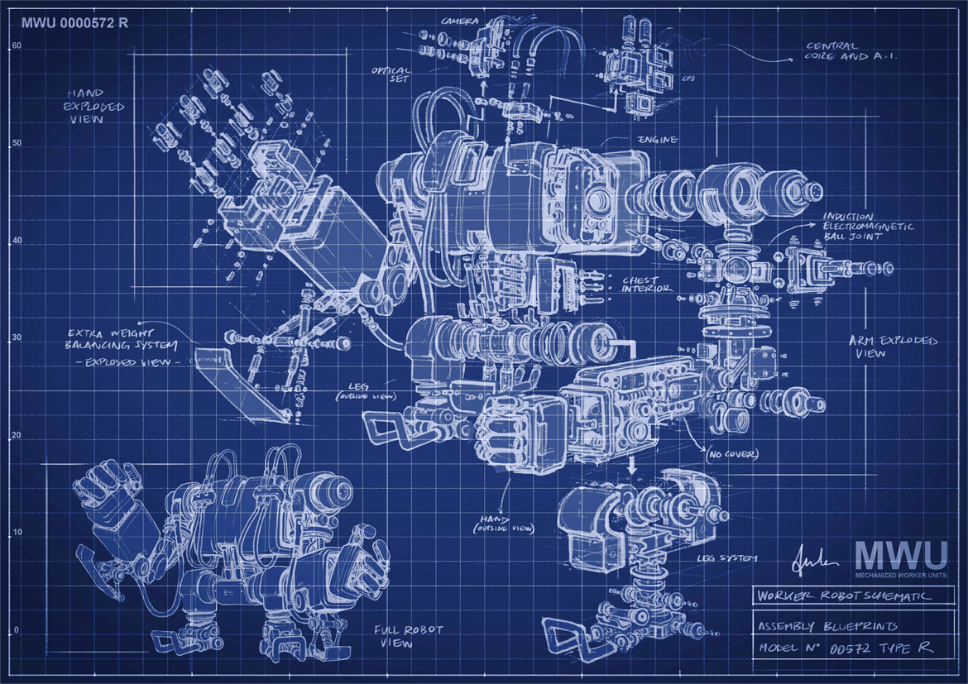
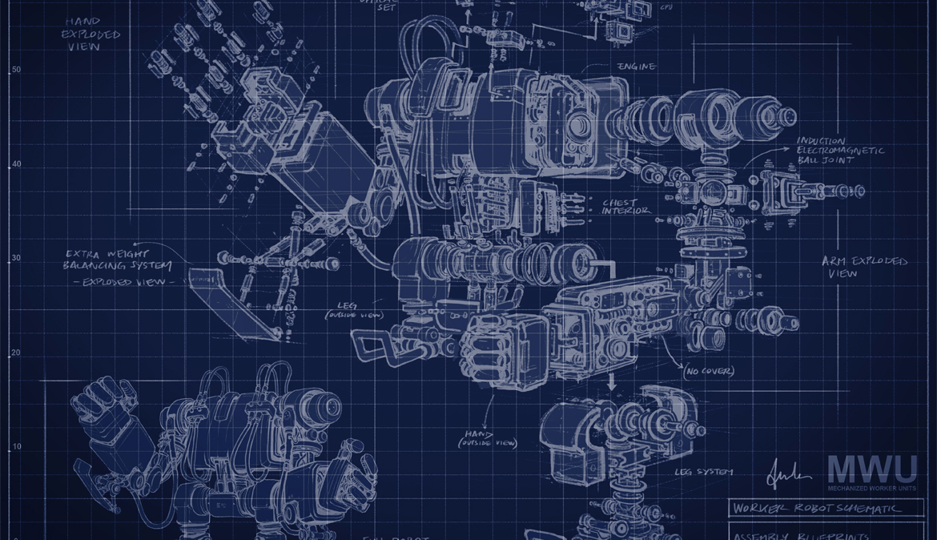
Design
&Overview of structure

Slide 4
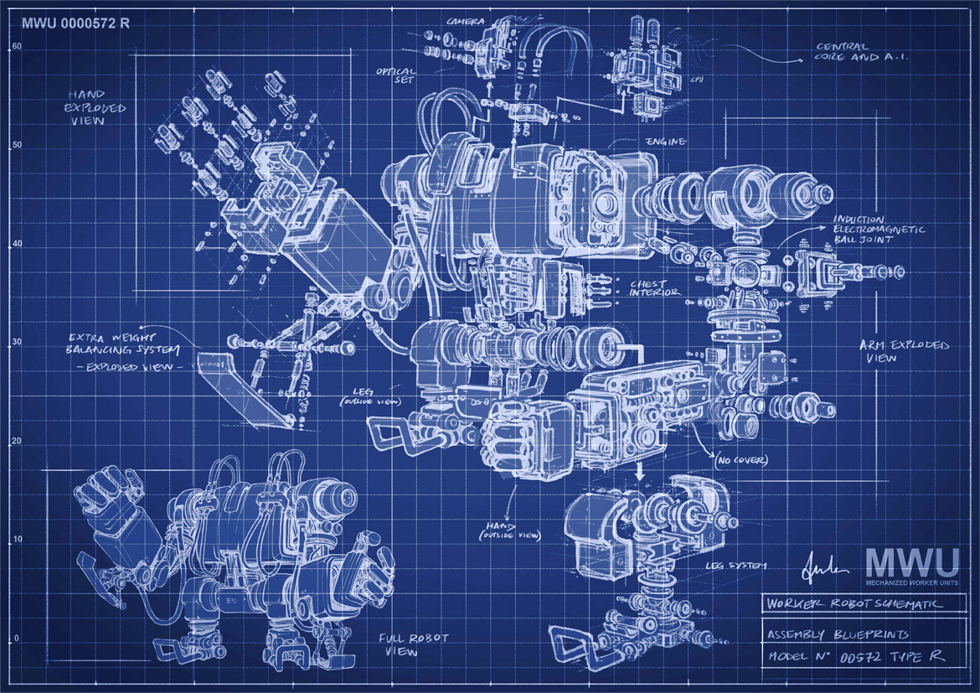
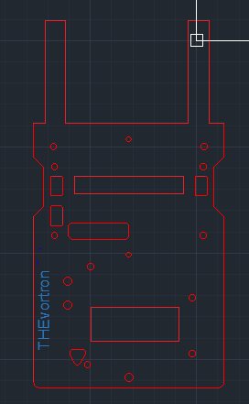
Chassis design(AUTOCAD)
-This design is based on original chassis model. Key difference between the older version and the update is that empty spaces were made under the components in order to remove mass of the rover for the aliens that require a certain limit on scale.
space not used on the chassis was removed to further reduce mass, but streamline optimisation is not taken into account as small distances travelled by rover with regular intervals of stops suggests terminal velocity will most likely not be reached: Further more mass has more effect on speed limit of the rover since friction is greatly influenced by weight of the robot.M
-One more notable feature in the chassis is that it was made sure to withstand additional pressure from components even with the addition of the holes
-Structural Integrity: The chassis should be designed to provide sufficient strength, stiffness, and durability to support the robot's components and withstand the loads it will experience during operation.
-Aerodynamics: While aerodynamics may not be as critical for a small car robot compared to a full-sized vehicle, optimizing the chassis shape and adding features like fairings can reduce drag and improve efficiency.

Slide 5
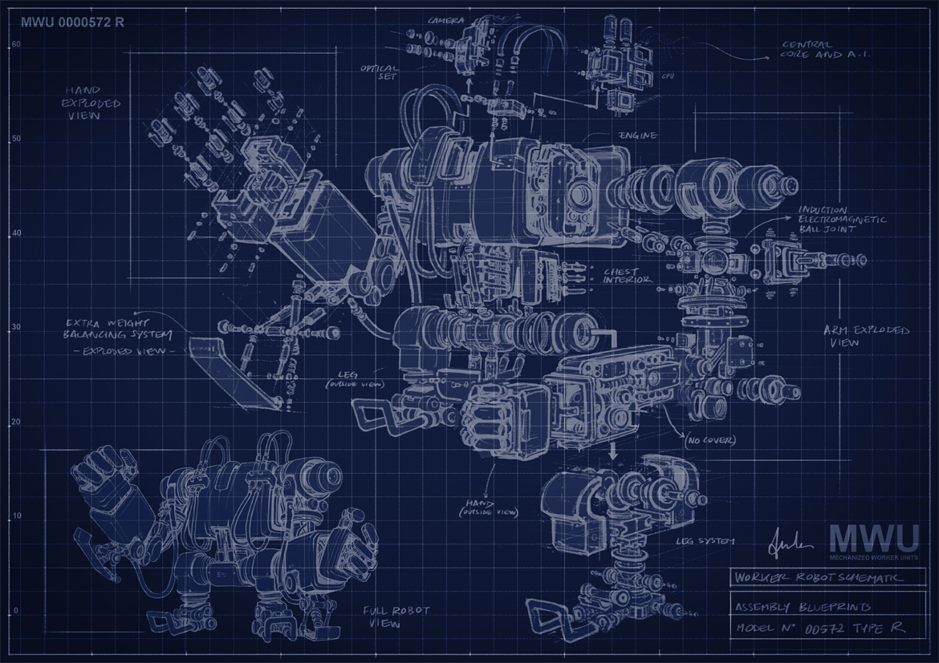
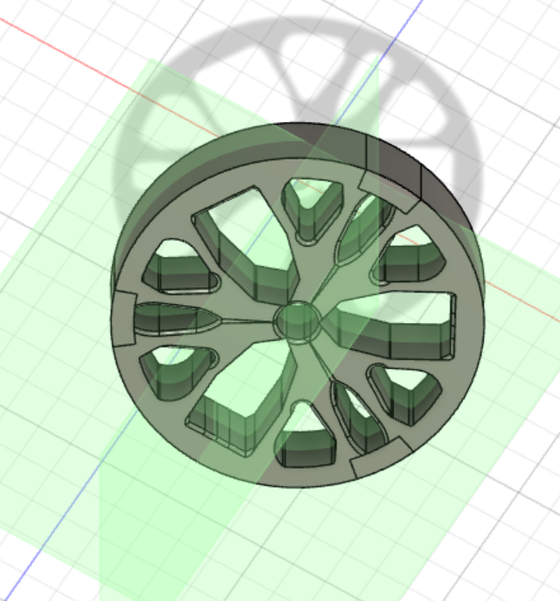
Design
moving on to the wheels, Fusion360 software was a key tool in designing the rim. Due to limited knowledge of mechanical design from an electrical engineer, this software was used to enhance a simple design of the wheel into an optimized model that balances mass and pressure withstand of the complete model.
Aesthetic Considerations: While not directly related to functionality, the visual appearance of the wheel rim is often an important aspect for many customers. Designing an aesthetically pleasing rim can enhance the overall look of the vehicle and contribute to its market appeal.
Structure: high surface area to improve heat dissipation to surroundings and many air holes to allow flow to further decrease thermal energy in wheels

Slide 6
Completed Features

Slide 7


Completed
features
Age
Name
Wi-fi connection
Magnetism
Control

Slide 8

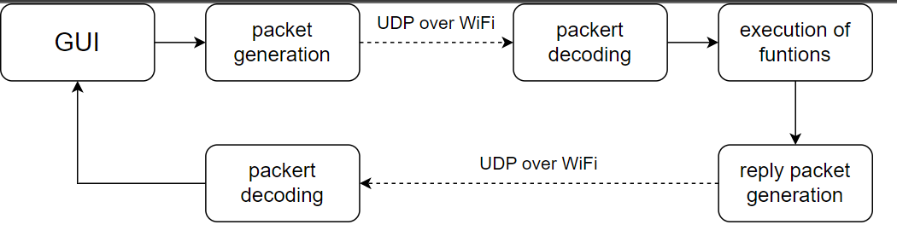
WI-FI communication
UDP instead of HTTP
Rover receives and sends short text packets
Reduces workload on M0 chip
Allows for the use of timer interrupts for sampling

Slide 9
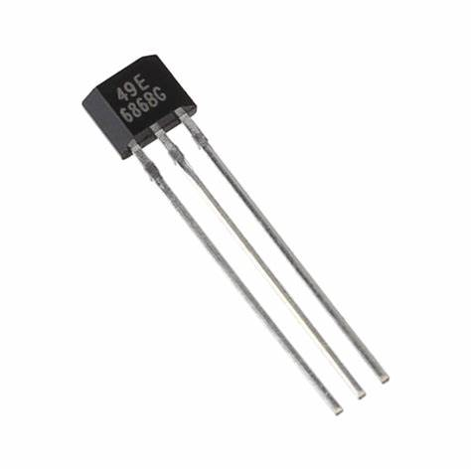
Magnetism
SS49E hall effect sensor
Analogue readings
Calibration required

Slide 10

Age(time flies even for an alien)

Slide 11


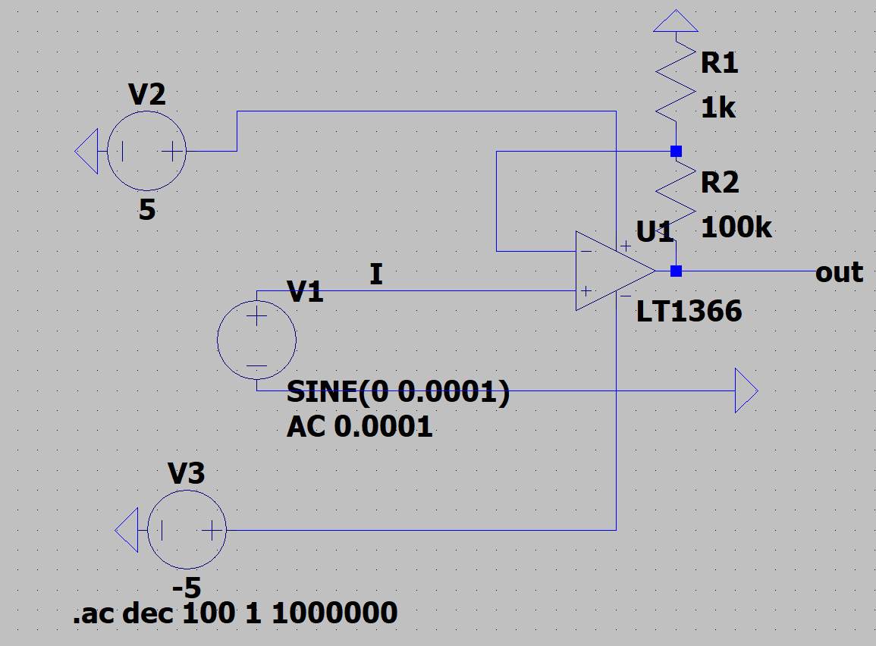

Age from IR pulses
A simple non - inverting amplifier may be needed
As signal picked from long distances may be weak
The flow chart below describes the process by which the signal is sampled to get an average value which will be used as a threshold value to determine the time between pulses. Further calibration of the time to convert it to age of each alien in centuries, provided in the Arduino code in the linkhere.

Slide 12

Name

Slide 13
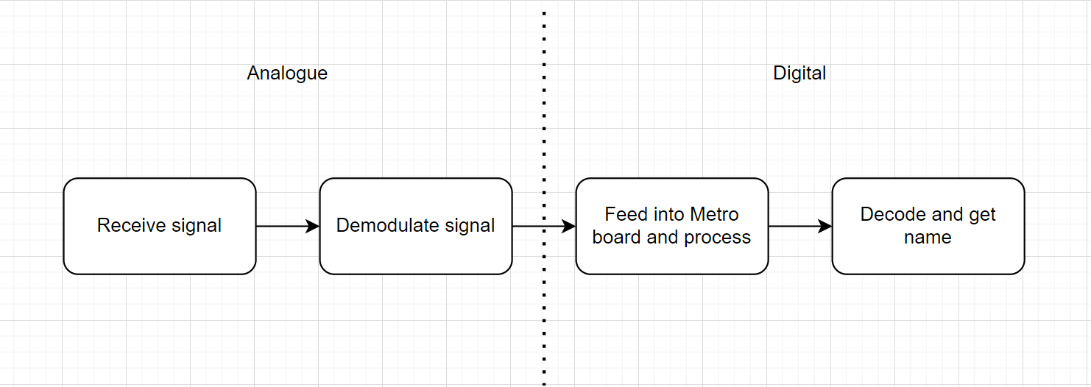
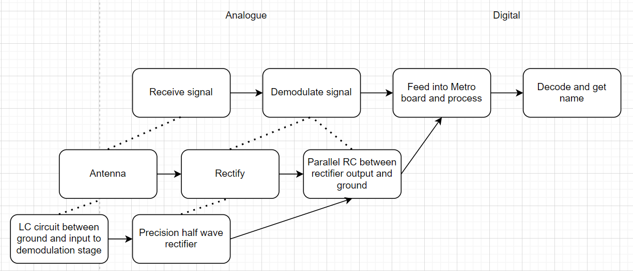
What was considered?

Slide 14
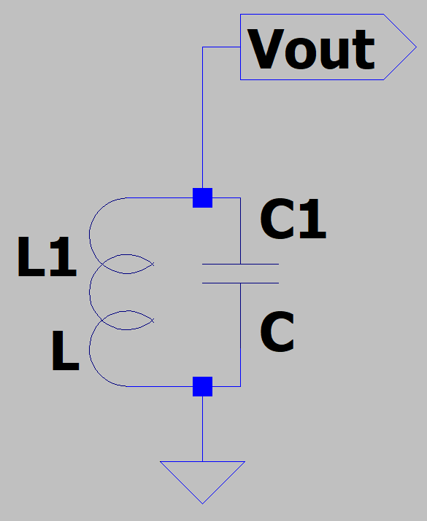
Analogue circuits
Resonant circuits at the frequency of radio signal ensures circuit is most sensitive at the alien’s information:
Antenna: Should be able to pick up on signal over a decent range
ｊ(⍵L-1/⍵C) Plays a key factor in our resonant circuit

Slide 15
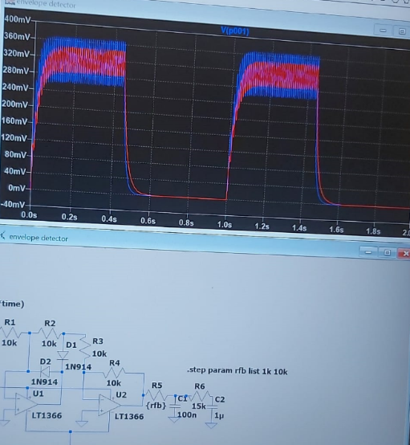
Demodulation of signal
First attempt for
An envelope detector. A complex circuit that will add on to the mass, cost, and space on breadboard.

Slide 16
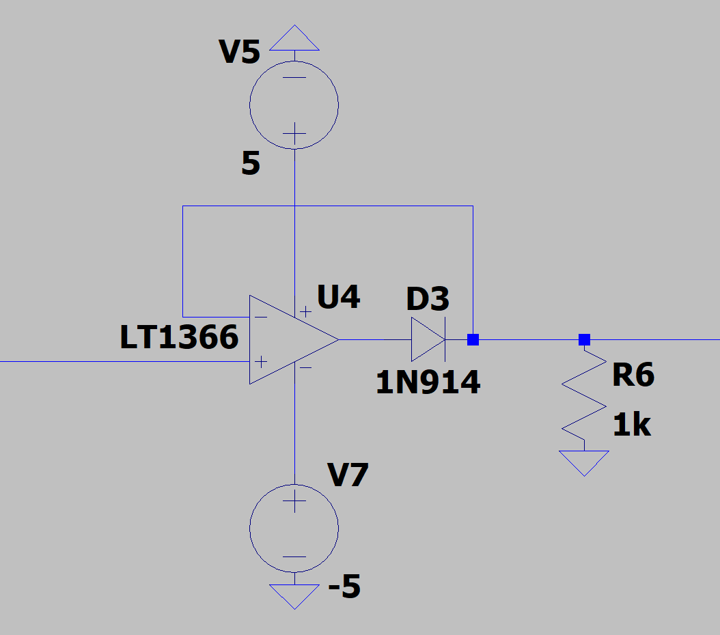
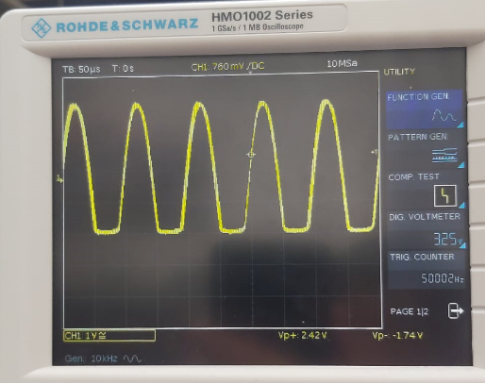

Slide 17

Key Functions
Layout
TC3_Handler() - Checks if the interrupt is due by comparing the register matching and the timer count. If it’s due then the interrupt flag is cleared and the analog value is read and returned.
decodeName() - This is the main function used to decode. It’ll initially define the signal and sampling frequency constants.
pinMode of the IR receiver is set to INPUT
startTimer() is called to initiate the timer and sampling processes.
TC3_Handler() is assigned to a variable in order to make use of reading.
Algorithm is performed to detect start bit, repeatedly add bits to a string variable and end once the required bit length is reach and the stop bit has been received. Binary value is then converted into its ASCII value.
setTimerFrequency(unit32_t sampling frequency) - Main aim is to set the frequency of the timer used for sampling. CPU frequency and sampling frequency are used to calculate compare register values; this and the timer count are set and then printed.
startTimer(int frequencyHz) - Starts the timer using frequencyHz. Timer mode, waveform generation and prescaler division are also configured. setTimerFrequency is called here to set the timer frequency. Compare interrupt is also enabled and will wait for synchronization before returning.

Slide 18

Start
Set Timer Frequency()
Decode Name()
Start timer()
TC3_Handler
Stop after name is outputted
Name is constructed

Slide 19
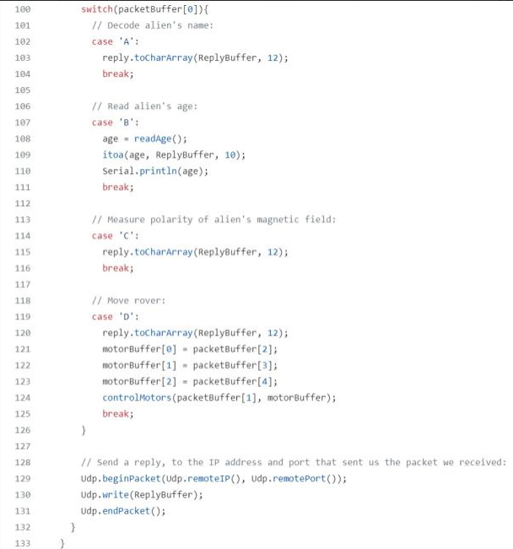

Control and movement
Wheel selection (did research on 4 wheel designs using mecanum and omni-directional wheels but decided on a 2 wheel design)
Focused mainly on the optimization of weight
Initial concept design was done in Arduino shown here
Next steps: creating a joystick using a Python desktop app which automatically generates packets
  Simple to implement as we can easily build upon our initial design
  Testing movement control as a priority next week

Slide 20
Debug
And Teamwork

Slide 21

Debug
And teamwork

Slide 22
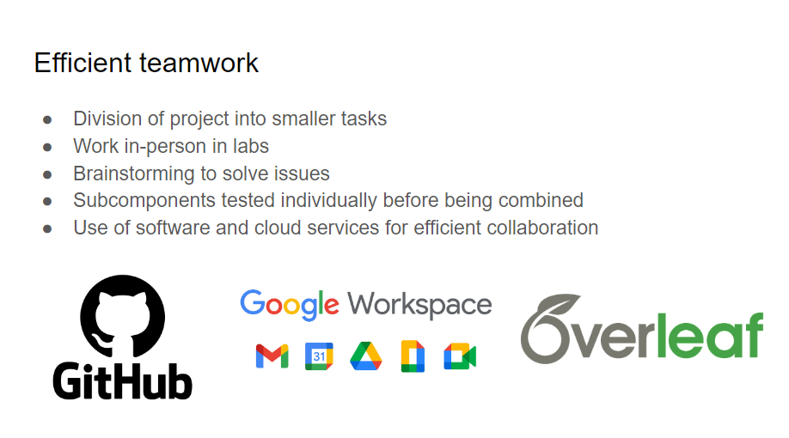

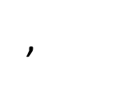
,

Slide 23
We have planned regular meetings throughout the week so that each of us gets updated on what everyone is doing.
Leader was chosen quickly ( no storming )
Fast response to questions in group chat
Programming parts were posted on git hub and improved by people with expertise.
Everyone was available to reach in this period of time.
Leader gave roles fast to each of us so everyone had a clear task

Slide 24
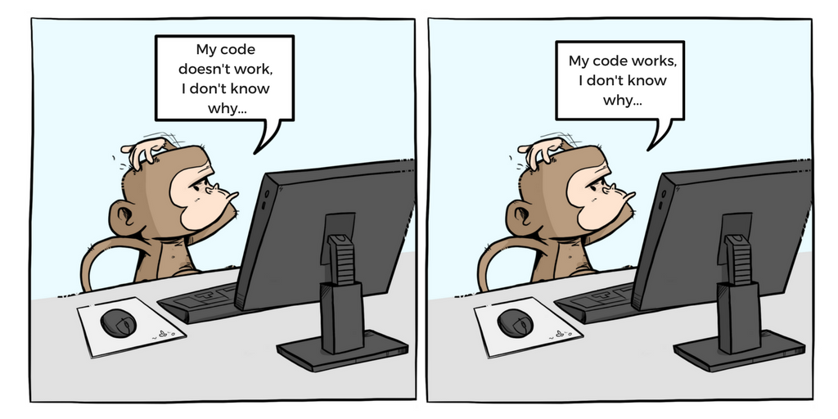


Slide 25
What’s next?

Slide 26
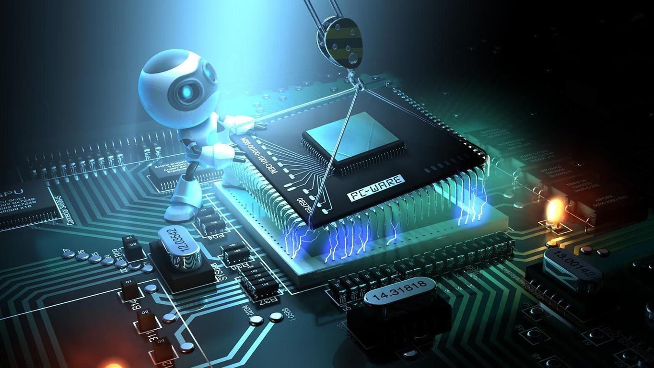
What’s next?

Slide 27

3D-printing chassis
3D-printing wheels/or ordering wheels
Assembling all sensors and circuits on chassis
Further work on controlling the rover
Looking for errors in code
Starting the report
Testing overall design and improving it

Slide 28

Desktop app
In Python
Has a GUI for controlling the rover
In early stage of development
Automatically generates and sends UDP packets

