Slide 1

TYPESCRIPT
WORKSHOP
SUBSET OF JAVASCRIPT
PRESENTED BY : NIMRA MUGHAL

Slide 2

INTRODUCTION TO TS
TypeScript is a programming language powered by Microsoft.
TypeScript is a superset of JavaScript.
TypeScript is transpiled into JavaScript.
TypeScript files operate with the .ts extension, TypeScript uses the JavaScript syntaxes and adds additional syntaxes for building types.

Slide 3
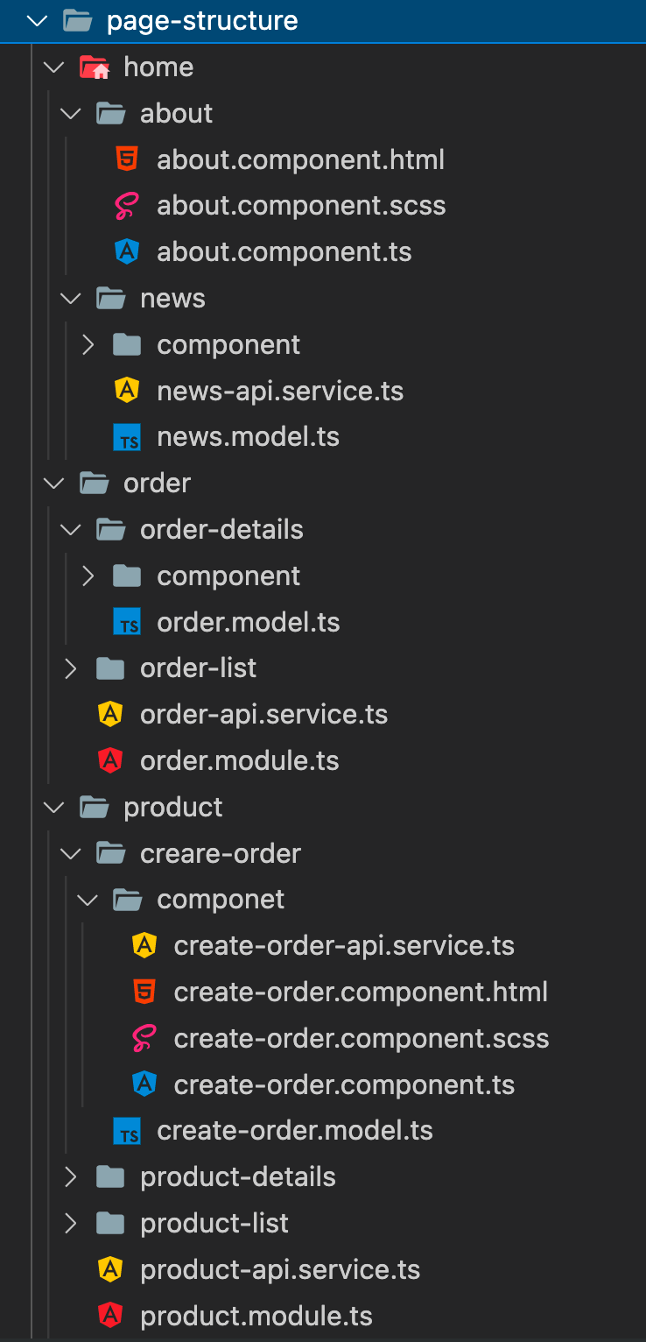

Angular Project Directory

Slide 4
CHARACTERSTICS OF TS
OBJECT ORIENTED PROGRAMMING (OOPS)
TS IS CONVENIENT
TS SUPPORT OTHER JS LIBRARIES
DOM MANIPULATION
JUST LIKE JS

Slide 5
TYPESCRIPT SETUP
Node.js
Typescript Compiler
Visual Studio
OR
Visual Studio Code

Slide 6
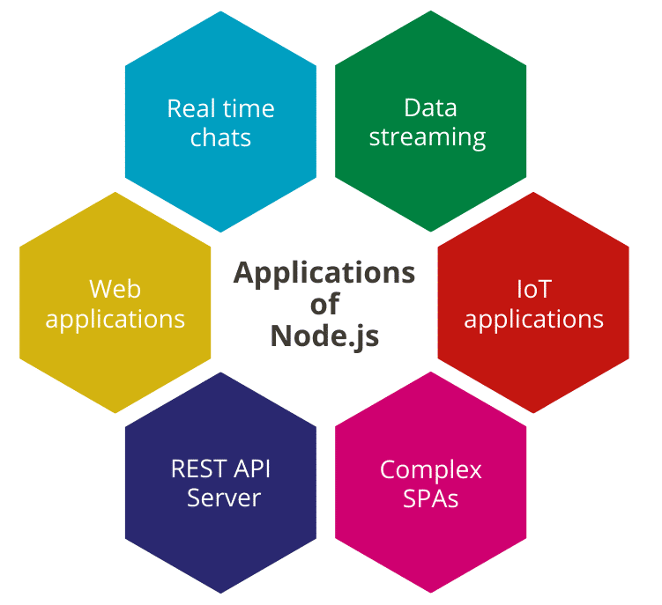
WHAT IS NODE?
Node.js
Node.js is an open source, cross-platform runtime environment for server-side JavaScript. Node.js is required to run JavaScript without a browser support

Slide 7
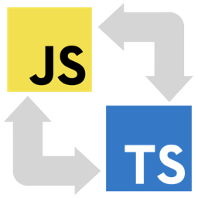
WHAT IS TYPESCRIPT COMPILER?
Typescript Compiler
npm install –g typescript

Slide 8
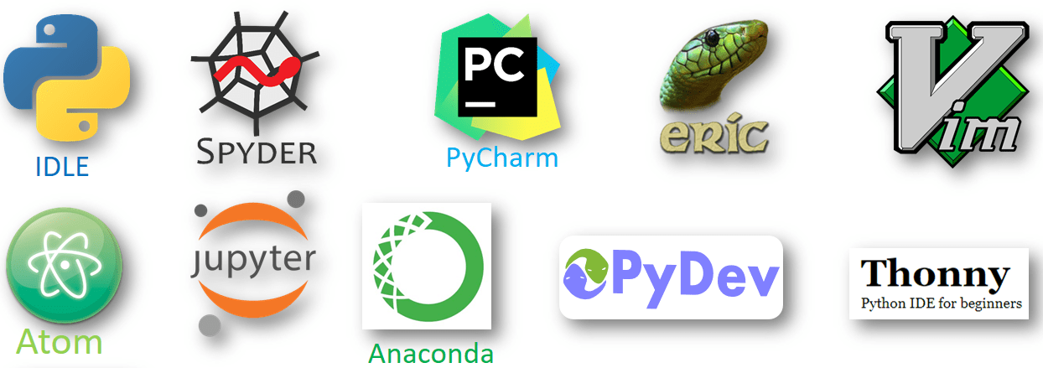
IDE
IDE
Vscode
OR
Visual Studio
WHAT IDE IS?
IDE(INTEGRATED DEVELOPMENT ENVIRONMENT)

Slide 9
DATATYPES IN TS
• The DataType System represents the different types of values supported by the language.
• The DataType System checks the validity of the supplied values, before they are stored or manipulated by the program.
• This ensures that the code behaves as expected.

Slide 10
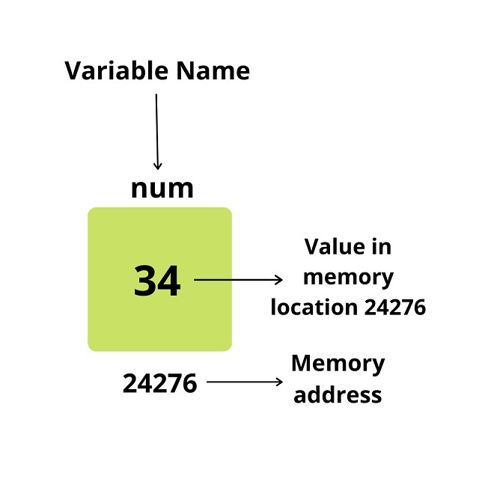
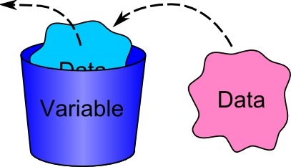
VARIABLE

Slide 11
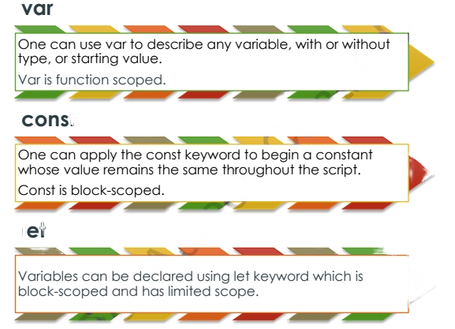
VARIABLE

Slide 12
DATATYPES IN TS
• The DataType System represents the different types of values supported by the language.
• The DataType System checks the validity of the supplied values, before they are stored or manipulated by the program.
• This ensures that the code behaves as expected.

Slide 13
DATA TYPES
NUMBER
STRING
BOOLEAN
ENUM
VOID
NULL
UNDEFINED TYPE
INTERFACE
CLASS
ARRAY
TUPLE

Slide 14
Template Strings
Multiline Strings - In ES6, a new way of displaying multi-line strings was introduced, by applying the back-tick character.
Variable Substitution - An additional interesting part of declaring strings with ' is that they can now grow by making use of ${variable_name} syntax.

Slide 15
Example of ts
const app = document.getElementById("app");
const p = document.createElement("P");
p.textContent = "hello world";
app?.appendChild(p);

Slide 16
Example of ArraY
An array is a homogenous collection of values. To simplify, an array is a collection of values of the same data type
const names: string[] = [];

Slide 17
Looping an Array
for (let i = 0; i < my.length; i++) {
console.log(my[i])
}
for (const i in my) {
console.log(my[i])
}
for (const i of my) {
console.log(i)
}

Slide 18
Tuple
A tuple is a typed array with a pre-defined length and types for each index.
Tuples are great because they allow each element in the array to be a known type of value.
To define a tuple, specify the type of each element in the array
Syntax
let my:[number,string,boolean];
my=[23,"ali",true]

Slide 19
SUMMARY
TypeScript is a programming language powered by Microsoft.
TypeScript files operate with the .ts extension, while JavaScript files use .js extension. TypeScript uses the JavaScript syntaxes and adds additional syntaxes for building types.
Datatypes in Transcript include Number, String, Boolean, Enum, Void, Null, Undefined Types, Any, Never, tuple.
Three different keywords to define variables are namely, var, let, and const.
TypeScript has three different loops including:
for loop
for..of loop
for..in loop

Slide 20

Angular 16
Building angular application

Slide 21
Angular 16
Angular is a free and open-source front-end Web application framework Written by JavaScript
It is supported by Google
It is used for building single-page applications for mobile and desktop Web apps

Slide 22
Prerequisites for Angular 16
HTML, Document Object Model (DOM), CSS, but isn't a must-have
JavaScript
Typescript
It also requires the basic concept of OOPS
NO Angular 1 or Angular 2 or Angular 4 or Angular 5 or Angular 6 or Angular 7,8,9,10,11 knowledge is required

Slide 23
Building Module for Angular 16
Following are building blocks of Angular. These are:
Modules
Components
Templates
Metadata
Data binding
Directives
Services
Dependency Injection

Slide 24
Module
Every Angular application must have at least one module. If Angular application contains only one module, it is referring as root module. Every Angular application has one root module and many more featured modules.
Angular module is a class which is decorated with @NgModule. NgModule takes a single metadata object and its properties describe the module. Following are the important properties of NgModule.
exports - It is the subset of declarations which would be used in the component template of other module. imports - imports other modules
providers - It is a creator of services. They can be accessible in all the parts of the application.
bootstrap - The root module has to set the bootstrap property. It is used to host all other views.
declarations - It declare the view class that belong to current module. There are three type of view classes supported by Angular components, directives, and pipes

Slide 25
Components
The component is class with the template that deals with the View of application and it's containing the core logic for the page. We can compare it with the Controller in Angular 1.x. We need to write the application logic inside the class which is used by the View. The component class interacts with the View through Methods and Properties of API.

Slide 26
Template
The template is the component View that tells Angular how to display the component. It looks like normal HTML.

Slide 27
Service
Service in Angular is a function or an object that can be used to share the data and the behavior across the application. It is JavaScript function which is used to perform a specific task. It includes the function, values, or any other feature required by the application. Typical examples of services are logging service, data service, message service etc. There is no base class for service

Slide 28
Directives
Directives are used to extend the power of the HTML attributes and to change the appearance or behavior of a DOM element. Directive in Angular is a javascript class, which is declared as @directive. Angular has 3 types of directives, which are listed below-
1) Component
2) Structural
3) Attributes

Slide 29
Directives
Dependency Injection is a software design pattern in which objects are passed as dependencies. It helps us remove the hard coded dependencies, and makes dependencies configurable. Using Dependency Injection, we can make components maintainable, reusable, and testable. Point to remember about Dependency Injection,
➤ It is stimulated into the Angular framework so that it can be use anywhere in an application. The injector is a main mechanism to maintain the service instance and can be created using a provider.
➤ The provider is the way of creating a service. We can register the providers along with injectors

Slide 30
Angular 16 Setup
To Set up Development Environment for Angular 2+, we require the following-
✓IDE for writing your code (Editor)
✓ Nodejs
✓ Npm
✓ Angular CLI (npm install -g @angular/cli)

Slide 31
Angular CLI
The Angular CLI is a command-line interface tool that you use to initialize, develop, scaffold, and maintain Angular applications directly from a command shell.

Slide 32
Angular CLI
Booting Angular Application
Index.html
Main.ts
Appmodule.ts
Appcomponent.ts
Appcomponent.html

Slide 33
Installing bootstrap, jquery and fontawsome

Slide 34
Installing bootstrap, jquery and fontawsome

Slide 35
Ng if
Nglf is an structural directive that can add or remove host element and its descendants in DOM layout at run time. It conditionally shows the inline template.

Slide 36
Angular 16 Mini Project
TODO LIST

Slide 37
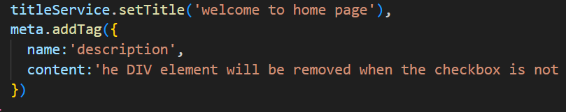

Slide 38
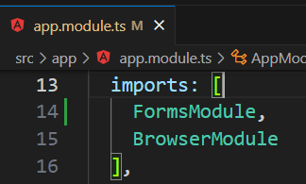
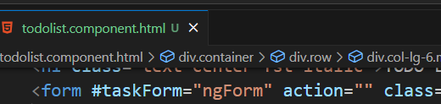

Import FormsModule in appModule.ts
Add #taskForm in form

Slide 39
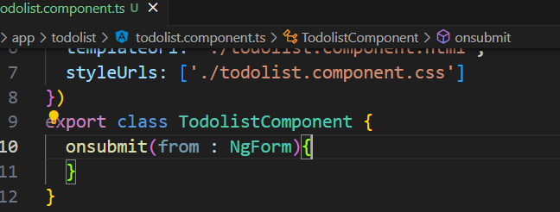

Add onsubmit in todolist.ts

Slide 40
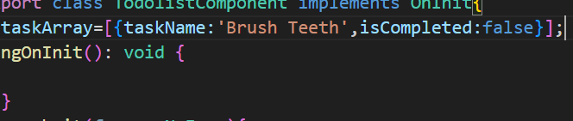


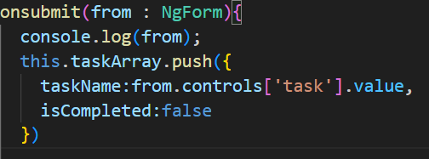

Slide 41
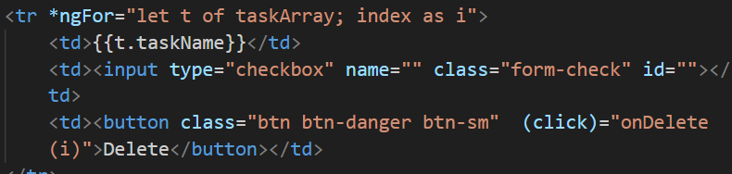
For Delete

Slide 42

ngFor

Slide 43
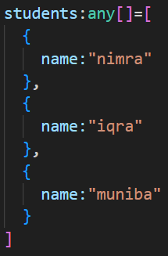
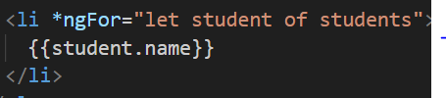
ngFor

Slide 44
ngFor

