Slide 1

Bitcoin Historical Prices & Activity (2010-2024)
Nimra Saeed 22F-3040

Slide 2

Outline
Overview of the Dataset
Problem statement
Data Preparation
Data Processing
Model Architecture
Model Training
Model Evaluation
Data Visualization

Slide 3
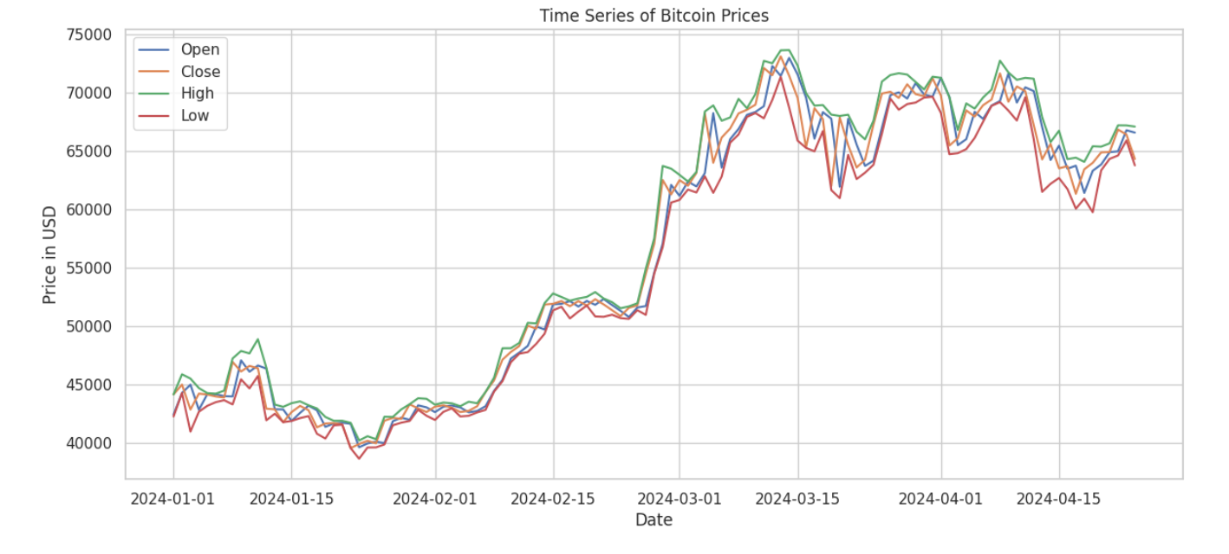
Dataset
This dataset has Bitcoin's trading activity, meticulously detailing daily market statistics from July 27, 2010, to April 25, 2024.
It provides a deep Bitcoin's price movements, trading volumes, and market capitalizations. The data covers over 5,021 days.
Notes:
Each record in the dataset consists of the following fields:
1. Start: start date of the data record.
2. End: end date of the data record.
3. Open: Bitcoin started trading at the beginning of the day.
4. High: The highest price point reached by Bitcoin during the day.
5. Low: The lowest price point reached by Bitcoin during the day.
6. Close: Bitcoin ended trading at the close of the day.
7. Volume: Bitcoin traded during the day.
8. Market Cap: Bitcoin at the end of the day.
Dataset includes date, price, volume, and market cap: Understanding historical trends crucial for informed decision-making and market analysis.
Analysis of price fluctuations over time: Identifying patterns aids in predicting future movements and optimizing investment strategies.
Relationship between trading volume and market capitalization: Volume reflects market participation, while market cap indicates overall size and stability.

Slide 4
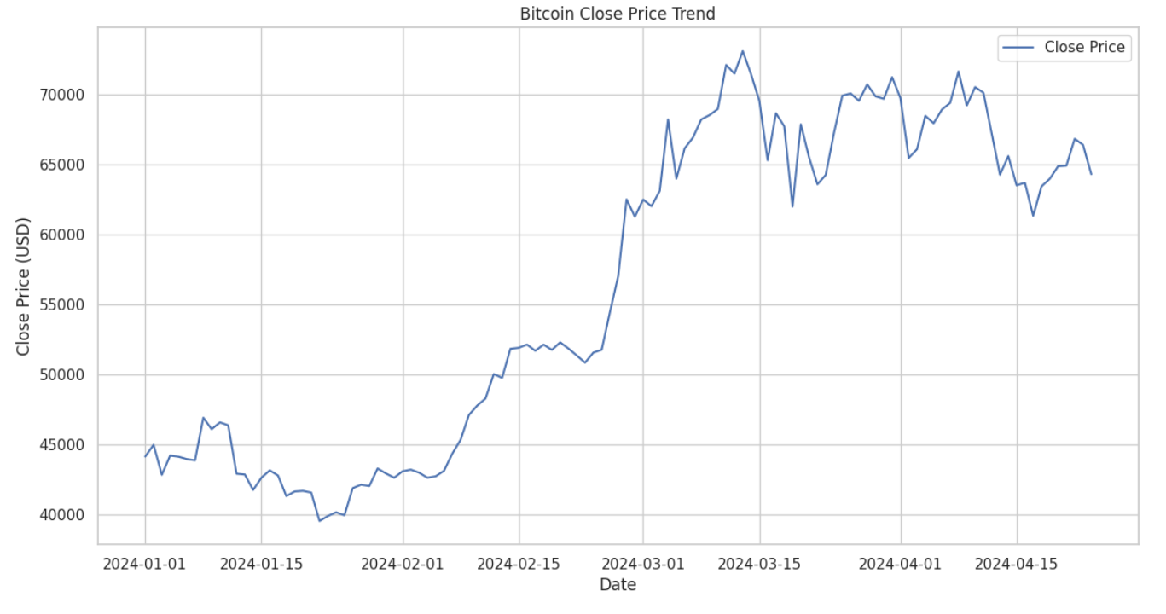
Let's focus on the year 2024, To provide a comprehensive analysis of the Bitcoin historical prices and activity dataset, explore several aspects:
Monthly Trends: Examining how prices have fluctuated on a monthly basis within 2024.
Volatility: Assessing the price volatility throughout the months of 2024.
Volume Analysis: Investigating how trading volumes have varied month by month.
Market Cap Fluctuations: Observing changes in market capitalization.
Notes:
analyze the Bitcoin dataset has 115 rows and 8 columns.
Descriptive Statistics: Overview of the price movements and trading volumes.
Trend Analysis: How Bitcoin prices have trended over the years.
Volatility Analysis: Examination of daily price changes.
Volume Analysis: Relationship between volume and price changes.
Market Cap Analysis: Trends in market capitalization over time.

Slide 5

Problem statement
Bitcoin, the first and most well-known cryptocurrency, exhibits significant price volatility.
Its market behavior is influenced by various factors including market demand, macroeconomic indicators, geopolitical events, and investor sentiment.
Needed to explore correlation between external events and price fluctuations.
Notes:
Exploring correlation between external events and price fluctuations: Understanding how external factors influence Bitcoin prices aids in formulating strategic market responses.

Slide 6
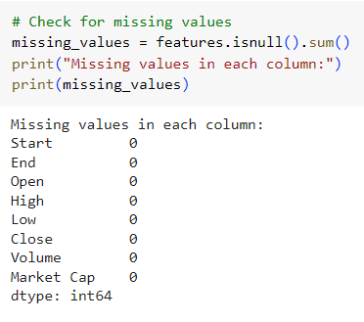
Data Preparation
Data Cleaning: Check missing values or inconsistencies, and handle them appropriately. Ensure data types are correct for all columns.
Notes:
(e.g., converting dates into a datetime format).
Handling missing values in the dataset: Imputing missing data ensures completeness and accuracy for effective model training.
Normalization and scaling of features for model input: Standardizing data ranges improves model convergence and performance during training.
MinMax Scaling: Applies Min-Max scaling to scale 'Close', 'Volume', and engineered features between 0 and 1. This is crucial for neural network models to converge more efficiently.
Sequence Creation: Transforms the series into a supervised learning format where the past 60 days' data (features) are used to predict the next day's 'Close' price. The function create_sequences generates these sequences, suitable for training LSTM models.

Slide 7
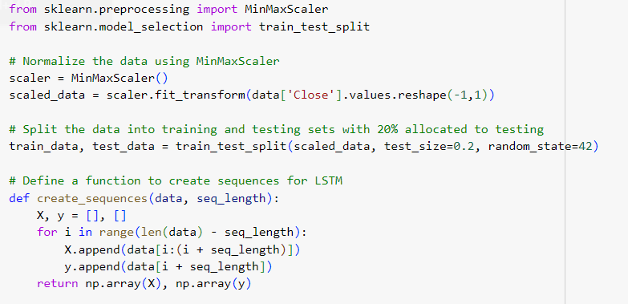
Data Processing
Normalization: Scale the features, particularly price and volume, using methods like Min-Max scaling or Standardization to aid in neural network performance.
Sequence Creation: Transforms the series into a supervised learning format where the past 60 days' data are used to predict the next day's 'Close' price.
The function create_sequences generates these sequences, suitable for training LSTM models.
Notes:
Normalization and scaling of features for model input: Standardizing data ranges improves model convergence and performance during training.
MinMax Scaling: Applies Min-Max scaling to scale 'Close', 'Volume', and engineered features between 0 and 1. This is crucial for neural network models to converge more efficiently.
Sequence Creation: Transforms the series into a supervised learning format where the past 60 days' data (features) are used to predict the next day's 'Close' price. The function create_sequences generates these sequences, suitable for training LSTM models.

Slide 8
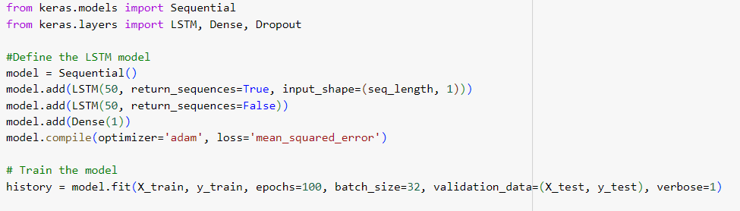
Model Architecture
LSTM Layers: The model uses two LSTM layers with 50 units each. The first LSTM layer has return_sequences=True to pass sequences to the next LSTM layer, capturing temporal dependencies.
Dropout Layers: Dropout layers are included to prevent overfitting by randomly setting a fraction of input units to 0 during training.
Notes:
.Analysis of historical data for LSTM training: Historical data provides insights for model learning, improving accuracy and prediction outcomes.
Iterative process of LSTM model refinement: Iterative refinement enhances model efficiency, optimizing predictions for dynamic cryptocurrency markets.

Slide 9
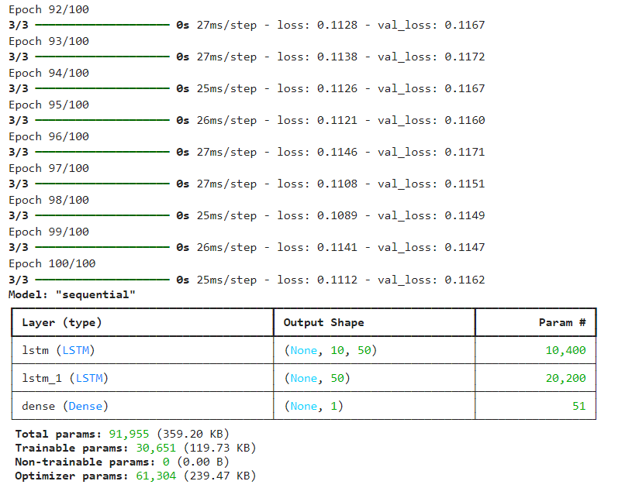
Model Training
Epochs: The model is trained for 100 epochs. This is a starting point, and based on model performance, you may increase or decrease this number.
Batch Size: A batch size of 32 is used, which is standard for most tasks but can be adjusted based on your system's memory capacity.
Validation Split: 20% of the data is used as a validation set to monitor the model's performance on unseen data during training.
Notes:
Validation metrics for LSTM model evaluation: Validation metrics assess model performance, ensuring reliability and effectiveness of predictions.

Slide 10
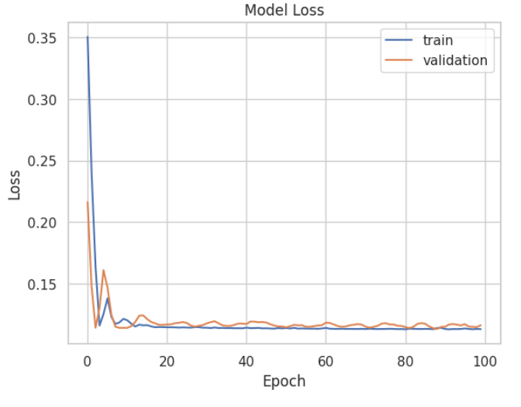
Model Evaluation
evaluate_model calculates the RMSE and MAE using predictions from the model on the test set. The function first predicts using the test set, then calculates mean squared error, takes its square root for RMSE, and calculates MAE directly.
Testing the Model: Selects a subset of data (X_test, Y_test) to perform the evaluation.
Notes:
Validation metrics for LSTM model evaluation: Validation metrics assess model performance, ensuring reliability and effectiveness of predictions.

Slide 11
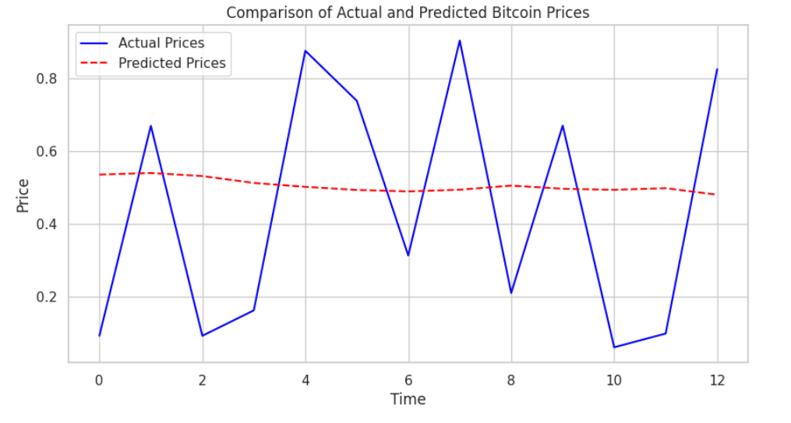
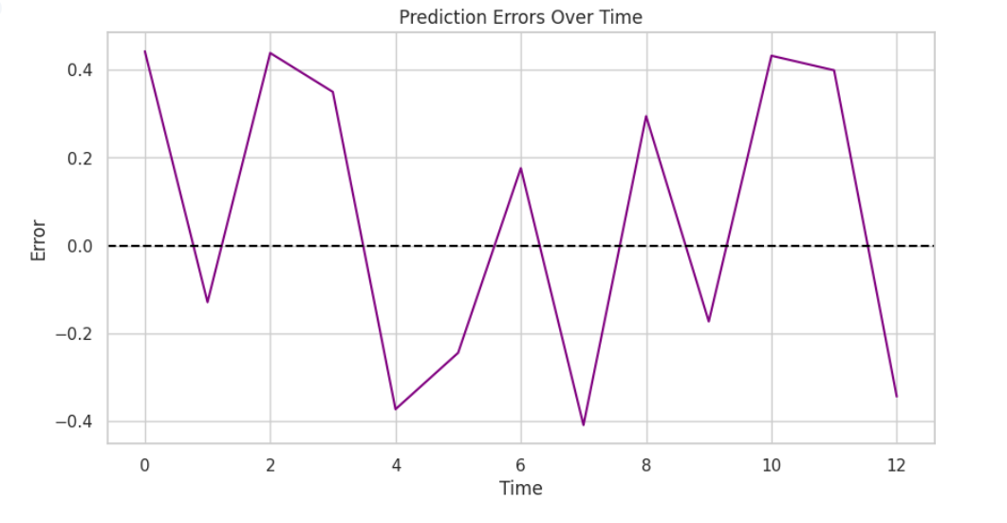
Data Visualization
Predictions vs Actual Prices: The first plot displays the actual prices (Y_test) and the predicted prices from the LSTM model.
Error Analysis: The second plot shows the prediction errors over time, calculated as the difference between predicted and actual prices. This helps in identifying whether the model consistently overestimates or underestimates the prices.
Notes:
Evaluation of LSTM model predictive power: Assessing model accuracy crucial for reliable Bitcoin price forecasts and informed investment decisions.
1.This visual comparison helps to assess how well the model captures trends and fluctuations in Bitcoin prices.
2.A horizontal line at zero error is plotted to easily visualize deviations.

Slide 12
The End

