Slide 1
Simulation of a speed camera detection system

Slide 2
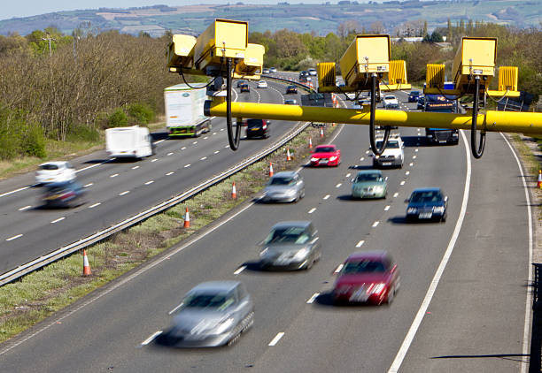
camera detection system simulation
simulation of vehicle speed monitoring and fine calculation .
Introduction & Features ::
modern traffic systems use speed cameras to monitor vehicles detects vehicle speed automatically calculates fines based on speed violation tracks vehicle violations and payment status .

Slide 3
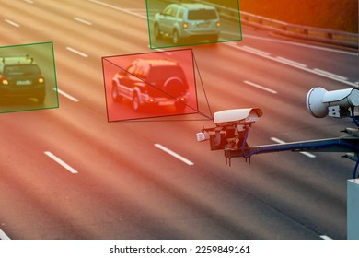
Speed Limits & Fine Structures
SPEED LIMITS
city roads: 60 km/h
highways: 100 km/h
motorways: 120 km/h
FINE STRUCTURE:
exceeded ≤10 km/h
Rs : 1000
exceeded ≤20 km/h
RS : 2000
exceeded >20 km/h
RS : 5000

Slide 4
Menu Simulation Vehicle Records
MENU OPTIONS:
enter vehicle record
view all violations
search vehicle
Pay unpaid fine
Calculate unpaid fine
exit program

Slide 5
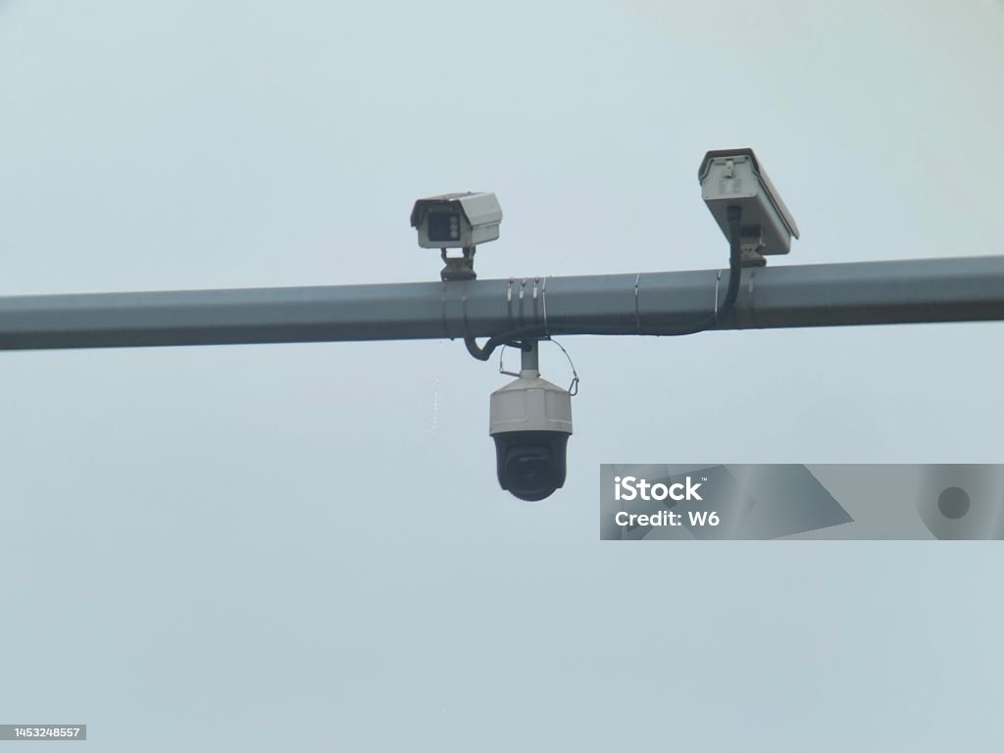
VEHICLE RECORD DATA
vehicle number
speed
road type
Speed limit
Fine
Fine status

Slide 6

benefits of simulation understand how speed cameras enforce traffic rules
benefits of simulation: understand how speed cameras enforce traffic rules
learn automated fine calculation
demonstrates real-world traffic monitoring

Slide 7
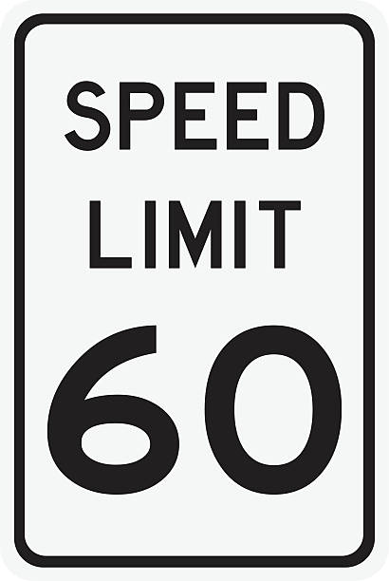
conclusion
this project simplified representation of real speed camera systems
highlights speed monitoring,
violation detection
fine management helps students and traffic authorities understand automated enforcement systems .

Slide 8
Thank You

