Slide 1
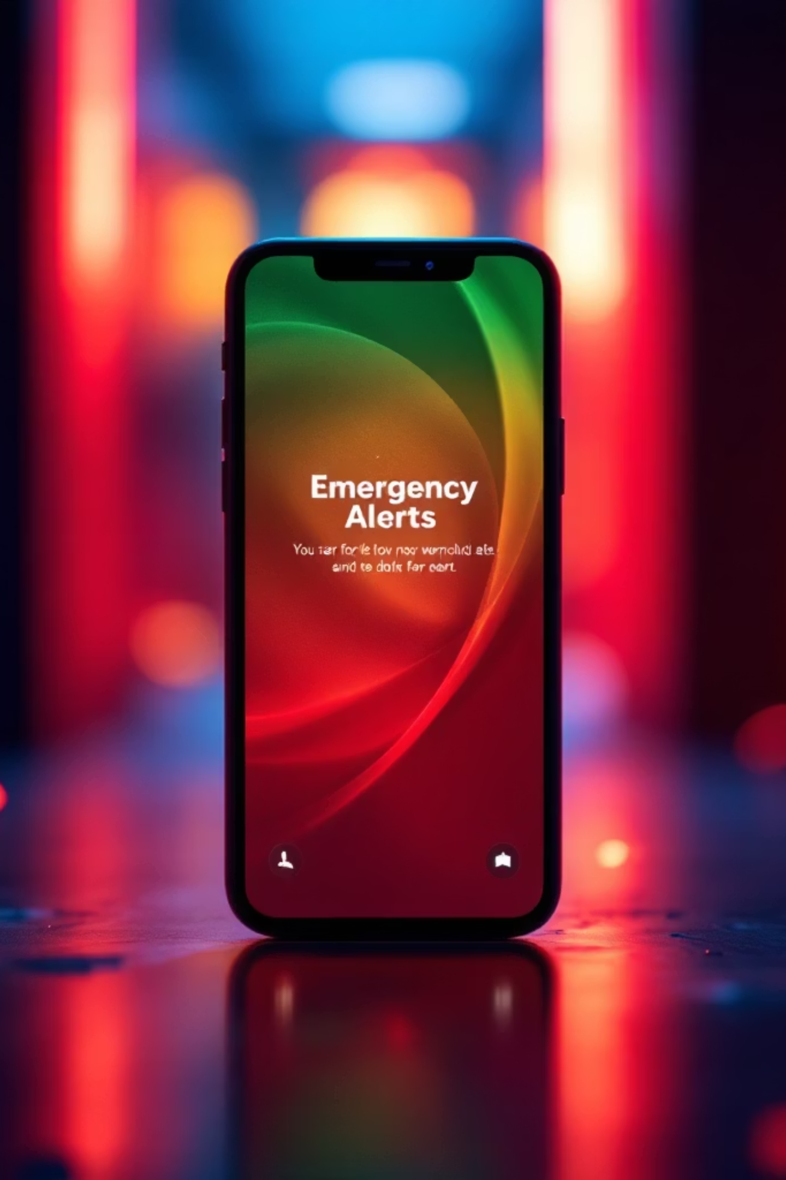
Smart Emergency Response System for Ghana
A real-time mobile and web platform transforming emergency reporting and response for national security services.

Slide 2

BACKGROUND
The Current Emergency Landscape
Ghana's emergency services rely on traditional phone calls to 191 (Police), 192 (Fire), 193 (Ambulance), and 112 (National Emergency Line). With rising smartphone usage and internet connectivity, there's an opportunity to leverage modern technology for faster, more reliable emergency response.
01
02
03
Traditional Reporting
Digital Transformation
Enhanced Response
Phone-based emergency calls
Mobile and web technology integration
Real-time evidence and location tracking

Slide 3
CRITICAL ISSUES
System Challenges
Delayed Response
Prank Calls
Location Difficulty
No Visual Evidence
Inefficient communication channels slow emergency response times
High incidence of false emergency reports waste resources
Inability to accurately locate victims during emergencies
Lack of real-time media for informed decision-making
Fragmented Systems
Verification Issues
Disconnected platforms across security agencies
Cannot authenticate incident legitimacy quickly
These challenges result in loss of lives and property, misuse of emergency resources, and reduced public trust in security services.

Slide 4
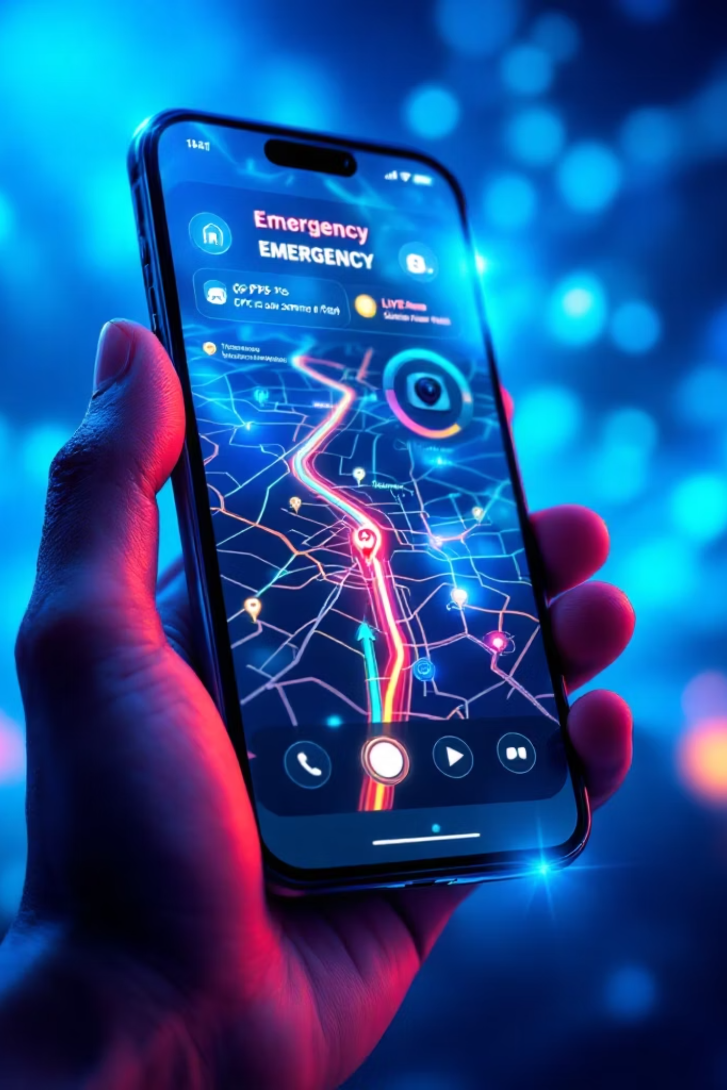
Project Aim
To design and implement a secure, real-time, mobile and web-based emergency reporting and response system that enables citizens in Ghana to report emergencies using live media and location tracking, while allowing security agencies to receive, verify, and respond efficiently.

Slide 5

OBJECTIVES
Seven Key Objectives
Mobile App Design
1
Enable emergency reporting with live images, streaming, audio, and GPS location
2
Identity Verification
Implement Ghana Card and national ID system integration
Agency Dashboard
3
Develop secure web interfaces for each security service
4
Real-Time Tracking
Implement incident notification and response monitoring
Fraud Detection
5
Design AI-powered prank and false report detection
6
Data Security
Ensure compliance with Ghana's Data Protection Act
System Evaluation
7
Test performance, usability, and reliability thoroughly

Slide 6
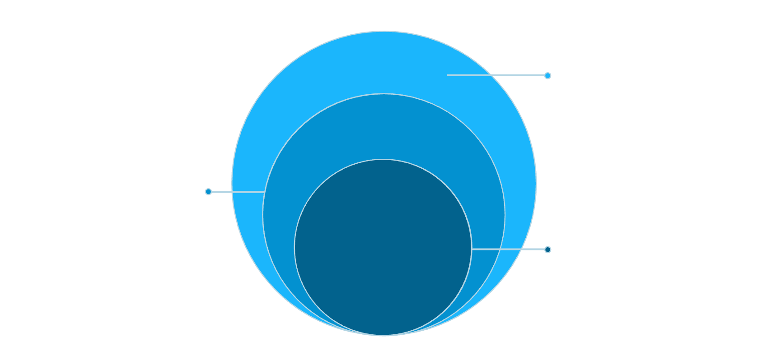
System Architecture
Mobile Layer
Android & iOS apps for citizens
Web Layer
Outer: Mobile & Web
Agency-specific dashboards
Citizen apps and agency dashboards
API Layer
Mid: Backend & Database
Backend services and routing
APIs, business logic, and persistent storage
Core: AI Fraud Detection
Database
Real-time anomaly detection and alerts
Secure incident storage
Security
The platform uses a multi-layered architecture ensuring scalability, security, and seamless integration across all emergency services.
Authentication and encryption
AI Module
Fraud detection and analysis

Slide 7


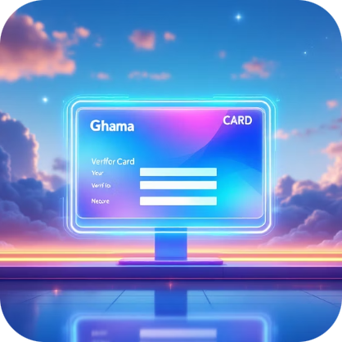



CORE FEATURES
Platform Capabilities
Live Media Capture
GPS Location Tracking
Identity Verification
Agency Routing
Real-time photos, video streaming, and audio recording for accurate incident documentation
Automatic real-time location sharing to help responders reach victims quickly
Ghana Card and NHIS integration to authenticate users and reduce false reports
Intelligent incident categorization and routing to Police, Fire Service, or Ambulance
AI Fraud Detection
Secure Data Handling
Behavioral analysis and pattern recognition to identify and filter prank calls
End-to-end encryption and compliance with Ghana's Data Protection Act

Slide 8




Development Approach
Agile Methodology
Testing Strategy
Unit testing for individual components
Integration testing across layers
System testing for end-to-end functionality
User acceptance testing with agencies
Performance and security testing
The project follows Agile Software Development for iterative progress and continuous improvement.
Requirements
Design
Analysis and planning
System and database architecture
Development
Testing
API, mobile, and web implementation
Quality assurance and deployment

Slide 9



Expected Impact
60%
75%
90%
Faster Response
Fewer Pranks
Better Coordination
Reduction in emergency response time
Decrease in false emergency reports
Improvement in inter-agency collaboration
This platform will save lives, reduce property loss, and align with Ghana's digital transformation agenda while enhancing public trust in security services.

Slide 10

CONCLUSION
Transforming Emergency Response
This project delivers a modern, secure, and intelligent emergency reporting platform that enhances public safety, improves emergency service efficiency, and supports Ghana's national security objectives.
Modern Solution
Enhanced Safety
National Impact
Leveraging mobile and web technology
Protecting lives and property
Supporting Ghana's security goals

