Slide 1



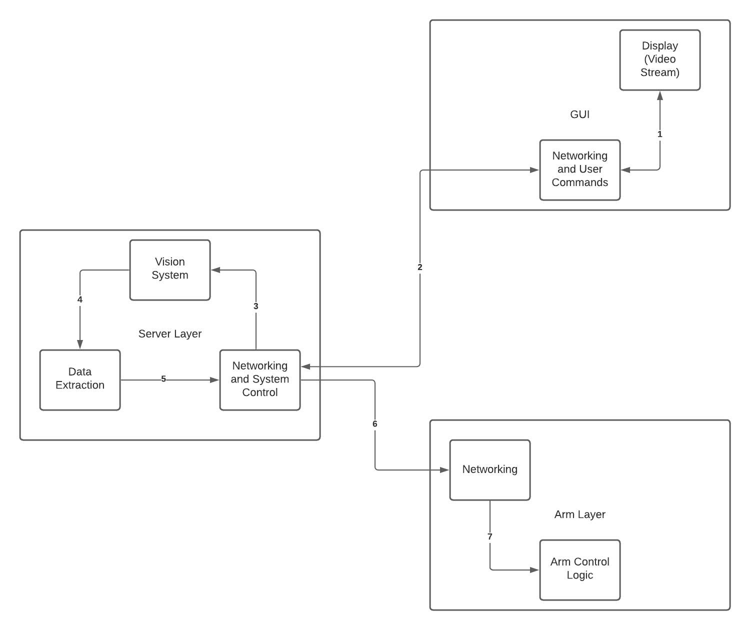
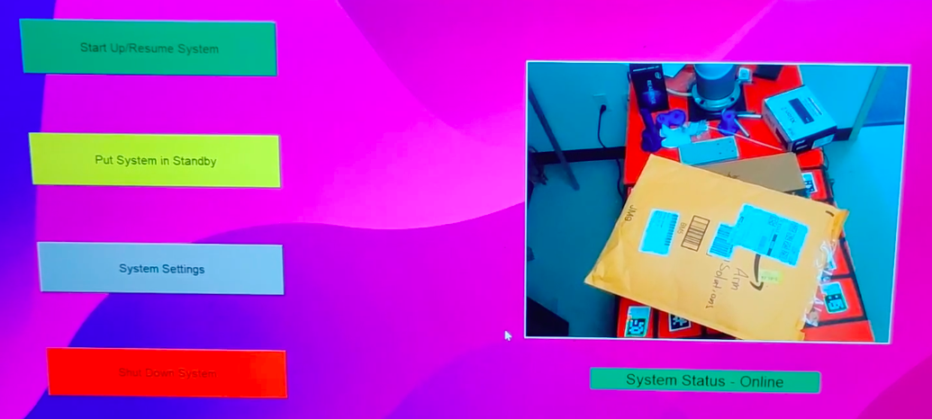
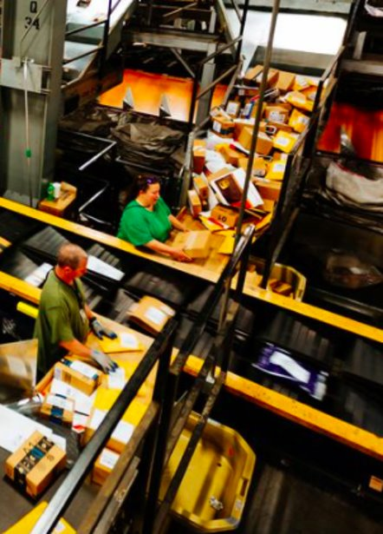
UR5 Parcel Sorter: Arm Solutions
Gregory Ferguson, Krishna Patel, Donny Pham, Inara Rupani, Mathew Zinke
Department of Computer Science and Engineering, University of Texas at Arlington, Arlington, TX 76019, USA
Executive Summary
System Overview
Prototype & Test
With the ongoing Industry 4.0 revolution, and with the recent pressures of coronavirus, many delivery organizations are facing unprecedented levels of worker stress and inefficiency. The objective of this report is to evaluate a design solution created by the engineering with the goal to create a market-ready system that would work alongside personal to pick and place parcels to increase efficiency. To reduce design time and costs for the hardware and electrical systems, off-the-shelf components and systems were used. This includes using an existing robotic product and a standard vacuum gripper. To identify the package type and location, the team created an AI to identify the package and a marker system for parcel location. Furthermore, a GUI was created to interact with the system allowing non-technical people to operate the system. While the system is automated, the GUI allows high-level control over the system. Testing by the engineering team has concluded the system can perform its objective, but more time is needed to streamline the design. The evaluation of this solution suggests it is possible for a commercial environment but is unreliable in its current state. Further time and analysis will be needed to determine if the solution is commercially feasible. the solution is commercially feasible.
Abstract
Raspberry Pi with Ubuntu desktop was used to standardize development, testing and integration. As we developed incrementally, we tested on the ubuntu 20.10 version.
Unit Testing files were created for the server to check their connection and response between the robot and the raspberry Pi
Run Configuration:
On Pi Terminal 1: python3 Integrated_server.py
On PI Terminal 2: python3 ArmMovement.py
On client: python3 UserInterface.py
GPIO pins were tested using a breadboard and LED's if the input output signals are synchronized before integrating with a relay switch on the gripper
(a)
(b)
(c)D
Background
Detailed Design Phase
In the light of coronavirus and the Industry 4.0 revolution, organizations like USPS, FedEx, and UPS have been overwhelmed with parcels and mail. Workers currently spend all hours of the day picking small parcels from a heap and placing them onto a conveyor for processing. Handling these parcels exposes them to germs on the parcels themselves. Our solution is to not only eliminate the risks to the employees but automate and improve the efficiency of thousands of jobs.
The Server includes the vision system and is the networking backbone for the system. The vision system itself is composed of a yolo5 model for package identification and Aruco markers to determine position. While eye-to-hand calibration would improve accuracy over Aruco markers, this design choice was made for time constraints. Additionally, an Intel Real sense was used as our camera and while there are no design tradeoffs for choosing this camera, the system is currently only designed to work with this brand.
The Arm Movement contains the logic to move the arm in an automated manner, using data from the Servers vision system. Both of these programs communicate using simple TCP/IP sockets, using the IPv4 protocol.
The User Interface (GUI) allows the operator to control the system from anywhere if it’s connected to the network. The GUI itself was built using Tkinter (python’s default GUI library). Using Tkinter allowed us to quickly design and test a GUI, and while more advanced GUI libraries are available, this design choice was made for time constraints. A video streaming functionality is also built into the server and GUI to allow the operator a visual image of the workspace.
Conclusions
The goal of this project was attained by using computer vision to recognize a parcel in the receiving area, moving the robotic arm to it and picking up the parcel for transportation. The work-cell used in our project deviates from a traditional postal company in that it does not have a conveyor belt system running through it, however, this is an environmentally dependent feature that does not take away from the overall desired behavior or goal of the project. The system conceived in the Detailed Design Specification (DDS) has proven to be robust enough for the needs of the project.

