Slide 1
Large Language Models for Clinical Diagnosis and Treatment Recommendation
Project Omega - Bachelor Semester Project S2 (2025/2026) University of Luxembourg
Can Yildiz, Nina Vojtassak, Tuna Karakus

Slide 2
Introduction: The Clinical Challenge
Electronic Health Records (EHR) represent rich, longitudinal medical patient histories.
Generating clinical recommendations (diagnoses, treatments) historically requires years of medical training.
Large Language Models (LLMs) show exceptional performance on multiple-choice benchmarks (e.g., MedQA, USMLE).
However, real clinical workflows are open-ended and safety-critical:
Formulating new differential diagnosis hypotheses.
Proposing detailed treatment plans with dosage recommendation.
Identifying drug interactions and patient safety flags.
Standard multiple-choice tests fail to evaluate this generative complexity.

Slide 3
Project Omega: Objective
Goal: Conduct a systematic comparative study of open weight LLMs on realistic clinical tasks using patient records.
Core Research Question: How do smaller instruction-tuned models compare to larger models when tasked with generating free-form clinical summaries and safety warnings?
Target Models:
LLaMA-3.3-70B-Versatile (Meta) - Accessed via Groq API.
Gemma-4-31B-IT (Google) - Accessed via Google Generative AI API.
Evaluation Method: Build a Python-based pipeline to process clinical data, query models, and run automated evaluations.

Slide 4
Methodology: Dataset & Patient Cohort
Clinical Database: MIMIC-IV (version 3.1), covering patient admissions from 2008 to 2019.
Cohort Selection:
Random sample of 2,000 critically ill patient admissions (seeded shuffle for exact reproducibility).
Selected cohort IDs persisted to disk.
Patient Eligibility Criteria:
Must contain at least one ICD-coded diagnosis.
Must contain at least one lab measurement event.
Must contain at least one prescription record.
Database Engine: Locally indexed using DuckDB to optimize query performance and memory footprint.

Slide 5
Methodology: Pipeline & Prompts
Two Phase Data Loading to maintain a constant memory profile:
Phase 1: Retrieve cohort demographics and ICD codes.
Phase 2: Load batch-wise clinical details (vitals, labs, procedures, cultures).
Prompt Structure (8 Sections):
Demographics, Diagnoses, Laboratory Results (15 recent), ICU Vitals, Vital Signs/Anthropometrics, Procedures, Microbiology Results, ICU Stay Duration.
Output Format Constraint:
Models forced to respond in 4 sections: (1) Additional Diagnosis Hypotheses, (2) Proposed Treatments (Drugs/Doses), (3) Safety Flags/Contraindications, (4) Confidence Level.

Slide 6
Evaluation Strategy
Traditional Lexical Metrics:
BLEU and ROUGE-1/2/L computed against the ground-truth ICD-coded diagnosis list.
Pharmacological Accuracy (Drug Overlap):
Fuzzy string matching (difflib, threshold >= 0.75) comparing model-recommended medications to actual clinical prescriptions.
Clinical Quality (LLM-as-Judge):
GPT-OSS 120B evaluator scoring both outputs on four clinical dimensions (1 to 25 points each):
1. Clinical Accuracy (correctness of hypotheses and drug choices).
2. Completeness (coverage of clinical context).
3. Safety (identification of interactions and contraindications).
4. Practical Usefulness (clarity, structure, and clinical actionability).

Slide 7
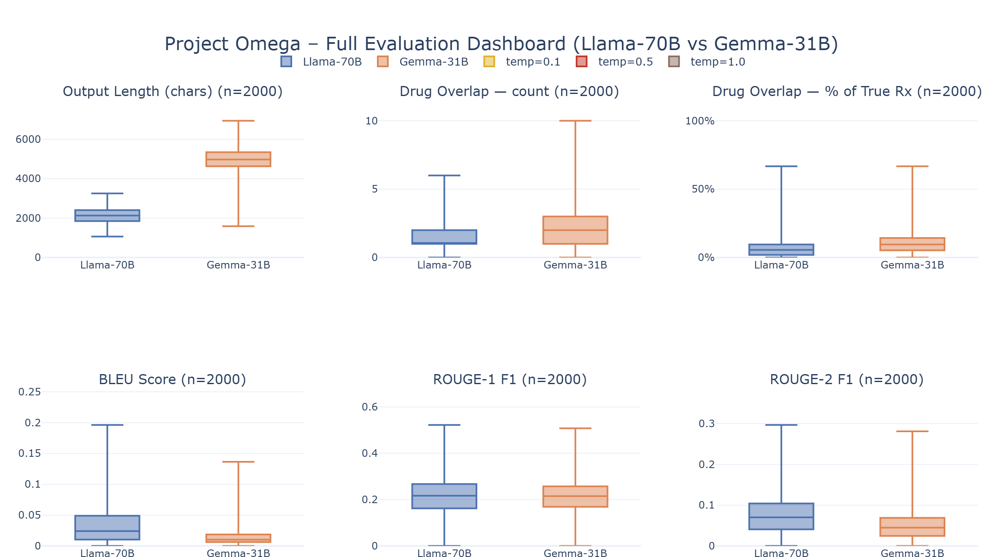
Results: Verbosity & Drug Overlap
Pronounced Difference in Verbosity:
LLaMA-70B: Highly concise, direct (median ~2,100 characters).
Gemma-31B: Comprehensive, detailed (median ~4,500 characters).
Drug Overlap:
Both models show modest drug overlap with true prescriptions (median 2 drugs, <10% recall).
Reflects the difficulty of predicting exact treatment regimes from raw ICD codes alone.
Gemma shows slightly wider distribution at upper quartiles, capturing more secondary medications.

Slide 8
Results: The 'Brevity Effect'
Paradoxical Lexical Results:
LLaMA-3.3-70B achieves higher median BLEU (0.052 vs 0.018) and ROUGE-1 (0.220 vs 0.121).
The 'Brevity Effect' Explanation:
The ground-truth reference is a concise list of ICD diagnoses.
LLaMA's shorter, diagnosis-centric output contains a higher density of ICD terms, boosting precision.
Gemma's comprehensive output contains treatment plans, safety flags, and rationales.
The extra clinical details 'dilute' Gemma's n-gram scores, causing severe penalty.
Conclusion: Standard n-gram metrics (BLEU, ROUGE) are inherently biased against detailed clinical summaries.

Slide 9
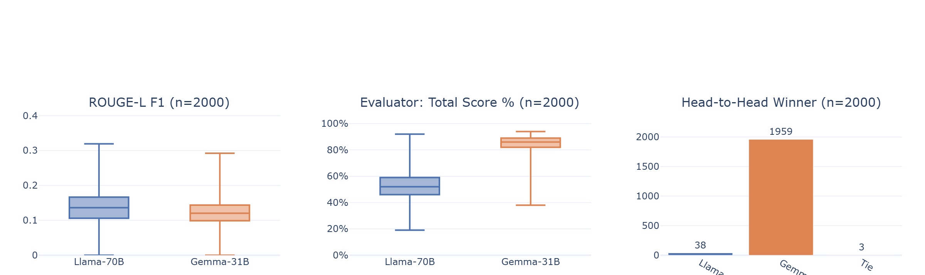
Results: Clinical Quality (LLM-as-Judge)
Head-to-Head Preference:
Gemma-4-31B-IT wins 97.9% of evaluations (1,959 wins).
LLaMA-3.3-70B wins 1.9% (38 wins).
3 cases result in a tie.
Total Evaluator Scores (out of 100):
Gemma-31B: Median score of 75%.
LLaMA-70B: Median score of 50%.
The evaluator strongly prefers Gemma's detailed explanations, safety flag sections, and structured reasoning.

Slide 10
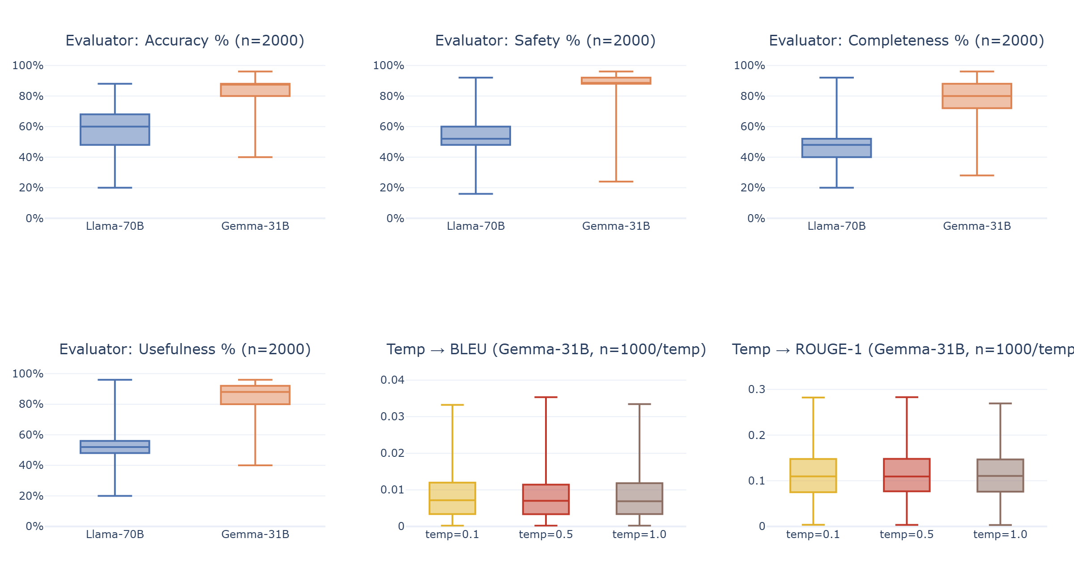
Results: Subscores & Temperature
Quality Dimensions (Gemma vs LLaMA):
Accuracy: Gemma 85% vs LLaMA 65%
Completeness: Gemma 80% vs LLaMA 48%
Safety: Gemma 85% vs LLaMA 56%
Usefulness: Gemma 82% vs LLaMA 48%
Temperature Robustness (Gemma, n=1,000):
Tested across T = 0.1, 0.5, and 1.0.
Lexical metrics remain highly stable.
Indicates Gemma's clinical reasoning is robust to decoding temperature variations.

Slide 11
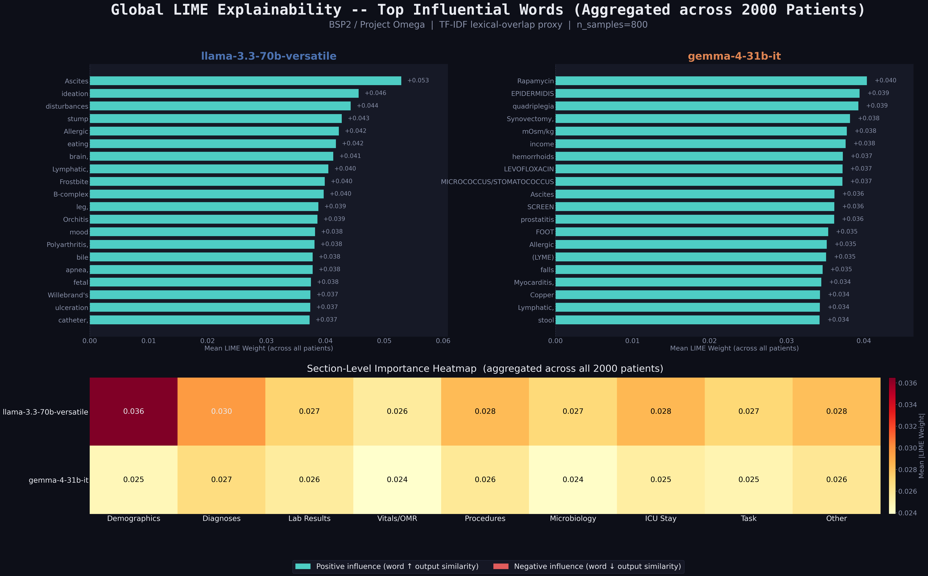
Explainability: LIME Analysis
Global Feature Importance:
Perturbed prompt tokens by masking subsets to measure lexical output changes.
Both models anchor heavily on Diagnoses and Lab Results sections.
Confirms models focus on relevant clinical context rather than demographics.
Attention Distribution:
LLaMA is highly sensitive to primary diagnoses.
Gemma distributes influence across labs, diagnoses, and vitals, mirroring its comprehensive synthesis style.

Slide 12
Discussion & Key Takeaways
Traditional Metrics are Flawed for Generative Clinical Tasks:
BLEU and ROUGE are biased towards conciseness and fail to assess safety, correctness, or clinical utility.
Value of Model Verbosity:
Gemma-31B's longer output is not 'fluff'; it contains critical clinical details, safety flags, and treatment justifications that make it more useful.
LLM-as-Judge is Crucial:
Standardizing multi-dimensional autonomous evaluation helps capture nuance where traditional metrics fail.

Slide 13
Limitations & Future Work
Limitations:
Lexical Proxy: LIME setup measures lexical output similarity, not true causal clinical reasoning.
Evaluator Bias: Autonomous evaluator (GPT-OSS) could potentially have a slight preference for longer, structured outputs.
Single Site: Dataset is limited to a single medical center (MIMIC-IV, Boston).
Future Work:
Human Expert Validation: Clinician reviews to correlate autonomous scores with human judgment.
Diverse Datasets: Test generalization on contemporary and multi-institutional data.
Semantic Attribution: Apply gradient-based interpretability methods.

Slide 14
Thank You
Questions and Answers

