Slide 1
Road Accidents in Israel
2013-2024
by Nina Garmash

Slide 2
CBS Data for 2013 - 2024
Central Bureau of Statistics:
Over 4.6 GB data on road accidents in Israel from 1.1.2013 to 31.08.2024:
Accidents
Vehicles
1.173M
2 M
Fatal
6K fatal cases - 0.55% of the total accidents recorded.

Slide 3
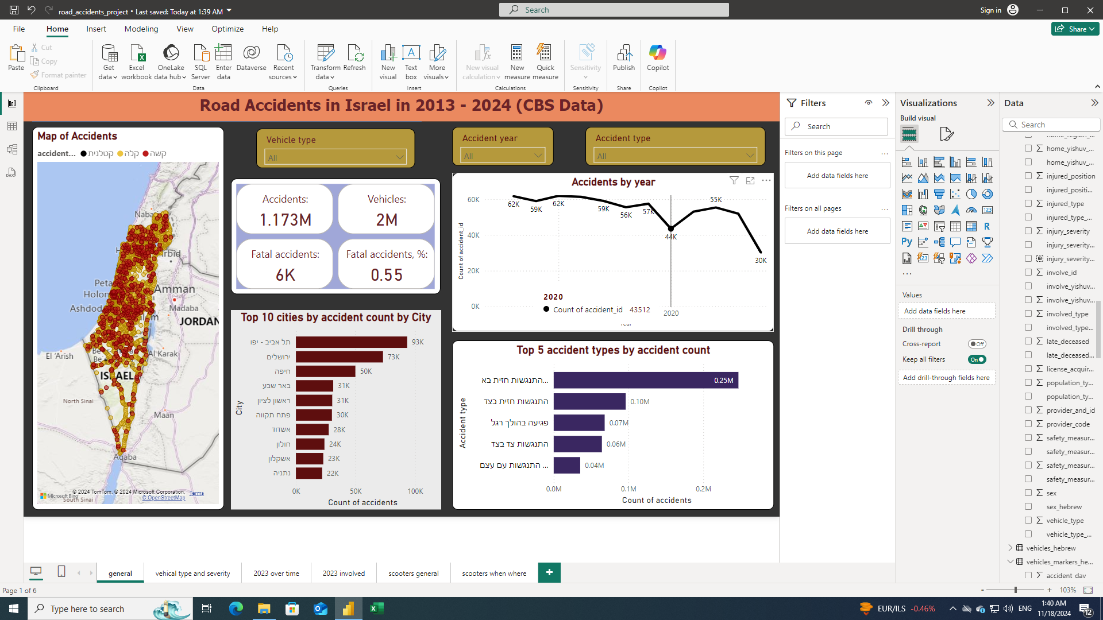
Accident Trends over Time
📈This chart illustrates the overall downward trend in yearly number of road accidents in Israel from 2013 to 2024.
The decrease in 2020 is likely attributable to restrictions imposed during the COVID-19 pandemic.
52K - - 2023
30K
cases
in 8 months
of 2024

Slide 4
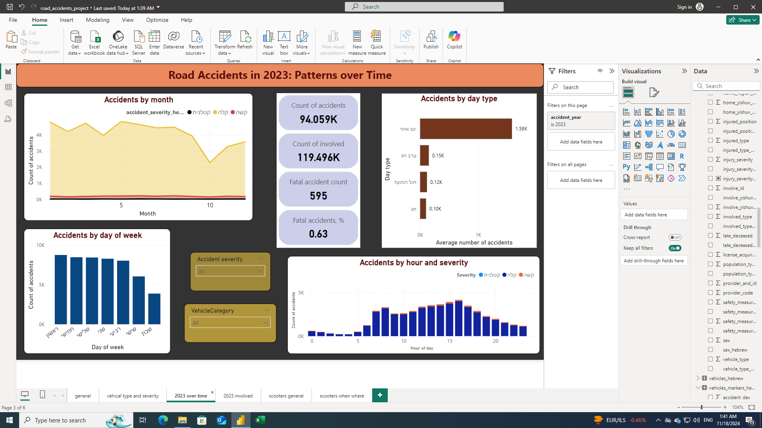
Accidents in 2023 Over Months
📈 Summer Spike
Monthly number of accidents in 2013 peaked during the summer months when more drivers are on the roads for vacation and leisure activities.
📈 During spring and autumn holidays, as well as on Shabbats, road accidents occur less frequently.
The significant drop in October 2023 correlates with both the autumn religious holidays and the war events following the events of October 7th.

Slide 5
Accidents by Day of the Week
📈 Overall number of accidents by day of the week decreases to the end of the week and is the smallest on Shabbat for all vehicle types.
The greatest number of accidents is on Sunday for most vehicle types, but can be different (motorcycle - Thursday, tractor - Friday).

Slide 6
Accidents by Hour of Day
📈 Rush Hour Risks
The majority of accidents occurred during morning and evening rush hours (8am, 4pm) when traffic congestion was highest.
This pattern is valid for most vehicle types except tractors (1am), train and cargo vehicles (12am).

Slide 7
Geographical Distribution of Accidents
🚨This chart presents the top 10 cities in Israel with the highest number of reported road accidents (overall data for 2013-2024).
As expected, the cities with the highest accident counts are major metropolitan areas with high population and traffic density, primarily located in central Israel.

Slide 8
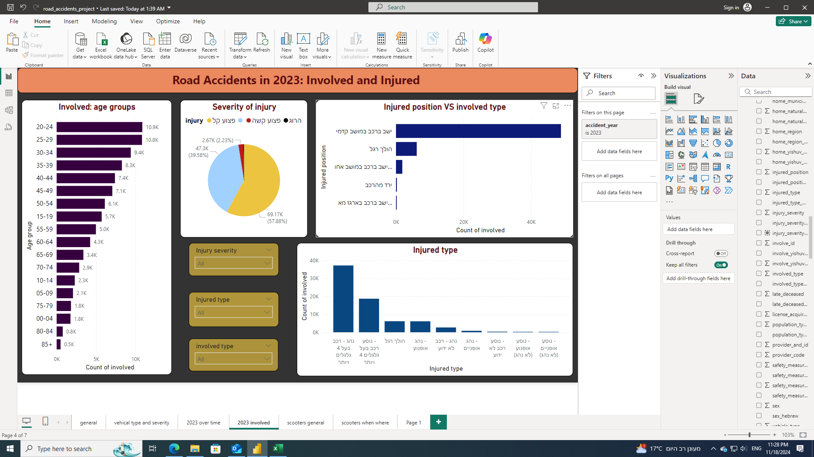
Demographic Factors - 2023
INVOLVED
DRIVERS NON-DRIVERS
🚨 Age People aged 20-30 are most frequently injured as drivers and non-drivers.
Non-drivers: the proportion of younger individuals increases significantly: age groups 15-19, 10-14, 05-09 appear in top 5 rating.

Slide 9

Demographic Factors - 2023
🚨 Gender?
or

Slide 10

Accident Severity Analysis
Minor injury - 96.1%
serious injury - 3..3%
0.55%
Fatal accidents
represent a small percentage overall,
but saw an increase in 2024 compared to 2023:
0.89% 0.63%
Mi
Fatal
FATAL
🚨 So, in the first eight months of 2024, the fatality rate increased by approximately 1.5 times compared to the previous year.
📈 This upward trend warrants further investigation and targeted safety measures.

Slide 11


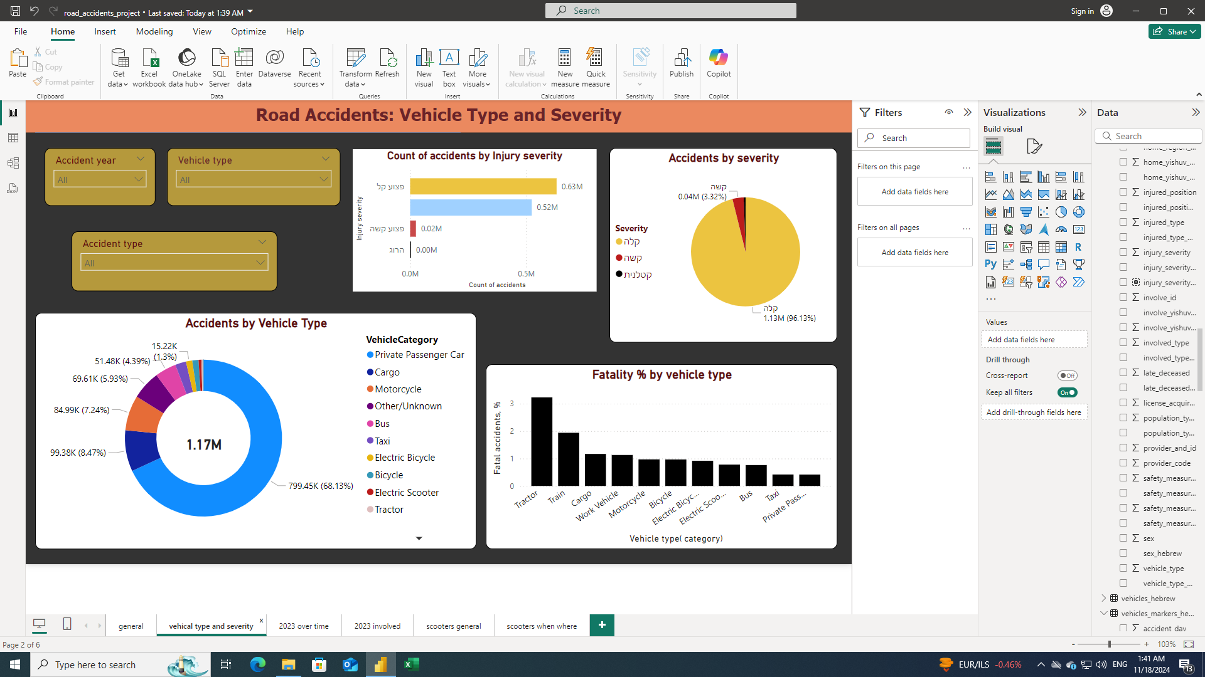


Road Accidents: Vehicle Type VS Injury Severity
= 70% of all accidents, but the smallest fatality percent among all accidents caused with them - 0.42% (2013-2023).🚨
Most dangerous vehicle type with maximal share of fatal accidents (2013-2024).
all accidents 2013-2024
Yearly changes example:
Electric Scooter
2013 - the most dangerous vehicle type
2023 - the least dangerous vehicle type

Slide 12
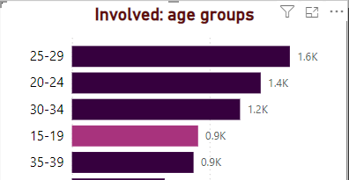
Electric scooters: accidents overview
involved
vehicles
accidents
2013-2024:
6.879K
11K
13.775K
fatal
54 cases - 0.78%
🚨More young people are involved in accidents with scooters: aged 15-19 are in top 5 among all age groups.

Slide 13
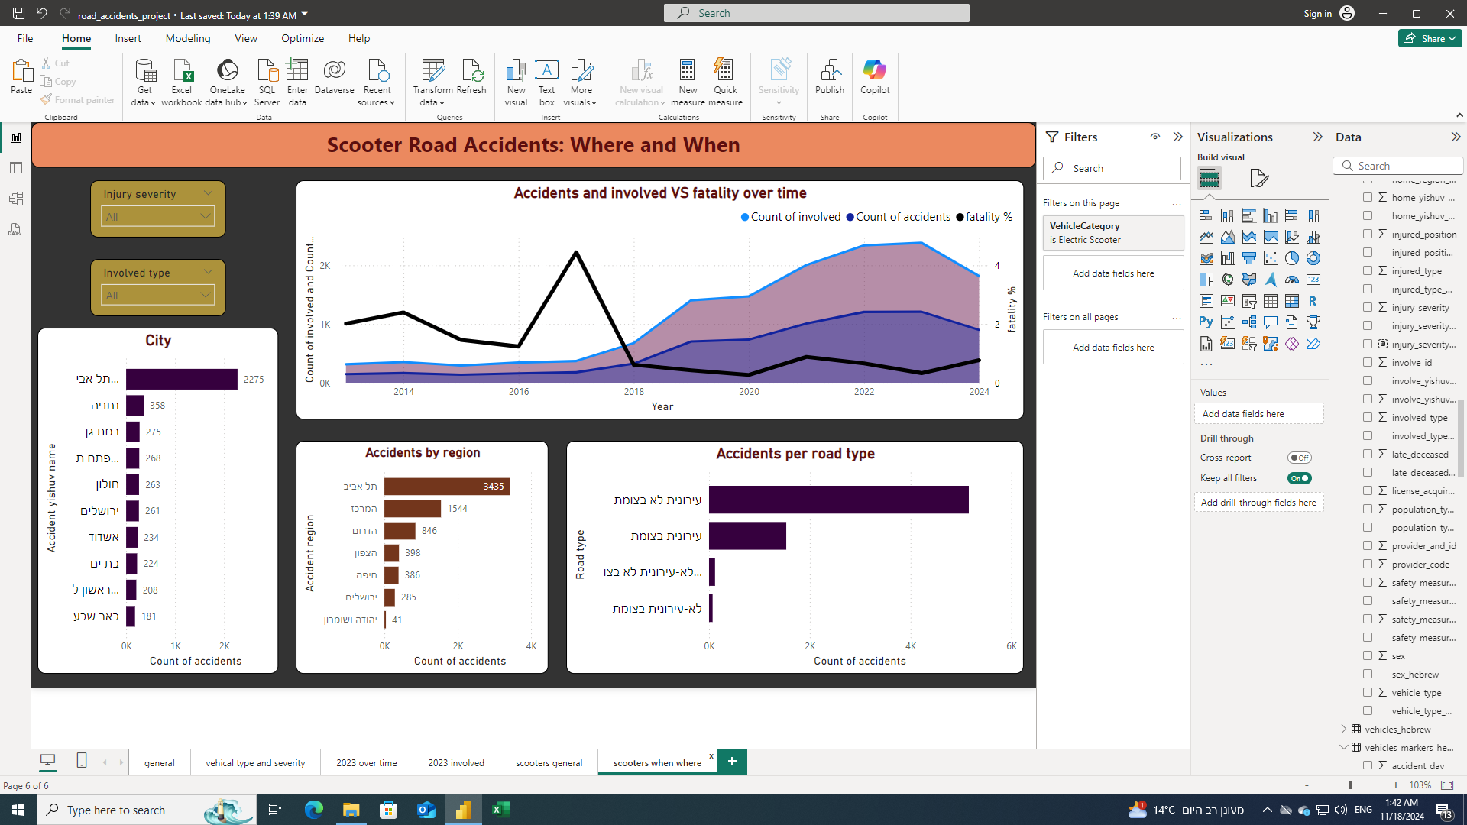
Accidents with Electric Scooters Over Time
📈 In 2023, the number of accidents involving electric scooters was 8 times higher than in 2013 - due to significant increase in the number of electric scooters on the roads.
.📈 Despite this increase, the share of fatal accidents has since decreased.
In 2013, scooter fatality was the highest among all vehicle types.
In 2023, electric scooters were the last in the fatality rate ranking.

Slide 14
Now, to dashboards!

Slide 15
Conclusions
Overall Trend: Road accidents in Israel have declined from 2013 to 2024, with a notable drop in 2020 due to COVID-19 restrictions.
Temporal Patterns: Accidents peak in summer and decrease during holidays and Shabbat; Sundays and rush hours see higher incident rates.
Geographic Focus: Major cities, primarily in central Israel, have the highest accident counts due to high population and traffic density.
Demographic Insights: Male drivers are involved in more and more severe accidents. Young drivers (20-30) are frequently injured, while children and teenaagers are more at risk among non-drivers.
Vehicle Risks: Tractors lead in fatal accidents, passenger car is the most safe vehicle. Electric scooter accidents rose eightfold but saw reduced fatality rates.

Slide 16
Takeaways
Infrastructure Improvements: Focus on safer roads for high-risk vehicles like scooters.
Targeted Interventions: Safety campaigns for male drivers, young scooter riders, and elderly non-drivers.
Policy & Behavior Changes: Enforce helmet laws, improve road education, and manage rush-hour traffic better.
Seasonal & Temporal Focus: Tailor interventions for weekends, holidays, and high-risk hours.
Next Steps: Maintain this dashboard and continue analyzing data to identify high risk zones, emerging trends and refine interventions.

Slide 17
THANK YOU!

