Slide 1
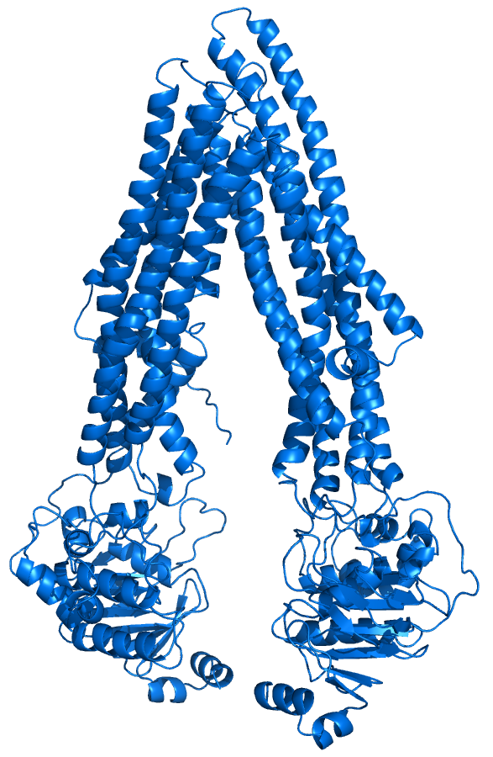
Erythromycin
Clarithromycin
Verapamil
Itraconazole
(+ metabolites)
Perpetrator
Rifampicin
P-gp
Victim
Digoxin
Dabigatran

