Slide 1
Qualitative Approaches: Making Sense of Words and Pictures Nick Spedding
Geography & Environment, School of Geosciences
GG3052 / GG3573 / GG3574
Research Design

Slide 2
Coding
Lots of words / images. Must extract key themes, meanings, issues…
Describe – how much detail?
Summarise
Analysis – how scientific?
Patterns – similarities, relationships, contradictions?
Explanations of patterns? Interpretations?
CODING of text – classify + relate different parts of texts + different texts

Slide 3

What codes to look for?
Research questions: existing theory & preconceptions
From the data – be open minded!
Descriptive codes – what? [face-value]
Analytic codes – why? [read into data]
Build up themes and linkages

Slide 4
Jim Perrin The Guardian, ‘Country Diary - Talsarnau, Gwynedd’, 11 September 2020 https://www.theguardian.com/environment/2020/sep/11/country-diary-the-swifts-are-long-gone-and-the-swallows-too
Across the sands of Traeth Bach, rearing above the Aber Iâ peninsula, Yr Wyddfa – the topmost peak of Snowdon – donned its habitual cloud cap. Arctic blasts of air wuthered across my evening perch on sea-wall rocks. A neap tide ran fiercely. Waders left off from feeding along its margins and scudded before the flood to roosts among the myriad of muddy inlets of Traeth Las. Oystercatchers, brilliant orange Pinocchio beaks and pied plumage catching the light, piped away upriver. The ice-polished crown of Ynys Gifftan reflected the sun dipping beneath the spreading cloud of an incoming front. I shivered, packed my rucksack, and turned for home.
By the level crossing, I ducked into a thicket that made me think of Hardy’s “wind oozing thin through the thorn from norward” (The Voice), and plucked one of its heavy crop of purple fruits, biting through the skin’s bloom into bracingly bitter pale green flesh…

Slide 5
Content analysis
Quantify the qualitative – social scientific
Frequency counts (absolute or relative)
[Compare analysis of questionnaire surveys]
Extensive
Descriptive of what
Emphasis on message – manifest aspects of data
Frequency of occurrence = important (?)

Slide 6
Content analysis as science?
Deductive codes: defined a priori
Systematic + comprehensive
Exhaustive (everything assigned to one category)
Exclusive (no overlap between categories)
Greater accuracy + precision
Systematic, rule-driven quantification reveals patterns not visible to casual analysis
Eliminates prejudice (led by data/rules)
Emphasis on reliability + replicability (same rules + same codebook + same data = same results?)
Superior validity/reality?

Slide 7
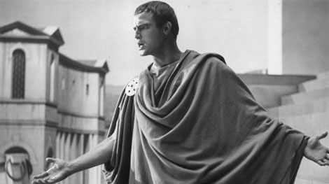
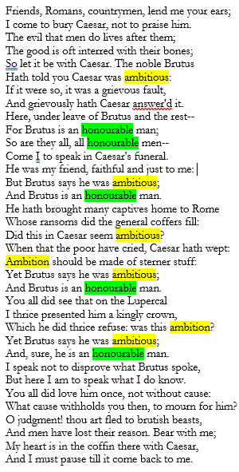
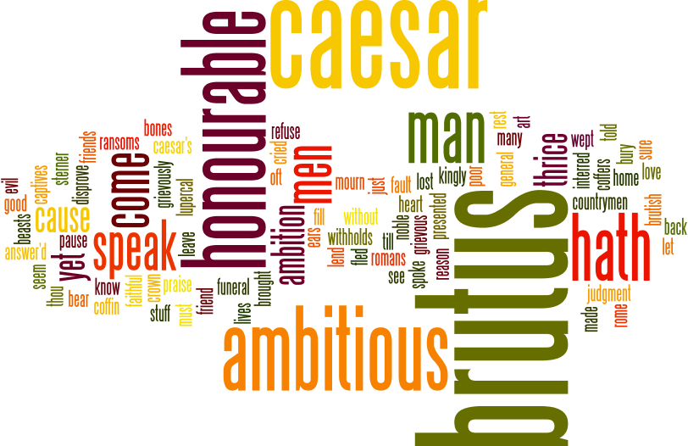
Friends, Romans, countrymen...
Interpretation – pushing things beyond word counts
For example:
https://literatureessaysamples.com/antony-s-and-brutus-speeches-in-julius-caesar/

Slide 8
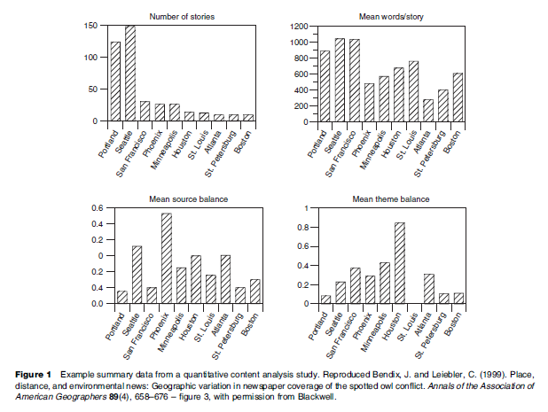
Counts + charts [Baxter in IEHG] Tests of hypotheses (distance decay) specified in advance
Quantity of coverage
 distance
Bias of coverage (pro-cut or pro-save)

Slide 9
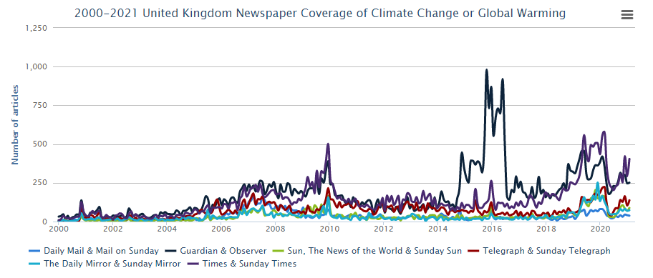
Media coverage: quantity
http://sciencepolicy.colorado.edu/media_coverage/
https://sciencepolicy.colorado.edu/icecaps/research/media_coverage/summaries/special_issue_2019.html
https://sciencepolicy.colorado.edu/icecaps/research/media_coverage/summaries/special_issue_2020.html

Slide 10
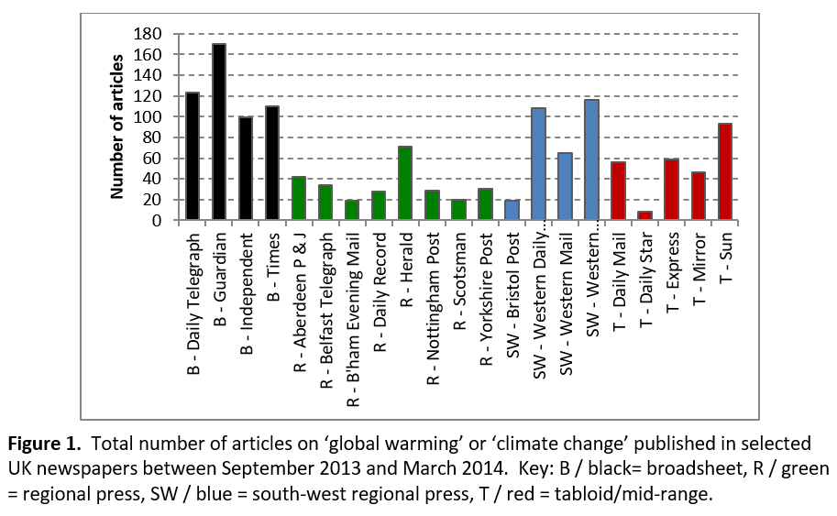
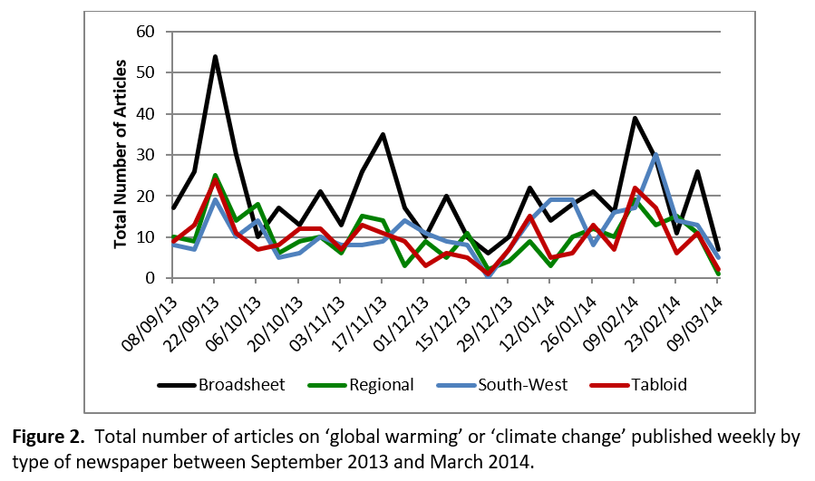
SX1505 UK newspapers
September: IPCC AR5
November: Typhoon Haiyan + UNFCCC Warsaw
January-February: floods, SW hard hit

Slide 11
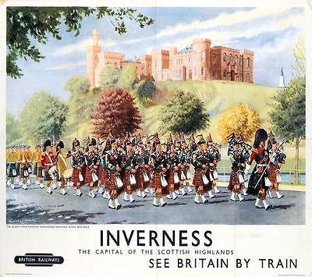
Inverness
Description – face value
A bright, fine day in Inverness. A military pipe band, in full highland dress, leads a parade. In the background, beyond the river, a castle sits on top of a tree-covered hill. The scene is presented from the viewpoint of a roadside spectator.
Objective codes
People. Yes – but what kind of people (e.g., hosts, visitors), how many, doing what?
Buildings. Yes – but what kind? Castle…
Natural features? River (just), hill, trees. Does the size of the hill, or the type of tree matter?
Weather. Fine, sunny
Perspective. Eye-level (as opposed to, say, low shot, looking upwards; elevated shot, looking downwards; wide-angle)

Slide 12
Inverness
Description – face value
A bright, fine day in Inverness. A military pipe band, in full highland dress, leads a parade. In the background, beyond the river, a castle sits on top of a tree-covered hill. The scene is presented from the viewpoint of a roadside spectator.
Attractions: parade, pipes and drums music, castle (cultural)
Actors: military pipe band (hosts)
Actions: marching, playing music
Atmosphere: ceremonial, celebration, commemoration?

Slide 13
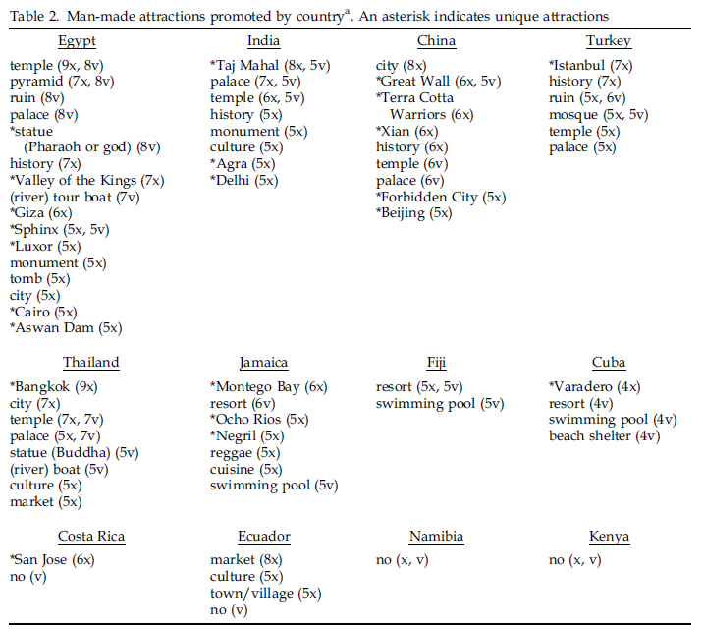
Echtner: 4As – attractions (cultural)

Slide 14
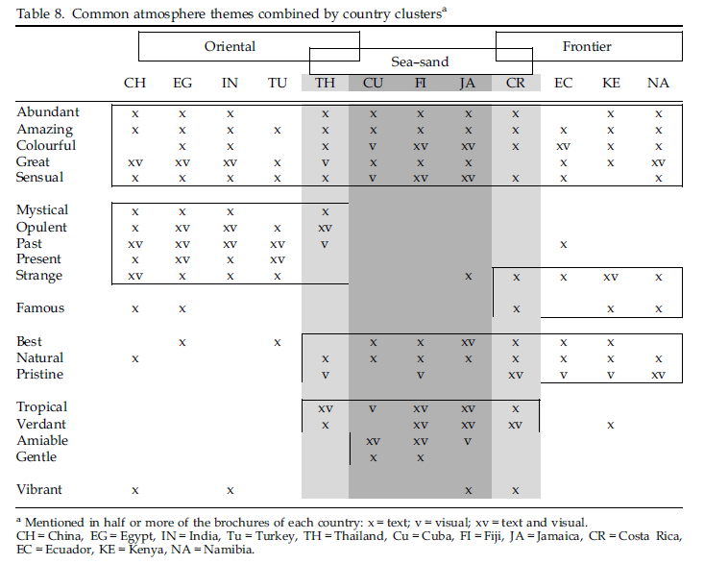
Echtner: 4As - atmosphere
Text = adjectives and adverbs
Pictures = interpretative: e.g., from facial expressions, dress, striking features
The other two As? Actors and actions

Slide 15
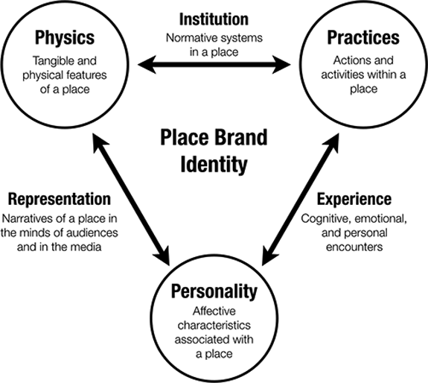
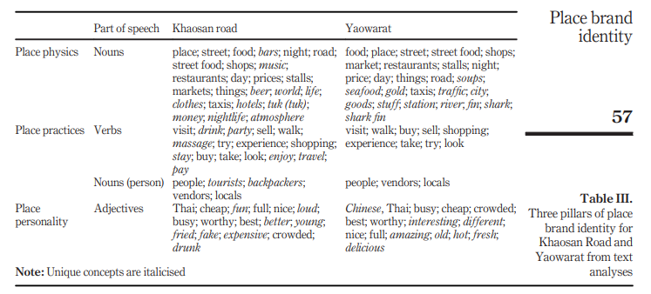
Place promotion + branding
Three pillars…
Taecharungroj, V. 2019. User-generated place brand identity: : harnessing the power of content on social media platforms. Journal of Place Management and Development.

Slide 16
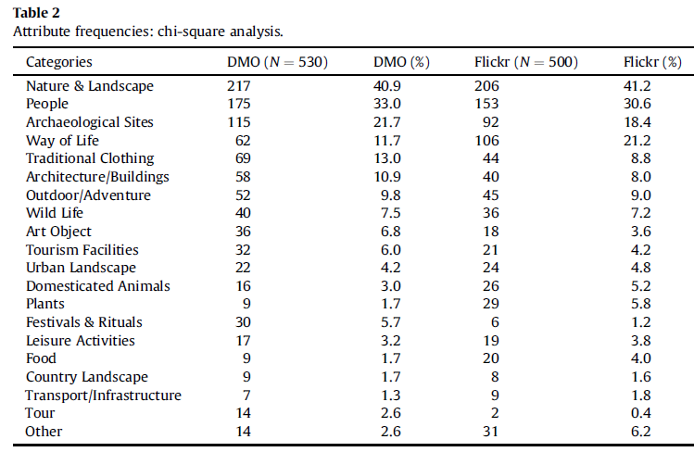
Code, categorise, count and tabulate (or graph)
Stepchenkova, S. and F. Zhan. 2013. Visual destination images of Peru: Comparative content analysis of DMO and user-generated photography. Tourism Management, 36, pp. 590-601.

Slide 17
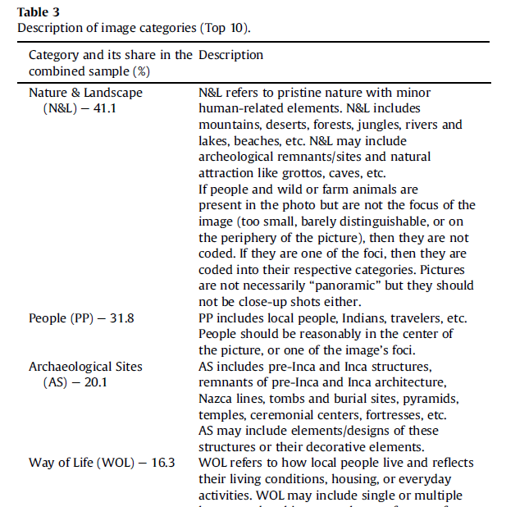
Describe and exemplify codes!
Stepchenkova, S. and F. Zhan. 2013. Visual destination images of Peru: Comparative content analysis of DMO and user-generated photography. Tourism Management, 36, pp. 590-601.

Slide 18
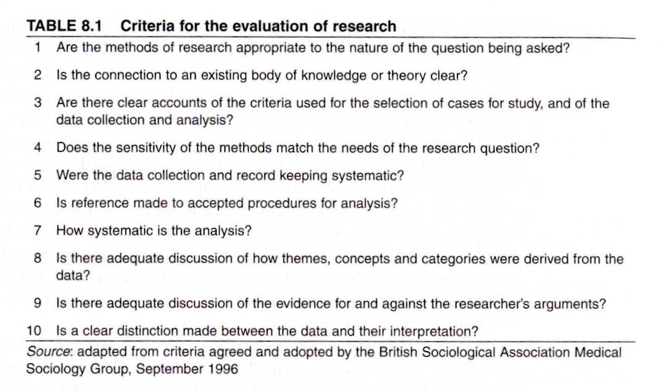
Criteria for credibility?
Source: Silverman (2006) Interpreting Qualitative Data (but aren’t these just positivist?)

Slide 19

Selling the seaside
Science and Society Picture Library – National Rail Museum poster collection – search this for “seaside” (these six are all 1950s/early 60s)
Going by these posters (adverts!), what might you expect to find at the seaside? How is this different to everyday places + life?
Starfish? Warm, sunny weather? Fun? Freedom? Glamour? Sex? Who are these images intended for?
Six posters – so unlikely to be representative. Still – similarity/repetition of themes deserves some thought
Odd one out: what are the wider connotations of the bucket and spade? Are these important?

Slide 20


Other seasides are available…

Slide 21
Semiotics* of the beach Foote and Azaryahu (2009) ‘Semiotics’ in IEHG
The semiotic perspective has been employed often to analyze elements of popular culture – the beach, the shopping mall, the tourist site, and the theme park such as Disneyland. A semiotic reading entails decoding the meanings of signs and an exploration of how signs align with specific myths, concepts, and themes.
These sites, such as beaches, have gained such attention because they are often positioned at interfaces between public and private, commercial and noncommercial, and nature and culture. Reading the beach, for example, involves an analysis of the cultural codes and social norms that govern modes of behavior as well as patterns of meaning that are inscribed into the local architecture. It also involves an exploration of how uses of the beach signify myths of popular culture and the conflicts that arise when different ideologies compete to gain control over beach uses.
* Semiotics is a branch of the study of culture that explores the communication of meanings and how messages are encoded and decoded.

Slide 22
But...
Retain creativity + need to tease out meaning!
Constrained subjectivity – rigour + skills of researcher
Core of technique = choice of categories used (codes / topics / themes / signifiers)
Codes = deeper/wider significance
Hermeneutics – contribute to discourse analysis
Work as signs (point to something)
E.g., Hopkins (1998) on socio-semiotics of place promotion (advertising!) around Lake Huron

Slide 23
Qualitative content analysis
Less-than-objective method
Relax emphasis on frequency as (literally) what counts
Counts + codes do not expose fixed + stable meanings
Messy!
Reworking of codes as go along – not use of rigid a priori structure + theory
Inductive / grounded theory
Flexibility + reshaping of hypotheses
Greater interest in context of authorship + reception (read into + beyond text)
Recovery of deeper meaning (latent not manifest content)
Prose description + quotation (not tables or graphs) to exemplify data

Slide 24
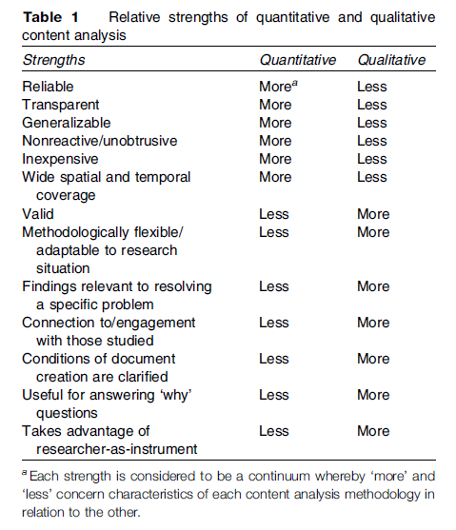
Baxter (IEHG) Quantitative vs. qualitative / Extensive vs. intensive

Slide 25
Implications
Applied to wider range of sources
Media (newspapers + propaganda)
Interview + focus group transcripts
Open questions responses to surveys
Image collections
Advertising materials, brochures, websites,
Sample size ↓
Reliance on skill + creativity of researcher ↑
Precise quantification → semi-quantitative
Interests in absence as well as presence
In-depth discussion of selective examples
Intensive – or mixed methods - approach

Slide 26
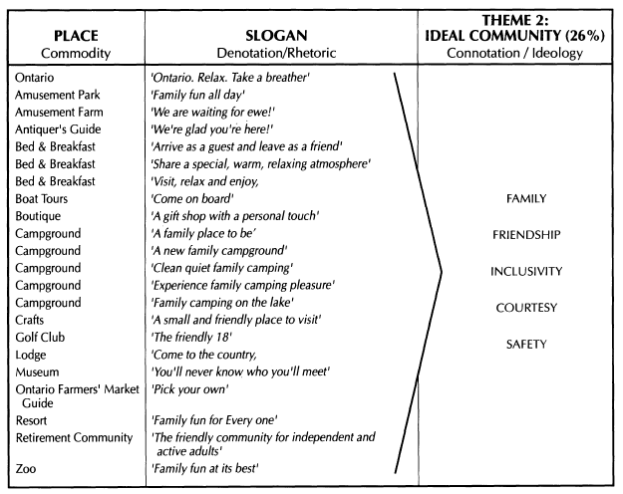
Hopkins, J. (1993) Signs of the post-rural: Marketing myths of a symbolic countryside. Geografiska Annaler, Series B, Human Geography, 80, 2, pp. 65-81.

Slide 27
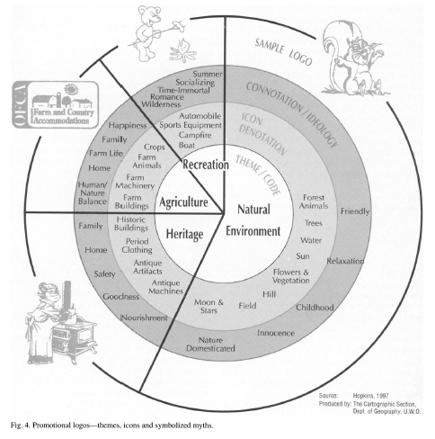
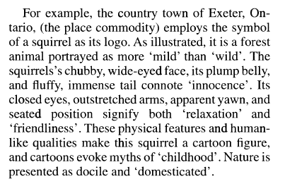
Hopkins, J. (1993) Signs of the post-rural: Marketing myths of a symbolic countryside. Geografiska Annaler, Series B, Human Geography, 80, 2, pp. 65-81.
For the sake of brevity, one logo from each code was selected for further
analysis on the basis that it was among the best examples of its particular theme…

Slide 28
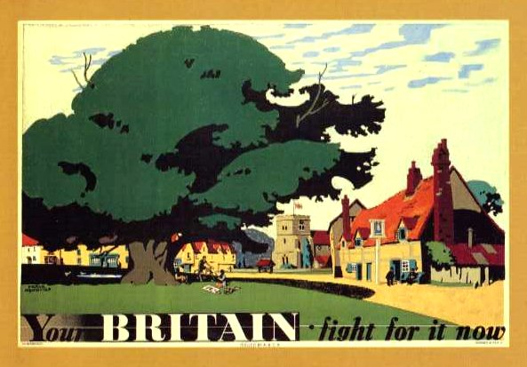



Wartime propaganda + sense of place

Slide 29
Jim Perrin The Guardian, ‘Country Diary - Talsarnau, Gwynedd’, 11 September 2020 https://www.theguardian.com/environment/2020/sep/11/country-diary-the-swifts-are-long-gone-and-the-swallows-too
Across the sands of Traeth Bach, rearing above the Aber Iâ peninsula, Yr Wyddfa – the topmost peak of Snowdon – donned its habitual cloud cap. Arctic blasts of air wuthered across my evening perch on sea-wall rocks. A neap tide ran fiercely. Waders left off from feeding along its margins and scudded before the flood to roosts among the myriad of muddy inlets of Traeth Las. Oystercatchers, brilliant orange Pinocchio beaks and pied plumage catching the light, piped away upriver. The ice-polished crown of Ynys Gifftan reflected the sun dipping beneath the spreading cloud of an incoming front. I shivered, packed my rucksack, and turned for home.
By the level crossing, I ducked into a thicket that made me think of Hardy’s “wind oozing thin through the thorn from norward” (The Voice), and plucked one of its heavy crop of purple fruits, biting through the skin’s bloom into bracingly bitter pale green flesh…

Slide 30
Discourse David Campbell – Dictionary of Human Geography 5th edition
A specific series of representations and practices through which meanings are produced, identities constituted, social relations established, and political and ethical outcomes made more or less possible. Although different fields in the humanities and social sciences have worked with varying accounts of discourse, all grow out of the decades of debates about language, interpretation and understanding in the natural and social sciences. As such, discourse is a concept that departs from the traditional philosophy of language’s relationship to the world. Instead of seeing the world as independent of ideas about it, with language transparently reflecting a pre-existing reality, theories of discourse analysis understand reality as produced via practices of interpretation deploying different modes of representation.

Slide 31
Discourse for Nick and other dummies
Point of view
Content of message (various texts – landscapes, institutions)
Way in which put across (metaphor, rhetoric, narrative...)
Partial – incomplete / biased / subjective
Potential to shape identities and attitudes + regulate behaviour
Associates knowledge + communication with power (hegemony)
Often taken for granted (unspoken rules)
Possibilities for contestation, subversion and resistance
SOCIAL CONSTRUCTION! Language/discourse structures/creates reality (not a neutral mirror)

Slide 32
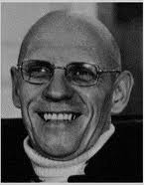
Discourse analysis
Unpick taken for granted + understand how it works
Thick description + detailed, critical reading of whatever makes up the discourse
Elucidate relationship with wider systems of knowledge / power / action (contexts)
Hard-core theoretical origins (Foucault)
Feel free to skip!

Slide 33
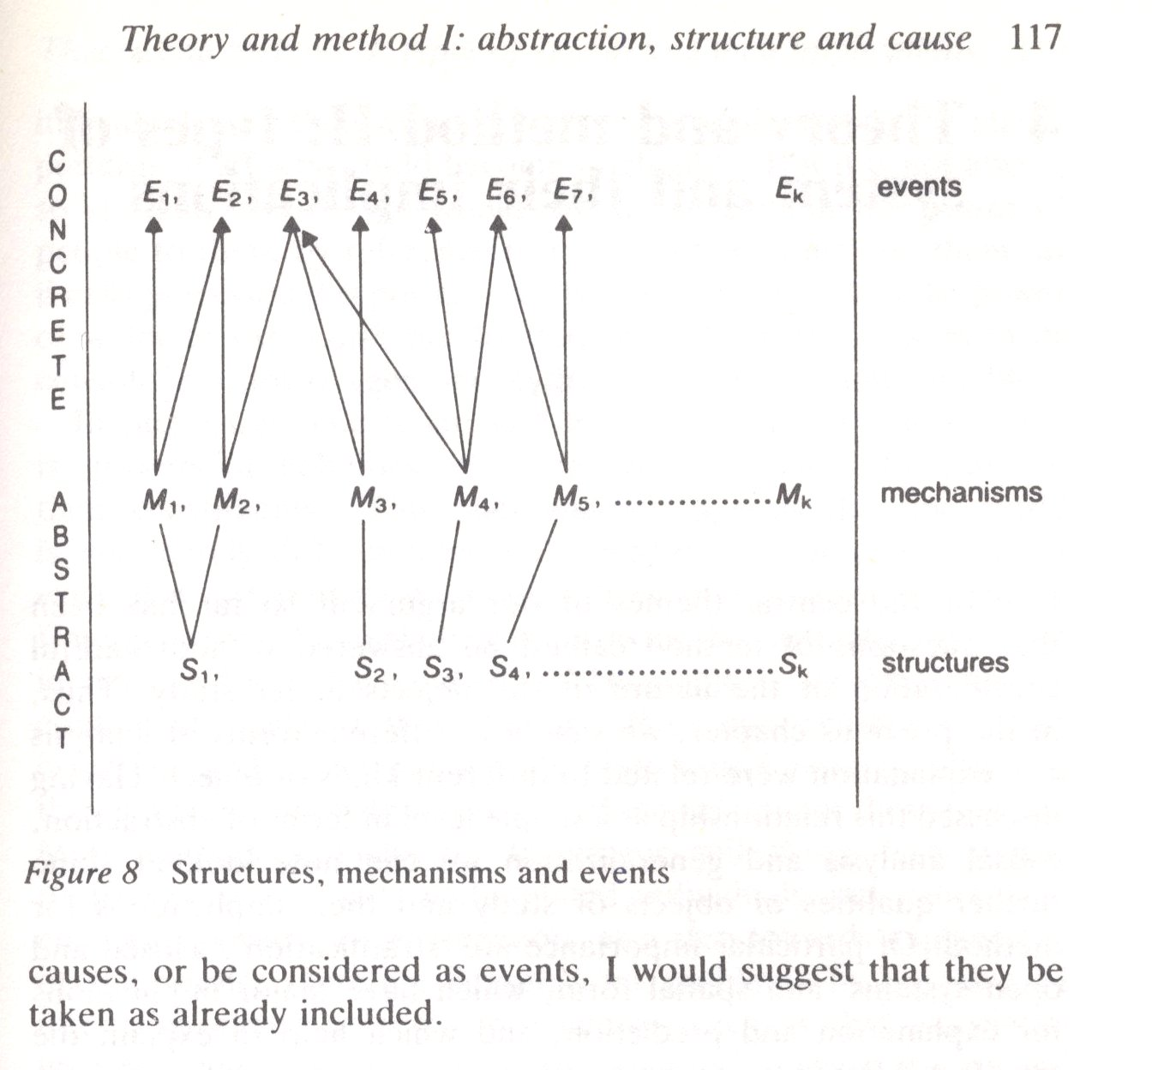
Critical realism + discourse analysis Marxism – (uneven) structures of capitalism Feminism – (uneven) structures of patriarchy Postcolonialism – (uneven) structures of race and empire
Sayer (1992)
Abstract research
Generalisation (extensive)
Intensive research
Synthesis
Texts as discursive events?
Conditioned by mechanisms...
Reflect (+ reproduce) underlying structures
Too rigid?
Excessively theory-laden? Conspiracies everywhere!
Existence/necessity of structures?

Slide 34
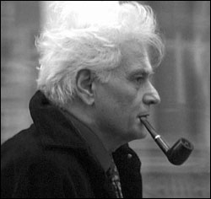
Deconstruction
More hard core French philosophy (Derrida)
Within HG + cognate disciplines instructive + inspirational
Deconstruction-lite = to take apart...
“… a popular verb referring to the dismantling and taking apart of authoritative narratives, opinions, or identities, exposing their contingency to view.” Clive Barnett (IEHG) = Critique!
Meaning is not fixed
Language (texts) work to make meaning = active representation – geography as literary criticism
Focus on use of rhetoric / context of authorship + reception
Critical study of the use of binaries in arguments (male/female – good/evil – ecocentric/technocentric – free market/regulation – develop/conserve)
Back to denotation + connotation…

Slide 35
Discourse analysis / deconstruction as method
Difficult to tie down – backlash against positivism + scepticism towards rules/procedures
Craft skill
Intuition + creativity of researcher crucial
[Vague methods?!]

Slide 36
7 key components Waitt (after Rose, cited by Berg in IEHG)
Abandon presuppositions (fresh eyes/open mind)
Let the text absorb you (deep + detailed engagement)
Code for themes (repetition, stereotypes, literary artifice...)
Identify regimes of truth (devices assert normality and legitimacy)
Identify inconsistencies (= possibilities for alternative interpretations + resistance)
Identify absence as well as presence (who and what excluded?)
Identify social contexts (by whom, how, for whom, with what consequences?)

Slide 37
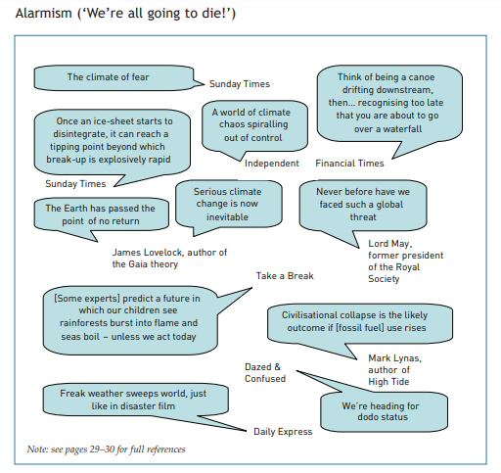
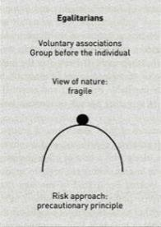
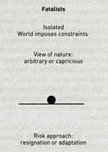
Media coverage of climate change: quality
Institute of Public Policy Research (UK): Warm Words
https://www.ippr.org/publications/warm-wordshow-are-we-telling-the-climate-story-and-can-we-tell-it-better
Linguistic repertoires (discourse)
Package of beliefs – reflect wider politics / ways of life
How these are expressed (rhetoric)

Slide 38
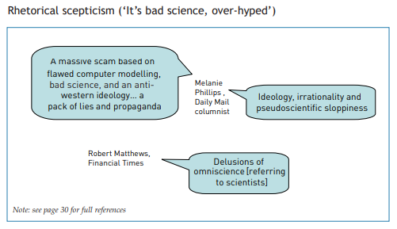
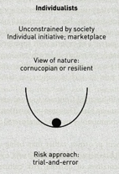
Media coverage of climate change: quality
Institute of Public Policy Research (UK): Warm Words
https://www.ippr.org/publications/warm-wordshow-are-we-telling-the-climate-story-and-can-we-tell-it-better
Linguistic repertoires (discourse)
Package of beliefs – reflect wider politics / ways of life
How these are expressed (rhetoric)

Slide 39
Nuclear power: interpretive packages Gamson, W. A. and A. Modigliani. 1989. Media discourse and public opinion on nuclear power: a constructionist approach. American Journal of Sociology, 95, 1, pp. 1-37.
Symbolic contest – role of culture – social construction of meaning
(+ individuals’ life histories, social interactions & psychology)
Progress Celebrates technology, scientific rationality + economic growth: Atoms for peace, not war!
Energy independence Energy security
Runaway Technology out of control (fatalism, necessary evil)
Devil’s bargain Above three together: ambivalent
Soft paths Green, renewables, decentralised (e.g., FoE)
Public accountability Mistrust of establishment, centralisation of power and profit
Not cost effective

Slide 40
Interpretative packages
= frame (central idea) + linguistic/symbolic tools and tricks used to communicate it (message + medium)
Framings devices = short-hand
Metaphors
Exemplars – examples from which lessons can be drawn
Catchphrases
Depictions
Visual images
Reasoning devices
Roots – causes
Consequences - efffets
Appeals to principle (morals)
Aspects of text (rhetoric) to identify + analyse

Slide 41
Coding
Criteria that define frames (deductive, a priori)
Progress package – find these in articles
Underdeveloped nations can especially benefit from peaceful uses of nuclear energy
Nuclear power is necessary for maintaining economic growth and our way of life
Nuclear power opponents are afraid of change
Prose synthesis… [Quotations + examples – not graphs!]
If the electric chair had been invented before the electric light, would we still be using kerosene lamps? There has always been resistance to technological progress by nervous Nellies who see only the problems and ignore the benefits. Resistance to nuclear energy development is the latest version of this irrational fear of progress and change, the expression of modern pastoralists and nuclear Luddites. Certainly nuclear energy development is not free of problems, but problems can be solved, as the history of technological progress shows. The failure to develop nuclear power will retard our economic growth and make us renege on our obligation to the poor and to future generations. If coercive utopians prevent us from moving ahead now with nuclear energy, the next generation is likely to be sitting around in the dark blaming the utilities for not doing something this generation's officials would not let them do.

Slide 42
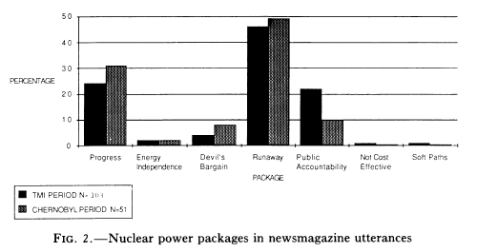
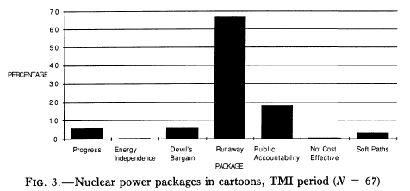
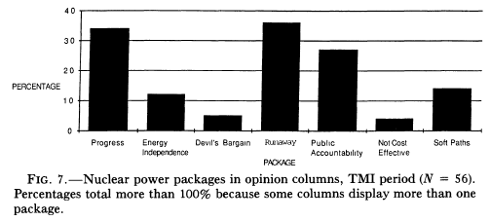
Nuclear power: interpretive packages Gamson, W. A. and A. Modigliani. 1989. Media discourse and public opinion on nuclear power: a constructionist approach. American Journal of Sociology, 95, 1, pp. 1-37.

Slide 43
Shale We Drill? Discourse Dynamics in UK Fracking Debates Elizabeth Bomberg (2015) Journal of Environmental Policy & Planning, 19, 1. pp. 72-88
Discursive framing
….how actors define, select and emphasize particular aspects of an issue according to an overarching shared narrative and set of assumptions… Frames mix empirical information and emotive appeals; they are most often connected to core political values and are communicated simply and directly to the public. They can be used not only to draw attention to a problem (or solution), but also to deflect attention away from an issue. In short, frames do not neutrally reflect an issue, they reconstruct meaning. The result is an argumentative struggle in which actors frame issues to increase or decrease attention to them, mobilize actors or demobilize them and direct policy-makers towards solutions

Slide 44
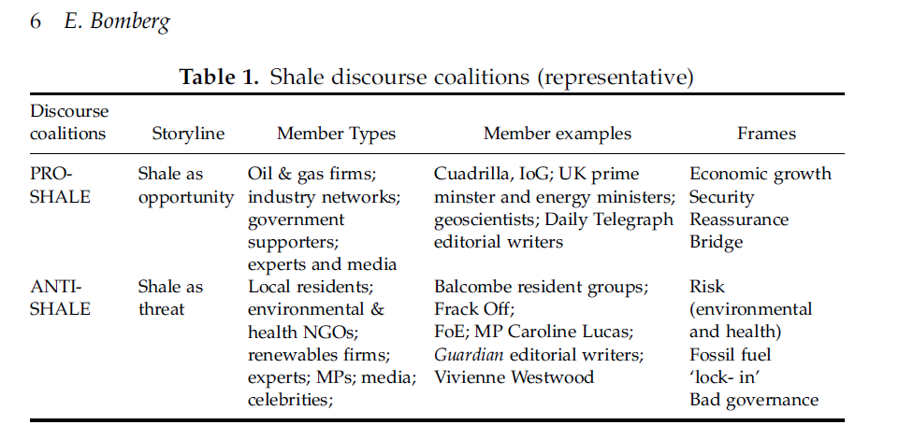
Shale We Drill? Discourse Dynamics in UK Fracking Debates Elizabeth Bomberg (2015) Journal of Environmental Policy & Planning, 19, 1. pp. 72-88
Media frame = particular way of telling a story (i.e., angle or discourse)

Slide 45
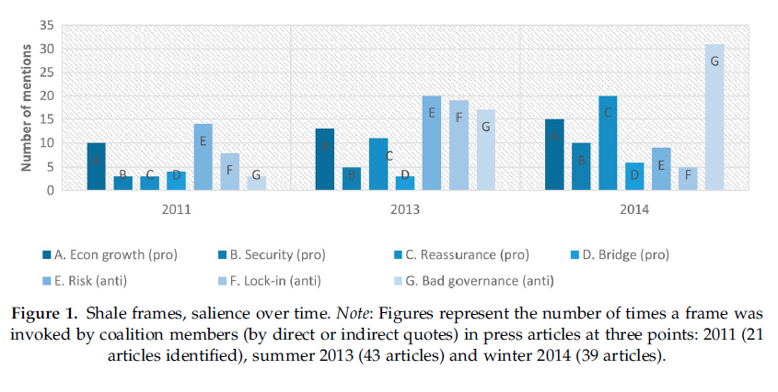
Shale We Drill? Discourse Dynamics in UK Fracking… Elizabeth Bomberg (2015) Journal of Environmental Policy & Planning, 19, 1. pp. 72-88
Coding of newspaper articles using key words and phrases: e.g.
Economic growth: jobs, boost, prosperity
Environmental risk: water contamination, industrialization and destruction.

Slide 46
So – some things to think about
How does all this relate to...
Wider understandings of qualitative methods?
Checklists in methods textbooks? (e.g., by Rose or Doel)
What we have said about the exercise set? (preamble + instructions)
What you read in papers reporting qualitative research

Slide 47
Analysis of words and pictures: checklists From: Key Methods in Geography, 2nd edition Chapter 28 by Marcus Doel

Slide 48
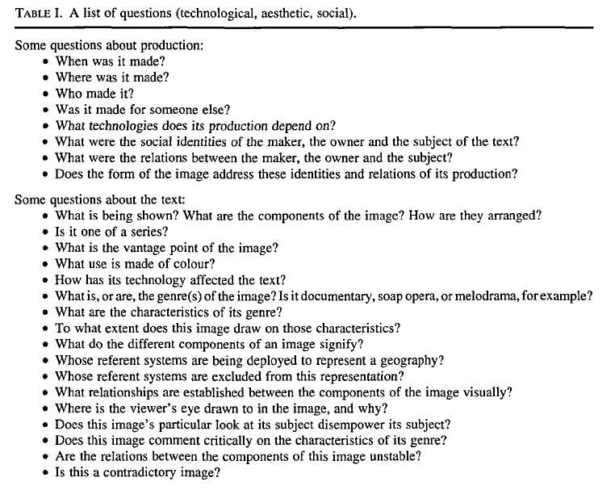
From: Teaching visualised geographies: towards a methodology for the interpretation of visual materials by Gillian Rose (Journal of Geography in Higher Education, 1996, 20, 3, 281-294)

Slide 49
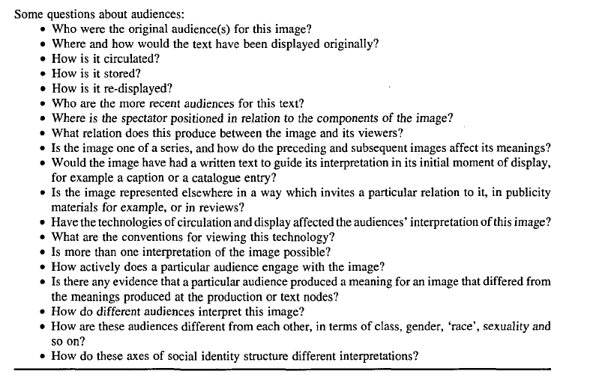
From: Teaching visualised geographies: towards a methodology for the interpretation of visual materials by Gillian Rose (Journal of Geography in Higher Education, 1996, 20, 3, 281-294 by Gillian Rose (JGHE, 1996, 20, 3, 281-294)

