Slide 1
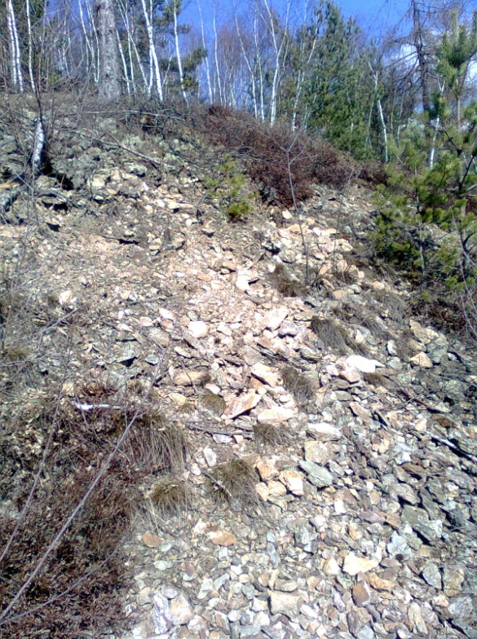
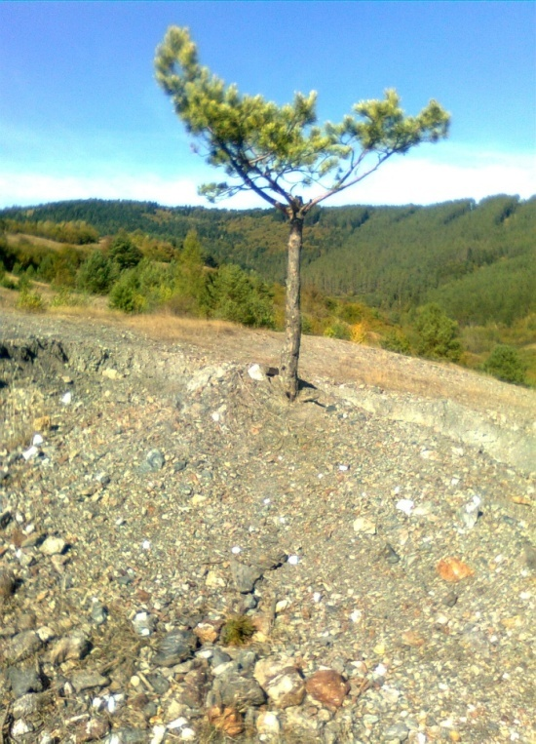
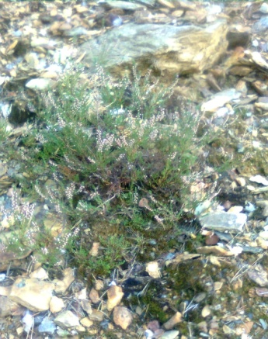
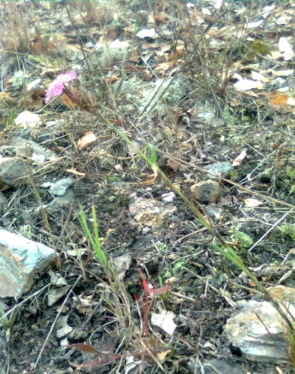
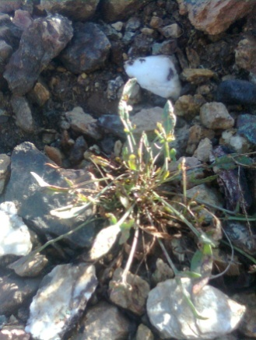
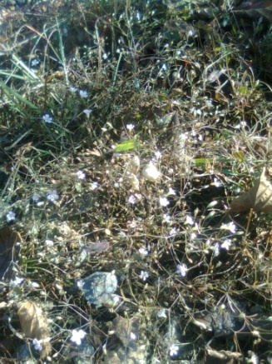
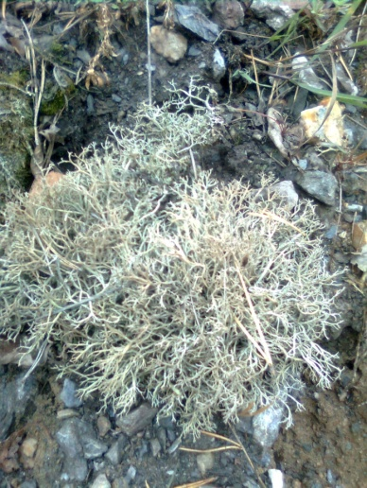
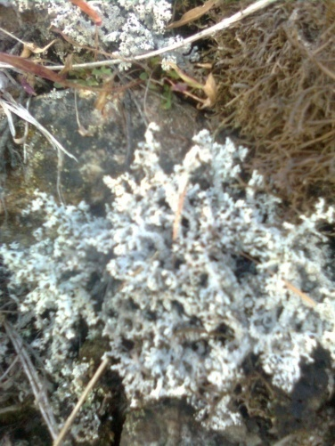
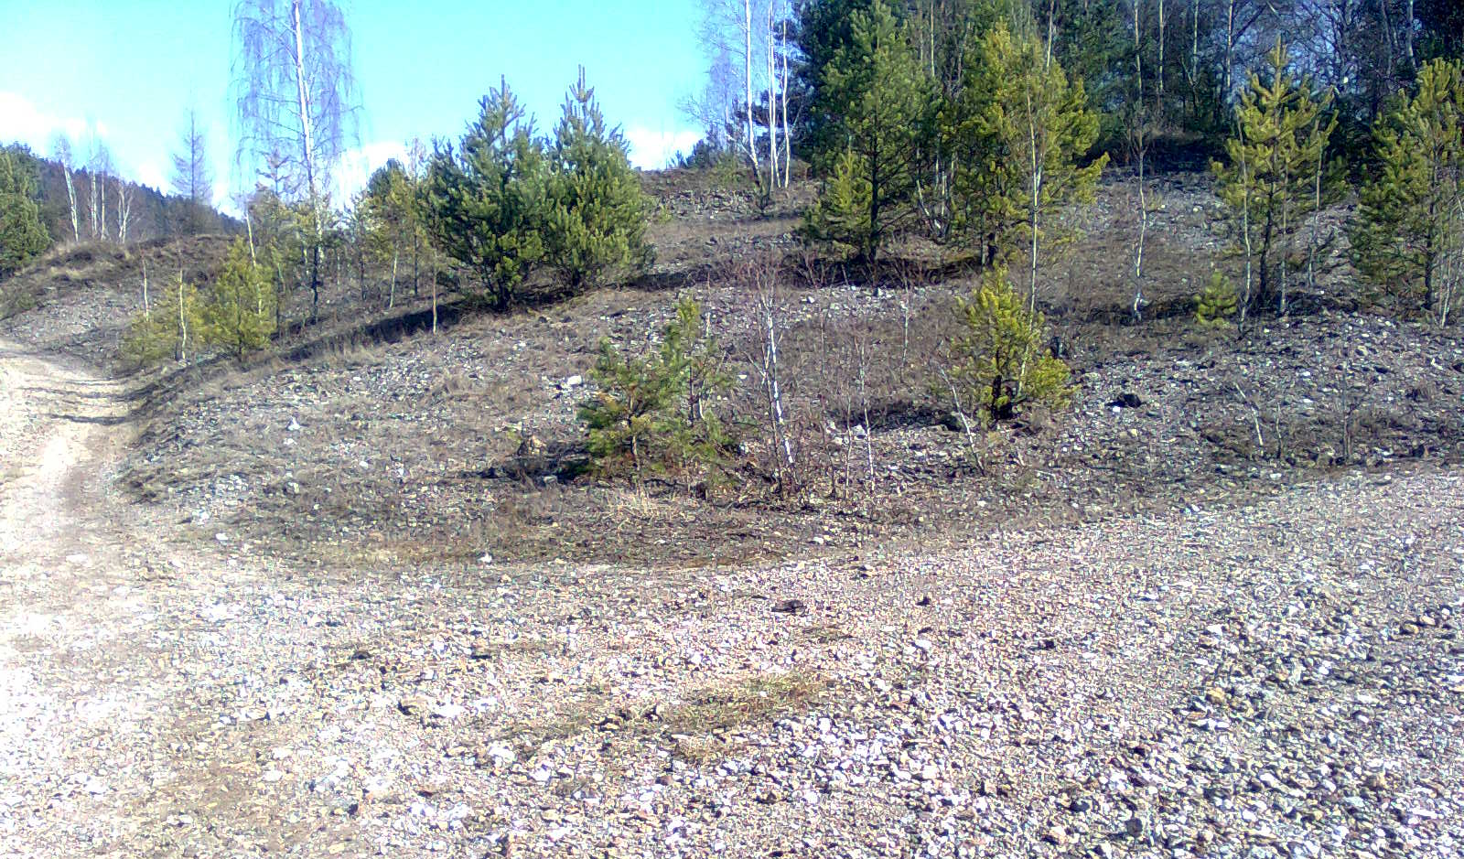
Metals mining and processing of wastewater material, which is largely exported from the mines to open areas. In connection with the exportation of waste slag heap was also portrayed in Gelnica site in Slovenské Cechy - Gaple, which therefore represents a secondary complex. According to data from the Mining Museum in Gelnica, is spoil heap about 200 per year rather large stony complex area of ​​approximately 5500 m² and is composed mainly of schist, quartz, siderite, chalcopyrite, pyrite, tetraedrit, to a lesser extent also secondary minerals of copper – limonite, malachite, azurit, olivenit, antlerit, cornwallit and other types of minerals. Spoil heap area is situated mostly in the local part Slovenské Cechy, but part of it extends beyond.
In the field of population research, I have heaps of vegetation followed the methods of Zurich-montpelier-school and in preparing entries was used for phytocenological records Braun-Blanquet combined scale and frequency coverage (Braun-Blanquet, 1964).
To determine the pH properties of the substrate, I used a pH meter. In determining the plant species I have worked with publications Grasses (Graun et al., 1998), The list of lower and higher plants of Slovakia (Marhold and Hindák, 1998), Big book of rock plants, minerals and fossils (Krejča et al., 1997) and Internet sites and other publications listed in the Bibliography.
In determining the species of lichens and the determination of toxic metals in the lichen species Cladonia insole arbuscula subsp. mitis I worked with Doc.RNDr.Martin Bačkor, PhD. from the Department of Botany, Faculty of Science, Safarik University in Kosice. Determination of toxic metals present in the lichens was performed by flame atomic absorption spectrometry (FAAS).
In determining the species of fungi and other identifying information about the presence of a fungus growing on the specifics of these locations I communicate electronically with Dr. Ivona Kautmanová from the Slovak National Museum.
2 Results
2.1 Ecological characteristics of the spoil heap
From an ecological perspective is a slag spoil heap of a specific type of habitat is characterized by mostly rocky structures in various stages of weathering of the lack of land and water, high content of toxic metals in the soil, low and limited number of plant species and also low vegetation coverage of the spoil heap – its settlement in the form of islands. Very often occur on the spoil heap solitary individuals and individuals dwarfed stature, perhaps with obviously impaired vitality (Fig.)
Fig.5 Inhospitable conditions on the spoil heap
Fig.6 The lone individual Pinus sylvestris
2.2 pH soil properties
Regarding our observed properties of soil pH, soil heap in Gelnica in the described area is characterized by pH in the acidic range of the measured value of 5.1.
2.3 Settlement of vegetation on the spoil heap
Spoil heap space is strictly separated from the environment surrounding the neighboring grassland ecosystems. Settlement of the heap is located mainly in peripheral areas and depressions. The total vegetation cover of the spoil heap is about 40%. With the highest frequency in the peripheral settlements involved species Betula pendula and Pinus sylvestris. Subjects were often of low stature and impaired vitality was particularly evident in orange-red color in particular needles of Pinus sylvestris. Storey herbs in the abundance of species colonies of Agrostis capillaris, Vaccinium myrtillus and heather Calluna vulgaris. In most mosses Ceratodon purpureus species occurred, and the moss Racomitrium lanuginosum also. The central part is characterized by irregular populated places with vegetation and a large part of which is uninhabited place, where appropriate, the where the only growing species were Agrostis capillaris. As regards the occurrence of other higher plants, increased incidence was observed in the case of Dianthus cartusianorum and Acetosella vulgaris. The less frequently occurring types of frequency Gypsophila muralis and Silene vulgaris.
Fig. 7 Calluna vulgaris Fig.8 Dianthus carthusianorum Fig.9 Acetosella vulgaris Fig. 10Gypsophila muralis
Fig. 11 Cladonia arbuscula subsp. mitis Fig. 12 Stereocaulon tomentosum
Sovereign representation in the population center of the group belonged to the species of lichens Cladonia arbuscula subsp. mitis. Often occurred a lichen species Stereocaulon dactylophyllum. In this context, it should be noted that although the incidence of this kind is in the area are common species of the genus Stereocaulon fall under the Red Book of endangered and critically endangered species.
For this species we also recorded the presence of rare species Stereocaulon tomentosum. By the Red book would be right to exist and this spoil heap lichen species Stereocaulon incrustatum, whose presence is known only from several sites and only in the Eastern Slovakia, but its presence we could not verify.
List of vegetation occurring on the heap with an indication of its presence in the peripheral or central part is elaborated in Table 2.
Fig.13 Place the most abundant occurrence of lichen species Stereocaulon
Table 2 List of vegetation occurring on the spoil heap with an indication of its presence in the central or peripheral part
2.4 Fytocenological vegetation records
No.1
Locality: Gelnica, locality Slovenské Cechy-Gaple, the peripheral part of spoil heap
Exposure: JZ
Slope: 30º
Altitude: 520 m.n.m.
Registration Area: 25 m²
Cover of: E2 30%, E1 40%, E0 40%
E2 Pinus sylvestris juv. 2a, Betula pendula juv. 2a, Coryllus avellana +,
E1 Calluna vulgaris 2m, Vaccinium myrtillus 1, Betula pendula juv. 1, Agrostis capillaris +
E0 Cladonia arbuscula subsp. mitis 2a, Stereocaulon dactylophyllum 2m, Cladonia pyxidata 1, Racomitrium lanuginosum +, Ceratodon purpureus +
No.2
Locality: Gelnica, locality Slovenské Cechy-Gaple, the central part of spoil heap
Exposure: JZ
Slope: 40º
Altitude: 530 m.n.m.
Registration Area: 25 m²
Cover of: E1 30%, E0 50%
E1 Agrostis capillaris 2, Vaccinium myrtillus 2m, Calluna vulgaris 1, Betula pendula juv. 1, Pinus sylvestris juv. 1, Dianthus carthusianorum +, Gypsophyla muralis r, Silene dioica r
E0 Cladonia arbuscula subsp. mitis 2b, Cladonia pyxidata 1, Stereocaulon dactylophyllum 1, Cladonia rangiformis +
Vegetation of spoil heap | Peripheral part | Central part | The occurrence on the heap in general
Trees and Shrubs: Pinus sylvestris | + | + | very often
Betula pendula | + | + | very often
Populus tremula | + |  | singular
Coryllus avellana | + |  | singular
Rubus fruticosus | + |  | singular
Larix decidua |  | + | singular
Rosa canina |  | + | singular
Humulus lupulus |  | + | singular
Carpinus betulus | + |  | singular
Grasses and Herbs: Agrostis capillaris | + | + | very often
Calluna vulgaris | + | + | often
Vaccinium myrtillus | + |  | often
Silene vulgaris | + | + | often
Acetosella vulgaris |  | + | less frequent
Gypsophila muralis |  | + | less frequent
Dianthus carthusianorum | + | + | less frequent
Mosses: Racomitrium lanuginosum | + |  | often
Ceratodon purpureus | + |  | often
Lichens: Cladonia arbuscula subsp. mitis | + | + | very often
Stereocaulon dactylophyllum* | + | + | often
Cladonia pyxidata | + | + | often
Peltigera rufescens | + |  | often
Cladonia furcata* | + | + | singular
Cladonia rangiformis | + | + | less frequent
Cladonia rei | + |  | singular
Stereocaulon tomentosum* | + |  | singular
2.5 Fungi growing on the spoil heap
Although is spoil heap characterized by low number of species and low coverage in August and September here in addition to plants, mosses and lichens can also be found representatives of fungi. The most common species of fungi on the heap is plain Suillus luteus. The occurrence of the species Suillus luteus is associated not only with the presence in the peripheral areas, but also it can often be found directly in the central parts of spoil heap, with very high frequency. Compared with the fruiting bodies of this fungi growing in natural stands, are this growing on the spoil heap darker and does not live hat wet and slippery. Together we recorded eight kinds of fungi, and are presented in Table 3, indicating the presence of central or peripheral part of the spoil heap.

