Slide 1
https://www.otakunest.net/article/sk/kimigajo-japonska-hymna

Slide 2
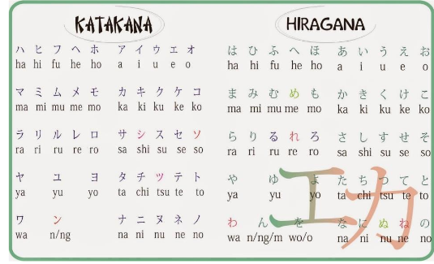

Slide 3
http://japanese-lesson.com/conversation/basic_japanese/basic01.html

Slide 4
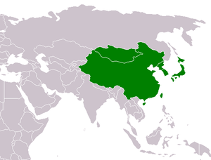
VÝCHODNÁ ÁZIA

Slide 5

Brainstorming ...

Slide 6
kimono
hikari
sushi
šinkansen
Fudži
sakura

Slide 7
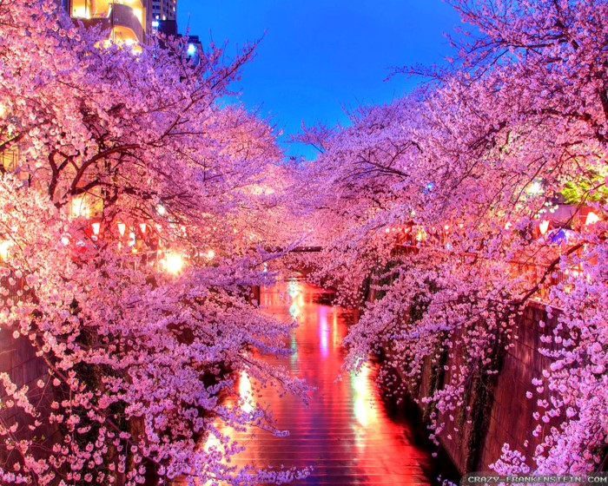

Slide 8
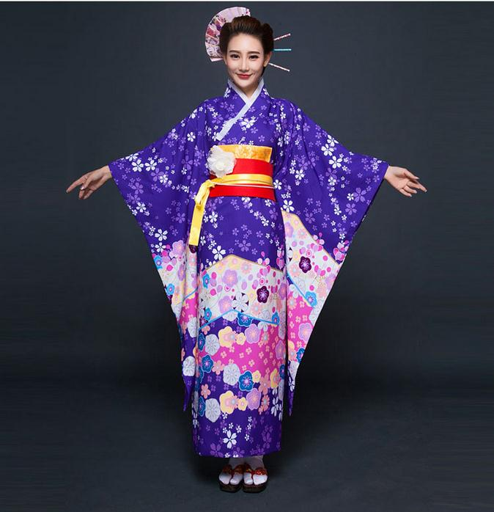

Slide 9
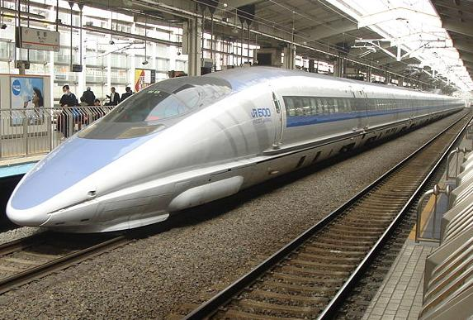
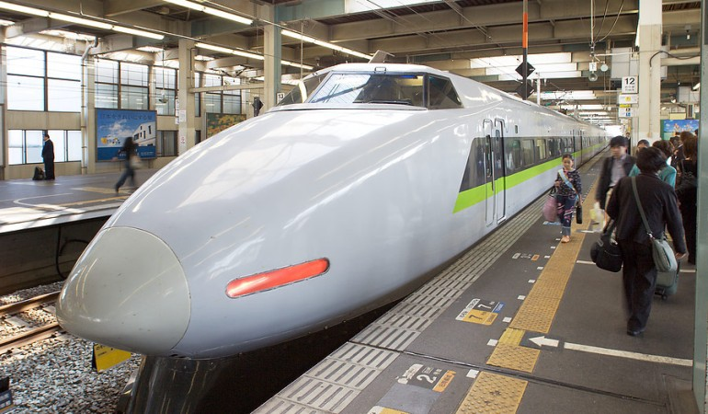

Slide 10
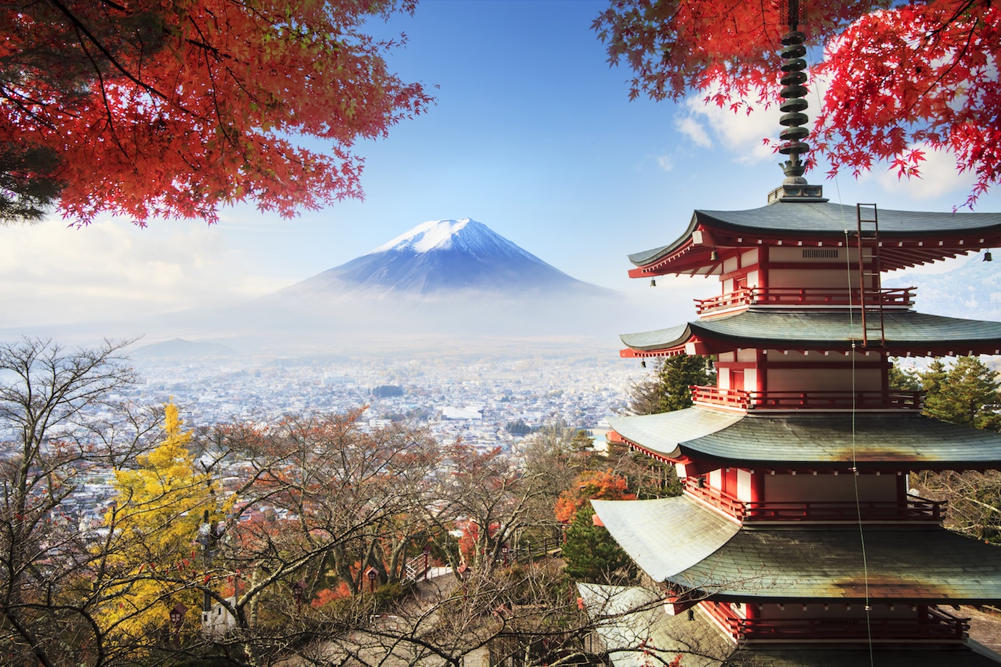

Slide 11
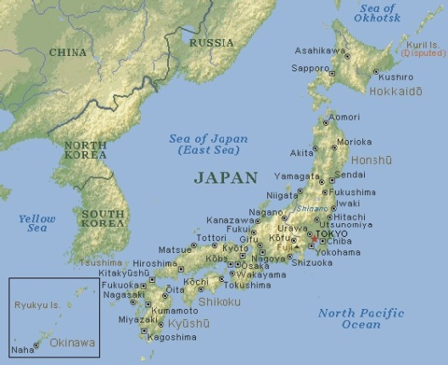

Slide 12
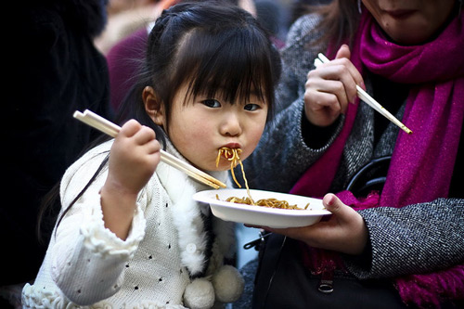

Slide 13
