Slide 1


Advent
Objectives: To know what Advent means
To describe some traditions associated with Advent

Slide 2
What is Advent?
Advent means “the coming”. It begins on the fourth Sunday before Christmas and ends on Christmas Eve.
Advent is the beginning of the Christian year and is a time when people look forward to celebrating the birth of Jesus.

Slide 3
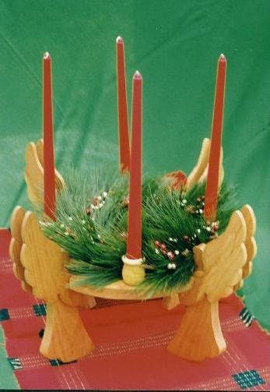
This is an Advent ring.
What is it used for?

Slide 4
The message of the Advent ring is that out of darkness comes light. Jesus himself said that he was "the light of the world" - and so, as Christmas and the coming of Jesus gets nearer and nearer, the greater is the light burning the darkness of winter.

Slide 5
What else do you know about Advent?

Slide 6
How Christians prepare during Advent…
Lighting one of the candles every Sunday
Burning an Advent candle a day at a time
Having an Advent calendar
Getting ready for Christmas – wrapping presents, writing cards, decorating the house
And all the time…
Remembering the coming of Jesus

Slide 7
Tasks
1) Put a title in your book, “Advent”.
2) Complete the tasks from the worksheet in your books. Don’t write on the sheets.
3) Colour in the picture of the Advent wreath and stick it in your book.
4) Write a short poem about the meaning of Advent for Christians.

