Slide 1
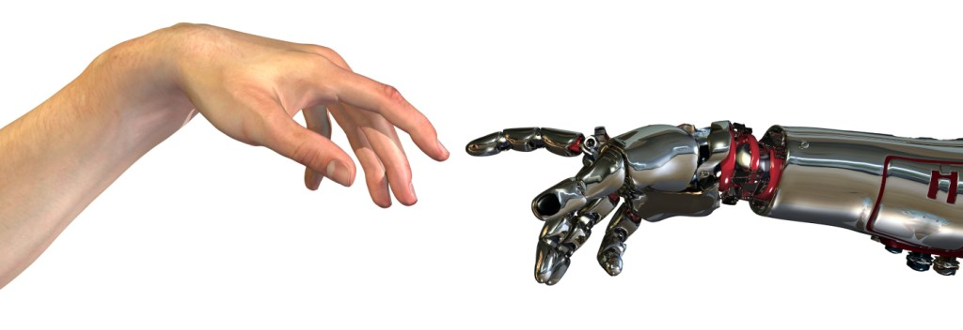
Paradox blaženej nevedomosti
Paradox blaženej nevedomosti
Bc. Dominik Valeš (DeVoM /FILM)

Slide 2
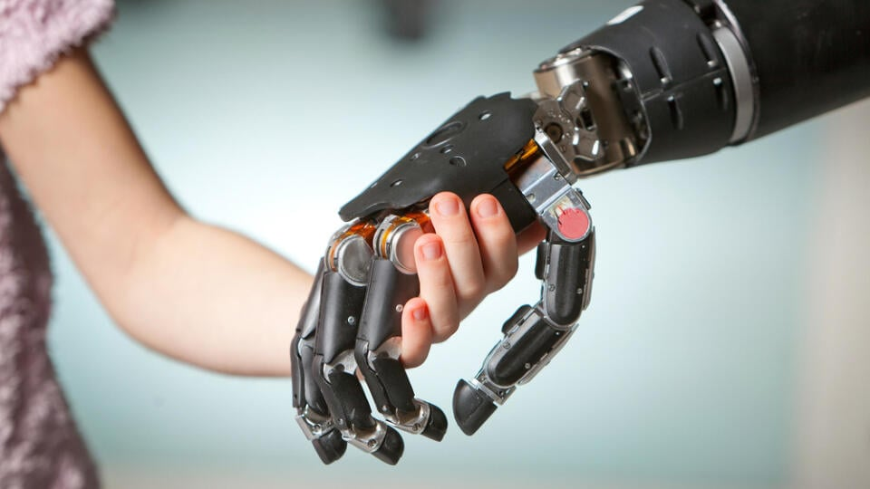
Človek vs. pokrok

Slide 3
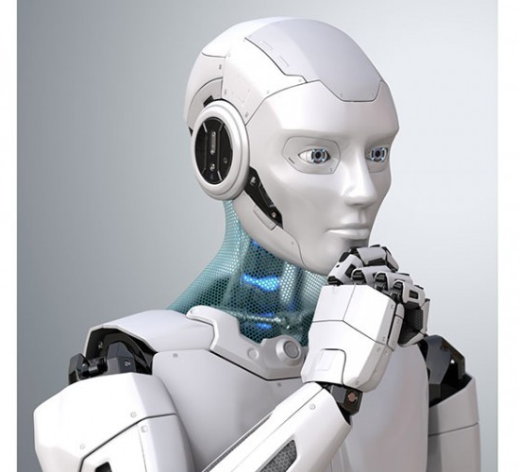
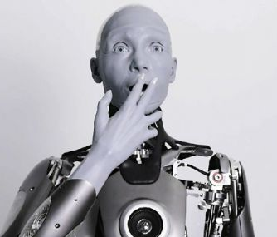
Humanizácia strojov
https://www.youtube.com/watch?v=mf2rvZ7Uv4s
https://youtu.be/RiTfe-ckD_g

Slide 4

Paradox blaženej nevedomosti
7:36 – The Philosophers

Slide 5
Zdroje obrázkov
https://dam.nmhmedia.sk/image/3940dcfe-f8c7-402a-8ab4-0f3d8f8dbb29_vedci-pracuju-na-robotoch-s-umelou-inteligenciou-ktore-by-sa-mohli-stat-spolocnikom-osamelych-alebo-.jpg/960/540
https://smt.rs/wp-content/uploads/2015/12/robotika.jpg
https://cdn4.focus.bg/fakti/photos/big/1b5/idva-li-vremeto-na-humanoidnite-roboti-video-1.jpg
https://cdn.glassrpske.rs/slika/2021/08/750x500/20210820090314_373638.jpg
https://vosveteit.zoznam.sk/wp-content/uploads/2021/12/titulka-robot-2.jpg
https://i.ytimg.com/vi/CVRTwUacxDw/maxresdefault.jpg

Slide 6
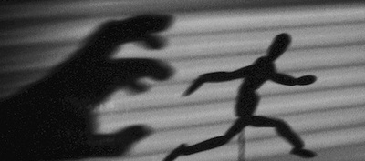
Ďakujem za pozornosť

