Slide 1


MY HOLIDAY WEEKEND
TAMARA GLADIŠOVÁ

Slide 2
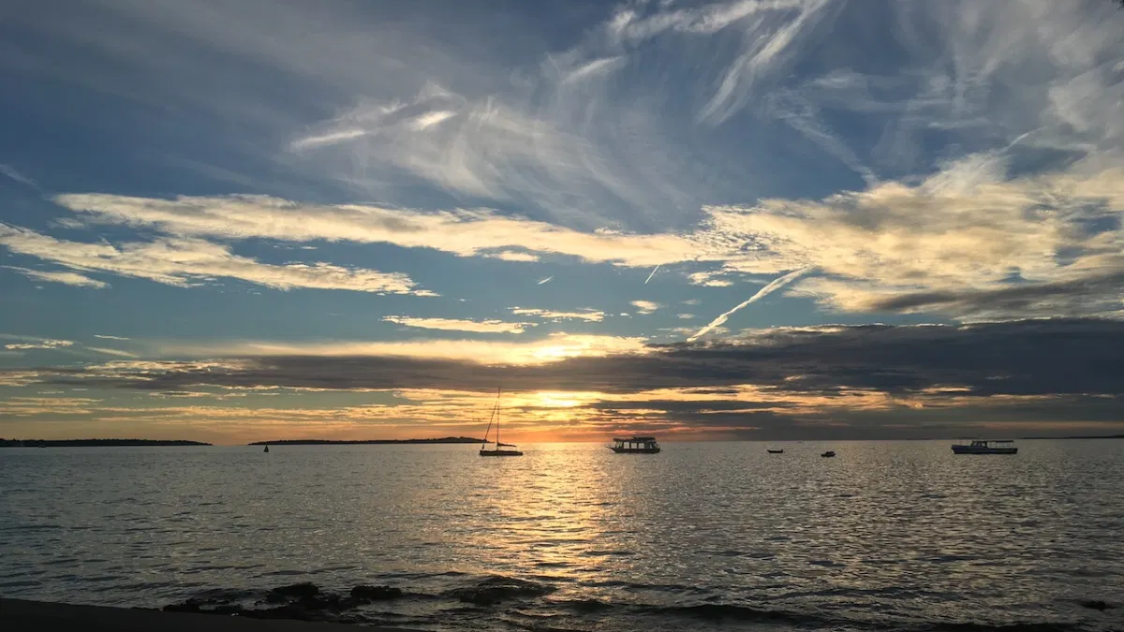
I get up at 9 o‘clock.
I go brush my teeth.
I change my clothes.
I have breakfast.
I go to the beach.
I go swim.
I have lunch.
Than i go again to the beach and go swim.
I have dinner.
I go to the trampoline.
Than we go to kofola.
At 10:00 P.M i go to the hotel.
Than i brush my teeth and go sleep.

