Slide 1
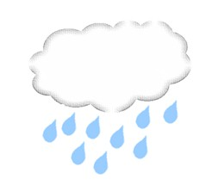
Punctuation
Full Stops
Use: to show where one sentence ends and the
next begins. A full stop must be followed by
a capital letter
e.g. Today is cold he rain is heavy
.
.
T
T
.
.
Activity
Put full stops and capital letters into these sentences.
I like coffee you prefer chocolate
Tim did not want to walk the dog he wanted to watch TV
The box was heavy Clare did not know what was in it
They enjoyed climbing mountains they said it was hard work

Slide 2
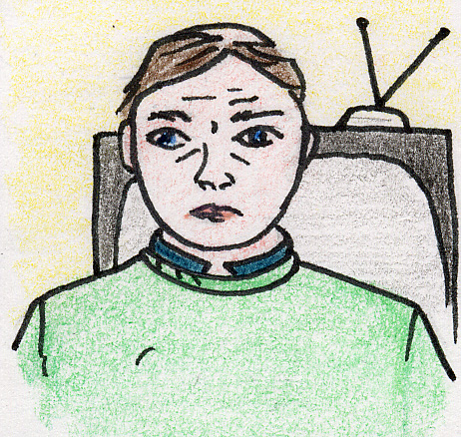
Answers
I like coffee you prefer chocolate
Tim did not want to walk the dog he wanted to watch TV
The box was heavy Clare did not know what was in it
They enjoyed climbing mountains they said it was hard work

Slide 3
Answers
I like coffee. You prefer chocolate.
Tim did not want to walk the dog. He wanted to watch TV.
The box was heavy. Clare did not know what was in it.
They enjoyed climbing mountains. They said it was hard work.

Slide 4
Extension Activity
Try joining the same sentences, using conjunctions instead of full stops.
Choose from: and, but, although, because.
I like coffee you prefer chocolate
Tim did not want to walk the dog he wanted to watch TV
The box was heavy Clare did not know what was in it
They enjoyed climbing mountains they said it was hard work

Slide 5
Extension Activity
Answers
Choose from: and, but, although, because.
I like coffee and/but you prefer chocolate.
Tim did not want to walk the dog because he wanted to watch TV.
The box was heavy but Clare did not know what was in it.
They enjoyed climbing mountains although they said it was hard work.

Slide 6
Commas
Uses: to insert a “breath” into a sentence after a clause
between items in a list
to separate off part of a sentence which is
informative but not grammatically necessary.
e.g. After you have fed the guinea-pig remember to shut the cage.
We need milk sugar flour and eggs to make a cake.
It would be fun although probably not easy to go surfing.
,
,
,
,
,
,
,
,
,
,
WARNING
Commas should be used SPARINGLY.
They are NOT to be sprinkled like confetti.

Slide 7

Activity
Put commas in these sentences.
If you want to go swimming you need to be ready by
five o’clock.
Remember to bring a towel your swimwear a bag
for your wet things and some money.
If you get hungry I know some of you do bring
something to eat on the way back.

Slide 8
Answers
If you want to go swimming, you need to be ready by
five o’clock.
Remember to bring a towel, your swimwear, a bag
for your wet things and some money.
If you get hungry, I know some of you do, bring
something to eat on the way back.

Slide 9
Question Marks
Use: to indicate questions.
e.g. “Are you going out today ”
?
?
Activity
Punctuate the following passage, inserting question marks, capital letters and full stops where necessary.
do you think we should get ready soon i thought we were leaving about now shall i get our things together they’re all over the place at the moment

Slide 10
Question Marks
Use: to indicate questions.
e.g. “Are you going out today ”
?
Activity
Punctuate the following passage, inserting question marks, capital letters and full stops where necessary.
Do you think we should get ready soon? I thought we were leaving about now. Shall I get our things together? They’re all over the place at the moment.

Slide 11
Exclamation Marks
Use: to indicate an exclamation which may be one word, or to show that something is shouted in speech.
e.g. “Oi,you What’re you doing?”
“Kath I told you to stop.”
!
!
!
!
WARNING
These should be used SPARINGLY.
Use too many and they look ridiculous.

Slide 12
Activity
The following sentences need punctuation to mark where they end. Look at them carefully and add ONLY the missing exclamation marks. You should not use more than one exclamation mark per task.
“I don’t think that’s a good idea, Carl Be careful ”
“Ouch The rabbit just bit me ”
“Who won ”
“We did ”

Slide 13
Answers
The following sentences need punctuation to mark where they end. Look at them carefully and add ONLY the missing exclamation marks. You should not use more than one exclamation mark per task.
“I don’t think that’s a good idea, Carl Be careful ”
“Ouch The rabbit just bit me ”
“Who won ”
“We did ”
Now add the rest of the missing punctuation, but do not use any more exclamation marks.
.
.
!
!
!
!
.
.
?
?
!
!

Slide 14
Extension Activity
Using the four elements of punctuation studied, punctuate the following passage correctly.
the snow fell heavily all that day and all the next by tuesday it was piling up around the back door and on the window sills beth leaned out and carefully swept the snow off the living room sills so that they could watch the swirling flakes outside the wind crashed into the side of the house making the open shutters bang against the wall suddenly the storm seemed somehow threatening surely it would blow itself out soon wouldn’t it
by lunch-time after some argument even beth had to admit that it would be warmer and quieter with the shutters closed as they opened the window to reach out for the hinged shutters the force of the wind seized it and slammed it into their faces suddenly the whirling nightmare was in the room with them

Slide 15
Answers
Using the four elements of punctuation studied, punctuate the following passage correctly.
The snow fell heavily all that day and all the next. By Tuesday, it was piling up around the back door and on the window sills. Beth leaned out and carefully swept the snow off the living room sills, so that they could watch the swirling flakes outside. The wind crashed into the side of the house, making the open shutters bang against the wall. Suddenly the storm seemed somehow threatening. Surely it would blow itself out soon, wouldn’t it?
By lunch-time, after some argument, even Beth had to admit that it would be warmer and quieter with the shutters closed. As they opened the window to reach out for the hinged shutters, the force of the wind seized it and slammed it into their faces. Suddenly the whirling nightmare was in the room with them!

