Slide 1
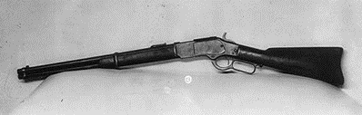

'The Gun That Won the West'
Bc. Dominik Valeš
Bc. Dominik Orolín

Slide 2
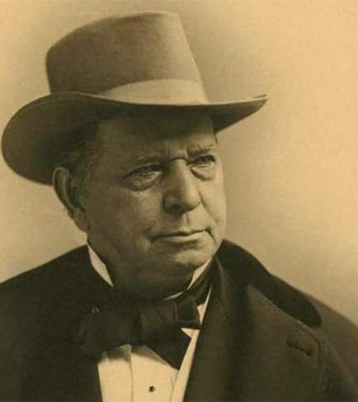
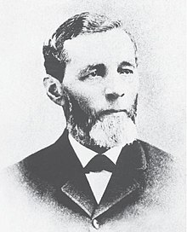
OLIVER WINCHESTER
30. novembra 1810
11. decembra 1880
americký podnikateľ a politik,
zakladateľ spoločnosti Winchester Repeating Arms Company.

Slide 3
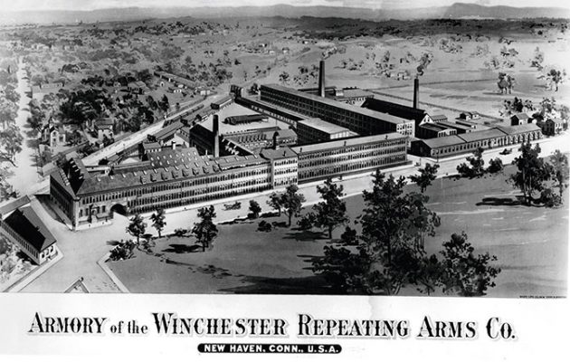

Slide 4
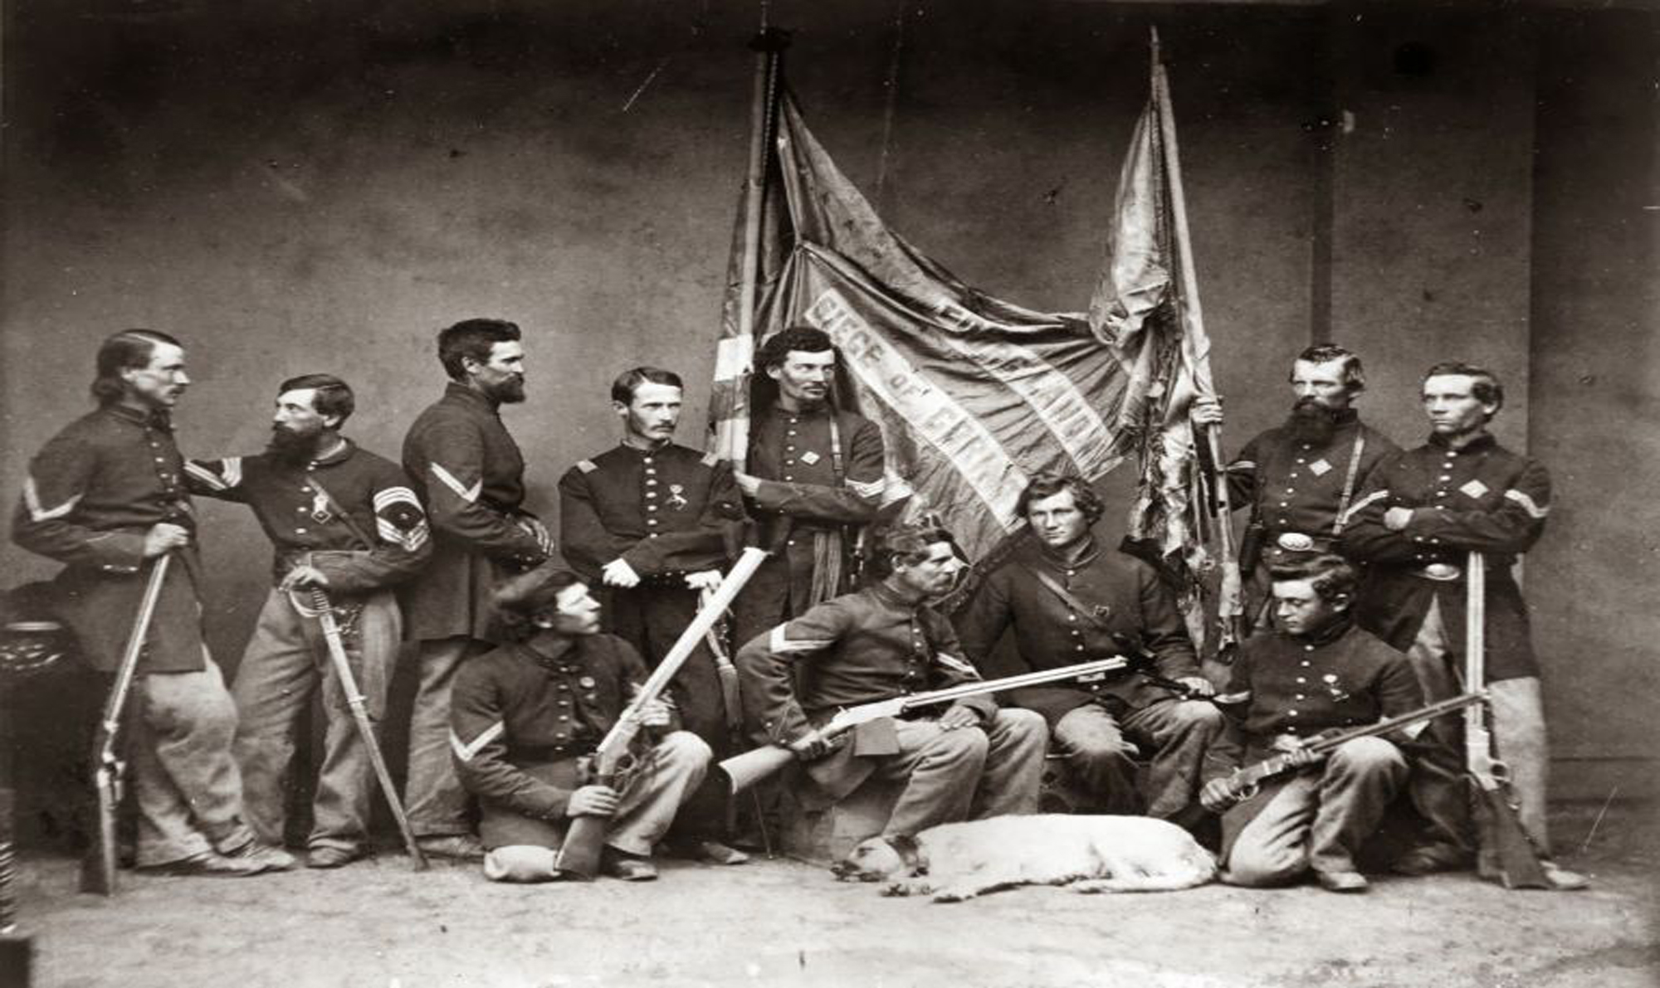

Slide 5
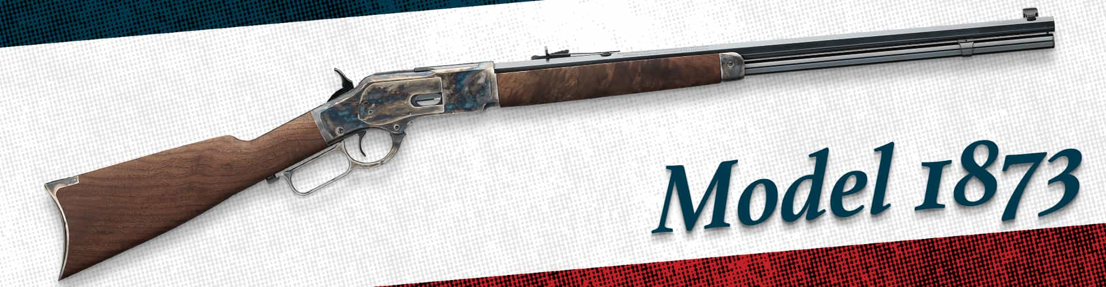
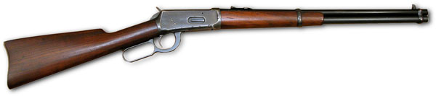

Slide 6
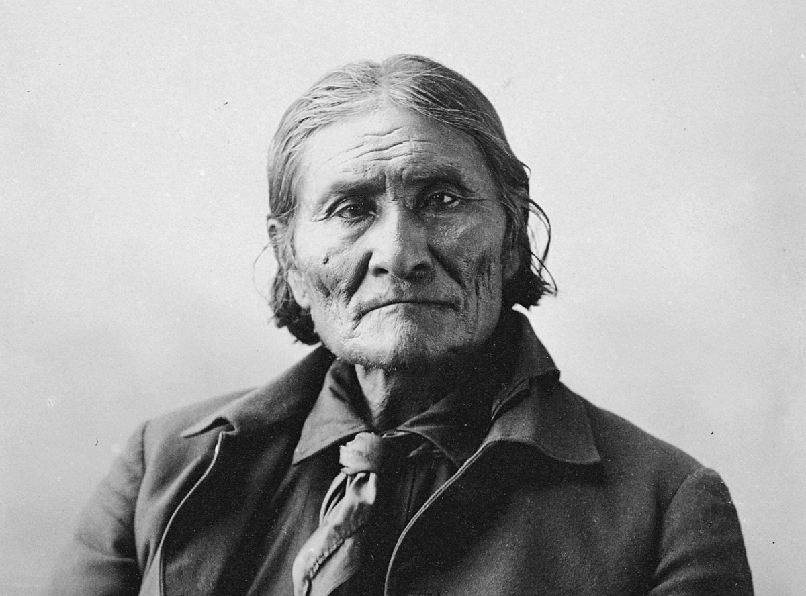

Slide 7

Winchester´73
1950

Slide 8
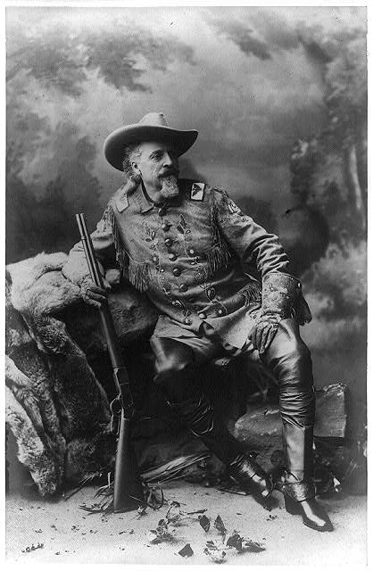
Portrét v celej dĺžke, sedí na skale, tvárou doprava, pravou rukou drží pušku, ľavú ruku má položenú na kolene. 1903.

Slide 9
Zdroje obrázkov:
https://www.loc.gov/rr/scitech//SciRefGuides/images/winchester.jpg
https://www.ammoland.com/wp-content/uploads/2019/11/Oliver-Winchester-600x487.jpg
https://winchester.com/-/media/Feature/Blog/2016/07/Oliver_Winchester_Crop.ashx?h=490&w=770&hash=516C441BC36156C36A356E9249ADCB22
https://keyassets.timeincuk.net/inspirewp/live/wp-content/uploads/sites/8/2017/01/Winchester_Model_1894.jpg
https://keyassets.timeincuk.net/inspirewp/live/wp-content/uploads/sites/8/2017/01/winchester2.jpg
https://keyassets.timeincuk.net/inspirewp/live/wp-content/uploads/sites/8/2017/01/Winchester_73_-_1950-_Poster.png
https://www.browning.com/content/dam/winchester-repeating-arms/products/rifles/model-1873/support/1873_Family_1920x500.jpg
https://tile.loc.gov/storage-services/service/pnp/cph/3a20000/3a23000/3a23100/3a23124r.jpg
https://upload.wikimedia.org/wikipedia/commons/thumb/4/4a/Benjamin_Tyler_Henry.jpg/220px-Benjamin_Tyler_Henry.jpg

Slide 10
Zdroje:
https://www.countrylife.co.uk/country-life/gun-won-tale-winchester-repeater-gun-changed-america-147204
https://www.popularmechanics.com/military/weapons/a23149/winchester-rifle/
https://www.loc.gov/rr/scitech//SciRefGuides/winchester-rifle.html
https://guides.loc.gov/winchester-rifle

Slide 11
ĎAKUJEM ZA POZORNOSŤ

