Slide 1
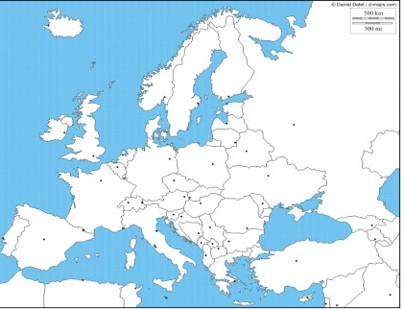

Slide 2
FJORDY
POLDER
Liverpool
Rovaniemi
GEJZÍR
VETERNÉ MLYNY

Slide 3
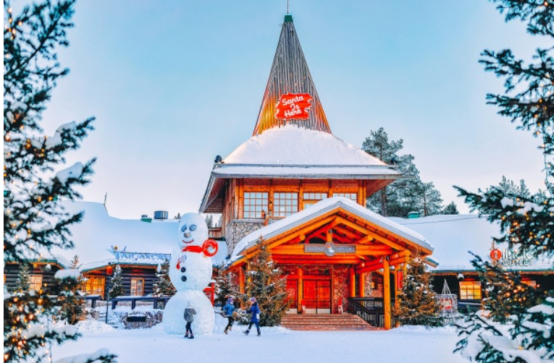
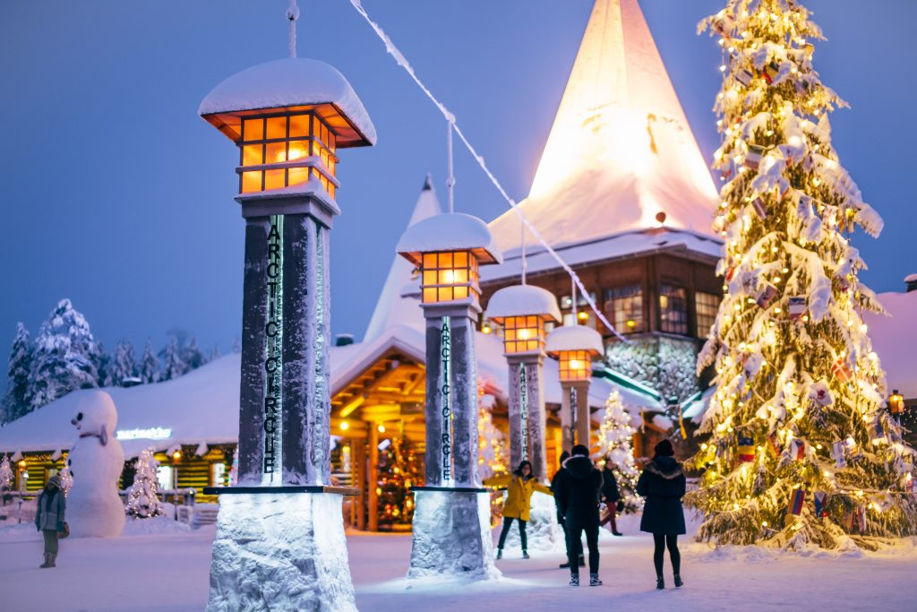

Slide 4
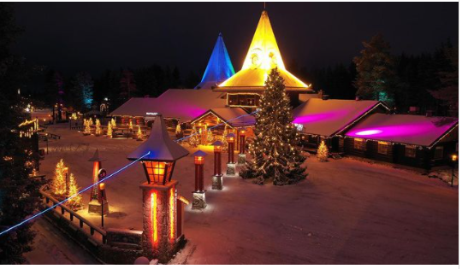

Slide 5
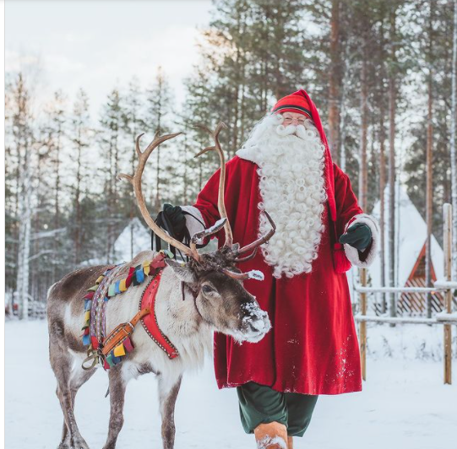

Slide 6
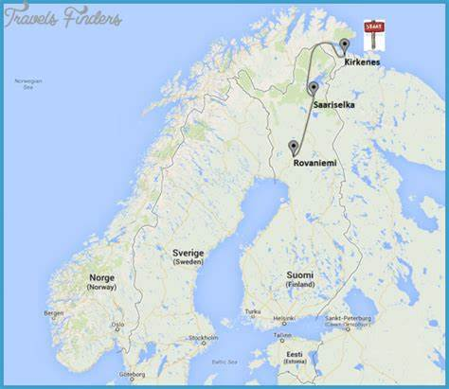
Santa Claus Village: winter arrives at Arctic Circle in Rovaniemi Lapland Finland Father Christmas - YouTube

Slide 7
