Slide 1




Description
This icon indicates that detailed teacher’s notes are available in the Notes Page.
This icon indicates the slide contains activities created in Flash. These activities are not editable.
For more detailed instructions, see the Getting Started presentation.
Notes:
This presentation matches Objective Wr14

Slide 2

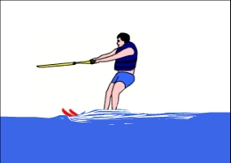
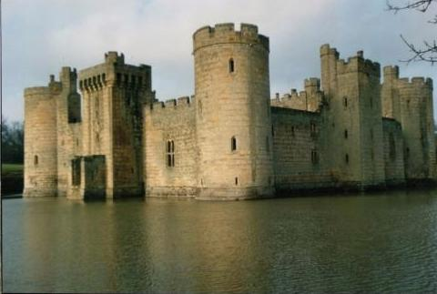
Description
In your writing, you will often have to describe...
people
events, etc.
places
How would you describe the pictures above?
Notes:
There are many other presentations that will complement this one including Characterization.ppt, Images and sounds.ppt and ones dealing with sentence level criteria.

Slide 3
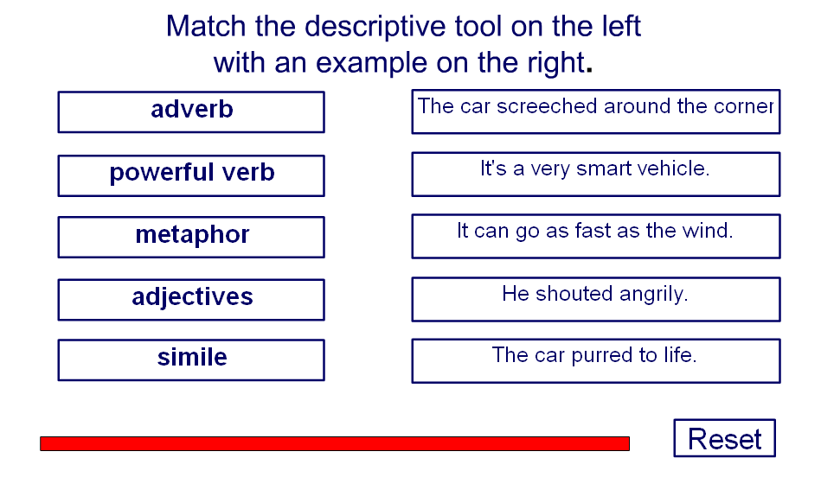
Descriptive tools

Slide 4
Adjectives
Adjectives, or describing words, are perhaps the first tool we think of using. Try to use a wide range of adjectives – don’t always go for the most obvious.
Use adjectives to complete these sentences
Bernard was a ______ man. He was ______, ______ and very _______.
It was a _______ location: _________, _________ and not even _______.
The party was _________. I had a ________, ________ time.

Slide 5
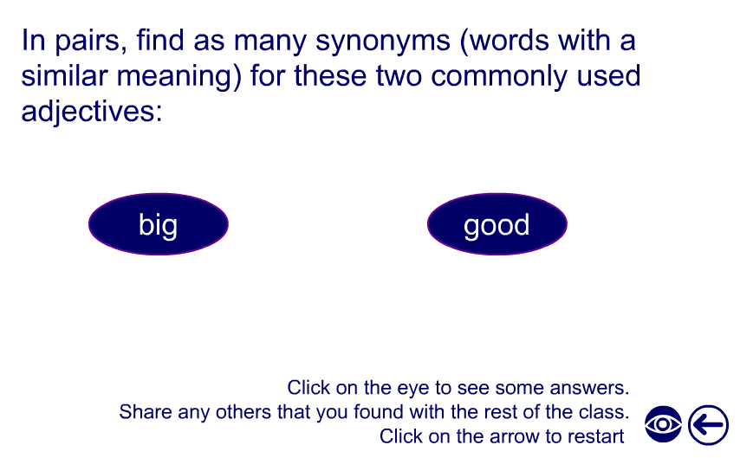
Synonyms

Slide 6
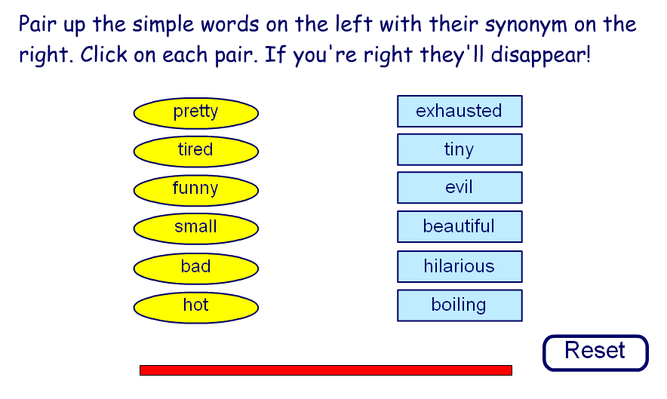
Synonyms

Slide 7
Powerful verbs
Verbs are sometimes known as ‘being’ or ‘doing’ words. They can be powerful when they tell you not only the action, but also about the character, mood or atmosphere involved.
For example, in the sentence
The boy went across the room.
The verb is went, but this does not tell us much about how the boy crossed the room, or his mood.
Compare it with
The boy hurtled across the room.
This gives us an idea of speed, urgency and perhaps recklessness. It is far more powerful.

Slide 8
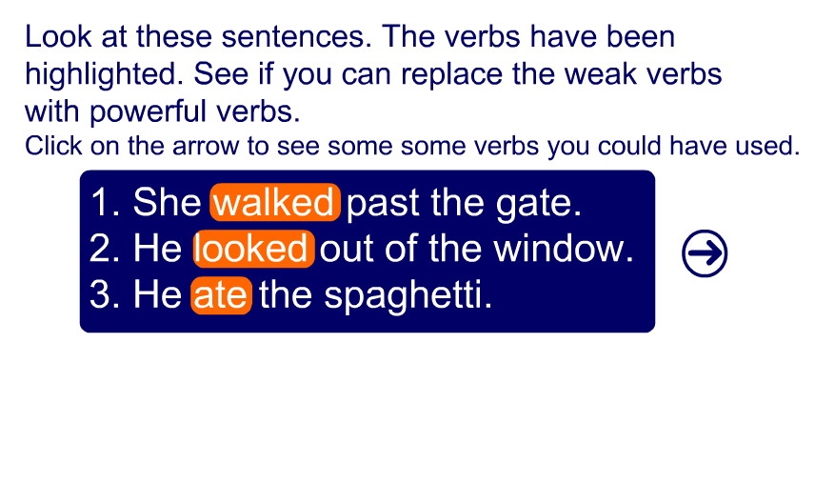
Powerful verbs
Notes:
Students could make a display of powerful verbs – perhaps in the form of mobiles.
They could also be asked to collect examples of powerful verbs from other writers.

Slide 9
Adverbs
Adverbs give extra meaning to verbs, adjectives and sentences. Many adverbs say how something is done.
They are often, but not always, formed by adding -ly to an adjective.
For example
She whispered softly.
He walked slowly.
Complete these sentences with adverbs
He moved ________ towards the door.
Fred _________ thought of another plan.
Last night you came in ________ ___________.

Slide 10
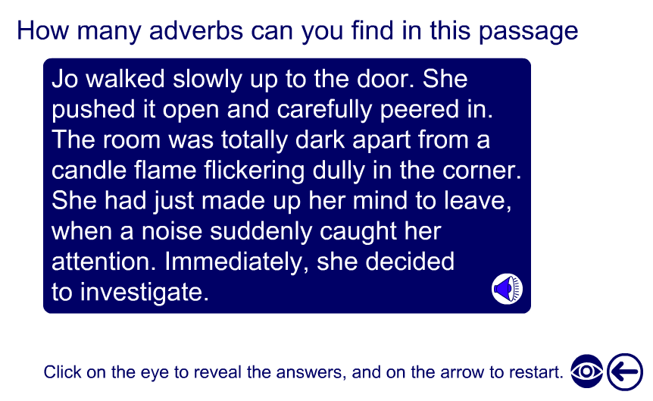
Adverbs
Notes:
Students could be asked to think of alternative adverbs to use instead of those highlighted.

Slide 11
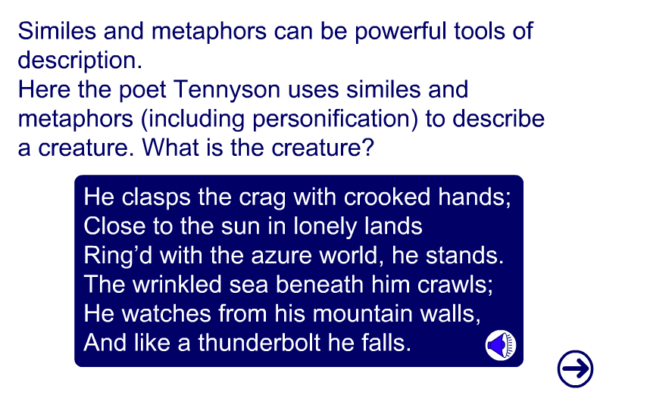
Similes and metaphors

Slide 12
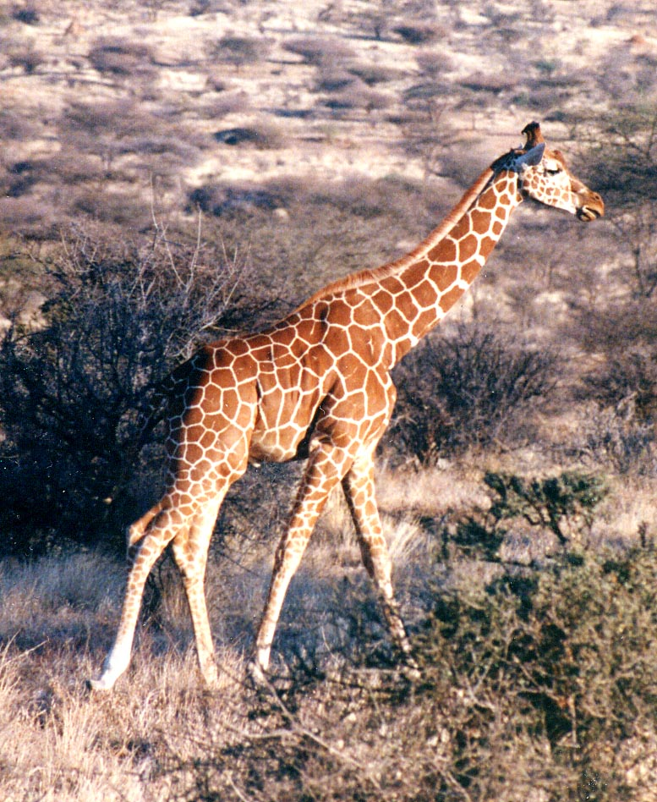
Similes and metaphors
Similes and metaphors create images in our minds. They help our mind’s eye see things better.
You can use all the senses when describing things:
sound
Write a sentence describing this giraffe using one of the senses.
touch
taste
smell
sight

Slide 13
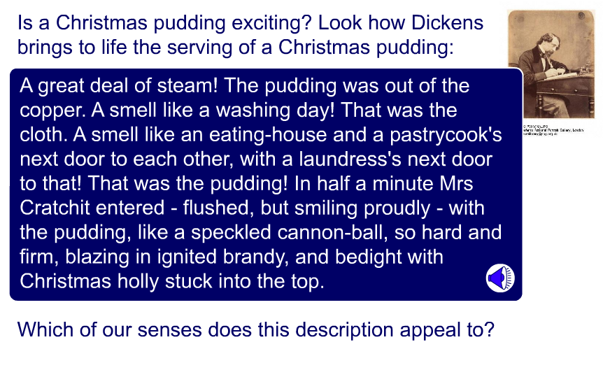
Senses

Slide 14
Senses
Choose an animal to bring to life! Make notes on how you could use the senses to describe it.
Here’s an example:
Smell
Dusty, like a horse
SIGHT
Tall and elegant,
like a ballerina
SOUND
Chewing leaves
TOUCH
Smooth fur
If you have time, write your notes up into poetry or prose.

Slide 15
Formality
When describing something, you need to be aware of the audience and the purpose for your writing. Sometimes you may be able to write with humour – if you were describing something for a friend, for example. A more formal situation will require a more formal style of writing.
Complete the table below by listing suitable writing styles for a formal and informal audience.
formal | informal
 | humour

Slide 16
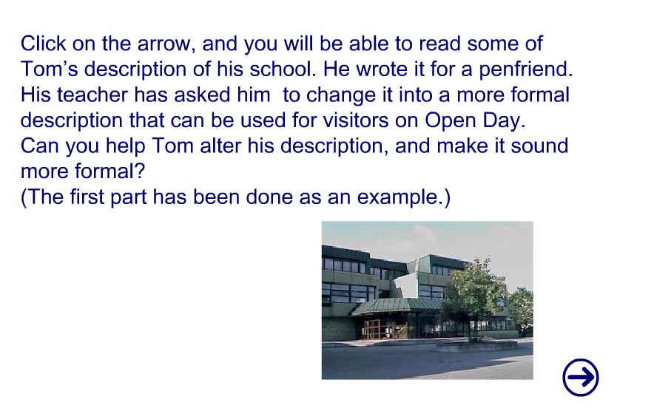
Formality

Slide 17
Activity
Choose one of the following tasks to complete:
Write a guide describing you own school, suitable for parents and visitors.
Write a guide for tourists, describing where you live.
Try and use some of the descriptive tools you’ve learnt!

