Slide 1



Londýn
Vzdelávanie učiteľov v oblasti práce a využitia IKT v práci učiteľa - PIRŠ
Anglický jazyk
Daniela Molnárová
Gymnázium Gelnica
Júl 2005

Slide 2
Contents
Basic information
History
Climate
Sights- Buckingham Palace
The Parliament, Trafalgar
Tower Bridge, St Paul´s
Westminster Abbey
Tower
Streets
Parks
Transport
Problems
My memories
Quiz
Task

Slide 3
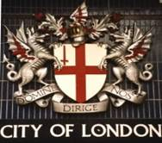
Basic information
The capital of England and the UK
Political, economical, educational, cultural centre
South-east coast off Europe
Area: 400 square km
Population: 10 million (with suburbs)
37 nationalities
River: The Thames
Parts: The City, Westminster, The East End,
The West End

Slide 4
History
Founded about in 4000 BC
Celtic settlement- from 6th century BC
Roman´s occupation – 1st century AD
Germanic tribes – 5th century AD
Magna Carta - 1215
The Great Plague – 1665
The Great Fire- 1666 (4/5 destroyed)
Industrial Revolution – 18 century
World Wars :1st: 1914-1918, 2nd: 1939-1945

Slide 5

Climate
Special: four seasons
never extreme weather
influence of the Gulf Stream
rarely snow, very rainy (170 days)
Spring, autumn: clear, sunny days
Summer: green, balmy
Winter: gray skies, rainy days

Slide 6
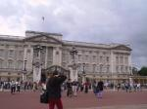
Sights
Buckingham Palace
residence of the British Royal family
Changing the Guards- 11:30

Slide 7
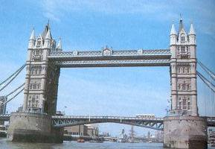

St Paul´s Cathedral-
the greatest church
Famous people buried there
Tower Bridge –
famous bridge
2 towers – city museums

Slide 8


The Houses of Parliament
Trafalgar Square-
the statue of Nelson
National Gallery
the seat of the British Parliament
Big Ben- famous bell (13 tons)

Slide 9

The Tower – used to be a fortress, royal palace, prison
Now: museum of arms, crown jewels

Slide 10
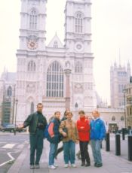
Westminster Abbey
The coronation church, kings are buried there
Poets corner- poets buried

Slide 11

Parks
Other parks
Green Park
Kensington Gardens
Regent´s Park
Kew Gardens
St James ´s
Hyde Park
Best known
Speaker´s corner
Lake Serpentine
Sports activities, relax

Slide 12
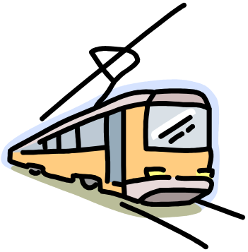


Transport
Bus, coach
Train
Ship
Plane: airports - Heathrow,
Gatwick,
Luton
Stanford
Tram
Underground - 273 stations
Special: double deckers
black taxis

Slide 13
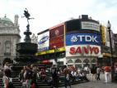
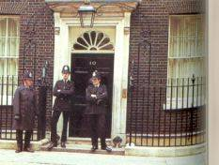

Streets
Picadilly Circus
The statue of Eros
Neon lights
Downing Street 10
Residence of The British Prime Minister
Oxford Street
Best known shopping street

Slide 14
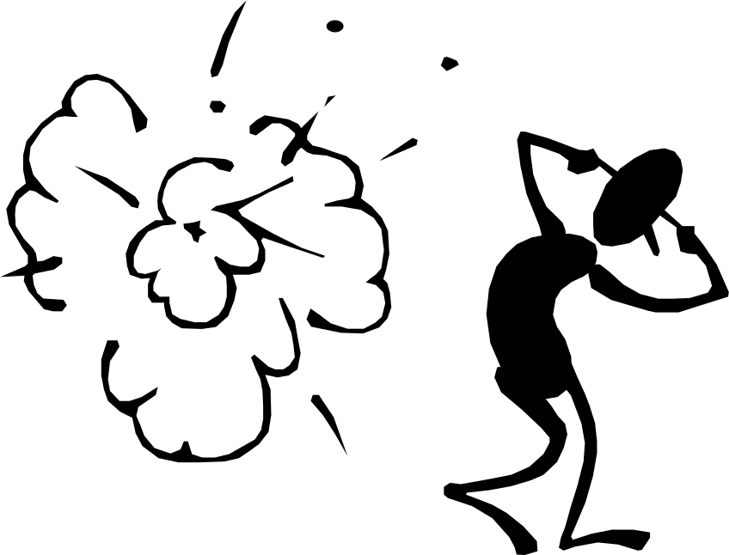
Problems
Social problems
Rasism
Immigrants
Unemployment (9 %)
Terrorism

Slide 15
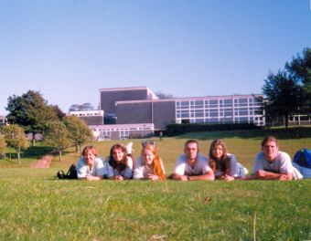
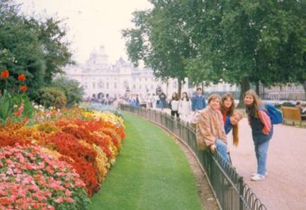
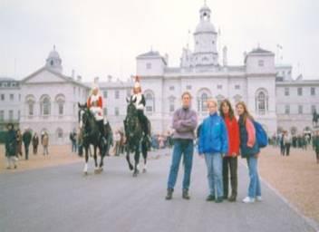
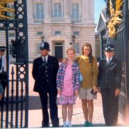
My memories - London 1996

Slide 16
Quiz
1. London is the capital of
a, UK
b, USA
c, Ireland
2. It has population of
a, 10 million
b, 20 million
c, 30 million
3. It lies on the
a, north west
b, west east
c, south east
4. The Great Fire was in
a, 1232
b, 1666
c, 1665
5. The taxis in London are
a, red
b, blue
c, black
6. The Royal family lives in
a, Buckingham Palace
b, Downing Street 10
c, The Tower
7. Kings are buried in
a, Westminster Abbey
b, St Paul´s Cathedral
c, Piccadily Circus
8. The London Eye is a
a, big tower
b, big wheel
c, big park

Slide 17


Task
Name the sights in the pictures and tell some information about them.
Read more at home: www. london. uk

Slide 18
Použitá literatúra
www. google. sk
SILVANOVÁ, B.: Angličtina. Bratislava: Enigma, 1999.
Londýn. Bratislava: Gemini, 1990.

Slide 19

Thank you for your attention

Slide 20
OK

Slide 21
NO!!

