Slide 1
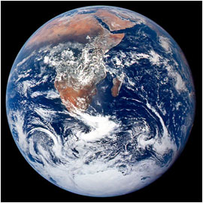
GAIA
What is it, and why is it important?
GG2509: Environment & Society
Nick Spedding
NASA AS17-148-22727

Slide 2

GG2509: Environment & Society
Nick Spedding
GAIA
Who is she, and why is she important?

Slide 3
Aims
To introduce the Gaia hypothesis
To consider how it relates to environmental science
  Earth Systems Science
To consider what it says about the relationships between humans and the natural world

Slide 4
Wider issues
Interface of natural world and society? E→H or H→E?
Extent of human impact? [ST, human or LT, Gaian?]
Big picture…
‘Messy real world’…
  complex causal relations, different levels, difficult to quantify…
…or is it? [Gaian order?]
Objective vs. subjective? Facts vs. values?
Equilibrium (natural) vs. change (social)?

Slide 5
Contexts for critique
Framework for the rest of this course!
Character of science
Rise of environmentalism / alternative lifestyles
Current environmental crisis:
  CLIMATE CHANGE, biodiversity loss, desertification, deforestation, pollution, urban environments, sustainable development, role of technology, policy response…

Slide 6
Traditional science
Reductionist
Analysis of simple causal systems: if A, then B
Experiment – control + replication
Empirical – first hand data [observations]
Objective – ‘real’ truth, value-free
Successful hypothesis tests → valid knowledge
Exemplar = laboratory physics

Slide 7
Alternatives – earth + environmental sciences
Holistic
Synthesis + complex systems; feedbacks
‘Messy’ real world – limited control, one-offs
Theoretical inference fills empirical gaps
Subjective – work with human creativity & values
Rigorous hypothesis tests impossible
Exemplar = ecology

Slide 8
Clash of scientific methods + cultures!
TRADITIONAL SCIENCE
Reductionist
Analysis of simple causal systems: if A, then B
Experiment – control + replication
Empirical – first hand data [observations]
Objective – ‘real’ truth, value-free
Successful hypothesis tests → valid knowledge
Exemplar = laboratory physics
ALTERNATIVE SCIENCE
Holistic
Synthesis + complex systems; feedbacks
‘Messy’ real world – limited control, one-offs
Theoretical inference fills empirical gaps
Subjective – work with human creativity & values
Rigorous hypothesis tests impossible
Exemplar = ecology

Slide 9
Four ‘laws’ of ecology – Barry Commoner (1971)
Everything is connected to everything else
Nature knows best
Everything must go somewhere
There’s no such thing as a free lunch
Powerful rhetoric – ecology adopted as science of environmentalism, 1970s
Challenge to objectivity – analysis or activism?

Slide 10
What is Gaia?
Gaia theory:
A view of the Earth that sees it as a self-regulating system made up from the totality of organisms, the surface rocks, the ocean and the atmosphere tightly coupled as an evolving system. The theory sees this system as having a goal – the regulation of surface conditions so as always to be as favourable as possible for contemporary life.
James Lovelock, Revenge of Gaia (2006)
See the Amsterdam Declaration on Global Change, 2001

Slide 11
Worster on Gaia
The most widely discussed metaphor of the Age of Ecology… [Gaia had] …all the breathtaking impact of the newest technology, the most up-to-date science, yet paradoxically resonated with the oldest pagan beliefs… She was ancient, she was female, she was the Earth Mother, and she held our destiny in her hands.
Donald Worster, Nature’s Ecology, p. 378

Slide 12
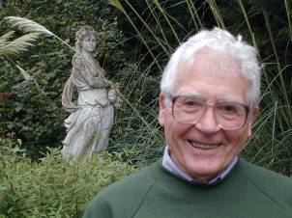
James Lovelock
Born 1919
Doctorates in chemistry + medicine
Taught engineering, physiology + cybernetics
Independent scientist – inventor
  Electron Capture Detector – DDT, CFCs + ozone hole
1960s – consultant to NASA’s Mars research programme
Number 5 in EA’s list of top environmentalists

Slide 13
Atmospheric chemistry
MARS AND VENUS:
  95, 98% CO₂
  Chemical equilibrium
  Lifeless

Slide 14

Atmospheric chemistry
MARS AND VENUS:
  95, 98% CO₂
  Chemical equilibrium
  Lifeless
EARTH:
  21% O₂, 0.03 CO₂ (pre-industrial!)
  Chemical disequilibrium
  Presence of life / “planet alive”
  + temperature, salinity of oceans conducive to life
  Not coincidental!

Slide 15
Self-regulation
Negative feedbacks + homeostasis
Marine algae DMS feedback:
  surface water photosynthesis produces dimethyl sulphide – cloud condensation nuclei
  clouds reflect sunlight – high albedo
  controls on DMS production: temperature, species composition
  ↑ T → ↑ DMS → ↑ clouds → ↑ reflection → ↓ T
  ↓ T → ↓ DMS → ↓ clouds → ↓ reflection → ↑ T
  Prevents runaway Ice Ages? CLAW hypothesis

Slide 16
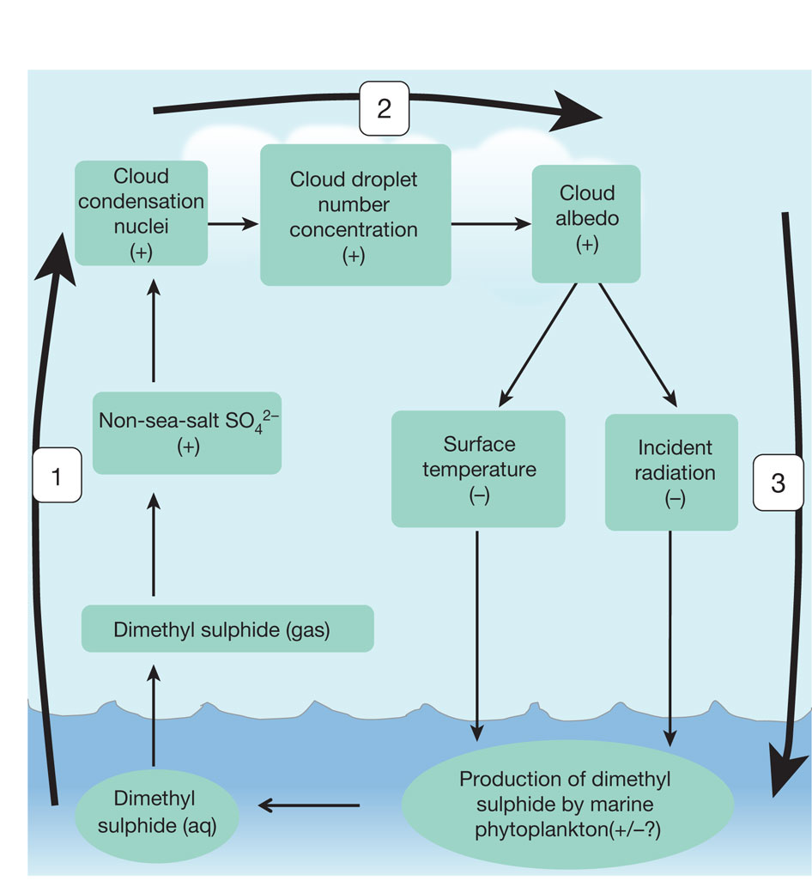

Modified diagram of the climate feedback loop proposed by ref. 7.
PK Quinn & TS Bates Nature 480, 51-56 (2011) doi:10.1038/nature10580

Slide 17
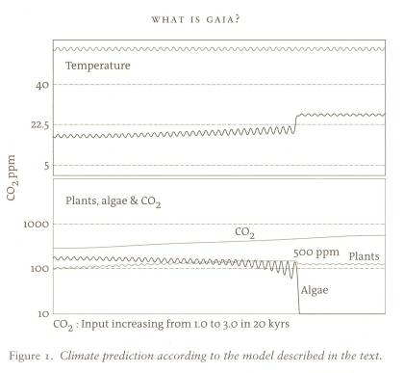
Limits to self-regulation? Crisis…
System is not invincible!
Under extreme stress, flips to new Gaian state
Model driven by ↑ CO₂
Upper figure = Temperature:
Top line – no life
Bottom line – life
Lower figure:
Algae crash at CO₂ = 500 ppm
  Stable stratification of warm water
  Nutrient supply cut off
  Photosynthesis drops
  Ocean biological pump shuts down
Tipping point
↑ to 24°C
← Holding at 16°C →
Steady rise in CO₂

Slide 18
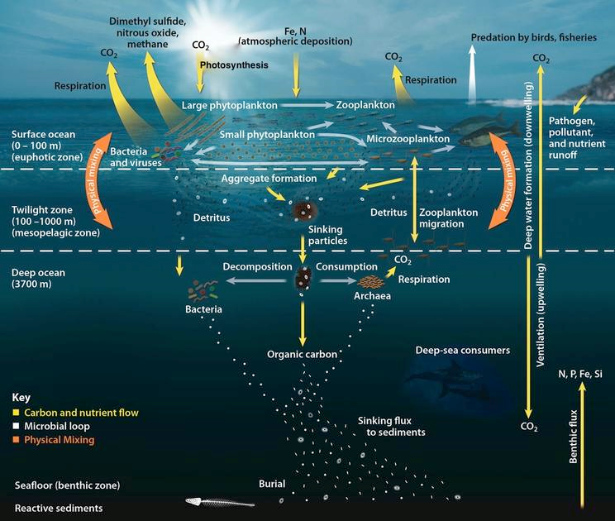
The oceanic biological pump http://serc.carleton.edu/eslabs/carbon/6a.html
Photosynthesis by phytoplankton removes CO₂ from atmosphere
But dependent also on other nutrients (‘fertiliser’) – supplied by upwelling of deep water
Cold water sinks – drives convective circulation
Warmer water does not – vertical circulation slows down / shuts off

Slide 19

Update (VF of G)
Thresholds / tipping points popular! 2 ºC? 1.5 ºC?

Slide 20
Update (VF of G)
Thresholds / tipping points popular!
Lovelock dislikes the concept
Prefers to talk of a convex slippery slope...

Slide 21
Update (VF of G)
Thresholds / tipping points popular!
Lovelock dislikes the concept
Prefers to talk of a convex slippery slope...

Slide 22
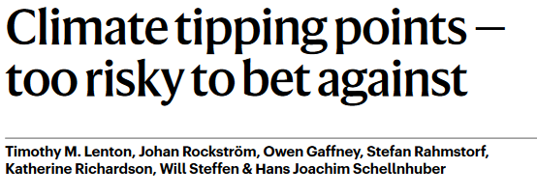
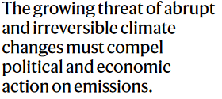
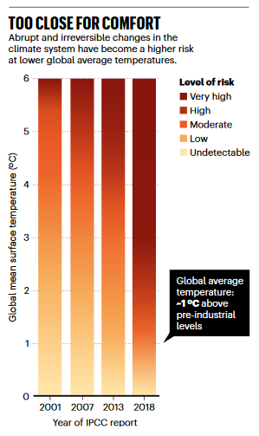
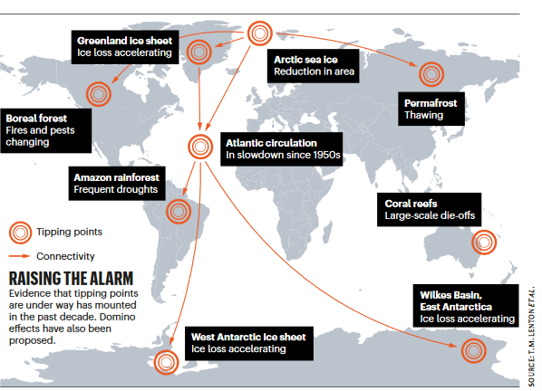

Slide 23
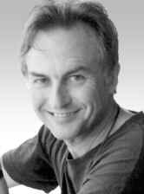
Reaction to first book
1979 – Gaia: A New Look at Life on Earth
Enthusiastic reception:
  Public
  Theologians
  New Agers – hippies and mystics!
  Minority of environmental scientists
Most scientists sceptical, e.g.
  Richard Dawkins [Selfish Gene and Blind Watchmaker, reductionist, atheist] = consciousness + altruism of all-seeing, supernatural guiding force
  James Kirchner = mix of state-the-obvious + untestable speculation

Slide 24
Daisyworld – Lovelock + Watson (1983)
Response to criticism from traditional scientists – reading too much into metaphors
Designed to show that Gaia did not require conscious goals to work
Simple computer simulation of planetary temperature regulation
Basic process mechanics
Consistent with Darwinian natural selection

Slide 25
Daisyworld
Vegetation cover – white and black daisies
White daisies:
  reflect sunlight – cooling
  preferential reproduction when hot
Black daisies:
  absorb sunlight – warming
  preferential reproduction when cold
So – what happens as the sun gets warmer?
Models online [2-D Daisyworld] Requires Flash!

Slide 26
How Daisyworld works
As the sun heats up over hundreds of millions of years, black daisies approach their optimum temperatures, become more fit, and thereby increase their numbers, causing the albedo (reflectivity) of the planet’s surface to drop. This is a positive feedback, because while more sunlight is absorbed by the dark flowers the planet further warms. Black daisies increase until the temperature passes their fitness peak and moves into the fitness range for the white daisies. These then begin to multiply and replace the black daisies; this shift increases the planet’s albedo, which serves as a negative feedback on further warming. The planet’s overall temperature is stabilized for eons even though the sun inexorably increases its luminosity. But eventually, the white daisies are heated past their fitness range and can’t resist further warming. The biota then collapses and temperatures rise rapidly to the level an inorganic rock would experience.
Stephen Schneider (2001) – Review of Homage to Gaia

Slide 27
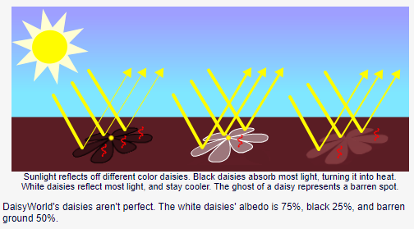
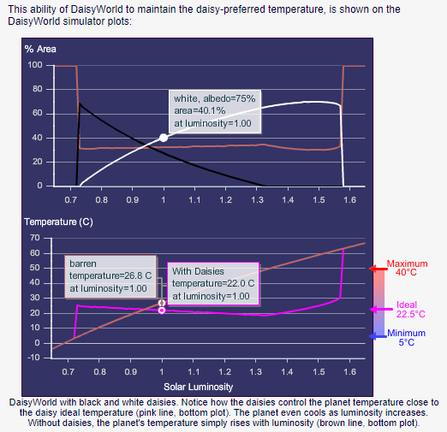
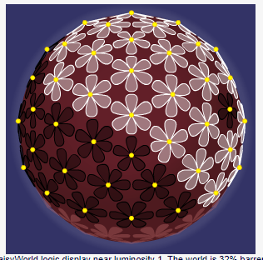
Daisyworld: http://www.gingerbooth.com/flash/daisyball/

Slide 28
Humans and Gaia – then
Early writings…
Humans (+ pandas, polar bears, blue whales, etc.) insignificant part of Gaia
Emphasis on primary productivity – forests + oceans
Humans benign – at worst, wipe ourselves out (+ pandas, polar bears, blue whales, etc.)
Enhance Gaia?
  appreciate her workings
  beneficial use of science + technology

Slide 29

Humans and Gaia – now
Later writings increasingly outraged + pessimistic
Humans unique ability to damage Gaia
At best, force major changes to our way of life:
  sustainable retreat?
  “global decline into a chaotic world ruled by brutal war lords on a devastated Earth”? [R of G, p. 154]
At best wipe ourselves out!
Take planet past threshold – “tipping point”
New Gaian state – much warmer, relatively barren

Slide 30
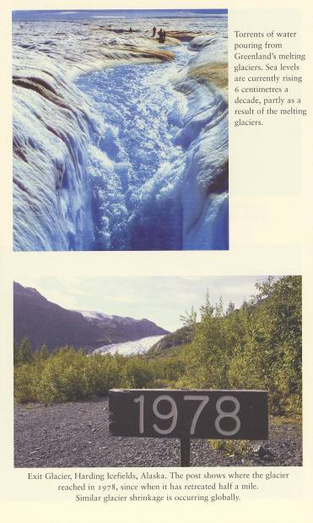
Familiar imagery!

Slide 31
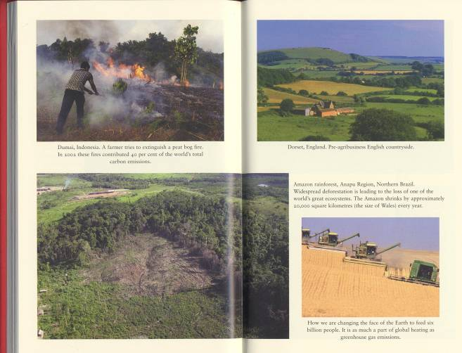

“Combustion, Cattle and Chainsaws are the three deadly Cs” – Lovelock’s mantra

Slide 32
Deep Greens
Radical eco-centrism
  value ‘nature’ for its own sake
  bioethics, geoethics (rocks have rights!)
Spiritualism, mysticism
Nostalgic – pastoral idyll
Reject possibility of continued economic growth
Dismantle existing socio-economic structures
So far, so Gaian…

Slide 33
Lovelock’s environmentalism
Contemptuous of moderate greens:
  anthropocentric – motivated by self-interest + continued human prosperity
Sides with deep greens:
  mystical sympathies
  need for radical restructuring of social, economic + moral systems
  sustainable development impossible

Slide 34
Lovelock’s environmentalism
Contemptuous of moderate greens:
  anthropocentric – motivated by self-interest + continued human prosperity
Sides with deep greens:
  mystical sympathies
  need for radical restructuring of social, economic + moral systems
  sustainable development impossible
BUT… !
  objects to naivety of deep greens – impractical romantics [rather ironic – nostalgic, rustic ideals]
  science + technology are best short-term bet

Slide 35
Controversial #1…
Dislikes measures to prolong human life
  obsessive fear of cancer wrong-headed – no hospices, no cancer research
  well-being + longevity of Gaia is what matters
Likes big science – ingenious technologies of geoengineering:
  space parasols
  add sulphur to aeroplane fuel to ↑ stratospheric aerosols
  ocean cold water pumps

Slide 36
Controversial #2…
Likes nuclear power*:
  renewable technologies underdeveloped – cannot wait
  radiation is part of Gaia
  nuclear technology is safe + clean; fossil fuel power is not (40 x worse)
  scaremongering of environmental + peace lobbies / irresponsible media
  Chernobyl, 1986: BBC = 30,000 deaths, WHO = 75 deaths!
  * and fracking, but not windfarms

Slide 37


Update – VF of G
Too late to mitigate – prepare to adapt!
Lifeboat ethics – people will die
Few areas habitable...
Fortress Britain (Eurosceptic Russophobe!)
Invokes image + spirit of WWII
  Self-sufficiency
  Enlightened dictatorship
A new hope... ?
  Anger of R of G disappeared...
  Acceptance?

Slide 38
Reading – Lovelock’s books
1979. Gaia: A New Look at Life on Earth, esp. Chapters 7 and 8.
1988. The Ages of Gaia, esp. Chapters 7, 9 and Epilogue.
2000. Homage to Gaia: The Life of an Independent Scientist, esp. Chapter 9.
2006. The Revenge of Gaia.
2009. The Vanishing Face of Gaia.

Slide 39
Further reading: Gaia
Wikipedia – entry on Gaia hypothesis
Schneider, S. 2001. A goddess of Earth or the imagination of a man? Science, 291, 5510, pp. 1906-7. Review of Homage to Gaia.
Radford, T. 2019. James Lovelock at 100: the Gaia saga continues. Nature, 570, pp. 441-442 (25 June 2019).
D. Worster. 1994. Nature’s Economy: A History of Ecological Ideas, 2nd edition. CUP. Ch. 16, ‘Healing the Planet’, esp. pp. 378-387. QML HD
Pepper, D. 1996. Modern Environmentalism: An Introduction. Use index to follow-up various entries on “Gaia”.
Gaian ethics
Lautensach, A. 2008. Environmental ethics and the Gaia theory. Encyclopedia of the Earth.
More ambitious: scientific critique + debate
Kirchner, J. W. 2002. The Gaia hypothesis: fact, theory and wishful thinking. Climate Change, 52, 4, pp. 391-408. [See also editorial comment by Volk, same issue, plus follow-up papers in Climate Change, 58, 1-2. E-journal.]

Slide 40
New Scientist special https://www.newscientist.com/round-up/gaia/
My verdict on Gaia hypothesis: beautiful but flawed – sceptical, if perhaps over-confident in it’s denunciation of Gaia
  1 November 2013 by Toby Tyrrell
Magazine issue 2940 Gaia's evil twin: Is life its own worst enemy?
  17 June 2009 by Peter Ward
  Magazine issue 2713
Gaia's comeback: How life shapes the weather
  01 July 2013 by Stephen Battersby
  Magazine issue 2923
***
Also:
Turney, J. 2013. Gaia at 40. Future Earth Blog. Available at: https://futureearth.org/2013/10/04/gaia-at-40/
Dyke, J. and T. Lenton. 2018. Scientists finally have an explanation for the ‘Gaia puzzle’. The Conversation. Online:
https://theconversation.com/scientists-finally-have-an-explanation-for-the-gaia-puzzle-99153

