Slide 1
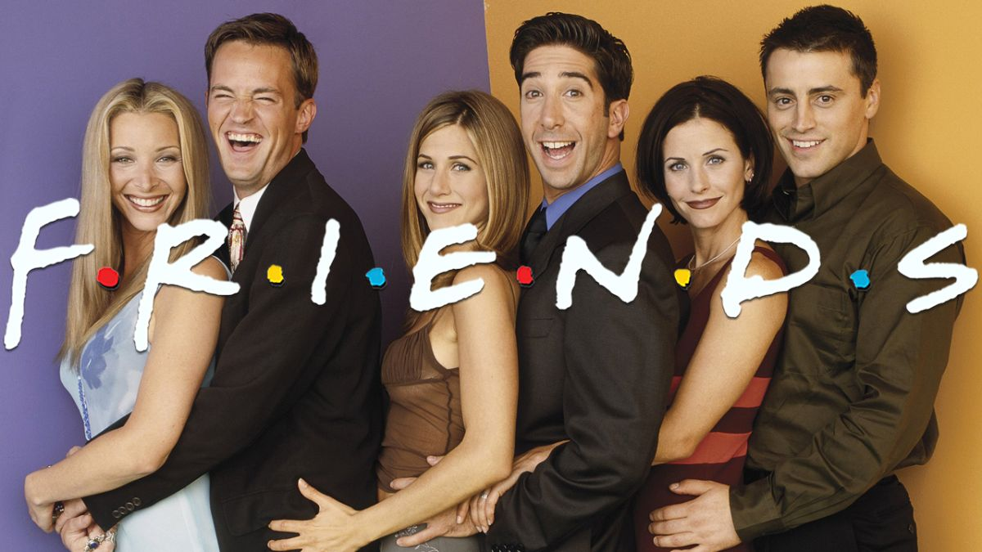
Emotion Recognition in
Multi-Party Conversations using
Multi-Modal Approach
Team - Emotional A-STAR
Saharsh Agarwal, Siddhartha Namburu, Ninaad Damis, Nitika Suresh, Jaldhir Trivedi (TA), Prof. Amir Barati Farimani
Notes:
Main title: 40 pt. Arial
Presenter Name: 16 pt. Arial
Presenters Title: 16 pt. Arial Italic

Slide 2

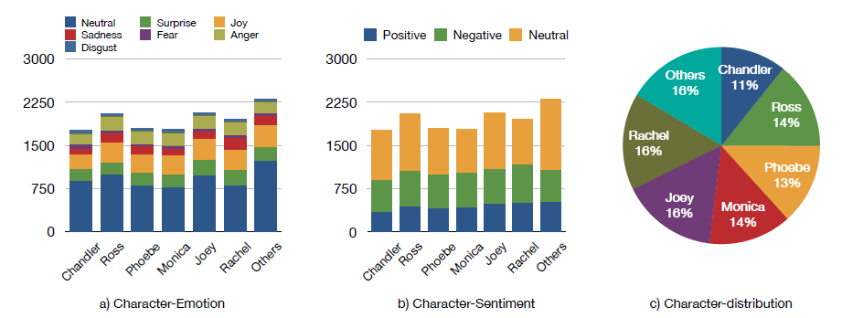


Background
Dataset – MELD, Emotion Lines dataset
13,000 utterances from 1,433 dialogues with emotion and sentiment labels, and encompasses audio and textual modalities from the TV show FRIENDS
Motivation:
Make ML models that are capable of identifying emotion and sentiment given the text and verbal audio
Applications:
User behavioral understanding
Dialogue generation
Generating response by analyzing user emotion
Overview of features of the data:
Data characteristics:
Emotions
7 classes
Sentiment
3 classes
Character Sentiment
Character Distribution
* A similar representation can be observed for the seven emotions

Slide 3
Feature Engineering
Text
Audio
Text + Audio
Feature Engineering :
Removing Punctuations
Removing Stop words
Stemming
Feature Generation :
Bag of Words
Spacy Vectors
Feature Generation: openSMILE
Feature set: ComParE 2016 -The features are obtained by applying functionals over low level audio descriptors such as loudness, pitch and jitter.
Feature Engineering : We employ L2 based feature selection using SVM and PCA to reduce dimension of feature set to 300.
Feature Engineering : Feature set is constructed by concatenating two components -
Spacy Vectors (Size 300)
Audio features (Size 300)

Slide 4
Workflow
Baseline Benchmarking
Analysis -
>> Reason for the achieved accuracies.
Open Smile
Audio
6373 Audio Features
tCNN, bcLSTM, dRNN
SVM: L2
Pre-trained Model
1422 Audio Features
PCA
300 Audio Features
Raw Dialogue Data
Combined Data
Spacy Vectors
4 Machine Learning Models -
Logistic Regression
Naive Bayes
Random Forest
Support Vector Classifier
Multi Layer Perceptron
Benchmarking
Bag of Words
Results (K-Fold => 5) -
>> Average and Standard Deviation of the 5 Training & Testing Accuracies
>> F1-scores for the Tested Models.
>> Time Taken for each model.
3 Feature Engineering

Slide 5
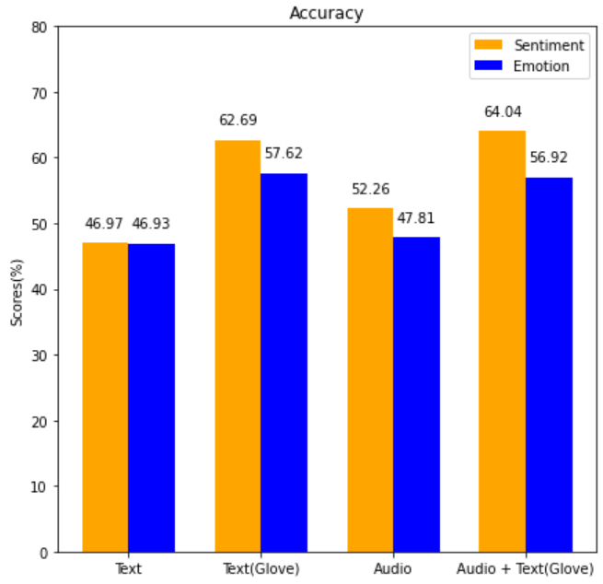

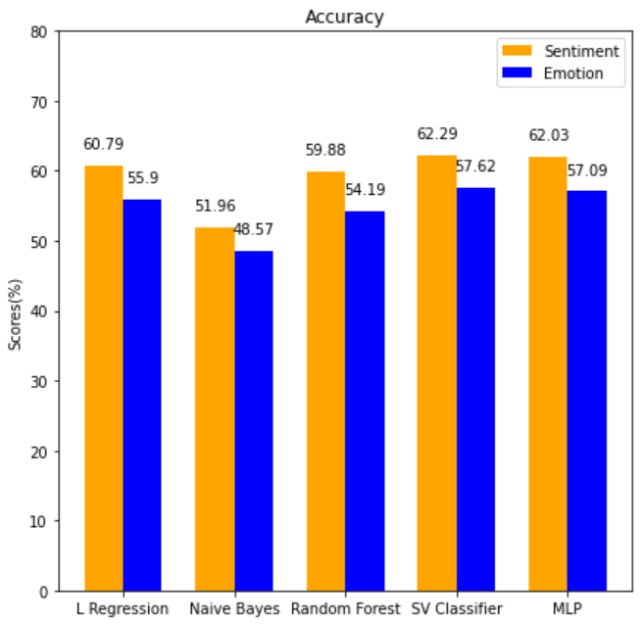
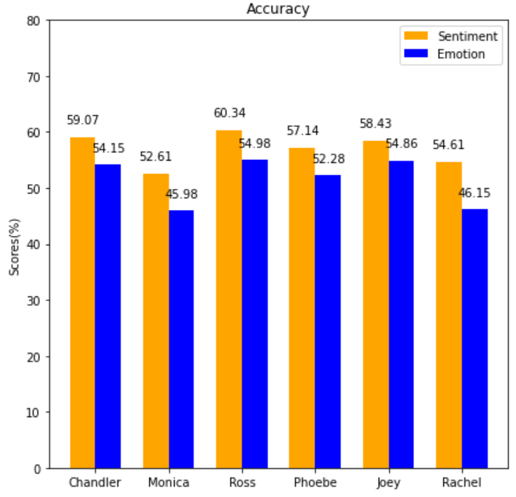

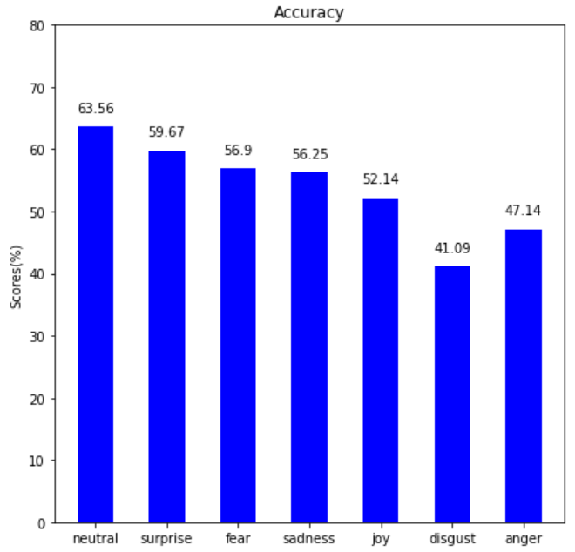


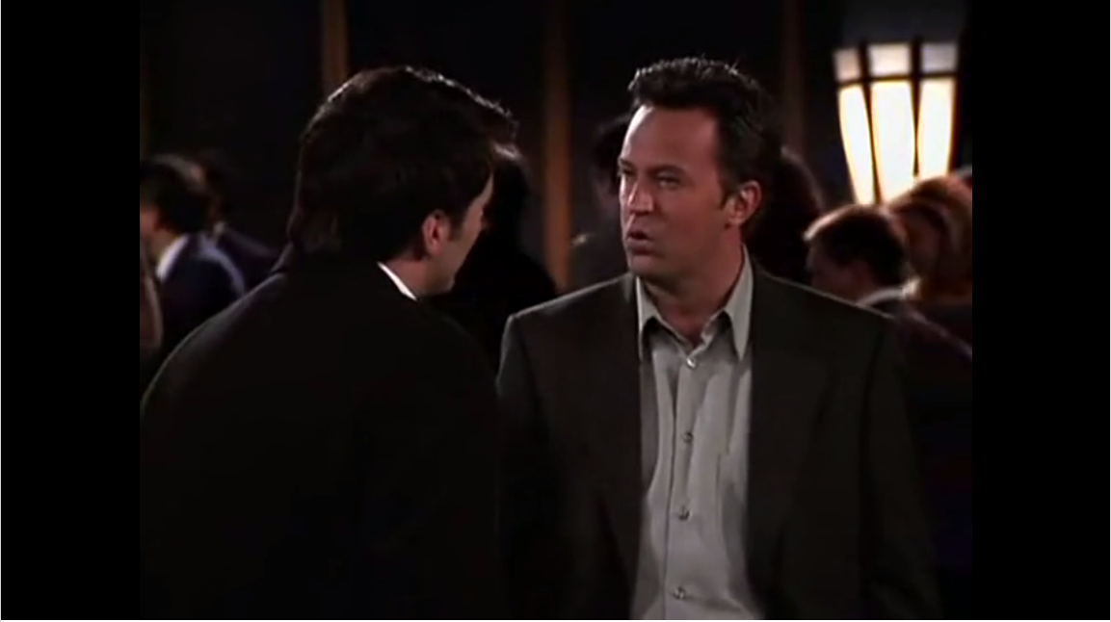
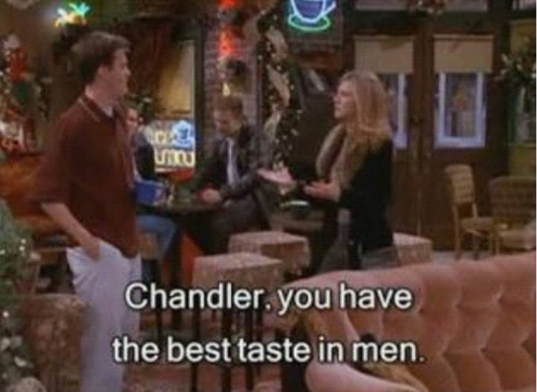
Results & Analysis
Sentiment
2%
1%
Emotion
Accuracy(Text Spacy) > Accuracy (Bag of Words)
Accuracy(Text + Audio) > Accuracy (Text, Audio)
Accuracy (SV Classifier) ~ Accuracy (MLP)
(6 layers)
Accuracy of Rachel, Monica is worst
Comparison with baseline
Models | Emotion | Sentiment
t-CNN | 55.02 | 64.25
bcLSTM | 59.25 | 66.68
D-RNN | 60.25 | 67.56
SV Classifier | 56.92 | 64.02
I was surprised to see a kangaroo in world war epic.
Accuracy of Disgust & Anger is the worst
Wrong Predictions (Why?)
F1 Score (SV Classifier) ~ F1 Score (t-CNN)

