Slide 1


Vidyavardhini’s College of Engineering and Techonology
Department of Information & Technology
K.T Marg, Vasai Road (W), Dist-Palghar: 401 202, Maharashtra
AgriConnect
Empowering Farmers, Redefining Agricultural Procurement
Team Members
Project Guide
Aditya Patil
Ninad Patil
Piyush Patil
Dr. Sainath Patil

Slide 2
Overview
Problem Statement
Project Scope & Objectives
Literature Review
Existing Commercial Products
Proposed Solution
System Architecture & Workflow
APIs & Data Sources
Features & Limitaions
Future Scope
Conclusion

Slide 3
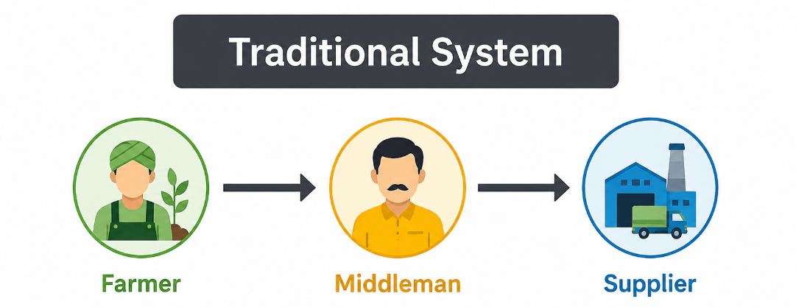
Problem Statement
The current agricultural procurement system is heavily dependent on intermediaries, resulting in unfair pricing, delayed
payments, and limited market access for farmers The lack of transparency and direct farmer–supplier interaction reduces
farmers' bargaining power and affects their overall profitability.
Middlemen exploitation
Unfair & non-transparent pricing
Lack of direct farmer-supplier connection
Delayed payments
Low bargaining power for farmers
Limited access to market information

Slide 4
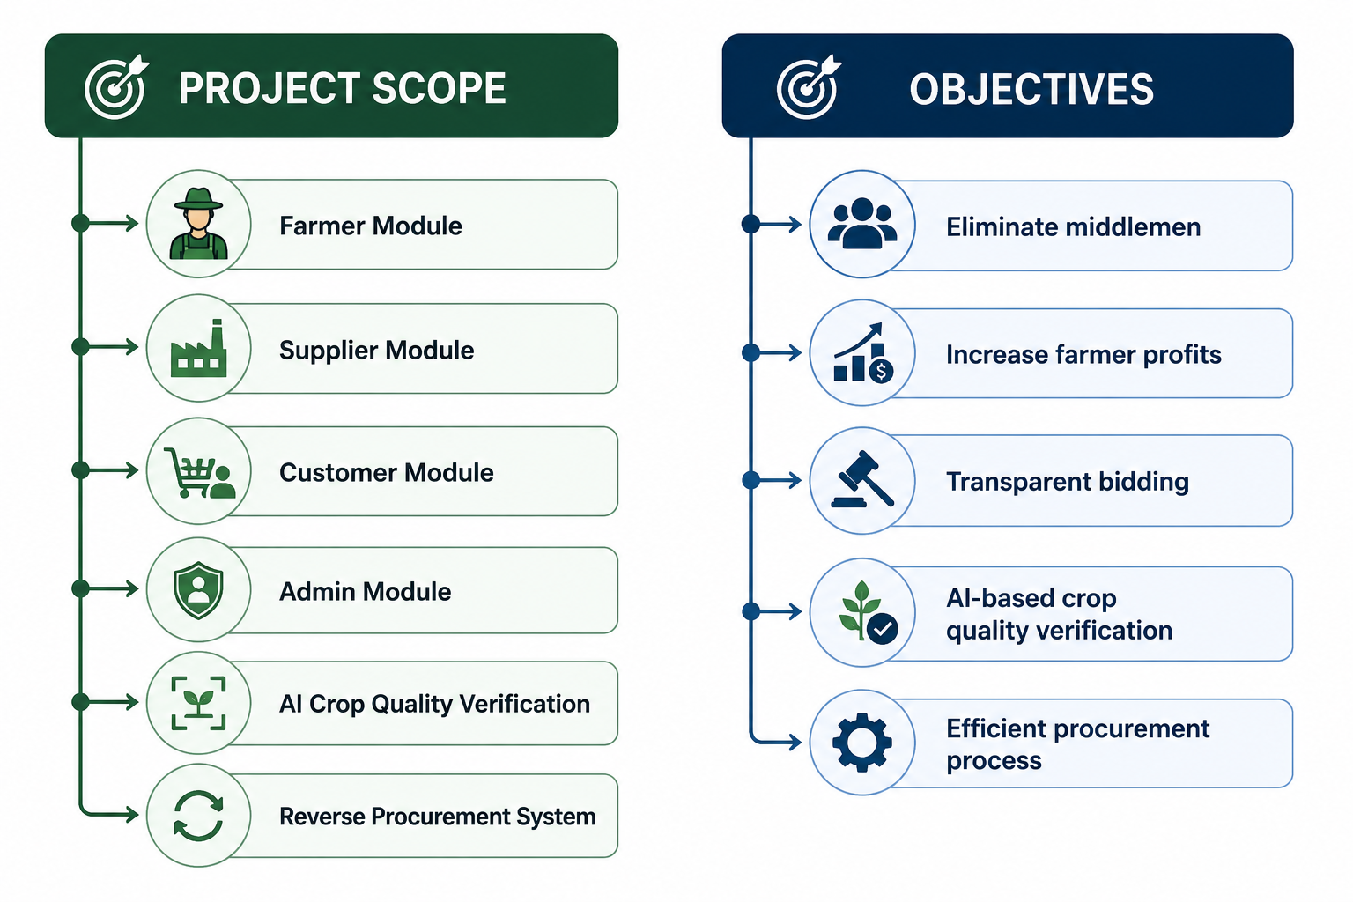
Project Scope & Objectives

Slide 5
Literature Review
c | Author(s) & Year | Technique / Method | Key Findings | Limitations
1 | Banker and Mitra (2007) [1] | Online coffee auctions in agricultural procurement | Examined how online auctions connect growers with markets and affect agricultural procurement. | Benefits depend on the supply chain structure and auction implementation.
2 | Reddy and Mehjabeen (2019) [2] | Electronic National Agriculture Market (e-NAM) | Studied the impact of electronic agricultural markets and the role of e-auctions in improving farmers' market participation and price realization. | Adoption challenges and implementation bottlenecks remain.
3 | Pavithra et al. (2018) [3] | E-tendering for agricultural marketing | Reported reduced transaction time, improved price transparency, increased market revenue, and stronger competition. | Implementation was not equally successful across all markets, partly due to trader resistance.
4 | Argade, Laha, and Jaiswal (2022) [4] | Electronic agricultural marketplaces and transaction-cost analysis | Examined electronic agricultural markets in India and the relationship between farmers and traders. | Electronic marketplaces did not significantly reduce transaction costs in the studied context.

Slide 6

S. No. | Author(s) & Year | Technique / Method | Key Findings | Limitations
5 | Aggarwal, Jain, and Narayanan (2016) [5] | Study of agricultural market reform in Karnataka | Discussed the transformation of agricultural markets in India and lessons from the Karnataka experience. | Findings are drawn from a single-state context and may not apply to all markets.
6 | Khandelwal et al. (2021) [6] | Literature review of agriculture supply-chain management (2010–2020) | Reviewed research on agricultural supply-chain management and summarized themes in the literature. | Review-based; does not propose an implemented procurement platform.
7 | Guo and Yao (2022) [12] | Big-data-platform-based agricultural supply-chain governance using blockchain | Explored how digital platforms and blockchain technology could support agricultural supply-chain coordination and governance. | Focuses on a specific technology and may require suitable infrastructure and implementation.

Slide 7


Existing Commercial Products
AgriConnect
Feature
eNAM
DeHaat
Ninjacart
AgriBazaar
Reverse Procurement
❌
❌
❌
❌
✅
AI Quality Verification
❌
❌
❌
❌
✅
Live Market Prices
✅
✅
Partial
Partial
✅
Smart Bid Allocation
❌
❌
❌
❌
✅
Transparent Procurement
Partial
Partial
Partial
Partial
✅
Key Highlight: AgriConnect integrates all essential procurement features into a single platform.

Slide 8
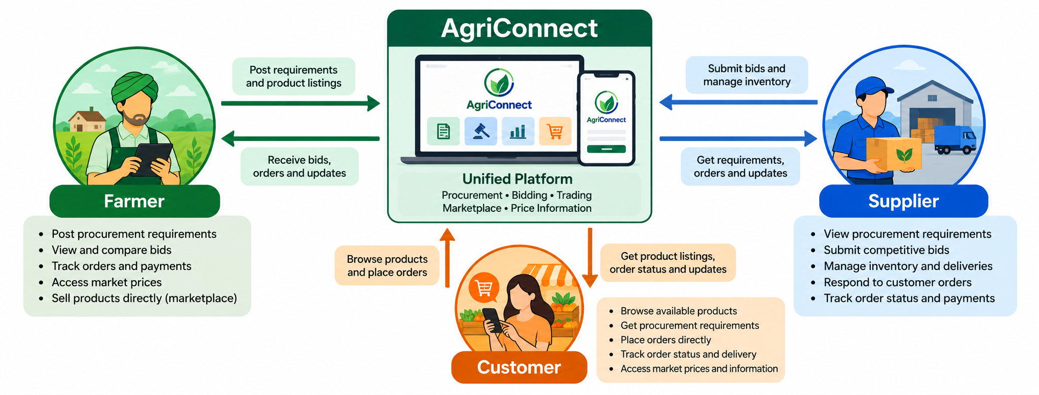

Proposed Solution

Slide 9
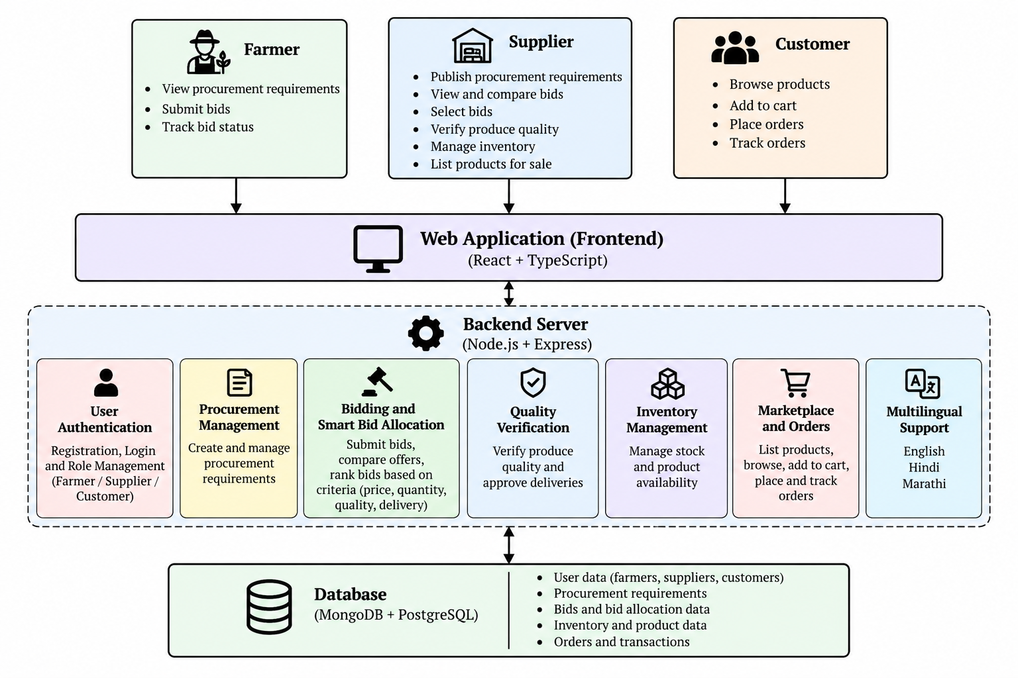
System Architecture

Slide 10
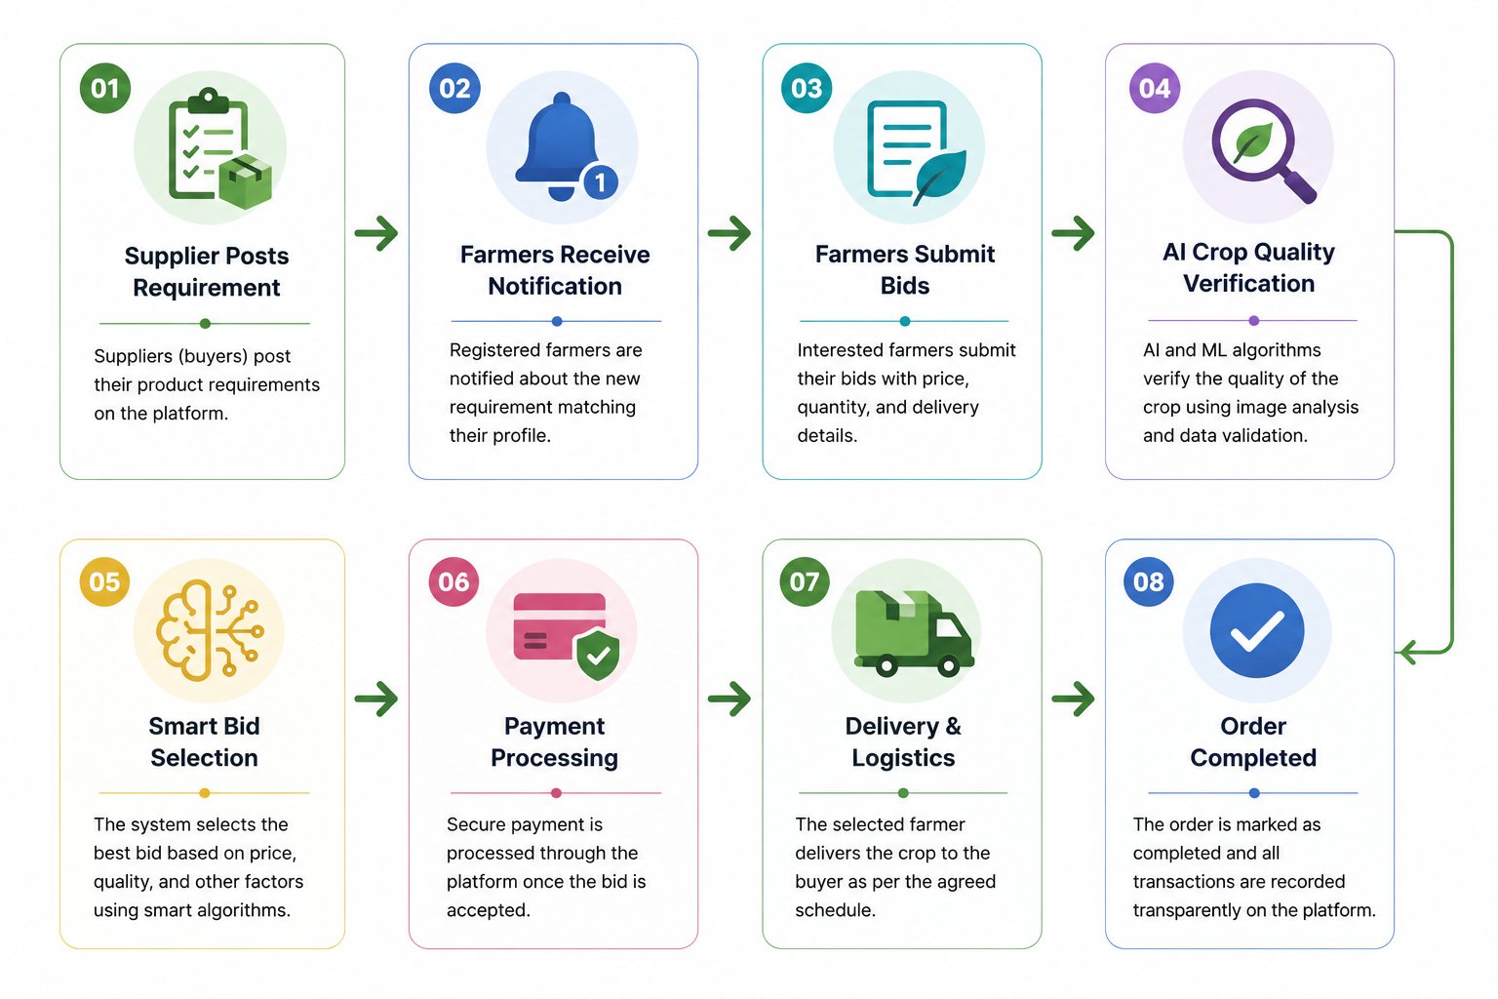

Workflow
Here is the step-by-step process of AgriConnect, ensuring transparency and efficiency:

Slide 11
APIs, Libraries & Data Sources
APIs
Libraries
Data Sources
OpenCV
Socket.IO
React
Tailwind CSS
AGMARKNET API
eNAM API
Google Maps API
Firebase
Razorpay
AGMARKNET
data.gov.in
PlantVillage Dataset
Kaggle Crop Dataset
Farmer Uploaded Images
Bid & Transaction History

Slide 12
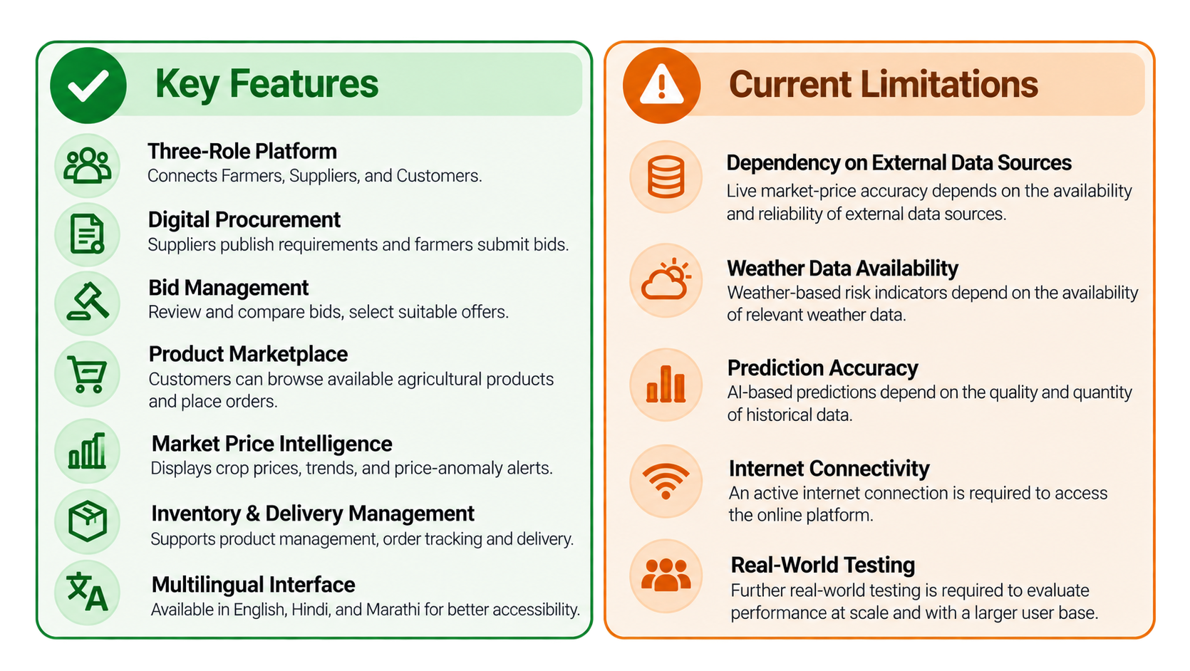

Features & Limitations

Slide 13
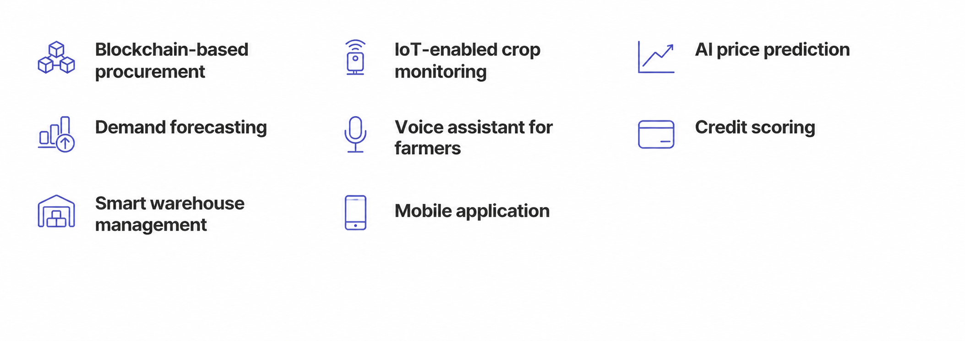
Future Scope

Slide 14


Conclusion
Eliminates middlemen
Reverse procurement marketplace
AI-assisted crop quality verification
Transparent bidding system
Fair pricing for farmers
Efficient procurement for suppliers
AgriConnect is a comprehensive solution that empowers farmers and streamlines procurement for suppliers through technology and transparency

Slide 15

Thank You
Questions & Discussion
AgriConnect
Empowering Farmers Through Transparent Digital Procurement.

